Slide 1
Cloud native temperature excursion and compliance platform
1

Slide 2
SHAAMAK | Code of Simulation Script
RIYA | Kafka with docker,offset
RUSSEL | Kubernetes architecture of telemetry,excursion and alert module
RONAK | UI Design Part 1
PRANAV | UI Design Part 2

Slide 3
Simulation Microservice: Implementation
Massive Concurrency (asyncio): Spawns 1,000+ independent, asynchronous background workers to simulate the entire sensor fleet simultaneously without blocking CPU threads.
Integrated Chaos Engine: Replaces static "mock data" with a probabilistic state machine to actively simulate hardware malfunctions and temperature spikes.

Slide 4
Network Jitter Simulation: Replicates physical "dead zones" by buffering telemetry data in local memory, then flushing it to Kafka in sudden bursts to stress test the broker's throughput.
Zero Data Loss Shutdown: Implements an asynchronous interception protocol to safely flush all remaining memory buffers to the cloud before the container terminates.

Slide 5
Work to be done next week
Design the Shipment API to strictly enforce compliance thresholds
Replace the hardcoded simulation variables with live database queries

Slide 6
KAFKA
First, set up Kafka using Docker
Then created topic telemetry-events
Then created one producer (Simulation Service)
Created 2 consumers Logging consumer and Detection consumer
Used 2 different group IDs
So both consumers receive same data
Flow:
producer → telemetry-events → logging + detection

Slide 7
Used Detection consumer for processing
Detection consumer reads data from telemetry-events
Applied temperature check logic
If temperature is high → send data to new topic excursion-events
Then created topic excursion-events
Then created alert consumer
Alert consumer reads data from excursion-events
Displays alert

Slide 8
Offset in Kafka
Ran producer and consumer
Stopped consumer and sent new messages
Restarted consumer → it continued from last message
Changed group_id → consumer read all messages again

Slide 9
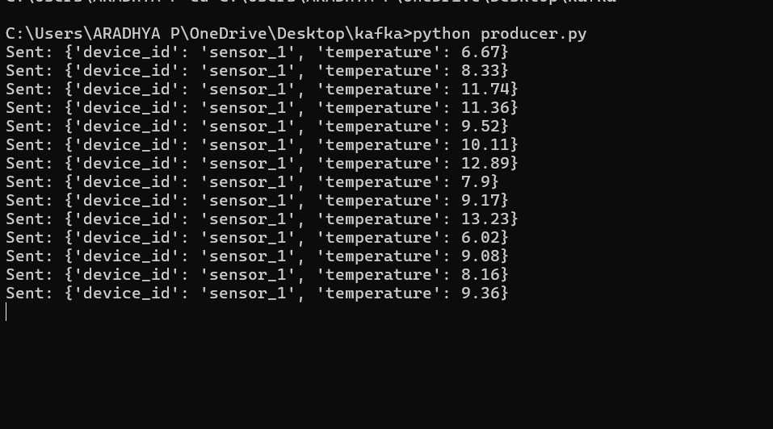

Slide 10
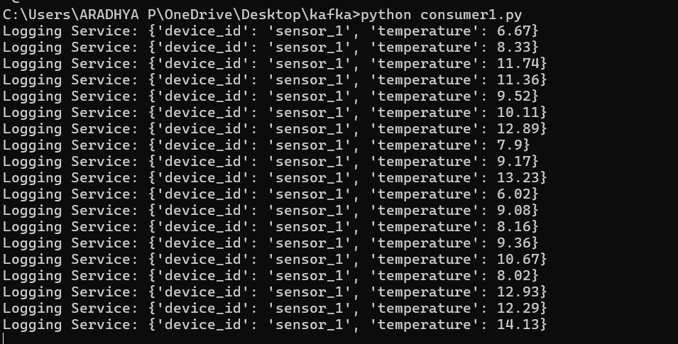

Slide 11
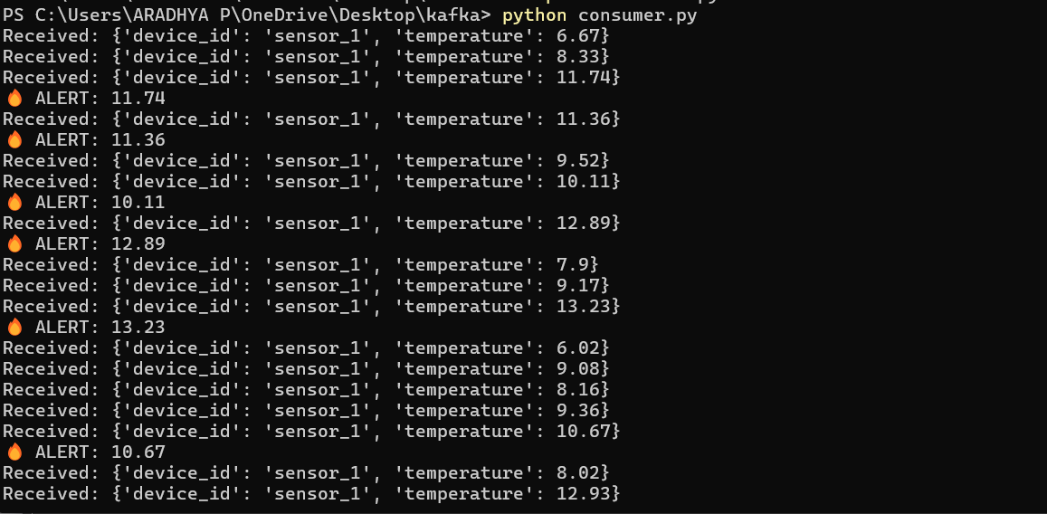

Slide 12
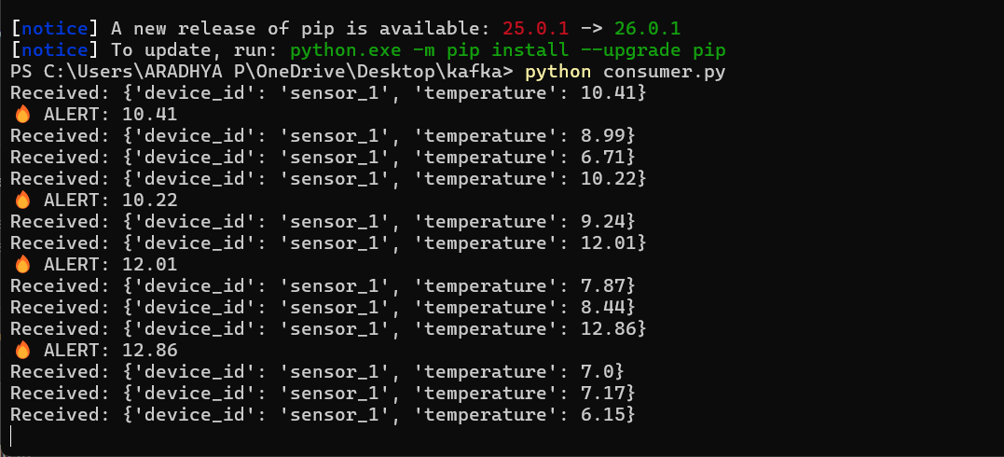

Slide 13
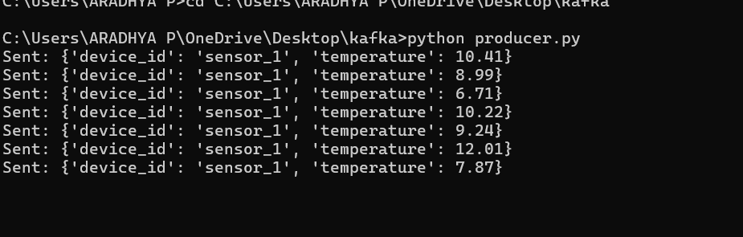

Slide 14
Work to be done next week
Implement Telemetry Service to consume data from telemetry-events and store it in database
Improve event flow with better data handling (device-wise processing using keys)

Slide 15
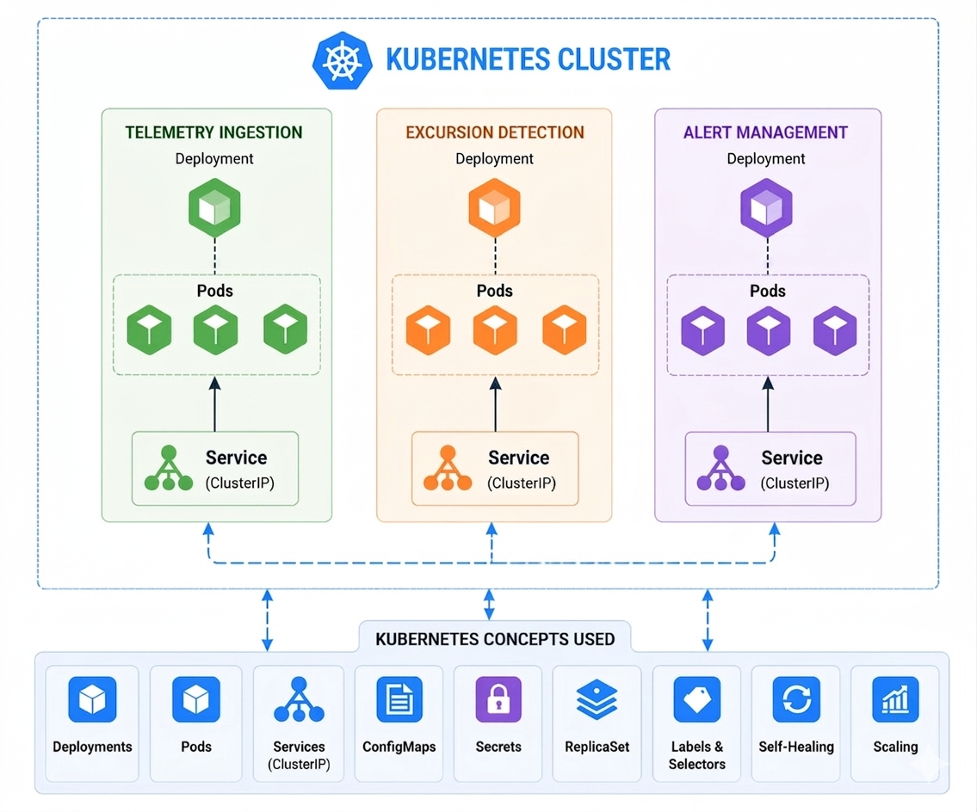
Kubernetes architecture of Telemetry, Excursion, and Alert Modules:

Slide 16
Namespace in Kubernetes:
Namespace is a way to divide a Kubernetes cluster into multiple
logical environments
Benefits of namespace are:
Separation of Applications
Avoid Name Conflicts
Environment Separation
Resource Control

Slide 17
Work to be done next week:
Includes deploying these modules using Kubernetes .
To integrate the remaining microservices into this architecture.

