Slide 1
Cloud native temperature excursion and compliance platform
1

Slide 2
SHAAMAK | Shipment API
RIYA | Shipment API
RUSSEL | Kubernetes deployment of reporting and dashboard module
RONAK | UI Design
PRANAV | Timescale db

Slide 3
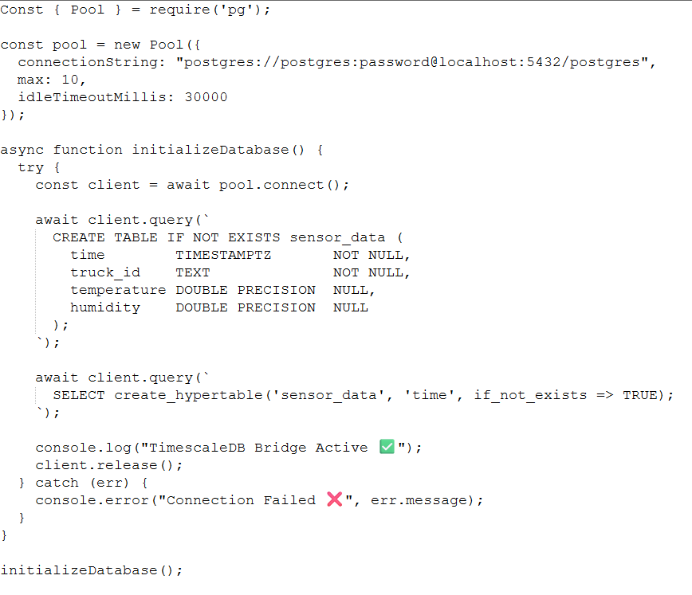
TimescaleDB

Slide 4
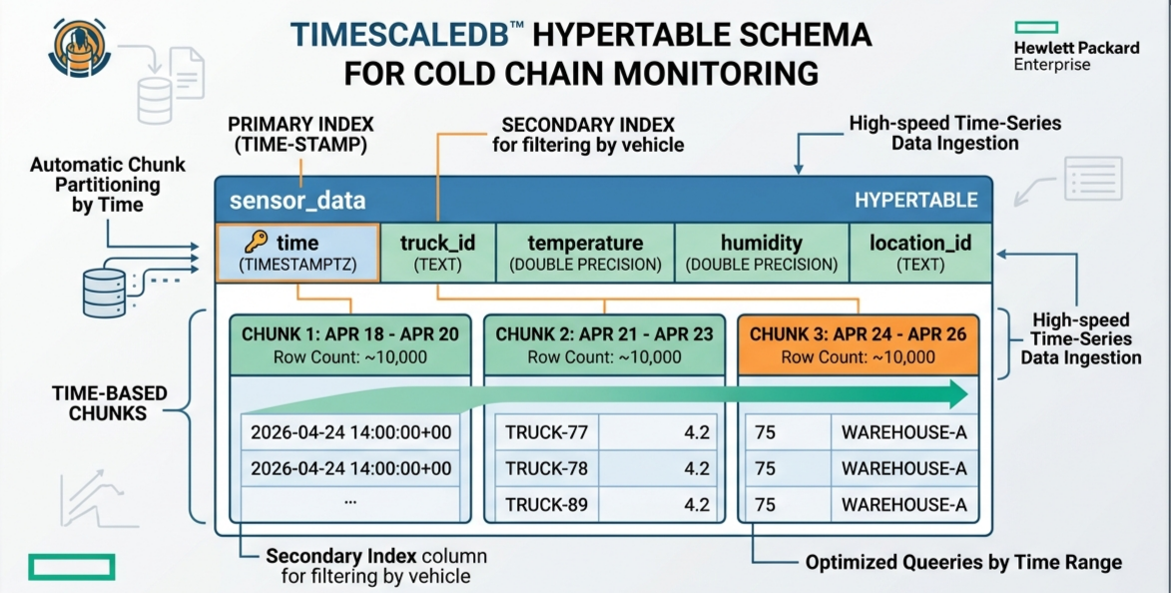

Slide 5
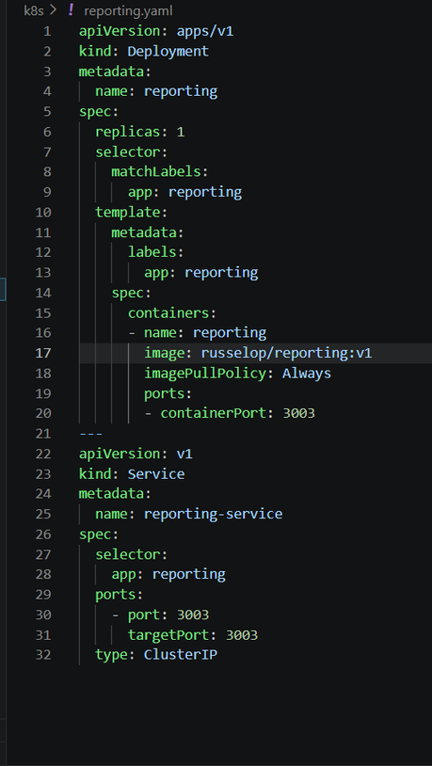
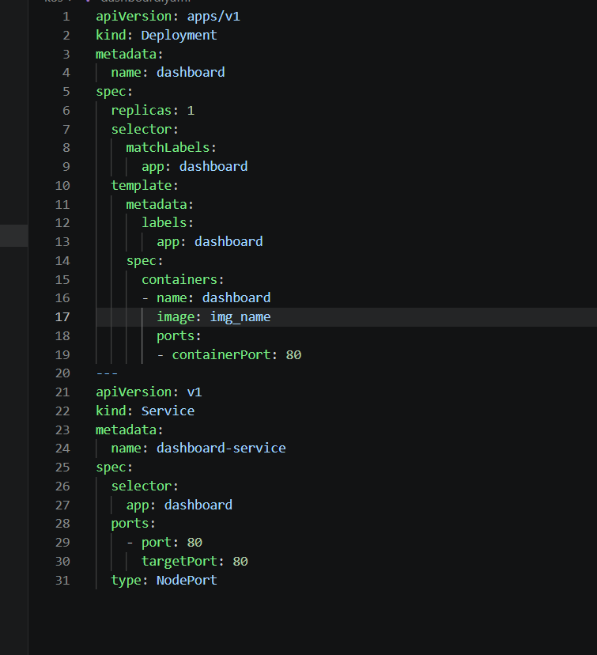
Kubernetes deployment of reporting and dashboard module:

Slide 6
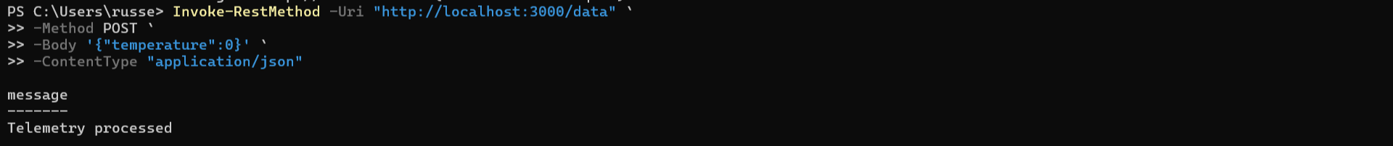

Slide 7
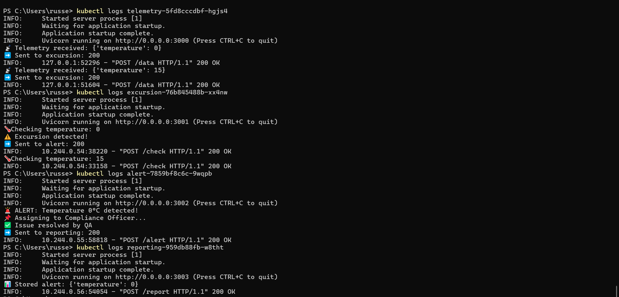

Slide 8
Work to be done next week:
Designing pseudocode for excursion detection.

