Slide 1

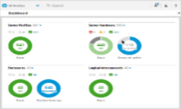




1. Event subscriptions
Event Receiver / Management Console
2. Events
Managed node
(iLO 4/5,6,7… Superdome Flex RMC…)

