Slide 1
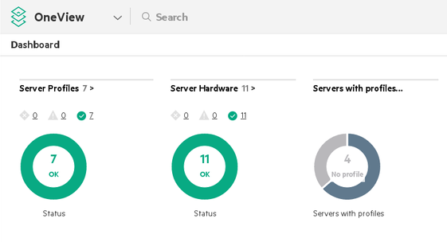
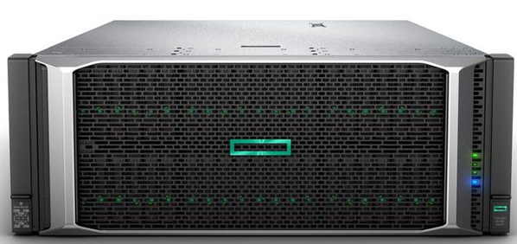
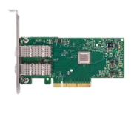

Introduction to PDLM
Offload Redfish processing from BMC to devices
Redfish client
Managed server
Redfish Service
PLDM capable device
BEJ* over PLDM over MCTP
HTTP request
request
response
request
response
HTTP response
request
response
*BEJ : Binary Encoded JSON (high compression)
Notes:
PLDM for RDE is a standard from the Distributed Management Task Force. This standard allows Redfish clients to receive H-T-T-P responses from R-D-E capable devices. In a nutshell, the Redfish clients sends an H-T-T-P request to the Redfish service of the managed server. The request is translated and forwarded to the device which answers it. When this dialog is complete, the B-M-C sends back the response to the client.

Slide 2
Introduction to PDLM
Offload Redfish processing from BMC to devices
Redfish client
Managed server
Redfish Service
PLDM capable device
BEJ* over PLDM over MCTP
HTTP request
HTTP response
*BEJ : Binary Encoded JSON (high compression)
Notes:
PLDM for RDE is a standard from the Distributed Management Task Force. This standard allows Redfish clients to receive H-T-T-P responses from R-D-E capable devices. In a nutshell, the Redfish clients sends an H-T-T-P request to the Redfish service of the managed server. The request is translated and forwarded to the device which answers it. When this dialog is complete, the B-M-C sends back the response to the client.

