Slide 1
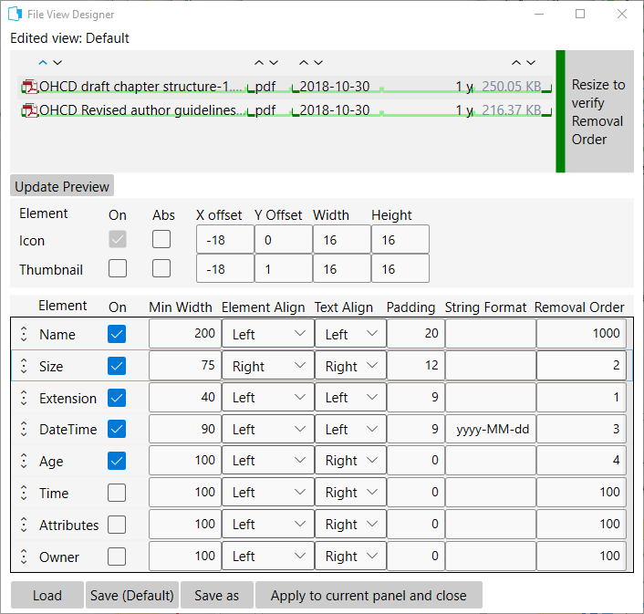
1
2

Slide 2
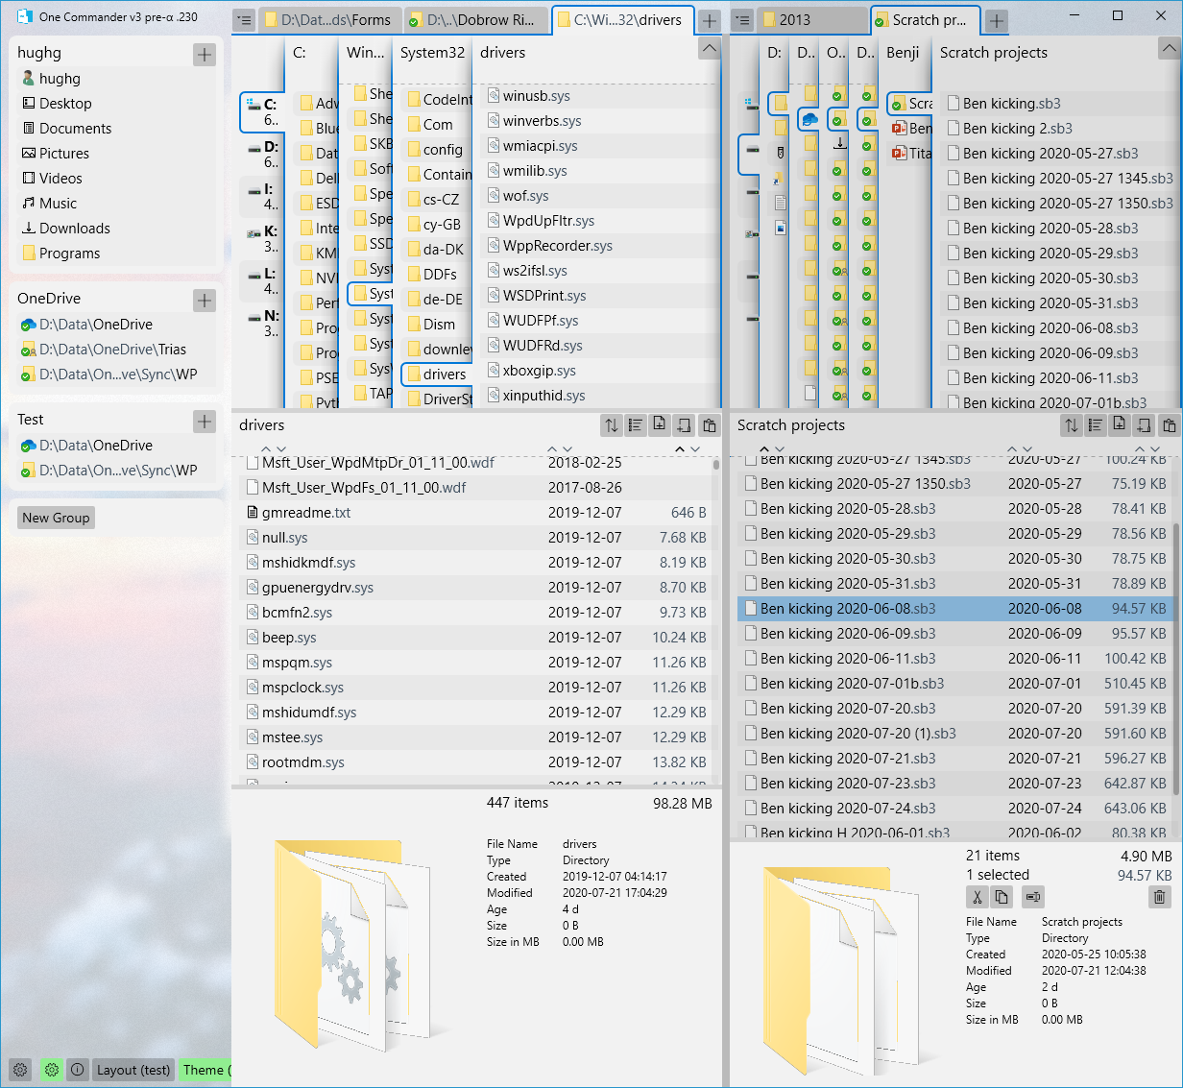
Favorites Sidebar
Left Browser
Right Browser
Layout Button

Slide 3
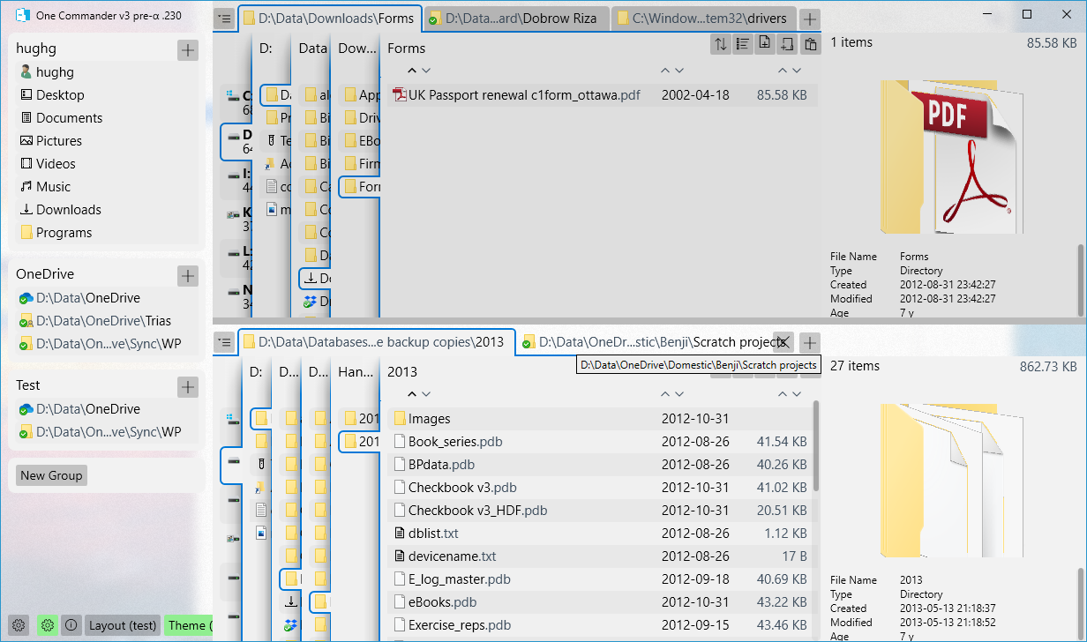
Favorites Sidebar
Top Browser
sd
Bottom Browser
Layout Button

Slide 4
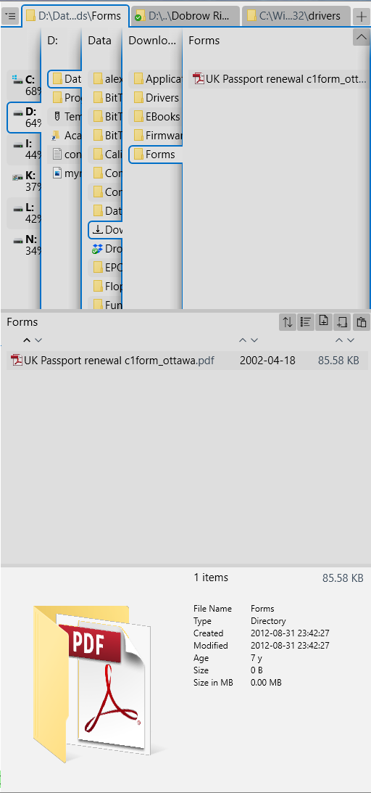
Browser Tabs
Navigation Pane
Current Folder Pane
File/Folder Details Pane

Slide 5
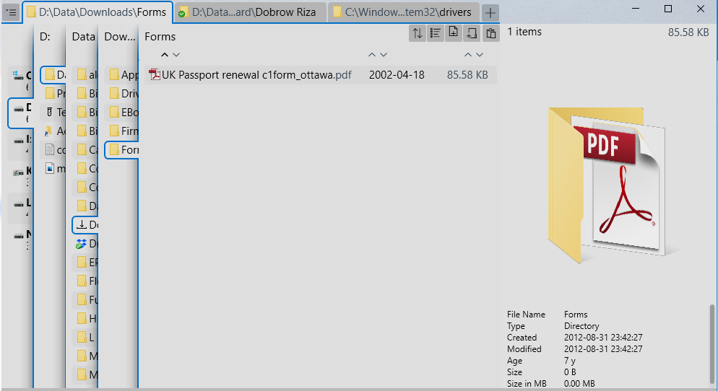
Browser Tabs
Navigation Pane
Current Folder Pane
File/Folder Details Pane

Slide 6
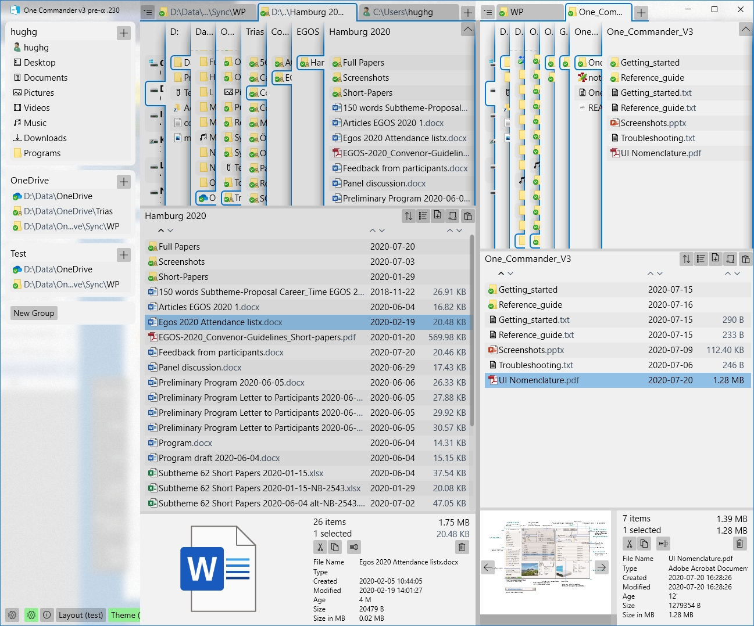
2020-07-20
Favorites Sidebar*
Left Browser
Right Browser
Title Bar Buttons
*for now
Folder Panel Tabs
Current Folder Pane
Scroll Indicator (not showing here)
Drives pane
Parent Folder Panes
Path Edit Button > opens Path Edit Panel
Right Folders panel
Folders Toggle Button
Favorites Group
Folders panels
Favorites Group Title
Add to Favorites Group Button
Browser Toolbar
Sort Arrows
New Favorites Group Button
Scrollbar “Thumb” (not showing)
Left Files Pane
Files panels
Message Rolldown/Rollup (not sure what this is)
Main Toolbar? Lower Toolbar (if you need one at the top)?
I like Editable TextBox
Left Details Pane
Browser divider
Details Pane resizer
Right Files panel
Left Details Pane Buttons
Thumbnail Navigation Buttons
File/Folder Thumbnail
System/Shell Context Menu: where is this?

Slide 7
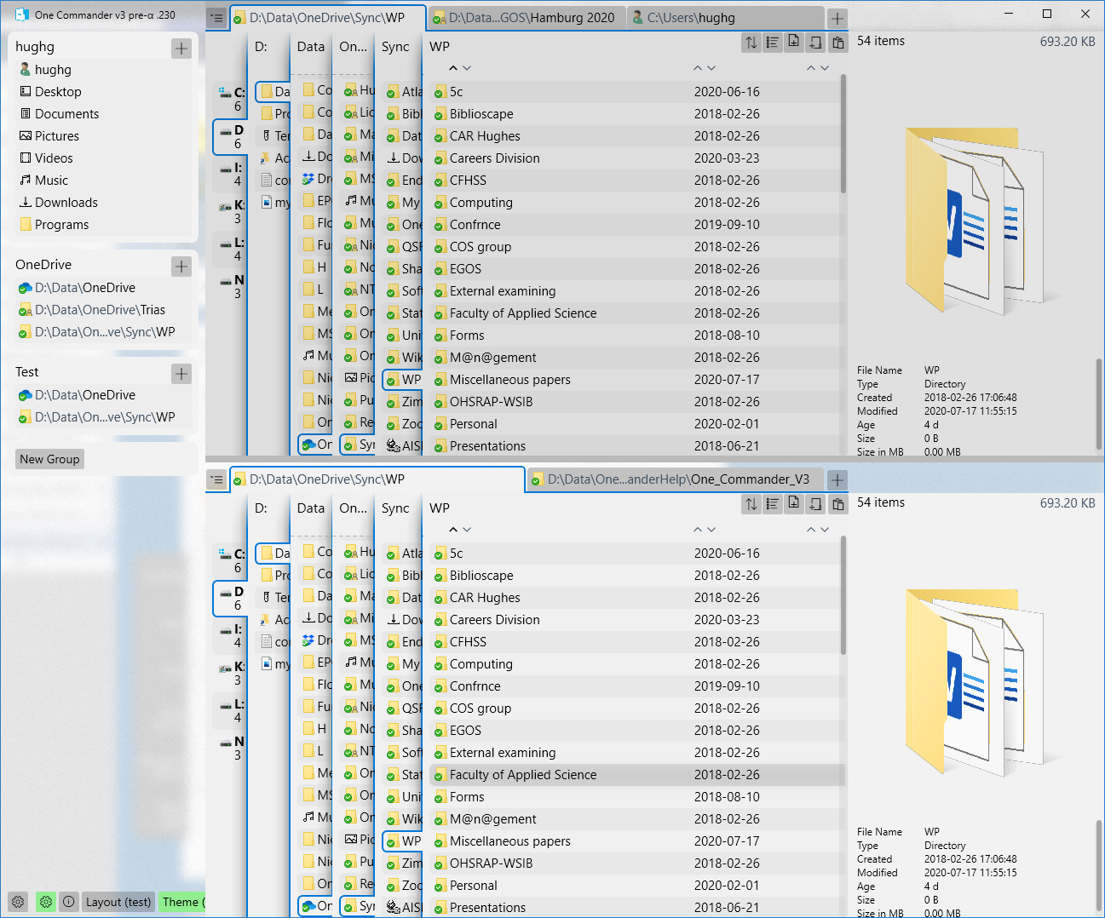
2020-07-20
Top Current Folder Panel
Top Browser
Bottom Browser
Bottom Current Folder Pane
Bottom Details Pane

Slide 8
2020-07-23
Favorites Sidebar*
Left Browser Pane
Or just “Left/Right Browser”?
Right Browser Pane
Title Bar Buttons
*for now
Navigation Pane Tabs
Current Folder Column
Scroll Indicator (not showing here)
Drives Column
Parent Folder Columns
Path Edit Button > opens Path Edit Pane (or Flyout, or just “Path Editor”?)
Right Navigation Pane
Navigation Pane Toggle Button
Favorites Group
Navigation Panes
Favorites Group Title
Add to Favorites Group Button
Folder Pane Toolbar
Sort Arrows
New Favorites Group Button
Scrollbar “Thumb” (not showing)
What’s the difference between “Scrollbar Thumb” and “Scroll Indicator”?
Context Menu: what you get when you right-click Folder or File
Current Folder Panes
Notification Pane at top or bottom
Main Toolbar? Lower Toolbar (if you need one at the top)?
Editable TextBox
Right Details Pane
Browser Divider
Details Pane resizer
Right Folder Pane
Left Details Pane Buttons
Preview Navigation Buttons
File/Folder Preview

Slide 9
2020-07-24
Favorites Sidebar*
Left Browser
Right Browser
Title Bar Buttons
*for now
Browser Tabs
Current Folder Column
Scroll Indicator (not showing here)
Drives Column
Parent Folder Columns
Path Edit Button
Right Navigation Pane
Navigation Pane Toggle Button
Favorites Group
Navigation Panes
Favorites Group Title
Add to Favorites Group Button
Folder Pane Toolbar
Sort Arrows
New Favorites Group Button
Scrollbar “Thumb” (not showing)
Context Menu: what you get when you right-click Folder or File
Current Folder Panes
Notification Pane at top or bottom
Main Toolbar? Lower Toolbar (if you need one at the top)?
Editable TextBox
Right Details Pane
Browser Divider
Details Pane resizer
Right Folder Pane
Left Details Pane Buttons
Preview Navigation Buttons
File/Folder Preview

Slide 10
2020-07-23
Drives Column
Parent Folder Columns
Top Current Folder Pane
Top Details Pane
Top Browser
Bottom Browser

Slide 11
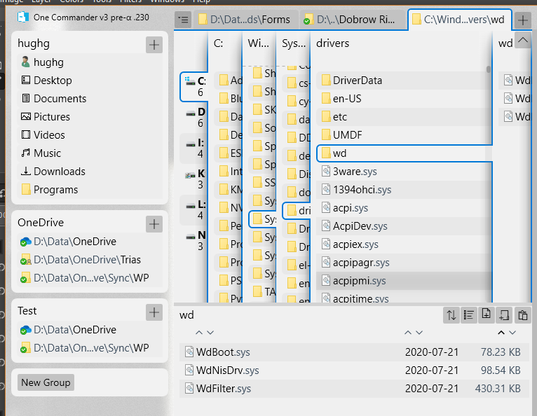

Slide 12
