Slide 1

Introduction to Probabilistic Machine Learning
Ralf Herbrich
Julia

Slide 2

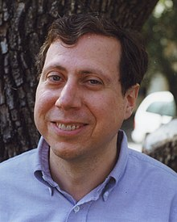


Julia
2012 developed by Jeff Bezanson, Alan Edelman, Stefan Karpinski and Viral B. Shah at MIT
Used for numerical and scientific computing with high performance
Execution speed is similar to C and FORTRAN
Hierarchical and parameterized type system as well as method overloading („multiple dispatching“) as central concepts
Native calls from C-(compiled) code possible (without wrappers)
Unicode is efficiently supported (e.g., UTF-8)
Alongside C, C++ and FORTRAN, the only programming language that has entered the “PetaFlop Club“
Jeff Bezanson (1981– )
Alan Edelman (1963 – )
Stefan Karpsinski (1981– )
Viral Shah

Slide 3
Features of Julia
Just-in-time (JIT) compilation implemented using LLVM
Approaching static compilation such as C!
Optional typing and type inference
Every object has a type; type declaration can be made
Types are run-time objects
A rich language of types for constructing and describing objects
Multiple dispatch
Functions are uniquely defined by their argument types
Alternative to classes in object-oriented programming
Very simple core language that imposes very little
Julia Base and the standard library are written in Julia itself, including primitive operations like integer arithmetic
Language support for meta-programming
Macros are a typed extensions to pre-processors that modify expression trees

Slide 4
Overview
Installation
Variables and Functions
Types
Methods & Interfaces
Modules

Slide 5
Overview
Installation
Variables and Functions
Types
Methods & Interfaces
Modules

Slide 6
Command Line Installation
All resources can be found on https://julialang.org/
On command line, execute
curl -fsSL https://install.julialang.org | sh
This will install the command line interface that can be launched with julia
_ _ _ _(_)_ | Documentation: https://docs.julialang.org (_) | (_) (_) | _ _ _| |_ __ _ | Type "?" for help, "]?" for Pkg help. | | | | | | |/ _` | | | | |_| | | | (_| | | Version 1.10.2 (2024-03-01) _/ |\__'_|_|_|\__'_| | Official https://julialang.org/ release |__/ |
The installation manager is called juliaup and you should regularly run
juliaup update
juliaup can also be used to install several (older) versions of Julia in parallel!

Slide 7


Visual Studio Code Installation
VS Code has excellent support for Julia but you should install two packages
Syntax highlighting
Integrated Julia REPL
Code completion
Linter
Debugger
Plot gallery
Grid viewer for tabular data
Automatic Julia code formatting

Slide 8
Overview
Installation
Variables and Functions
Types
Methods & Interfaces
Modules

Slide 9
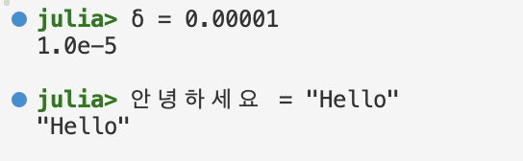
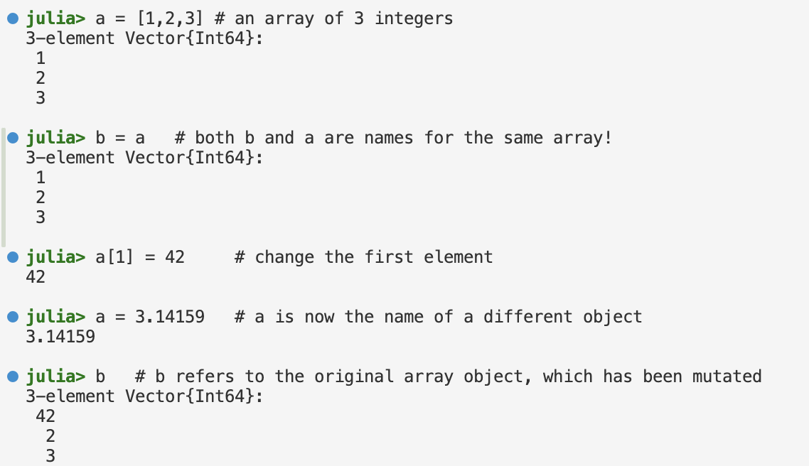
Julia Variables
Variables: A name associated (or bound) to a value
Variables names can contain any Unicode character (best typed by \<LaTeX name>-tab
A variable assignment with = binds the value but does not change it

Slide 10
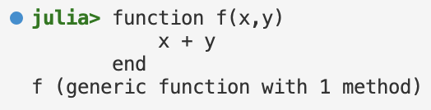




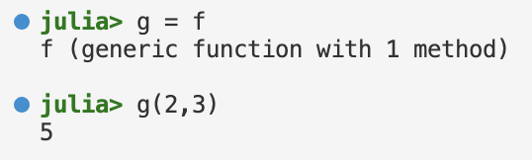
Julia Functions
Functions: An object that maps a tuple of argument values to a return value
Julia functions are not pure mathematical functions: they can alter and be affected by the global state of the program
Function call: A function is called using parantheses syntax
Functions are objects: A function is an object that can be assigned
Long syntax
Short syntax

Slide 11
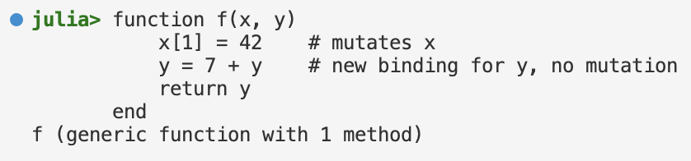
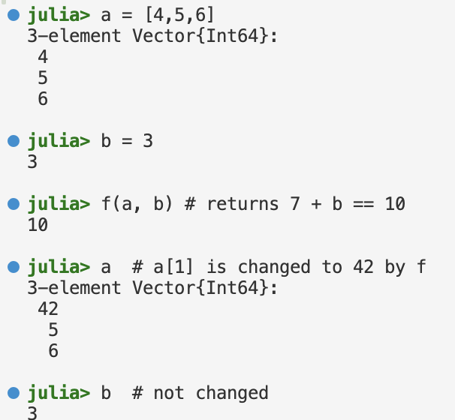
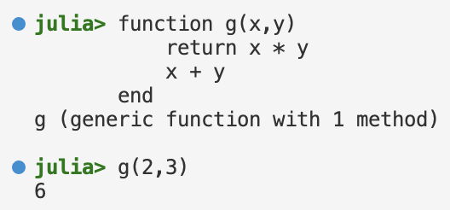
Julia Functions: Arguments and Returns
Arguments: Values are not copied when they are passed to functions
Function arguments themselves act as new variable bindings
Modifications to mutable values made within a function will be visible to the caller
A common convention is to put an explanation mark in the function name if the function mutates an argument
Return: The value returned by a function is the value of the last expression evaluated
The return keyword causes a function to return immediately
Function definition
Function application

Slide 12
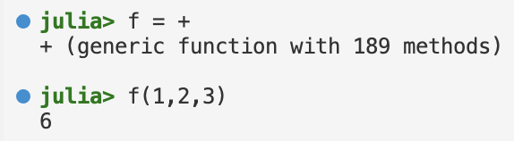

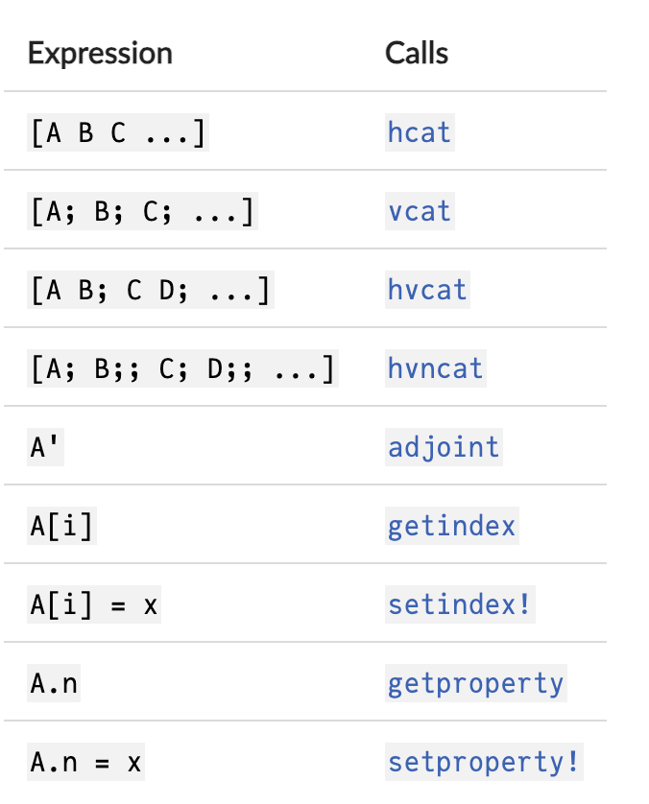
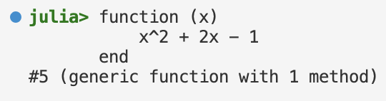

Julia Functions: Operators & Anonymous Functions
Operators: Operators are just functions with support for special syntax
Can also be applied using parenthesized argument lists
Can also be assigned to other variables
Operators with Special Names: A few special expressions correspond to calls to functions with special names
These operators can be made work for custom types by defining type-specific methods (see soon!)
Anonymous Functions: A function object without a name
In other programming languages, they are called lambda functions
Long syntax
Short syntax

Slide 13
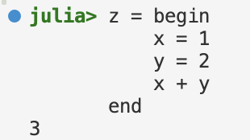

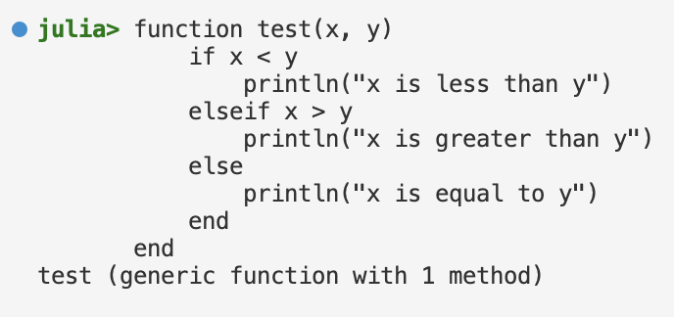
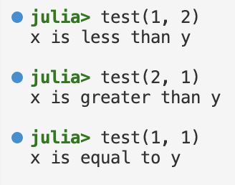
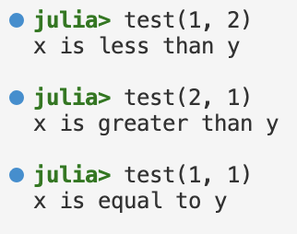
Julia Functions: Control Flow (Conditionals)
Compound expressions: Several sub-expressions that evaluate to the final expression
Conditional evaluation: Allows portions of code to be evaluated or not evaluated depending on the value of a Boolean expression
Ternary Operator: Shorthand for an if-then-else-end expression
Long syntax
Short syntax
Function definition
Function application

Slide 14
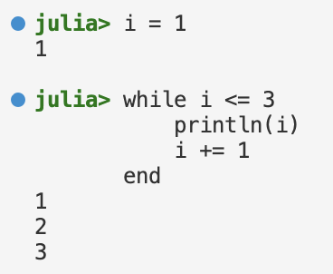
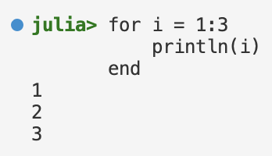
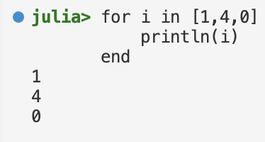
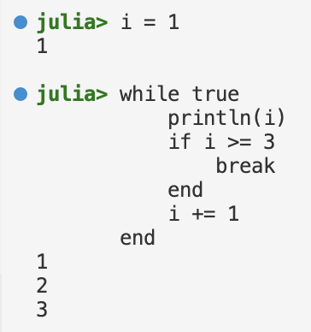
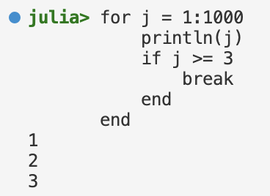
Julia Functions: Control Flow (Loops)
while-loop: Evaluates the condition expression and as long it remains true, keeps also evaluating the body of the loop
for-loop: Iterates through the container provided
A for-loop always introduces a new iteration variable in its body, regardless of whether a variable of the same name exists in the enclosing scope (a while-loop does not do that)
break: Terminate the repetition of a while–loop before the test condition is false or stop iterating in a for-loop before the end of the iterable object is reached

Slide 15
Overview
Installation
Variables and Functions
Types
Methods & Interfaces
Modules

Slide 16
Julia’s Type System
Julia's type system is dynamic (i.e. types are not known until run time)
There is no meaningful concept of a "compile-time type”!
It is possible to indicate that certain values are of specific types
Explicit types are used for method dispatching (see soon!)
Julia's type system is also nominative (i.e., hierarchical relationships between types are explicitly declared
Concrete types cannot subtype each other: all concrete types are final
Only abstract types can be supertypes
Julia's type system is also parametric
Types can be parameterized by other types or by symbols (e.g. numbers)
Powerful for container types (e.g., lists)
Note: Only values, not variables, have types!
Variables are simply names bound to values
"type of a variable" is shorthand for "type of the value to which a variable refers".

Slide 17
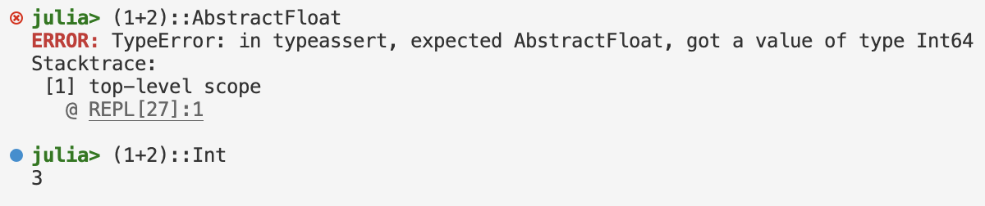
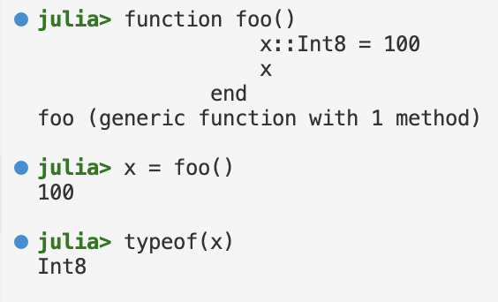
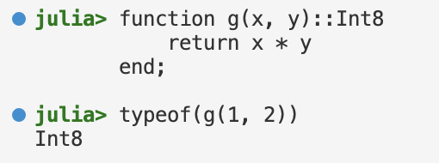
Julia Types: Type Declarations
:: operator: Can be used to attach type annotations to expressions and variables in programs
typeof function: Returns the type of the value that is passed to it
Function return types: Can be specified at function definition
typeof function
Function return type

Slide 18
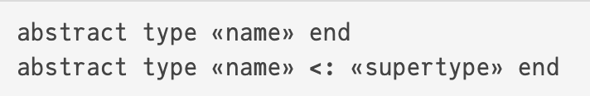
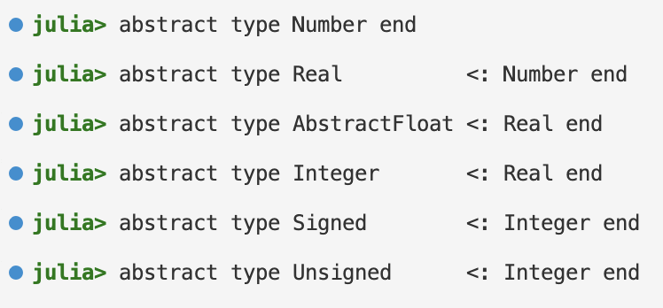
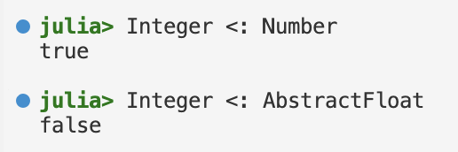
Julia Types: Abstract Types
Abstract Types: Cannot be instantiated, and serve only as nodes in the type graph
Abstract types are declared using the abstract type keyword
:< function: Allows to specify a supertype relationship or test for it
No loss in performance when using function whose arguments are abstract types
They are recompiled for each tuple of concrete argument types with which it is invoked!
Type declarations
Supertype check

Slide 19
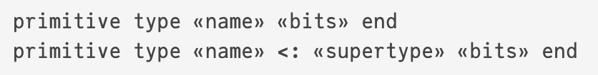
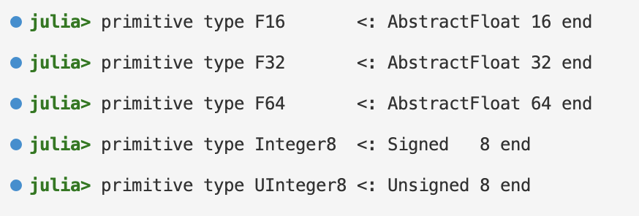
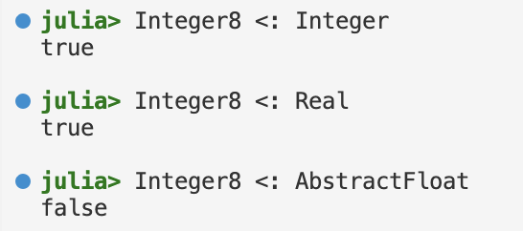
Julia Types: Primitive Types
Primitive Types: Concrete type whose data consists of plain old bits
Primitive types are declared using the primitive type keyword
The number of bits indicates how much storage the type requires
Unusual to redefine primitive types as Julia’s primitive types are highly performant
Type declarations
Supertype check

Slide 20
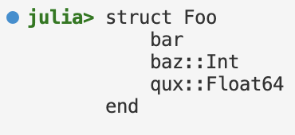
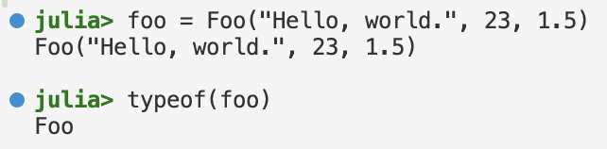
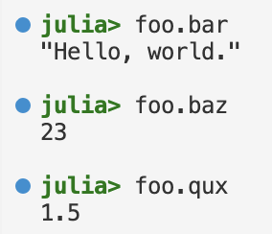
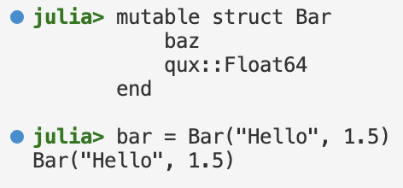
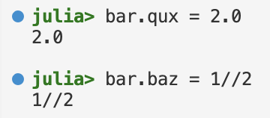
Julia Types: Composite Types
Composite Types: A collection of named fields
Composite types are declared using the struct keyword
New objects are created by applying the type name as a function (default constructor)
Fields can be accessed with the property notation <variable>.<fieldname>
Composite objects declared with struct are immutable!
Efficient and easier to reason about for the (just-in-time) compiler (can use registers!)
Composite objects declared with mutable struct are mutable!
Such objects are generally allocated on the heap and have stable memory addresses

Slide 21
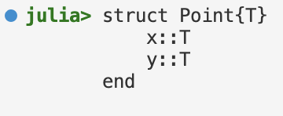
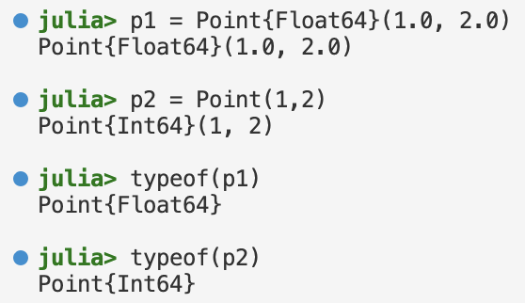
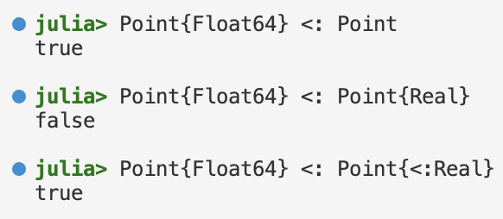
Julia Types: Parametric Types
Parametric Types: Types that have parameters that introduce a whole family of new types – one for each possible combination of parameter values
Type parameters are introduced after the type name, surrounded by curly braces
The type parameter can be any type at all (or a value of any primitive type!)
The non-parametric type is a super-type of any specialized parametric type!
Any
Number
Point
Real
Point{Real}
Point{Float64}
AbstractFloat
Integer
Float64
Any type that is a subtype of Real

Slide 22
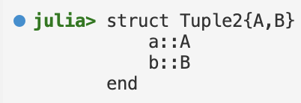

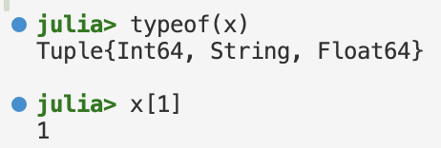
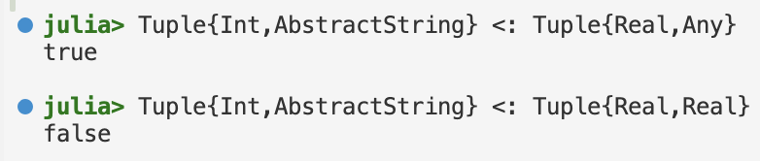
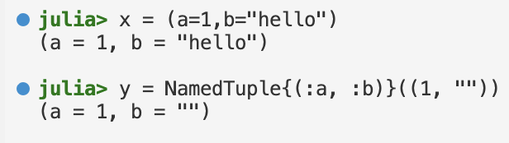
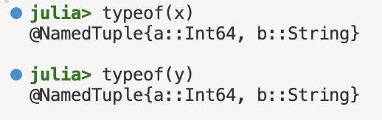
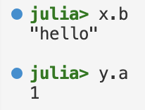
Julia Types: Tuple Types
Tuple Types: Parameterized immutable type where each parameter is the type of one field
Tuple types may have any number of type parameters
Tuples do not have field names; fields are only accessed by index
Tuple types are covariant in their parameters
Named Tuple Types: Tuple types with field names
Field names can be used to access elements
Tuple types are an abstraction of the arguments of a function

Slide 23
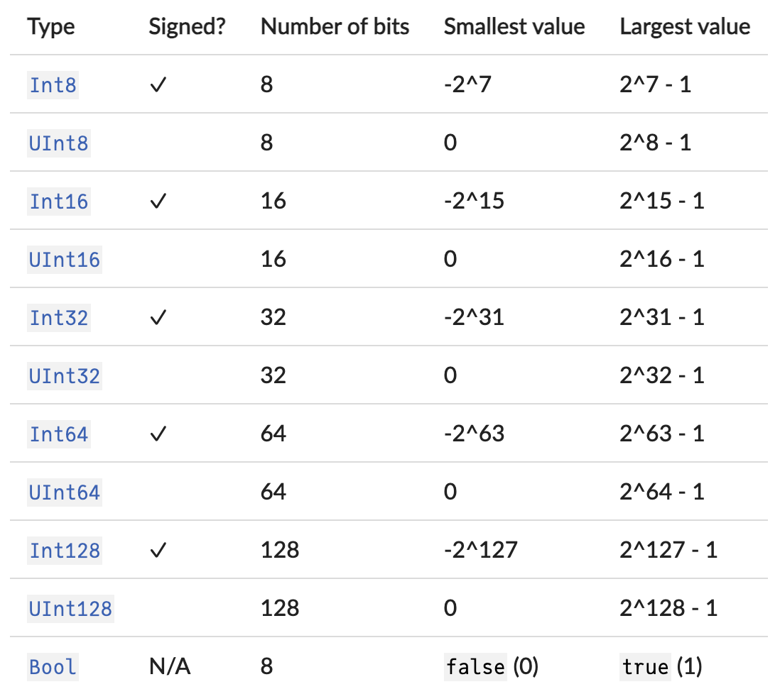



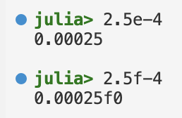
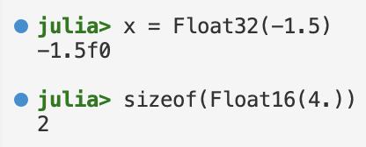
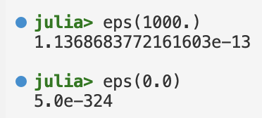
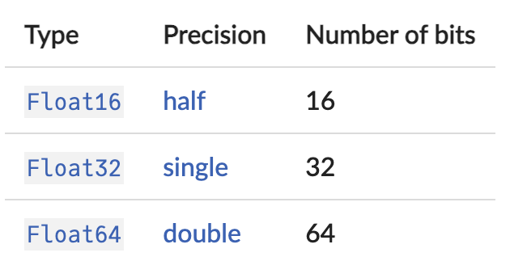
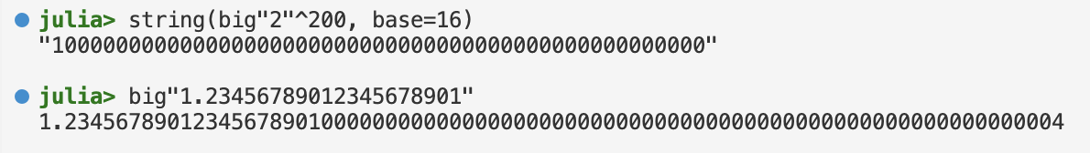
Julia Types: Numbers
Julia provides a broad range of primitive numeric types
Integers: Hexadecimal, octal and binary literals are input via 0x, 0o and 0b
Floating Point Numbers: 64-bit and 32-bit literals are input via <leading digits>e<exponent> or <leading digits>f<exponent>
Machine epsilon: Distance between two adjacent floating-point numbers
Arbitrary Precision Arithmetic: Julia wraps the GMP and GMPFR library

Slide 24
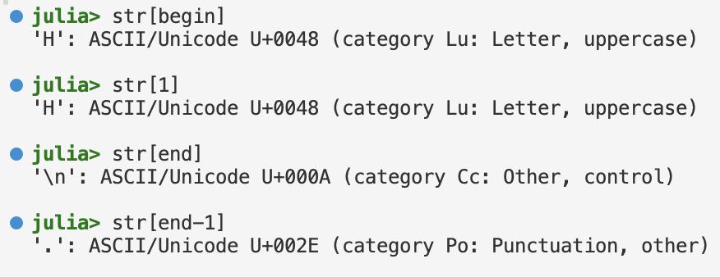




Julia Types: Strings
Strings are finite sequences of characters
The built-in concrete type used for strings (and string literals) in Julia is String
It supports the full range of Unicode characters via the UTF-8 encoding
String literals are delimited by double quotes or triple double quotes
Strings are arrays of characters with the special indexers begin and end
Strings are concatenated with * and interpolated with $
The shortest complete expression after the $ is taken as the expression whose value is to be interpolated into the string
Julia supports regular expression with the r string prefix for the regex:

Slide 25
Overview
Installation
Variables and Functions
Types
Methods & Interfaces
Modules

Slide 26






Julia Methods
A function is an object that maps a tuple of arguments to a return value
It is common for the same conceptual function or operation to be implemented quite differently for different types of arguments
Method: A definition of one possible behavior for a function
Method dispatch: Choice of method to execute when a function is applied
Multiple dispatch: Using all of a function's arguments to choose which method

Slide 27








Julia Parametric Methods
Method definitions can have type parameters qualifying the signature
Similar to subtype constraints on type parameters in type declarations one can also constrain type parameters of methods using where:
Constructor methods: Constructor is just like any other function in Julia
Defining a method with the same name as composite type is called an outer constructor

Slide 28





Julia Interfaces
Interface: By extending a few specific methods to work for a custom type, objects of that type can be used in other methods that are written to generically build upon those behaviors.
Example: Iterator interface
Custom type
Interface definition
Interface usage

Slide 29





Julia Interfaces (ctd)
Indexing interface allows any composite type to behave like an array
This is true even if the type never explicitly stores an array!
Example: Array of square numbers
The interface even allows to support new indexing modes!

Slide 30
Overview
Installation
Variables and Functions
Types
Methods & Interfaces
Modules

Slide 31


Julia Modules
Modules: Help organize code into coherent units
Modules are separate namespaces, each introducing a new global scope
Same name can be used for different functions or global variables without conflict
Can be precompiled for faster loading, and may contain code for runtime initialization
Module Definition: Using the keywords module … end
Explicit exports of symbols are done with export
Module Usage: Using the keywords using
Local defined modules start with a dot

Slide 32
Summary
Julia Concepts
Runs programs via JIT compilation implemented using LLVM (nearly as fast as C!)
Julia is 12 years old and has reached wide-spread adoption in scientific computing
Extensibility comes from using method dispatch and unbundling functions and data
Julia provides garbage collection and requires no explicit memory management
Julia Type System
Julia's type system is dynamic, nominative and parametric
It only has abstract, primitive and composite types (and the latter ones are all final)
Every object has a type; type declaration can be made
Julia Methods
A method is the concrete definition of a function’s behavior
Every function can have many methods; Julia run-time picks the right method based on the types of the arguments (method dispatch)
We only scratched the surface; keep using the language to get confident!

Slide 33
See you next week!

