Slide 1
Continuous Code Reviews A Social Coding tool for Code Reviews inside the IDE
Tobias Dürschmid
Hasso Plattner Institute, University of Potsdam, Germany
tobias.duerschmid@student.hpi.de

Slide 2





Reasons for Performing Code Reviews
Finding defects
Improving code quality
Discussing alternative solutions
Transferring knowledge
Improving team awareness
(Rigby and Bird 2013)

Slide 3



Problem
Contemporary code reviews are done only once before a pull request is merged
No feedback on legacy code
No support for questions of new developers
Involves context switches
How to make code reviews more live?

Slide 4
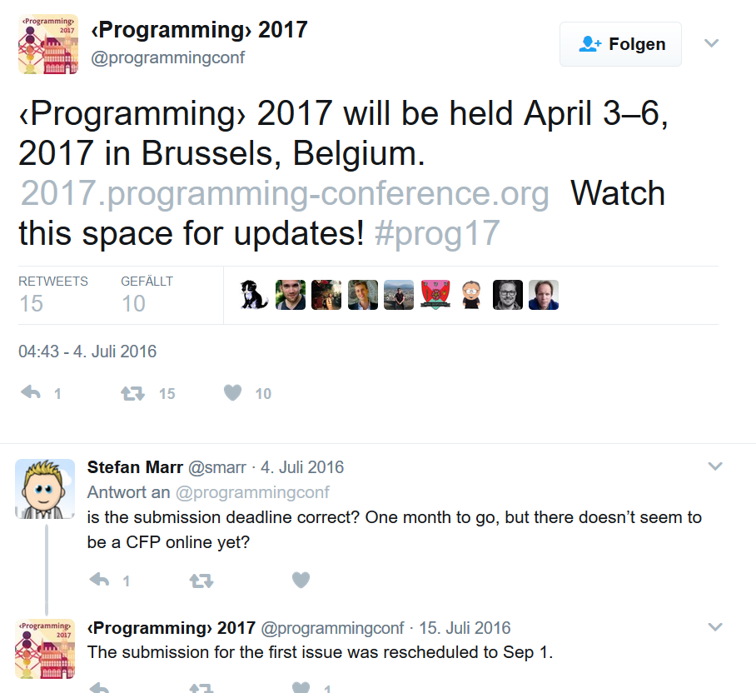
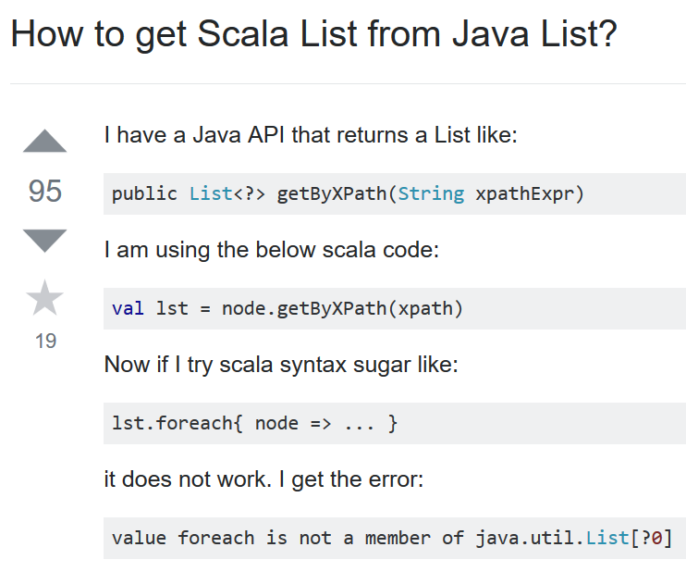
Social Media
Twitter
StackOverflow
Content is live!
Notes:
Post by <Programming>

Slide 5
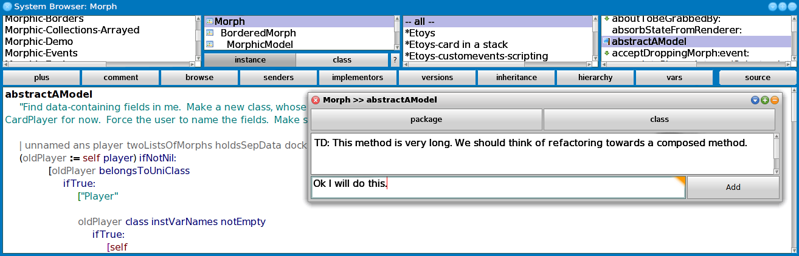
Demo
Notes:
The developer Alice reads a piece of code relevant to her current issue. She does not understand, why this is done like it is and adds a comment on this piece of code. Because Bob did the last change to this code, he gets informed about the new comment by a notification in the IDE. He opens the concerned method and answers the questions. Alice recommends Bob to refactor the code to directly reveal this intention. He does so and pushes the done button of the comment in order to hide the comment of the discussion. After Alice has finished her issue, Bob enjoys reading her code and therefore pushes the ”I like” button of the new method in order to help new developer getting to know the coding styles of the project.

Slide 6
Design
How to exchange comments between clients?
Client-Server Architecture with Squeak frontend and Ruby server for comment exchange using REST
IDE
Comments
IDE

Slide 7
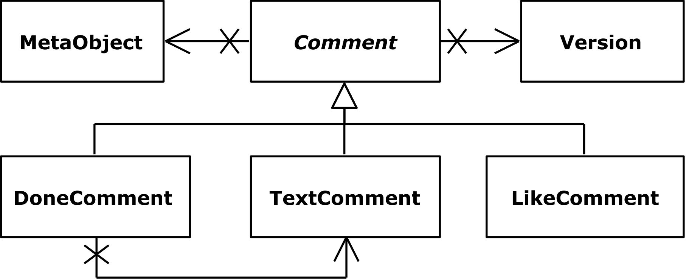
Design
How to encode the reference to meta objects?
Package: Package name
Class: Package name + class name
Method: Package name + class name + method name

Slide 8


Design
How to migrate comments when the meta object is moved to another class / package or renamed?
Comment has a list of references
When to reset comments?
Only explicitly by user only

Slide 9
Related Work
Stand-alone tools for code reviews
CodeFlow, Mondrian, Gerrit, Phabricator, ClusterChanges
Plug-Ins
EGerrit as Eclipse Plug-In
Pull-based code reviews
Change-based code reviews

Slide 10
Conclusion
New approach for merging reading code with adding reviews
Depict programmging as social activity.
To be used orthogonally to pull requests

Slide 11
References
(Rigby and Bird 2013) Peter C. Rigby and Christian Bird. 2013. Convergent Contemporary Software Peer Review Practices. In Proceedings of the ’13 9th Joint Meeting on Foundations of Software Engineering (ESEC/FSE ’13). ACM, New York, NY, USA, 202–212.

