Slide 1
Continuous Code Reviews aka
Community Code Review

Slide 2
Motivation of the project
Give feedback on code quality to the Squeak community & evaluate it duting
Identify clean code as good examples for students

Slide 3



Research Problem
Contemporary code reviews are done only once before a pull request is merged
  No feedback on legacy code
  No support for questions of
  new developers
  Involves context switches
How to make code reviews more live?
Notes:
Use Cases
Hall of Fame

Slide 4
Main Features
Add comments to metaobjects
Comment to deprecated sources are grayed out
Marking comments as done will hide them in the browser
Likes are displayed in the browser and comment view
Hall of fame displays the best methods, classes and packages

Slide 5
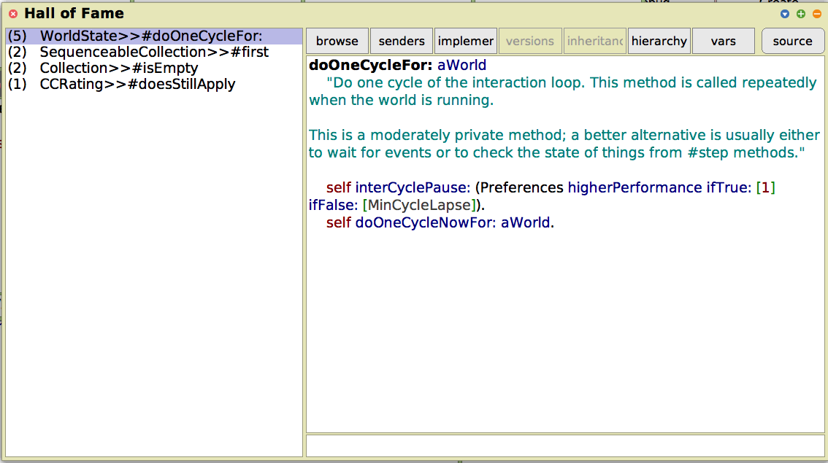
Hall of Fame

Slide 6
Conclusion
New approach for merging reading code
with adding reviews
Communicate good code style through examples
To be used orthogonally to pull requests

Slide 7
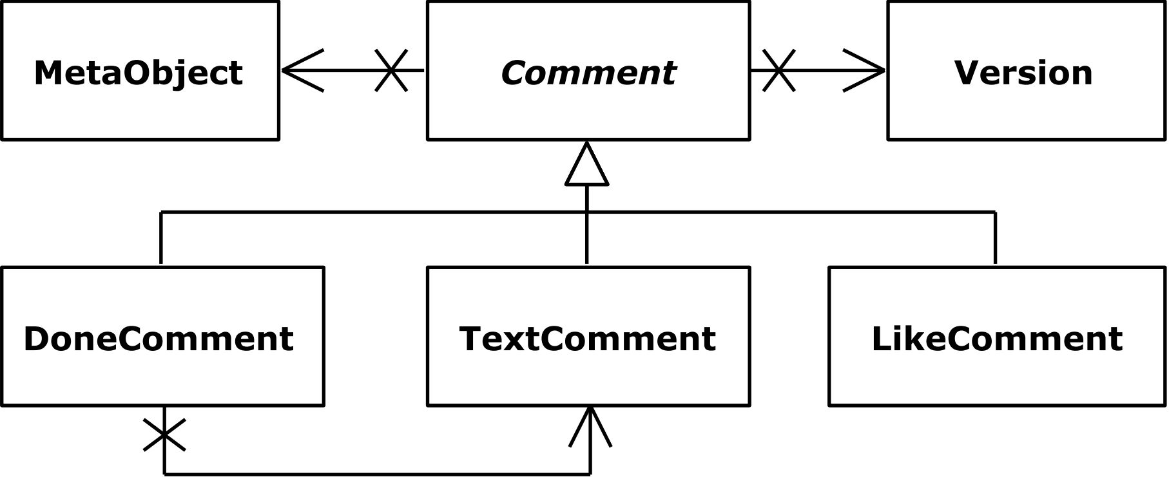
Design
How to encode the reference to meta objects?
Package: Package name
Class: class name
Method: class name + method name

Slide 8


Design
How to migrate comments when the meta object
is moved to another class / package or renamed?
Comment has a list of references
When to reset comments?
Only explicitly by user only

Slide 9
Related Work
Stand-alone tools for code reviews
  CodeFlow, Mondrian, Gerrit, Phabricator, ClusterChanges
Plug-Ins
  EGerrit as Eclipse Plug-In
Pull-based code reviews
Change-based code reviews

Slide 10
Design
How to exchange comments between clients?
Client-Server Architecture with Squeak frontend and Ruby server for comment exchange using REST
IDE
Comments
IDE

Slide 11
References
(Rigby and Bird 2013) Peter C. Rigby and Christian Bird. 2013. Convergent Contemporary Software Peer Review Practices. In Proceedings of the ’13 9th Joint Meeting on Foundations of Software Engineering (ESEC/FSE ’13). ACM, New York, NY, USA, 202–212.

