Slide 1
Continuous Code Reviews A Social Coding tool for Code Reviews inside the IDE
Tobias Dürschmid
tobias.duerschmid@student.hpi.de
Hasso Plattner Institute, University of Potsdam

Slide 2
Reasons for Performing Code Reviews
finding defects
improving code quality
discussing alternative solutions
transferring knowledge
improving team awareness
(Rigby and Bird 2013)

Slide 3
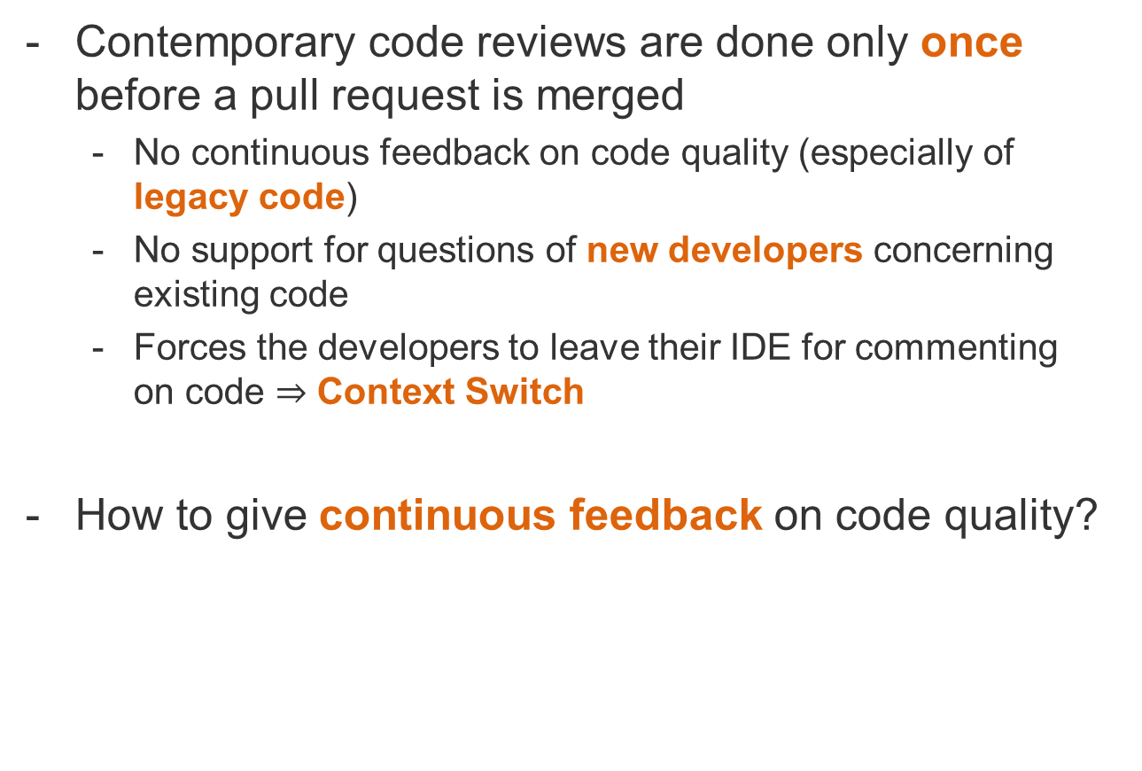
Problem
Contemporary code reviews are done only once before a pull request is merged
No continuous feedback on code quality (especially of legacy code)
No support for questions of new developers concerning existing code
Forces the developers to leave their IDE for commenting on code $⇒$ Context Switch
How to give continuous feedback on code quality?

Slide 4
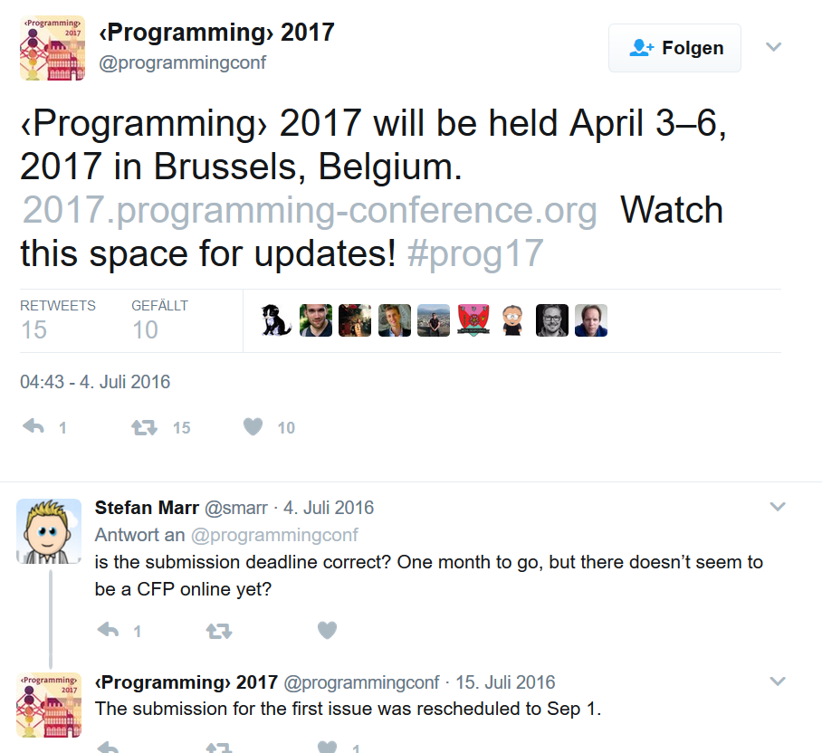
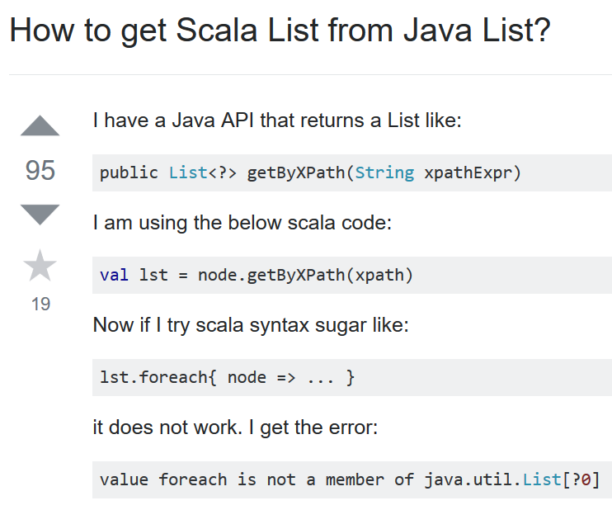
Social Media
Twitter
StackOverflow
Notes:
Post by <Programming>

Slide 5
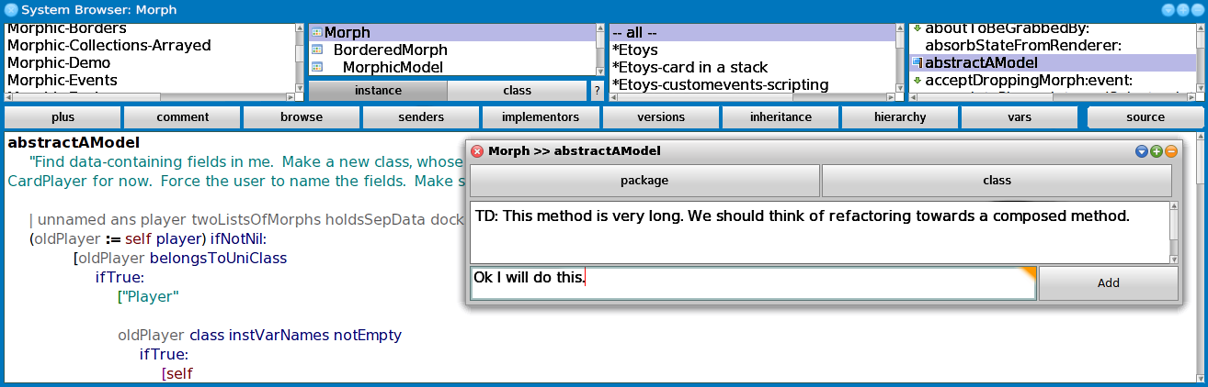
Demo
Notes:
The developer Alice reads a piece of code relevant to her current issue. She does not understand, why this is done like it is and adds a comment on this piece of code. Because Bob did the last change to this code, he gets informed about the new comment by a notification in the IDE. He opens the concerned method and answers the questions. Alice recommends Bob to refactor the code to directly reveal this intention. He does so and pushes the done button of the comment in order to hide the comment of the discussion. After Alice has finished her issue, Bob enjoys reading her code and therefore pushes the ”I like” button of the new method in order to help new developer getting to know the coding styles of the project.

Slide 6
Implementation
Client-Server Architecture with Squeak frontend and ruby server for comment exchange
Comment added
Comments
IDE
Comment added

Slide 7
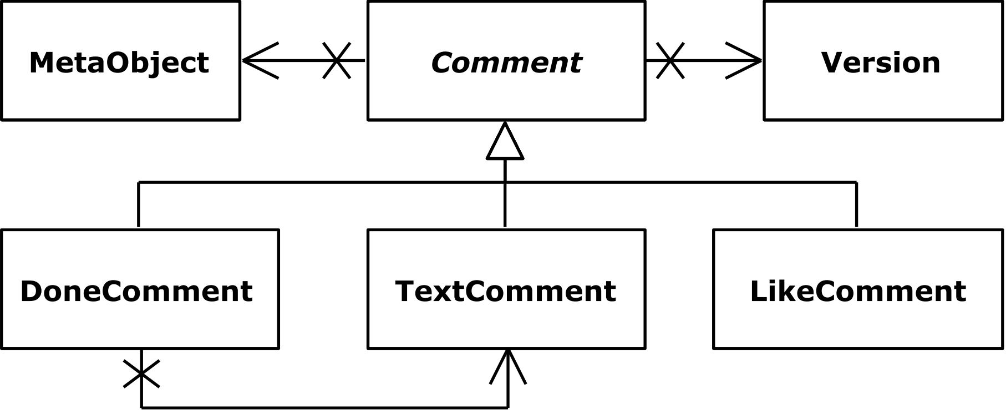
Implementation
Each comment references a meta object via hash
Package: Package name
Class: Package name + class name
Method: Package name + class name + method name

Slide 8
Implementation
Comments are migrated when the meta object is moved to another class / package
Reset of comments is performed explicitly by user only

Slide 9
Related Work
Tools like CodeFlow, Mondrian, Gerrit, Phabricator, ClusterChanges
Stand-alone tools for code reviews
EGerrit as Eclipse Plug-In
Pull-based code reviews
Change-based code reviews

Slide 10
Discussion
Enable adding comments to external libraries or frameworks Give feedback to developers of third party software
Source code comments will move out of the code base into the social coding comment database Keeps the code clean and focused.
Correctness only if all working developers have installed the tool Moving a method with attached comment leads to inconsistent state

Slide 11
References
(Rigby and Bird 2013) Peter C. Rigby and Christian Bird. 2013. Convergent Contemporary Software Peer Review Practices. In Proceedings of the ’13 9th Joint Meeting on Foundations of Software Engineering (ESEC/FSE ’13). ACM, New York, NY, USA, 202–212.

