Slide 1
insight
TEAM 1

Slide 2
Problem statement definition
PROBLEM STATEMENT: Twitter Sentiment/Social Media Analytics
DEFINITION: Twitter is a popular microblogging service where users create status messages (called "tweets"). These tweets sometimes express opinions about different topics. Sentiment analysis is the prediction of emotions in a word, sentences or corpus of documents. It is ntended to serve as an application to understand the attitudes, opinions and emotions expressed within an online mention. Precisely, it is a paradigm of categorising conversations into positive, negative or neutral labels. The purpose of this project is to build an algorithm that can accurately classify Twitter messages as positive or negative, with respect to a query term.

Slide 3
Team structure & roles
INSIGHT
TEAM LEADER:
AAYUSHI SOMANI
RESEARCH MEMBER:
1.VISHAAL SHARMA
2. KAMALNATH IRUKULLA
APPLICATION ARCHITECT:
1. HERAT MAKWANA
SOLUTIONS SPECIALIST:
1. SHUBHAM PAWAR
2. RUSHIKESH KHOT
NLP ENGINEER:
1.RUTURAJ CHOTHE
2. AISHWARYA SALIMATH
BUSINESS DEVELOPMENT MANAGER:
1. ANJALI SHAH
SALES SPECIALIST:
1. VISHAAL SHARMA
2. POORNIMA DESHPANDE
ML & AI MANAGER:
1. AMAL KRISHNA
2. ISHANK JAIN

Slide 4
Problems faced by the client
P1. What is the general sentiment (positive or negative) of the media coverage of an organization, brand, person, or legislation?
P2. What pros or cons are being brought up the most?
P3. What features of the company’s offering are key drivers of negative sentiment among your customers?
P4. How are different aspects of a product are perceived by customers, especially when compared with similar aspects of competing products?
P5. What sentiment do market analysts have toward certain securities and how has it evolved over time?

Slide 5
COMPETITOR BENCHMARKING
 | COMPETITOR A | COMPETITOR B | COMPETITOR C | OUR PRODUCT
NAME OF THE PRODUCT | StreamCrab | Germin8 | ExportTweet | ACM 1.0 (NEXGEN MINING)
Overview | A web based service provided to the users who are always on the go. A good UI makes it easy to use with java script based user interface making it ready to use on all java dependent platforms easily. | Enhanced accuracy based on the more accurate results In depth analysis using positive, negative and neutral outputs | Analysis of valuable Valuable information on the social traffic situations, demography, influencers and location | The first step towards training the machine learning model begins with collecting the datasets that are made available using theTwitter API, which is achieved using the Tweepy library. It offers labelled datasets that can be used to efficiently train themachine learning model. The tweet processing and classification is done using the textblob library, which offers a simple API fornatural language processing tasks such as sentiment analysis and classification. With this text classifier, we can label each Tweetas positive, negative or neutral of the sentimental value in a few minutes
Additional Value(Plus point)
Platform
Limitation
Cost | Paid | Paid | Paid | Paid

Slide 6
Technologies explored
BAG OF WORDS
MACHINE LEARNING
LOGISTICS REGRESSION
SVM
DECISION TREE
DEEP LEARNING
RNN

Slide 7
Concept Validation
Why we are using tweepy and TextBlob?
-TWEEPY -for accessing twitter
TEXTBLOB -simple interface
- build on shoulders of NLTK
- so, faster than NLTK
- Naive Bayes classifier is used
- Features like tokenization and parsing

Slide 8
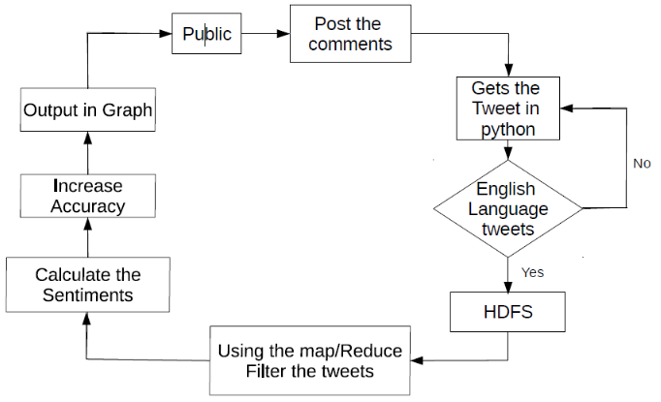
Application architect

Slide 9
Natural language processing
1.Language Understanding (NLU)
2.Natural Language Generation
Steps involved in the NLP phase of development
1.Tokenization-Converting sentence into single words.
2.Stemming-Normalize the words into root form or base form.
3.Lemmatization-Improvisation over stemming.
4.POS Tags-Tags each word with its type.
5.Named Entity Recognition: Process of recognising person names, organisation, quantity
6.Chunking-Grouping of words or tokens into chunks.*NLTK *TEXTBLOB*NAIVE BAYES

Slide 10
Solution to the problem
Problem 1. Approach
Solution 1. -using NLP: -using textblob library we are implementing our product.
Problem 2. Dataset
Solution 2. - Twitter API - Using twitter API we are accessing tweeter data.
Problem 3. Pre-processing
Solution 3. - re library
For better analysis there is need of pre-processing in which we are removing noise with the help 're' library.

Slide 11
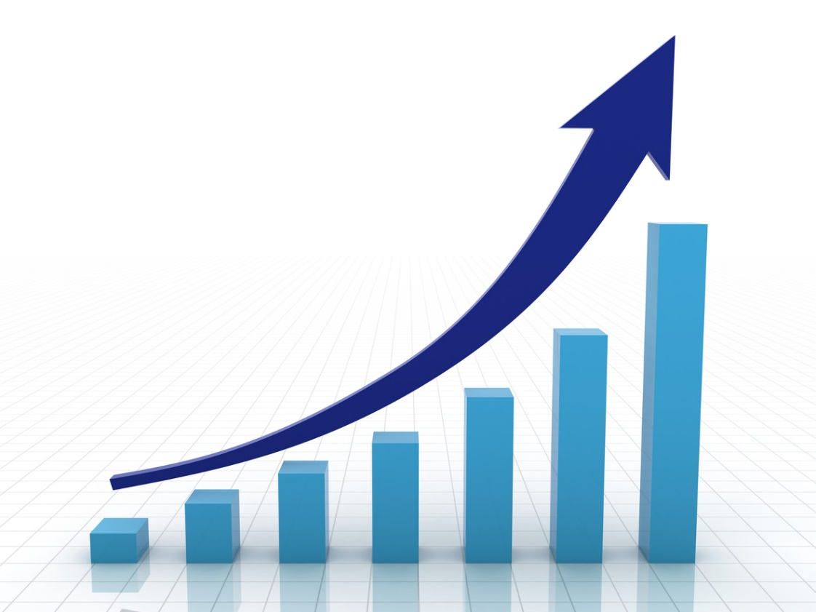
Improving scalability
Scalability is the capability of a system, network, or process to handle a growing amount of work, or its potential to be enlarged to accommodate that growth.
Examples:
A retail chain is typically considered scalable as long as it can launch new stores without declines in same-store sales.
Cloud computing : Modern techniques such as cloud computing have overcome such problems to the extent that services can be designed to be deployed at scale that is only limited by physical realities

Slide 12

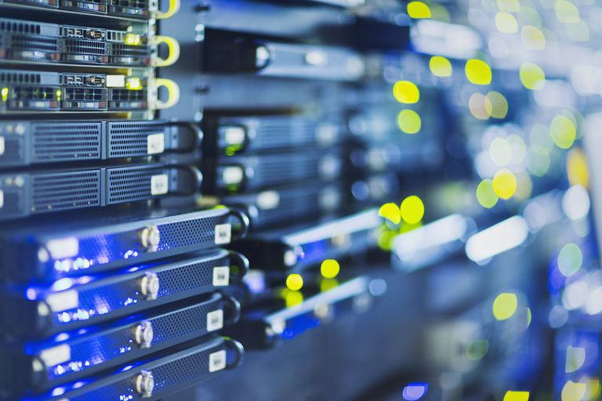
In the context of our Twitter Sentiment Analysis tool, it means –
The ability of the system to handle more searches is dependent on primarily four aspects:
Technology
Internet
Server
Twitter API

Slide 13
Ways to improve scalability:
Additional functionality to recognize emoji/emoticons
Ability to perform sentiment analysis on other platforms like Facebook, Quora etc.
Make it more versatile by integrating multiple languages

Slide 14
Accuracy
A measure of how often a sentiment rating was correct. For documents with tonality, accuracy tracks how many of those that were rated to have tonality were rated correctly.
Human language is elaborate, with nearly infinite grammatical variations, misspellings, slang and other challenges making accurate automated analysis of natural language quite difficult.

Slide 15
Depending upon the method used, it can be anywhere between 70 to 80%. Accuracy in the context of sentiment analysis is limited by the following :
Inability to recognize human slangs
Inability to distinguish irony and sarcasm
Variety in subjectivity, tone,
Lack of context

Slide 16
Further enhancements and time estimated

Slide 17
Swot analysis
STRENGTH: The biggest strength of our product is that it does not require human presence in hazardous environment of mines.
WEAKNESS: IoT is a brand new technology in this arena. So, it may take some time getting accepted in the mining industry. It will lack the ability to judge the situation in mine as an human onsite will do.
OPPORTUNITY: The future of IoT in mining industry is glorious. The scope is very extensive. Fully automated mining equipment can be used in unreachable sea beds for exploring oil, gas and various important minerals. In future it can also be used for asteroid mining which is worth trillions of dollar.
THREAT: It faces threat from various labour unions in developing countries because this product reduces human dependence on human labour and it will lead to decrease in employment. Depleting resources are also a major challenge as there will be no mines to mine if minerals resources do not exist

Slide 18
Estimated cost of the product
Cloud hosting over using servers which are more expensive
Process automation. Like using Internet of Things (IoT) and smart machines to build intelligent business processes.
Outsourcing

Slide 19
Marketing Concept
The domains where this tool will be useful :
Social media monitoring
Brand monitoring
Customer service
Workforce analytics and voice of employee
Product analytics
Market research and analysis

