Slide 1
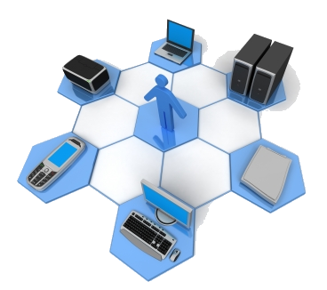
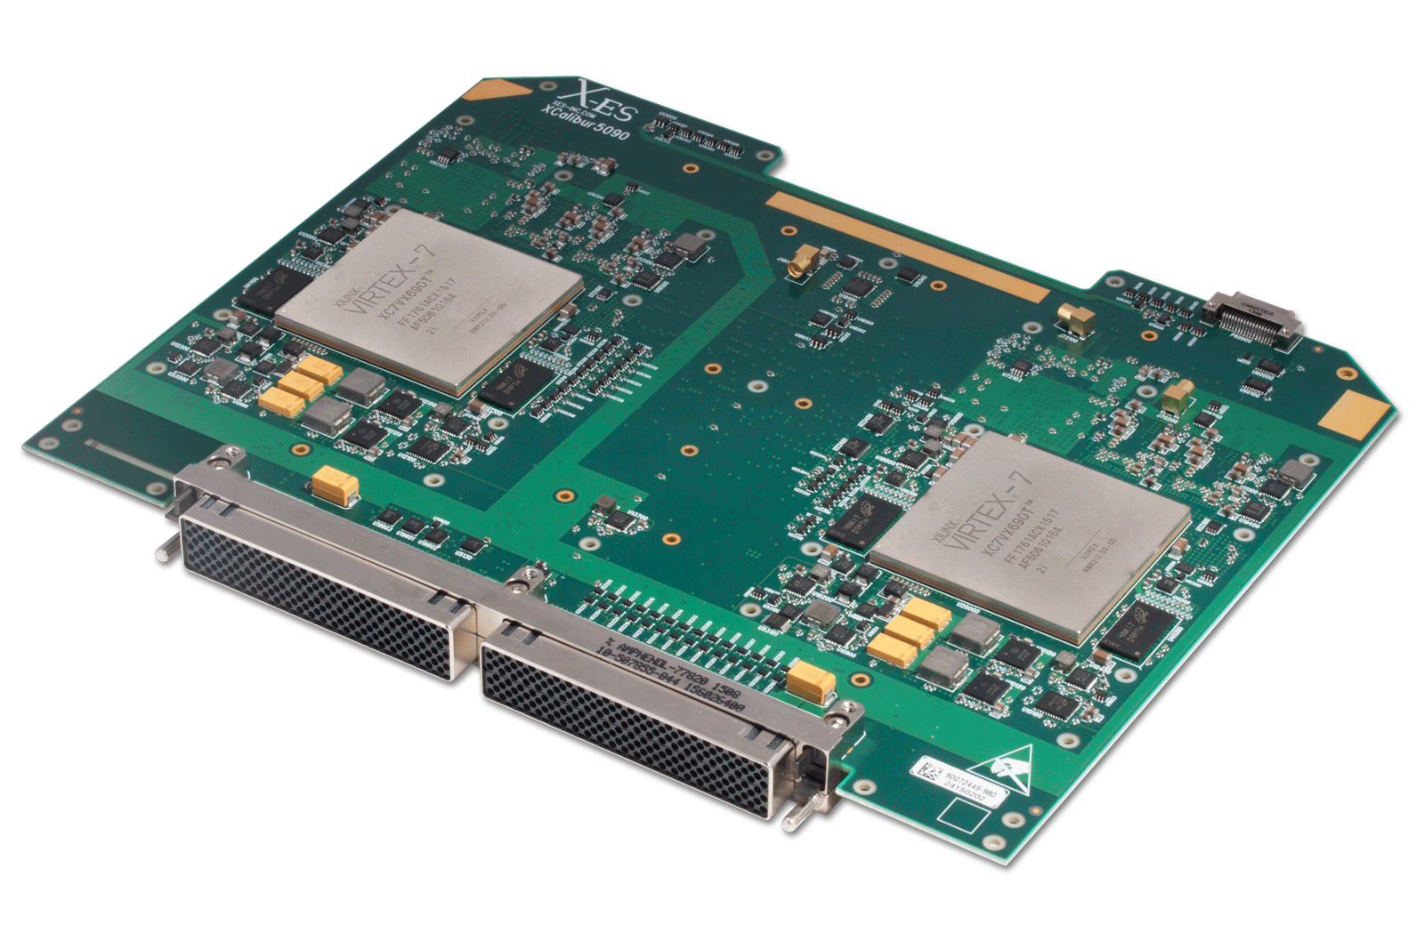
High-performance Networking Laboratory
VANET, Drone
Self Driving Car
NoC
Accelerators
IoT, Edge Computing
SDN and Cloud Computing
Security and Privacy
Big Data
A unique blend of basic and applied research, proving mathematical theorems on the one hand, and building practical systems on the other for improving the performance, dependability and security of computer and communication systems.
Notes:
Dr. Kolahdouz

Slide 2
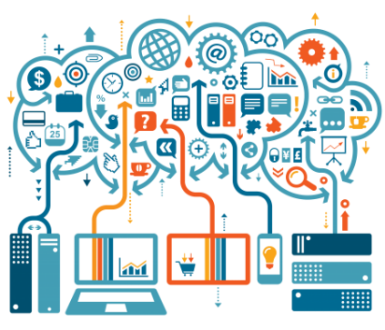
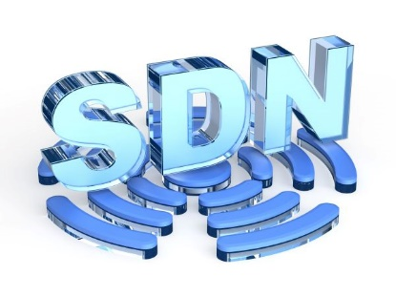
Internet of Things
the network of physical devices, vehicles, home appliances, and other items embedded with electronics, software, sensors, actuators, and connectivity which enables these things to connect, collect and exchange data.
Big Data Every day, we create 2.5 quintillion bytes of data – so much, that 90% of data in the world today has been created in the last two years alone. When data sets get so big that they cannot be analyzed by traditional data processing application tools, it becomes known as ‘Big Data’. In our lab we apply approximate computing in order to tackle the problems regarding the volume of data.
Software-Defined Networking
SDN is a major paradigm shift in the networking. In SDNs a globally centralized entity controller the behavior of the network, which solves many problems of the traditional networks due to their distributed stated. Nevertheless the whole systems remains an asynchronous distributed. Starting in 2015 we produced efficient algorithms to solve these inherent problems in SDN.

Slide 3
Self-Driving NetworkThe Self-Driving Network™, similar to a self-driving car, is an autonomous network that is predictive and adaptive to its environment.
Self-Driving Network encompasses all of the advantages provided by automation. Thus companies can redeploy their resources to focus on other tasks that provide a higher return on investment (ROI).
It simultaneously increases economies of scale and efficiencies, while decreasing operating costs.
it delivers an optimized and customized quality of experience inexpensively to the end-user. When automation frameworks are infused with telemetry, big data analytics, and machine learning, and network guidance is provided to self-analyze, self-discover, self-configure, and self-correct, the autonomous network is born.
The aim of the Self-Driving Network is to eliminate the “manual work” required to keep networks running.

Slide 4
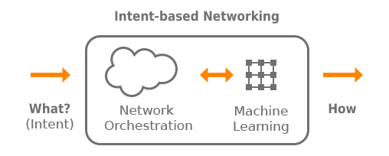
Intent-Based Networking (IBN) is a developing area of technology incorporating artificial intelligence (AI) and machine learning to automate administrative tasks across a network. The end goal of IBN is the creation of self-managing networks.
Gartner research: 75 percent of current networks are still managed manually
intent-based networking is based on telling the network what you want (your intent) rather than exactly what to do, on a technical level, to accomplish your goal.
According to many industry analysts, intent-based networking systems will be necessary to manage the networks of the future connecting data centers, public clouds and the Internet of Things (IoT).
Gartner predicts that IBN will be functioning in at least a thousand enterprise networks by 2020.

Slide 5
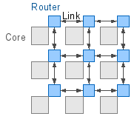
Network on Chip
Network-on-Chip (NoC), a scalable and modular design approach, has been proposed as a promising alternative to traditional bus based architectures for inter-core communication. Among different possible alternatives for the interconnect fabric of multicore SoCs, we envision the on-chip wireless communication network as a methodology capable of bringing significant performance gains for multicore SoCs.
Online optimization
a field of optimization theory, more popular in computer science and operations research, that deals with optimization problems having no or incomplete knowledge of the future (online). These kind of problems are denoted as online problems and are seen as opposed to the classical optimization problems where complete information is assumed (offline).

Slide 6

Blockchain
Blockchains are tamper resistant distributed digital ledgers implemented in a distributed method, without a central repository and central authority i.e. a bank, company, or government. Under normal operation of the blockchain network, no transaction can be changed once published. In 2008, the blockchain idea was combined with several other technologies and computing concepts to create modern cryptocurrencies. The first such blockchain based cryptocurrency was Bitcoin. Despite the many variations of blockchain networks and the rapid development of new blockchain related technologies, most blockchain networks use common concepts. Blockchain technology is still new and should be investigated with the mindset of “how could blockchain technology potentially benefit us?” rather than “how can we make our problem fit into the blockchain technology paradigm?”.
contact
Ahmad Khonsari
Main ECE Building, first floor , room 202
Web:
http://hpnl.ir
Email:
ak@ipm.ir, a_khonsari@ut.ac.ir

