Slide 1
PolyMLR: An analytic model for polyatomics.
Application to CO₂
Nike Dattani
20 June 2018

Slide 2
If we need 100 ab initio energies for each degree of freedom, how many is needed for a molecule with 3 degrees of freedom?
The problem:
Answer: 1 million
Vibrational problem can be solved accurately for 18 atom molecules with 4GB of RAM (Thomas & Carrington: MH03),
Assuming no symmetry, how many ab initio energies would be needed?
Answer: 10⁹⁶
Number of particles in the visible universe: ~ 10⁹⁰
Notes:
Experimental energy gap is hyperfine structure according to table 4 of: http://arxiv.org/pdf/hep-ph/0509010.pdf
He (from Table VIII of http://www.fuw.edu.pl/~krp/papers/hfs_theory_v2.pdf): Experimental: 6 739 701.177(16)
Theoretical: 6 739 699.93
Fourth order means: alpha^4

Slide 3
A. Powell, N. Dattani, R. Spada, F. Machado, H. Lischka, R. Dawes. "Investigation of the ozone formation reaction pathway."The Journal of Chemical Physics 147, 094306 (2017)
The problem:
In 2017 one FCI energy in aug-cc-pVDZ for ozone took 175,000 CPU hours using state-of-the-art methods.
A. Powell, N. Dattani, R. Spada, F. Machado, H. Lischka, R. Dawes.
“Investigation of the ozone formation reaction pathway.” The Journal of Chemical Physics 147, 094306 (2017)
Notes:
Experimental energy gap is hyperfine structure according to table 4 of: http://arxiv.org/pdf/hep-ph/0509010.pdf
He (from Table VIII of http://www.fuw.edu.pl/~krp/papers/hfs_theory_v2.pdf): Experimental: 6 739 701.177(16)
Theoretical: 6 739 699.93
Fourth order means: alpha^4

Slide 4
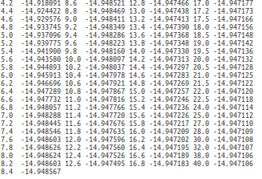
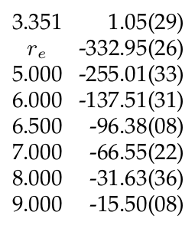
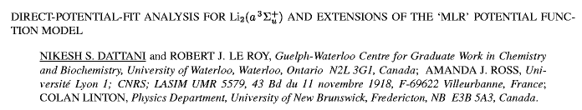
A solution for diatomics:
Dattani, Le Roy, Ross, Linton. ISMS 2008: RC-11
Notes:
Experimental energy gap is hyperfine structure according to table 4 of: http://arxiv.org/pdf/hep-ph/0509010.pdf
He (from Table VIII of http://www.fuw.edu.pl/~krp/papers/hfs_theory_v2.pdf): Experimental: 6 739 701.177(16)
Theoretical: 6 739 699.93
Fourth order means: alpha^4

Slide 5
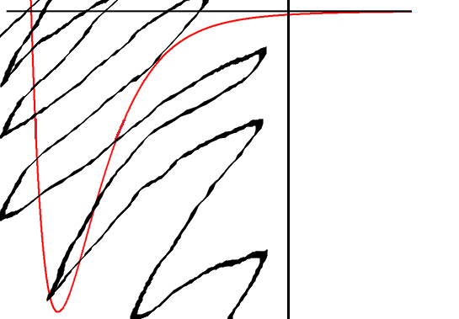
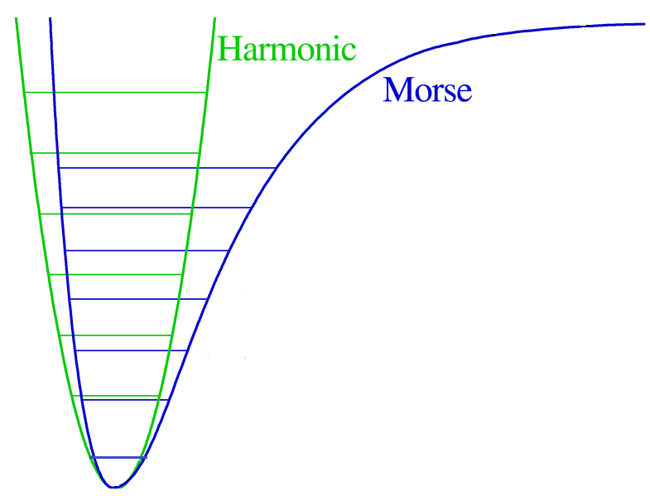

Analytic Potentials:
1924: Lennard-Jones
V(r) = - C₆/r⁶ + C₁₂/r¹²
1929: Morse
van der Waals /
London
van der Waals /
London
Nothing

Slide 6
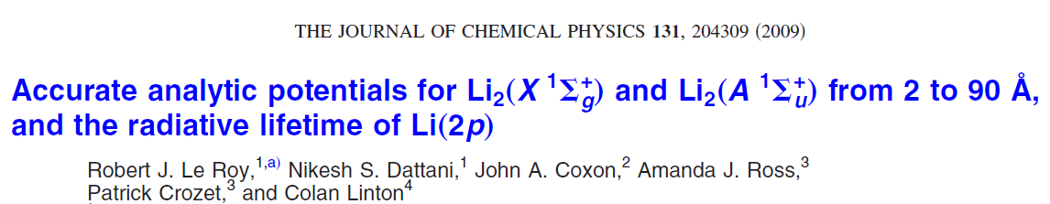
Analytic Potentials:
1924: Lennard-Jones
1929: Morse
Recent: Morse / Long-Range (MLR)

Slide 7
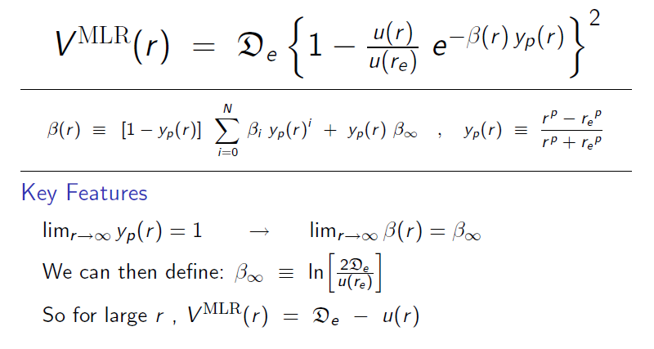
MLR (Morse / Long-Range) Potential:
1
β ∞
What is y_{p}(r) as r ⇒ ∞ ?
What is β(r) as r ⇒ ∞ ?

Slide 8
MLR (Morse / Long-Range) Potential:

Slide 9

MLR (Morse / Long-Range) Potential:
It’s a Morse potential,
but with the correct long-range built in !!!

Slide 10
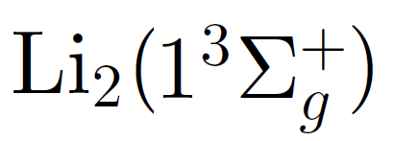
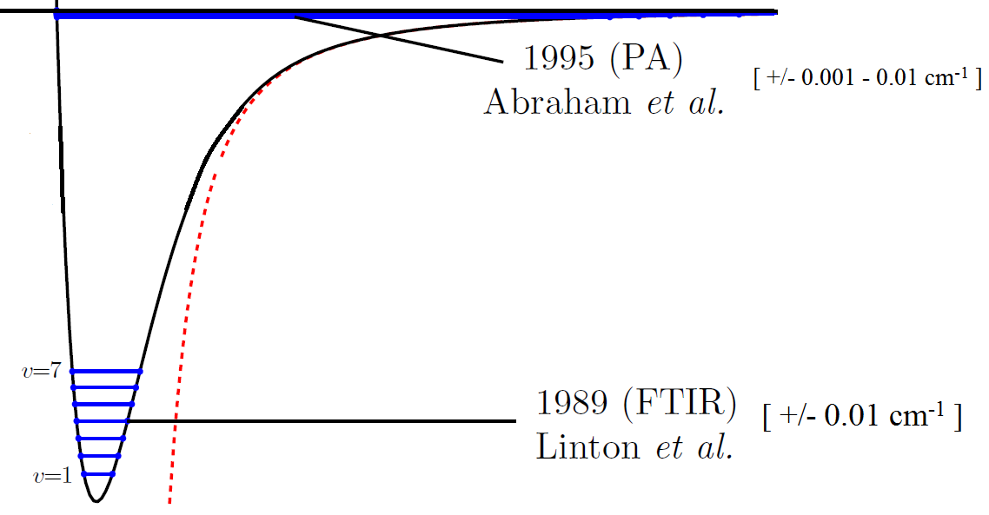

MLR Potential analytically bridged ~ 5000 cm⁻¹ gap in data
Dattani & Le Roy (2011) JMS, 268, pg. 199-210. ISMS: 2009 MI-02

Slide 11
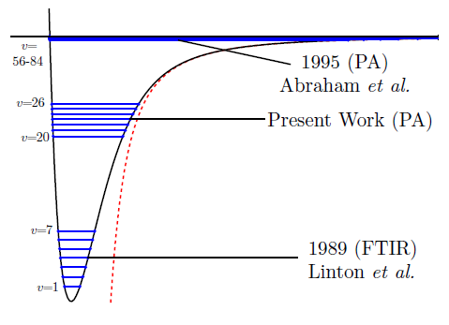
In 2013 we successfully measured energies in the middle with +/- 10⁻⁵ cm⁻¹ accuracy
Semczuk et al. (2013) PRA, 87, pg. 052505
Gunton et al. (2013) PRA, 88, 062510
Dattani et al. ISMS 2013: FB-11

Slide 12
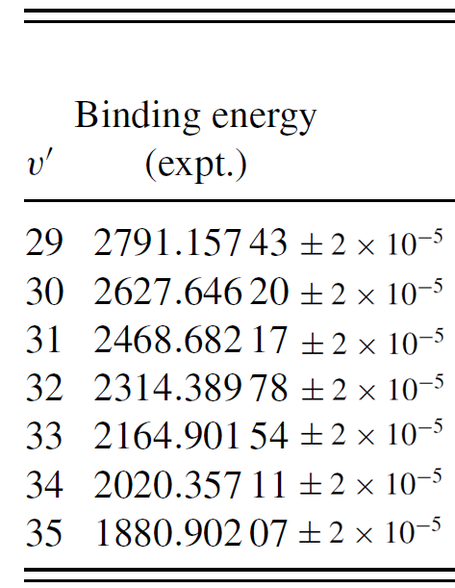
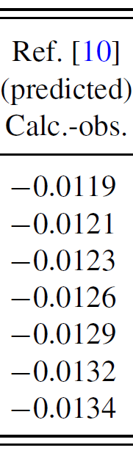
Here’s how well our empirical potential worked
(all energies in cm⁻¹):
Notes:
Used 1000 digits for maple calculation

Slide 13
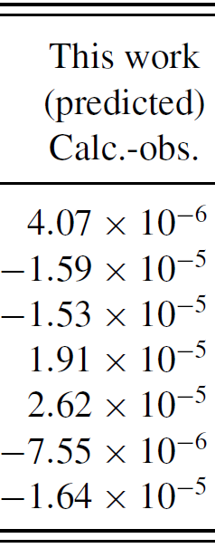
With the new data, we made a better empirical potential
(all energies in cm⁻¹):
Notes:
Used 1000 digits for maple calculation

Slide 14
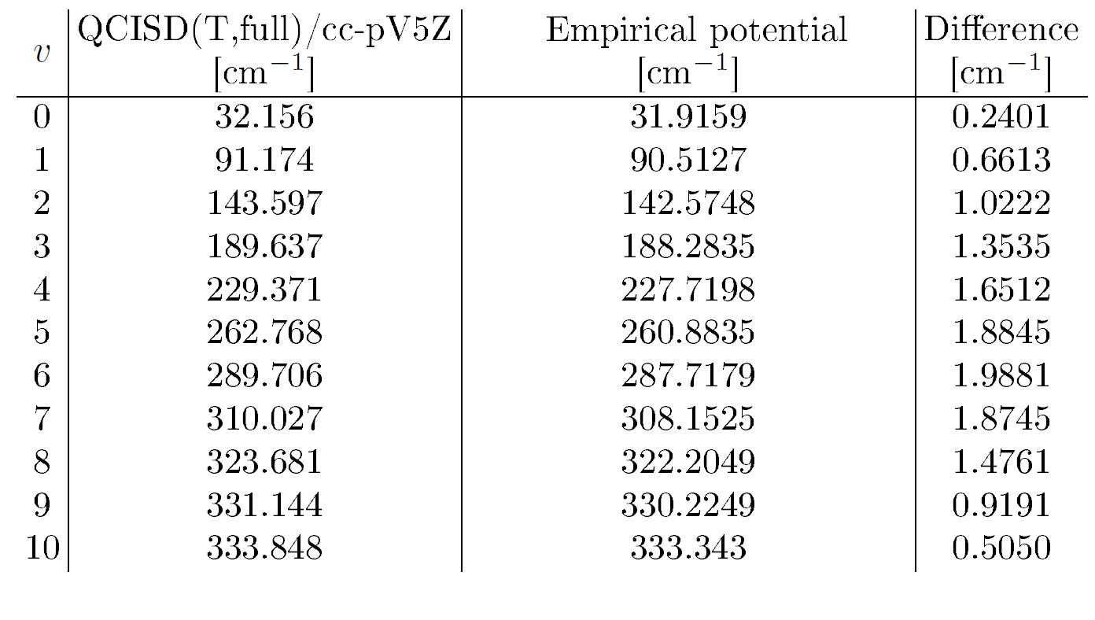
Best ab initio at the time for Li₂ :
H.B. Schlegel and Gordon Drake

Slide 15
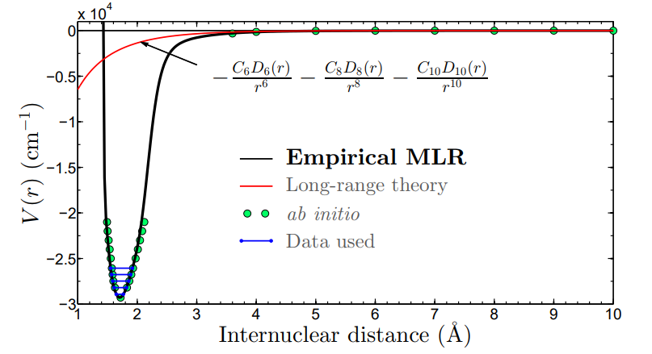
Potential from rotational data
Dattani, Zack, Sun, Johnson, LeRoy, Ziurys. ISMS 2014: FA-11

Slide 16
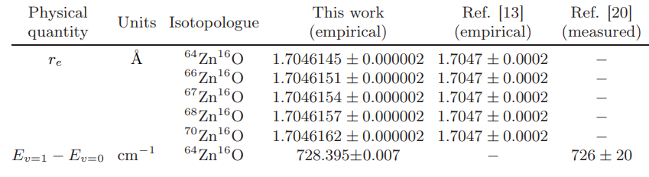
Potential from rotational data
Dattani, Zack, Sun, Johnson, LeRoy, Ziurys. ISMS 2014: FA-11

Slide 17
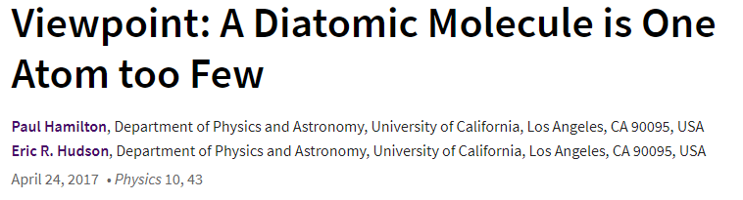
Diatomics aren’t enough.

Slide 18
Polyatomics!
- Difficult

Slide 19
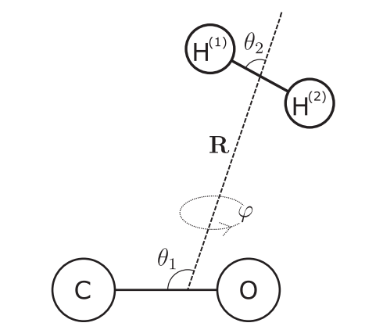

van der Waals complexes:
Zhai, Li, Le Roy. (2018) Molecular Physics. 116, pg. 843
Intra-nuclear distances can be neglected
V = V(r, θ₁ , θ₂ , θ₃ , …)
Fix all θ_{i} and build 1D potential in terms of inter-nuclear distance r.

Slide 20

What happens when we care about the intra-nuclear coordinates?
Per Jensen (1984): Power series in Morse-transformed bond lengths
Problem: Even when one bond length→∞, potential depends on angle
Partridge & Schwenke (1997):

Slide 21
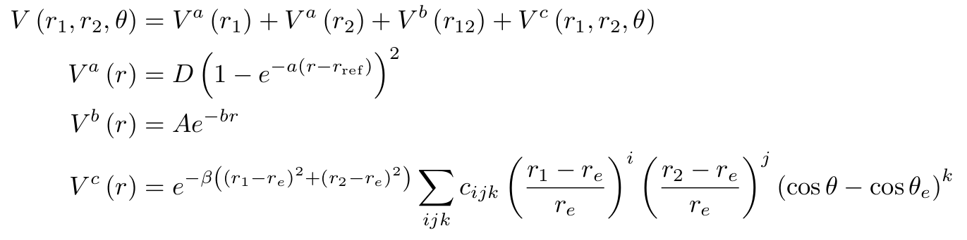
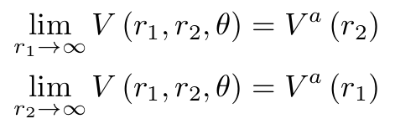

Per Jensen (1984): Power series in Morse-transformed bond lengths
Problem: Even when one bond length→∞, potential depends on angle
Partridge & Schwenke (1997):
What happens when we care about the intra-nuclear coordinates?
Looks great on paper, but 3-body interactions are removed using an exponential

Slide 22

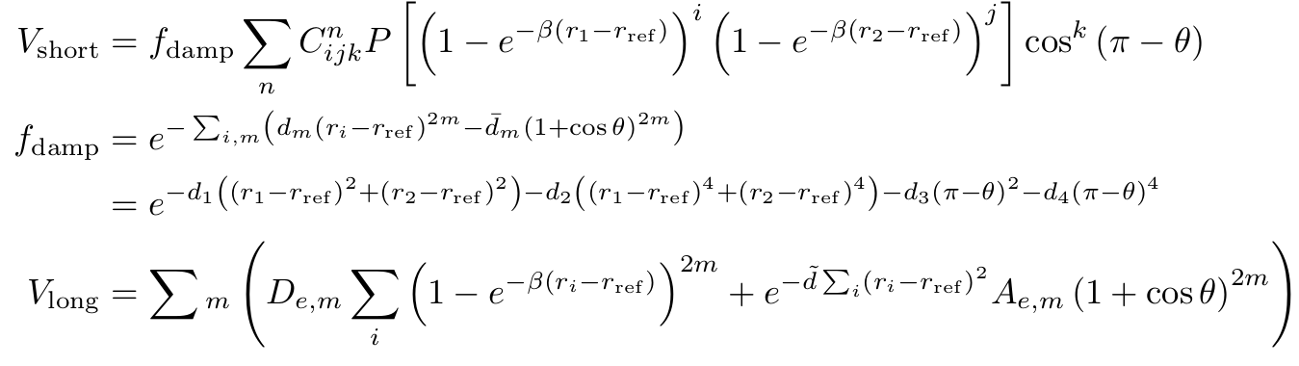
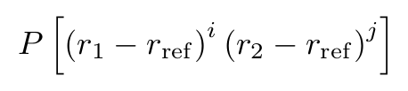
Per Jensen (1984): Power series in Morse-transformed bond lengths
Problem: Even when one bond length→∞, potential depends on angle
Partridge & Schwenke (1997):
What happens when we care about the intra-nuclear coordinates?
Problem: Not very flexible, not very accurate
Huang, Schwenke, Tashkun, Lee (2012):

Slide 23
Partridge & Schwenke (1997)
Huang & Schwenke (2017)

Slide 24

Per Jensen (1984): Power series in Morse-transformed bond lengths
Problem: Even when one bond length→∞, potential depends on angle
Partridge & Schwenke (1997):
State of the art for CO2
Problem: Not very flexible
Huang, Schwenke, Tashkun, Lee (2012)
Huang, Schwenke, Freedman, Lee (2017): Application to CO2
- small improvements to model
- state-of-the-art recommended potential (used in HITRAN, HITEMP, etc.)
- 400 parameters to fit potential to model with 0.1 cm⁻¹

Slide 25
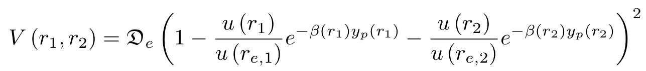
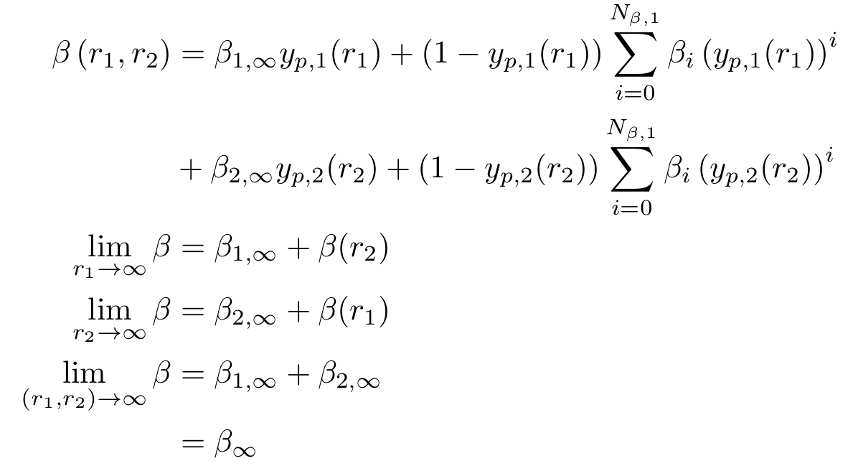
New (2018)

Slide 26
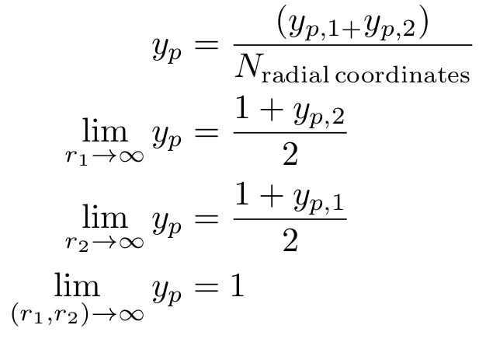
New (2018)

Slide 27


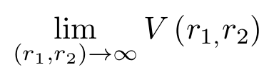
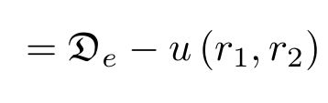
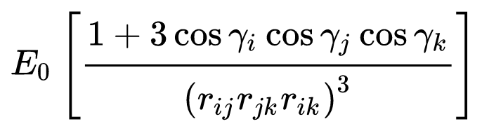
New (2018)
Flexible short range,
And custom long-range (including 3-body Axilrod-Teller)

Slide 28
State of the art for CO2 in 2017
400 parameters to reproduce 3D potential to within 0.1 cm⁻¹
New (2018)
25 parameters to reproduce 3D potential with RMSD = 0.027 cm⁻¹
Only ~ 8 ab initio points needed for each dimension

