Slide 1
PolyMLR: An analytic model for polyatomics. Application to CO₂
Nike Dattani
20 June 2018

Slide 2
The problem:
If we need 100 ab initio energies for each degree of freedom, how many is needed for a molecule with 3 degrees of freedom?
Answer: 1 million
Vibrational problem can be solved accurately for 18 atom molecules with 4GB of RAM (Thomas & Carrington: MH03), Assuming no symmetry, how many ab initio energies would be needed?
Answer: 10⁹⁶
Number of particles in the visible universe: ~ 10⁹⁰
Notes:
Experimental energy gap is hyperfine structure according to table 4 of: http://arxiv.org/pdf/hep-ph/0509010.pdf
He (from Table VIII of http://www.fuw.edu.pl/~krp/papers/hfs_theory_v2.pdf): Experimental: 6 739 701.177(16)
Theoretical: 6 739 699.93
Fourth order means: alpha^4
<number>

Slide 3
The problem:
In 2017 one FCI energy in aug-cc-pVDZ for ozone took 175,000 CPU hours using state-of-the-art methods.
A. Powell, N. Dattani, R. Spada, F. Machado, H. Lischka, R. Dawes.
“Investigation of the ozone formation reaction pathway.” The Journal of Chemical Physics 147, 094306 (2017)
A. Powell, N. Dattani, R. Spada, F. Machado, H. Lischka, R. Dawes. "Investigation of the ozone formation reaction pathway."The Journal of Chemical Physics 147, 094306 (2017)
Notes:
Experimental energy gap is hyperfine structure according to table 4 of: http://arxiv.org/pdf/hep-ph/0509010.pdf
He (from Table VIII of http://www.fuw.edu.pl/~krp/papers/hfs_theory_v2.pdf): Experimental: 6 739 701.177(16)
Theoretical: 6 739 699.93
Fourth order means: alpha^4
<number>

Slide 4
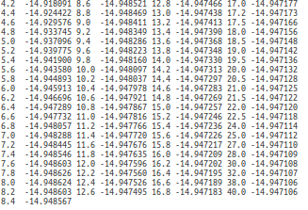
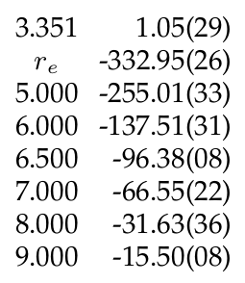
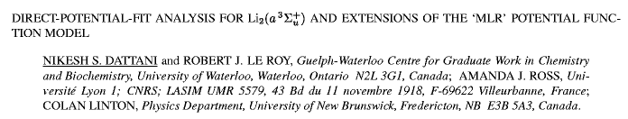
A solution for diatomics:
Dattani, Le Roy, Ross, Linton. ISMS 2008: RC-11
Notes:
Experimental energy gap is hyperfine structure according to table 4 of: http://arxiv.org/pdf/hep-ph/0509010.pdf
He (from Table VIII of http://www.fuw.edu.pl/~krp/papers/hfs_theory_v2.pdf): Experimental: 6 739 701.177(16)
Theoretical: 6 739 699.93
Fourth order means: alpha^4
<number>

Slide 5
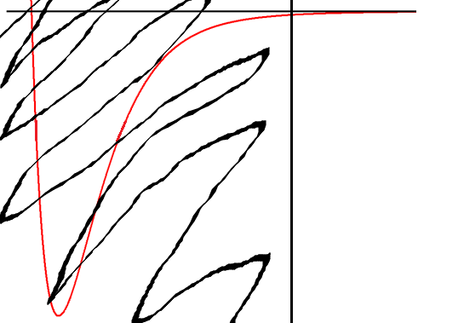
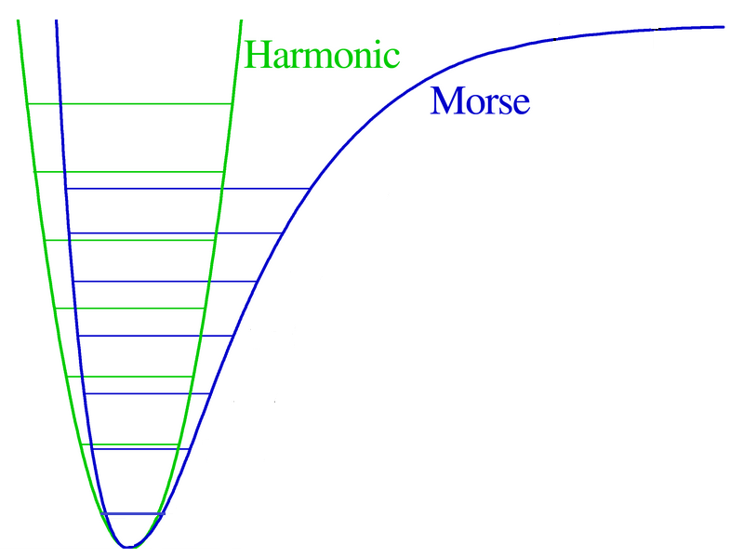

Analytic Potentials:
1924: Lennard-Jones
V(r) = - C₆/r⁶ + C₁₂/r¹²
1929: Morse
van der Waals /
London
van der Waals /
London
Nothing

Slide 6
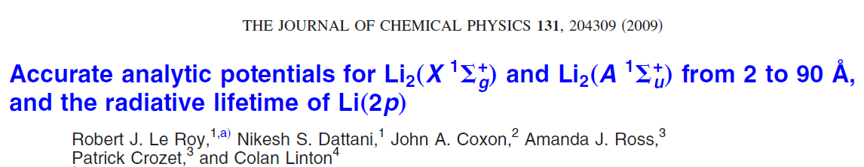
Analytic Potentials:
1924: Lennard-Jones
1929: Morse
Recent: Morse / Long-Range (MLR)

Slide 7
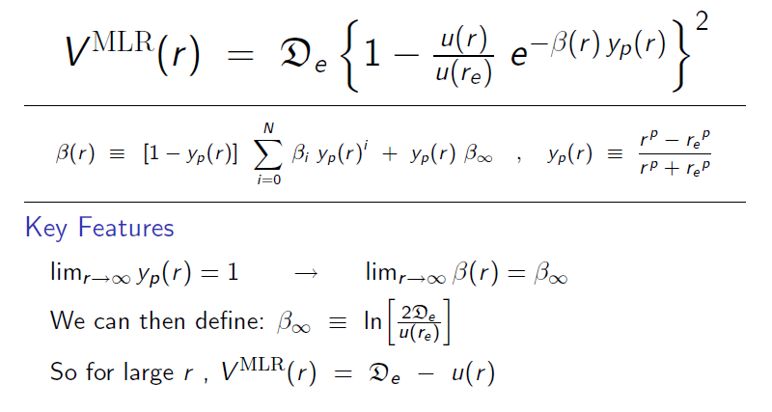
MLR (Morse / Long-Range) Potential:
1
β ∞
What is y_{p}(r) as r ⇒ ∞ ?
What is β(r) as r ⇒ ∞ ?

Slide 8
MLR (Morse / Long-Range) Potential:

Slide 9

MLR (Morse / Long-Range) Potential:
It’s a Morse potential,
but with the correct long-range built in !!!

Slide 10
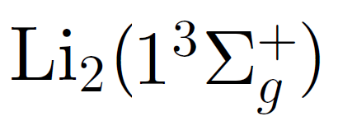
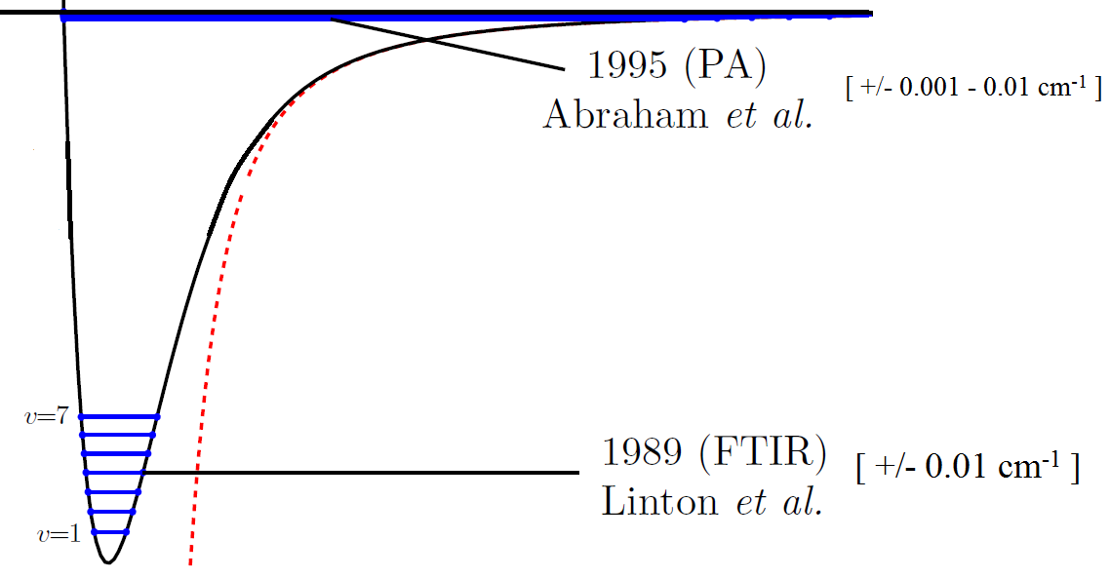
MLR Potential analytically bridged ~ 5000 cm⁻¹ gap in data
Dattani & Le Roy (2011) JMS, 268, pg. 199-210. ISMS: 2009 MI-02

Slide 11
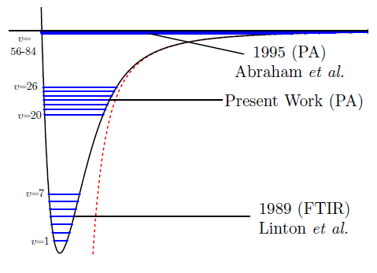
In 2013 we successfully measured energies in the middle with +/- 10⁻⁵ cm⁻¹ accuracy
Semczuk et al. (2013) PRA, 87, pg. 052505
Gunton et al. (2013) PRA, 88, 062510
Dattani et al. ISMS 2013: FB-11

Slide 12
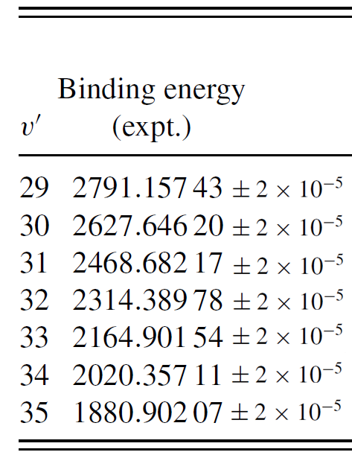
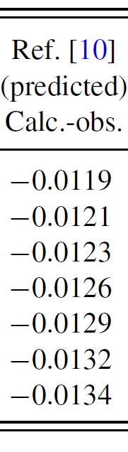
Here’s how well our empirical potential worked
(all energies in cm⁻¹):
Notes:
Used 1000 digits for maple calculation
<number>

Slide 13
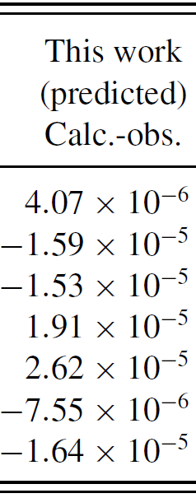
With the new data, we made a better empirical potential
(all energies in cm⁻¹):
Notes:
Used 1000 digits for maple calculation
<number>

Slide 14
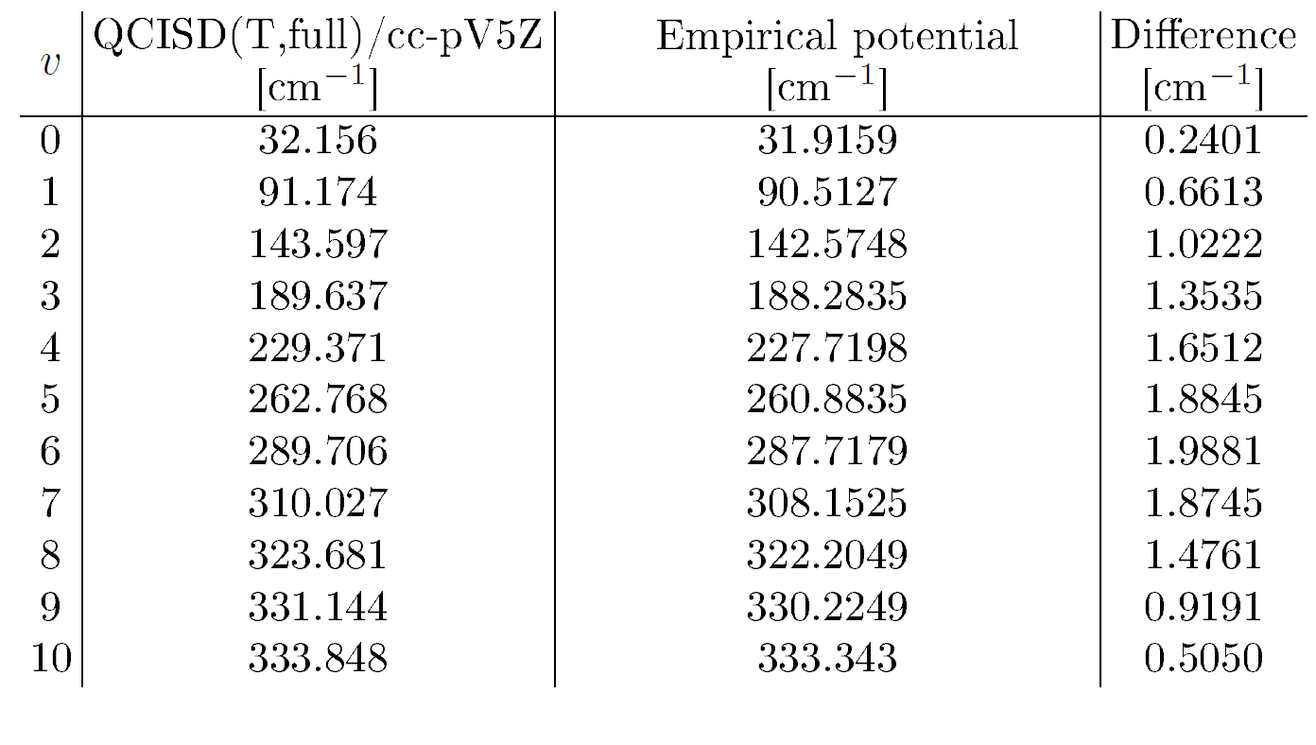
Best ab initio at the time for Li₂ :
H.B. Schlegel and Gordon Drake

Slide 15
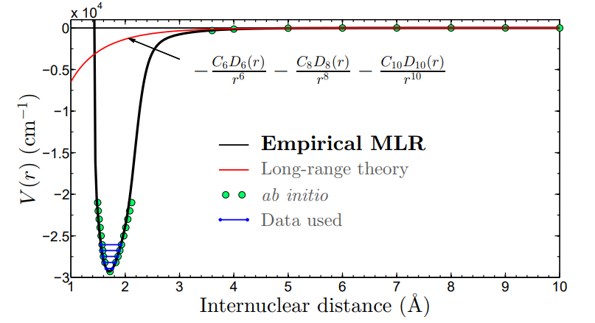
Potential from rotational data
Dattani, Zack, Sun, Johnson, LeRoy, Ziurys. ISMS 2014: FA-11

Slide 16
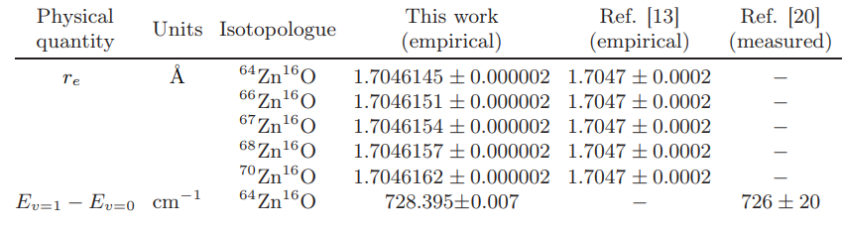
Potential from rotational data
Dattani, Zack, Sun, Johnson, LeRoy, Ziurys. ISMS 2014: FA-11

Slide 17
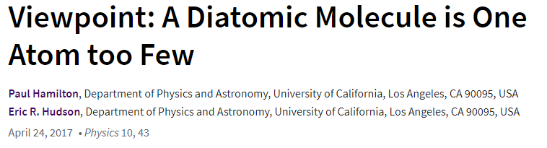
Diatomics aren’t enough.

Slide 18
Polyatomics!
- Difficult

Slide 19
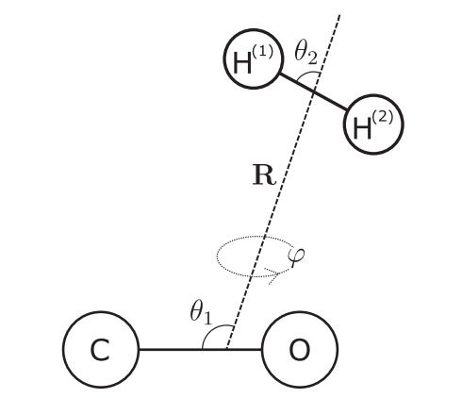

van der Waals complexes:
Zhai, Li, Le Roy. (2018) Molecular Physics. 116, pg. 843
Intra-nuclear distances can be neglected
V = V(r, θ₁ , θ₂ , θ₃ , …)
Fix all θ_{i} and build 1D potential in terms of inter-nuclear distance r.

Slide 20

What happens when we care about the intra-nuclear coordinates?
Per Jensen (1984): Power series in Morse-transformed bond lengths Problem: Even when one bond length→∞, potential depends on angle
Partridge & Schwenke (1997):

Slide 21
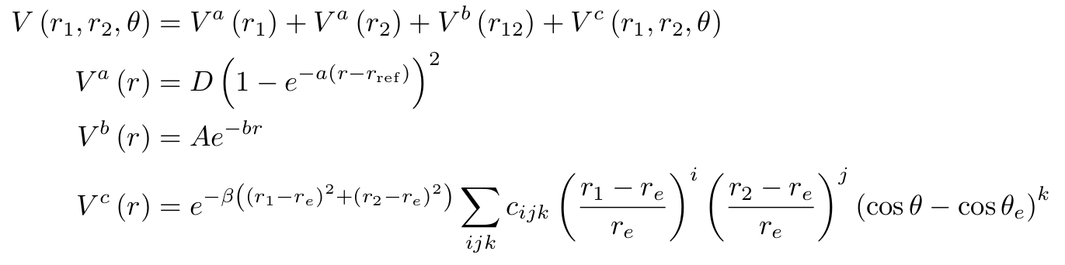
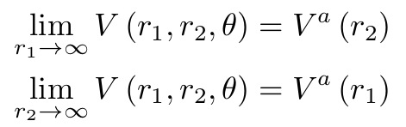

Per Jensen (1984): Power series in Morse-transformed bond lengths Problem: Even when one bond length→∞, potential depends on angle
Partridge & Schwenke (1997):
What happens when we care about the intra-nuclear coordinates?
Looks great on paper, but 3-body interactions are removed using an exponential

Slide 22

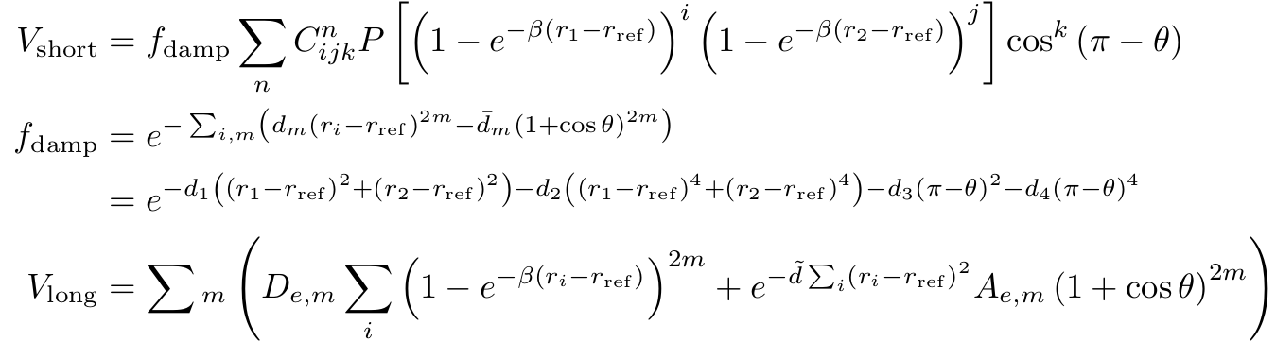
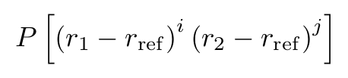
Per Jensen (1984): Power series in Morse-transformed bond lengths Problem: Even when one bond length→∞, potential depends on angle
Partridge & Schwenke (1997):
What happens when we care about the intra-nuclear coordinates?
Problem: Not very flexible, not very accurate
Huang, Schwenke, Tashkun, Lee (2012):

Slide 23
Partridge & Schwenke (1997)
Huang & Schwenke (2017)

Slide 24

Per Jensen (1984): Power series in Morse-transformed bond lengths Problem: Even when one bond length→∞, potential depends on angle
Partridge & Schwenke (1997):
State of the art for CO₂
Problem: Not very flexible
Huang, Schwenke, Tashkun, Lee (2012)
Huang, Schwenke, Freedman, Lee (2017): Application to CO₂
- small improvements to model
- state-of-the-art recommended potential (used in HITRAN, HITEMP, etc.)
- 400 parameters to fit potential to model with 0.1 cm⁻¹

Slide 25
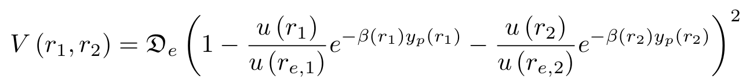
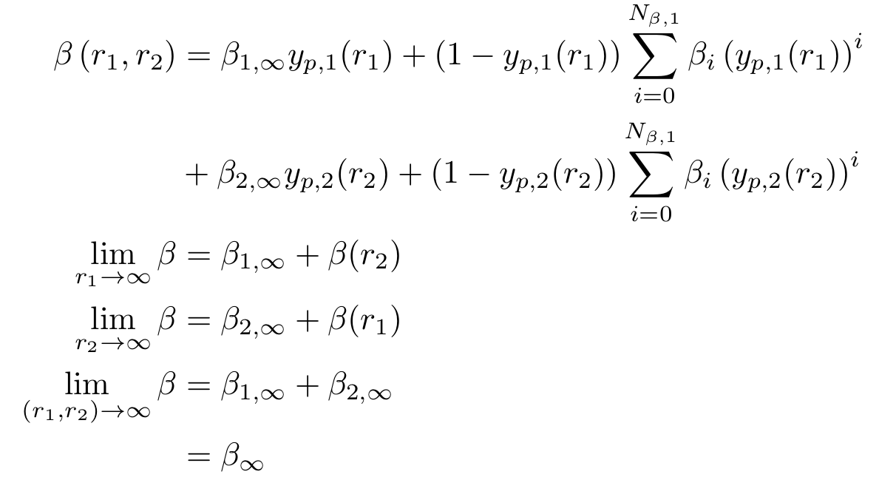
New (2018)

Slide 26
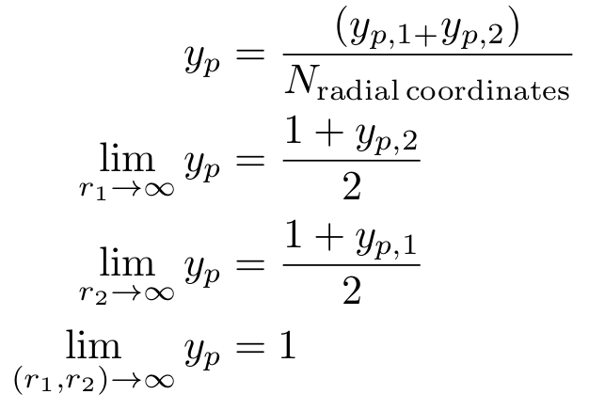
New (2018)

Slide 27

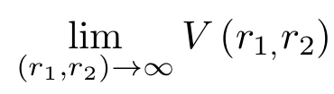
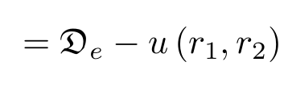
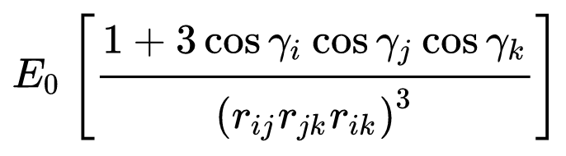
New (2018)
Flexible short range,
And custom long-range (including 3-body Axilrod-Teller)

Slide 28
State of the art for CO₂ in 2017
400 parameters to reproduce 3D potential to within 0.1 cm⁻¹
New (2018)
25 parameters to reproduce 3D potential with RMSD = 0.027 cm⁻¹
Only ~ 8 ab initio points needed for each dimension

