Slide 1


Compiling Linear Algebra Workloads from C to Quantum Circuits via Multi Level Intermediate Representation
Salvatore Pio Conte, Simone Cosenza, Giacomo Lancellotti, and Giovanni Agosta
International Workshop on High Performance and Quantum Computing Integration (HPQCI) @ CF'26
Catania, Italy, 20 May 2026

Slide 2
Classical Computing Model
Input
Today computer are based on the Memory-Controller-CPU architecture
The full computing stack is built on this model
Architectural Shift: Neuromorphic, In-Memory, Quantum…
Memory
Control Unit
Arithmetic Unit
Output

Slide 3
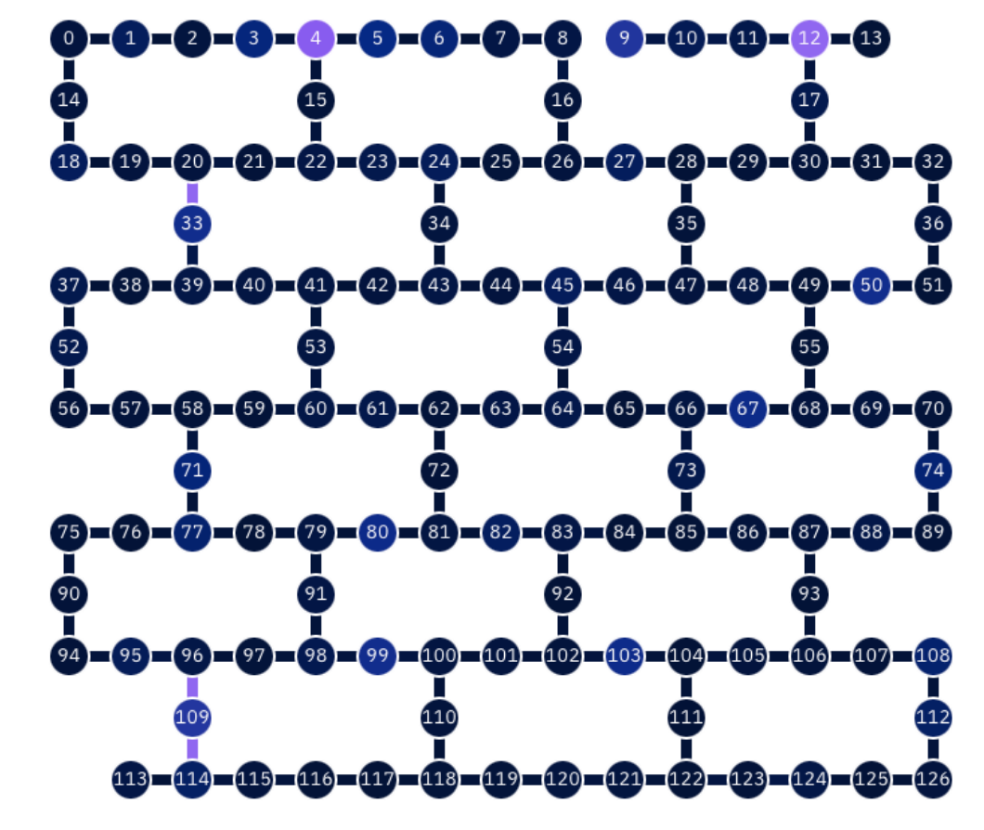
Quantum Computing Model
High-Level Language
No von Neumann architecture (yet, or maybe never)
Multi-layered stack
Think more like a stream of operations on the Quantum Processing Unit (QPU)
Compiler IR
Quantum Assembly
Abstraction Level
Error Correction
ISA
Physical Hardware

Slide 4
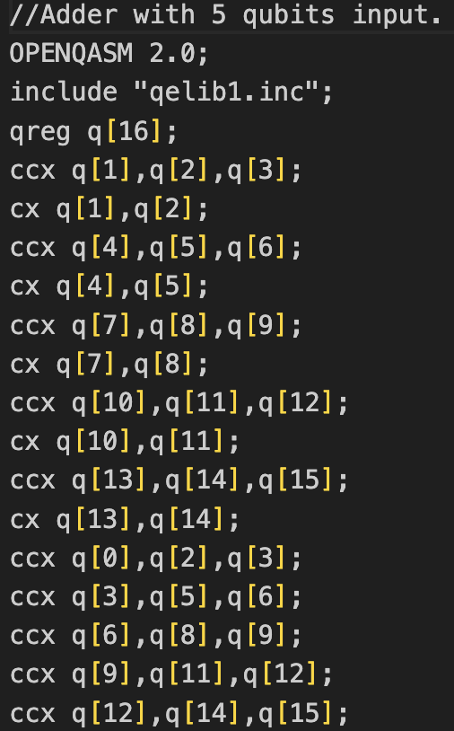
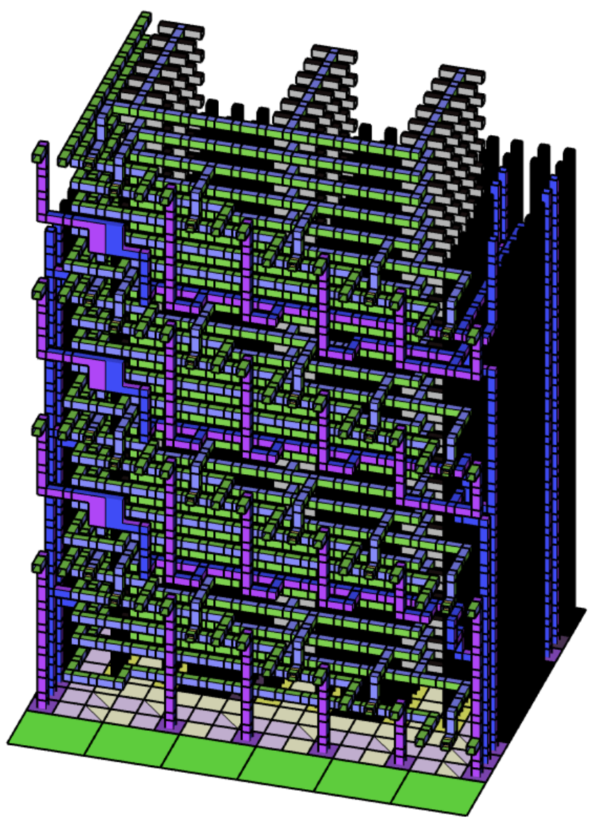
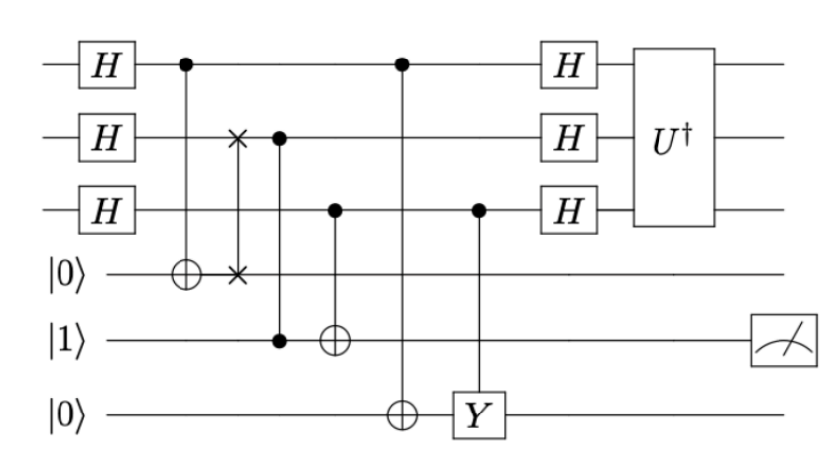
Quantum Programming
Circuit-level abstraction
Qubits function as registers, while quantum gates serve as instructions

Slide 5
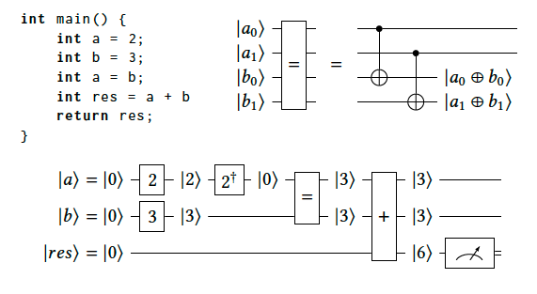
From C Programs to Quantum Circuits
Bridging the gap between classical and quantum programming
Facilitating the integration of quantum systems into classical workflows
Reuse of large codebases
Can we translate C programs to quantum circuits? Yes… with some tricks

Slide 6
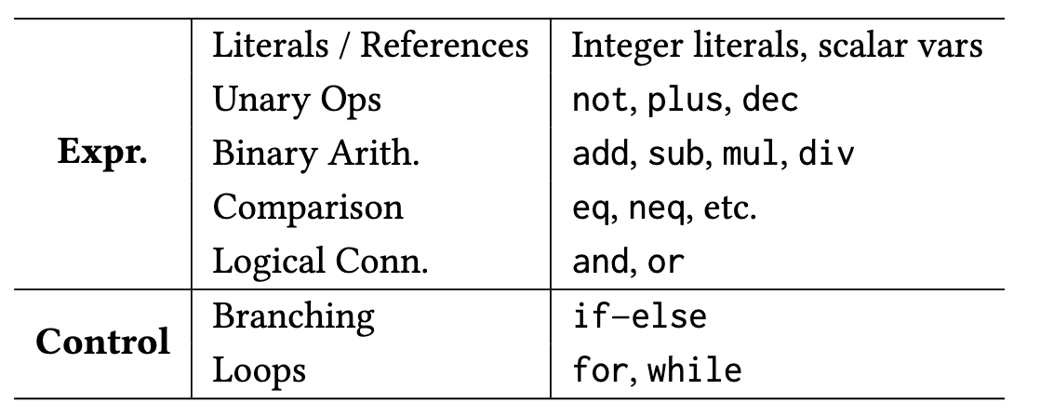
QuantumC
C-source
High-level synthesis toolchain to translate C programs into quantum circuits
AST construction
Quantum Aware IR
Quantum IR
QASM circuit
Giacomo Lancellotti, Francesco Rosnati, Leonardo Ignazio Pagliochini, and Giovanni Agosta,
’Quantum Circuit Synthesis from C via Multi-Level Intermediate Representation’
SAC 2026, Thessaloniki, Greece

Slide 7
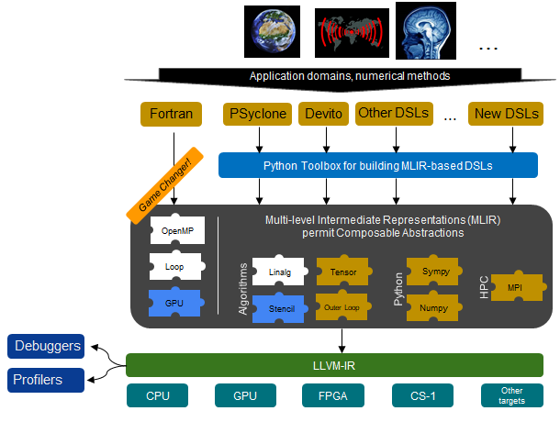

Multi-Level Intermediate Representation
Domain specific language issue
Multiple abstraction layers, each with its own Intermediate Representation and optimizations
Progressive lowering principle
Source: https://xdsl.dev/about/challenge/

Slide 8
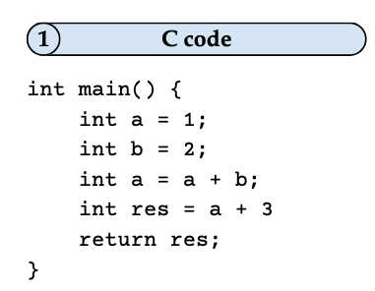
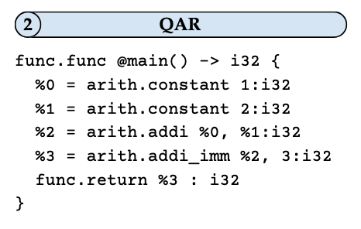
Quantum Aware Representation
Compliant with quantum constraints (e.g., no variable overwrites)
SSA-based
Opaque registers and operation definitions

Slide 9
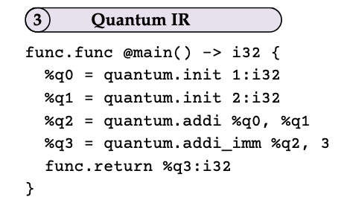
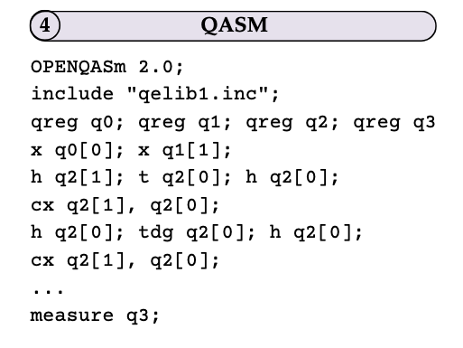
Quantum Representation
QAR is lowered to a quantum specifc dialect
Still SSA
Registers and operations are mapped to qubits and quantum operations
Final lowering to QASM (NP-Hard)

Slide 10
QuantumC Extension
C-source
Native support for vector and matrix operations
Maintain high-level semantic information of linear algebra kernels
Two arithmetic backends:
Ripple carry
QFT
AST construction
Pattern Recognition
VecMat IR
Quantum Aware IR
Quantum IR
QASM circuit

Slide 11
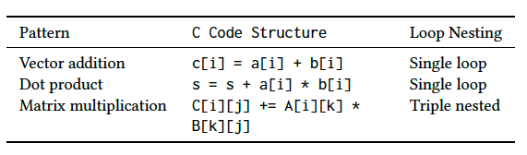
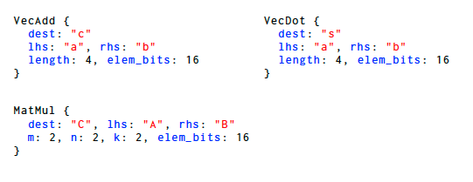
Linear Algebra Kernels
Three kernels supported:
Vector addition
Dot product
Matrix multiplication
Pattern recognition via AST traversal of canonical loop forms
Lightweight annotation layer for VecMat IR

Slide 12
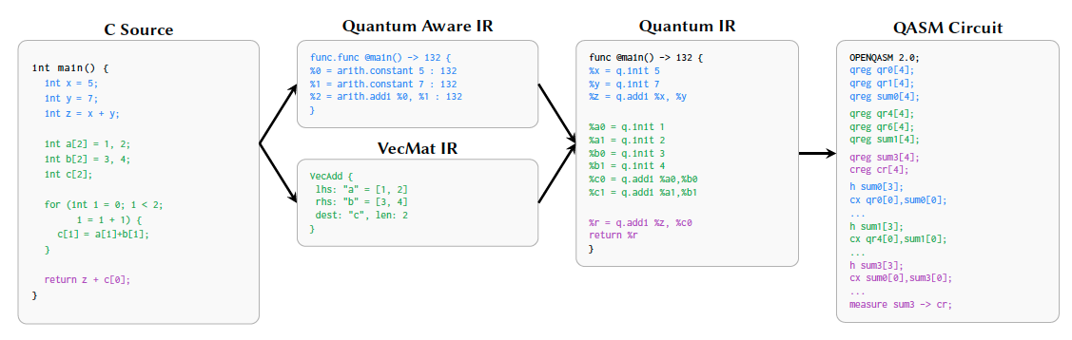
Compilation Flow
Scalar path (standard QuantumC) and vector/matrix path (VecMat IR) run in parallel
Merge phase combines the two modules via SSA-based register remapping
Cross-path dependencies (e.g. return z + c[0]) resolved transparently to the user

Slide 13
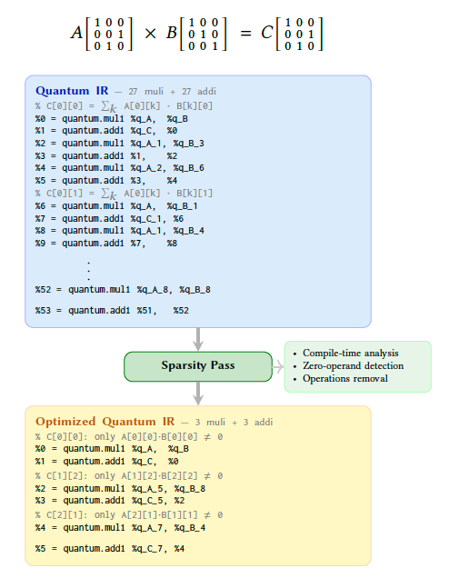
Sparsity Optimization
Real workloads often use sparse matrices (e.g. pruned NN weights, >90% zeros)
Compile-time pass on the VecMat IR before backend selection
Static analysis of zero operands/under threshold from C array initializers
Example: 3×3 matrix multiplication
54 → 6 mul/add ops

Slide 14
Performance Evaluation
Goal: characterize the connection between linear algebra kernels and quantum resources
Resources:
Cliffor+T decomposition (𝜖 = 10⁻¹⁵ precision)
Qubits, T-count, T-depth
Validation: simulation with Qiskit compared against C output

Slide 15
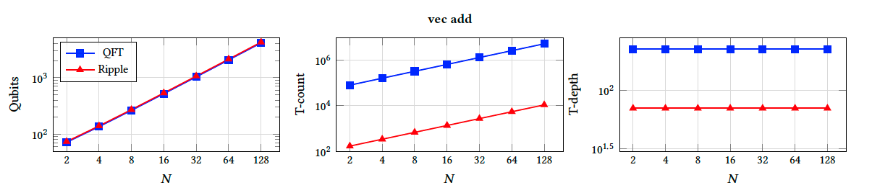
Resource Analysis – Addition
Similar qubit count (Ripple-Carry +3% for carry ancilla)
QFT T-count ~3 orders higher (due to arbitrary rotation gate approximation)
T-depth flat in N → N independent additions execute in parallel

Slide 16
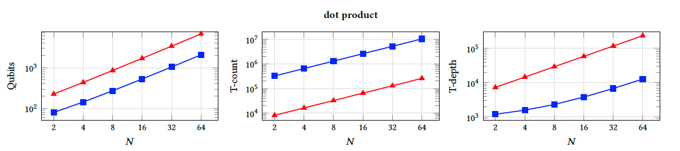
Resource Analysis – Dot Product
Ripple utilizes more qubits (add/mul ancilla) but ~10× fewer T gates than QFT
N multiply–accumulate steps: introduces sequential dependencies
Ripple T-depth ~10× higher (long chains from multi-controlled NOT decomposition)

Slide 17
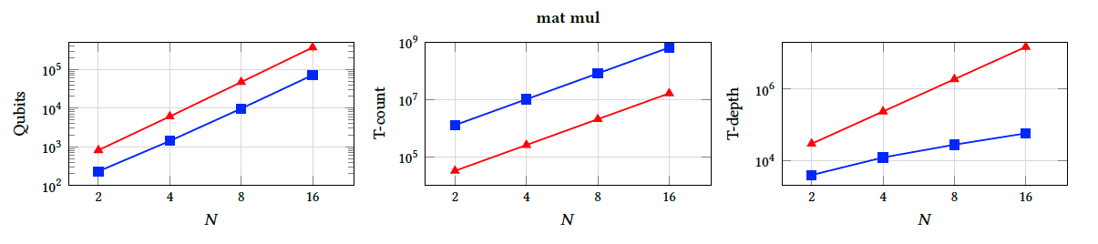
Resource Analysis – Multiplication
Highest resource consumption across all metrics
Same trade-off as dot product, amplified by an extra dimension
Backend choice guided by target HW: QFT for NISQ (lower qubits/depth), Ripple-Carry for fault-tolerant (lower T-gate count)

Slide 18
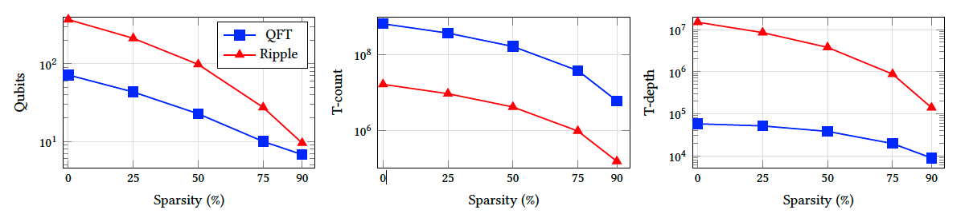
Sparsity Optimization Impact
16×16 matrix multiplication, 8-bit integers, up to 90% sparsity
Qubits: −91% (QFT, 71.7K→6.8K), −97% (Ripple-Carry, 370.7K→9.5K)
T-count: −99% for both backends (QFT: 661M→6.1M; Ripple-Carry: 16.6M→154K)
T-depth: −85% (QFT, 57.4K→8.8K), −99% (Ripple-Carry, 15M→139K)

Slide 19

Findings
High-level semantics pay off:
VecMat IR enables compile-time analysis that scalar pipelines lose to loop unrolling
Backend choice is a hardware trade-off:
QFT for NISQ, Ripple-Carry for fault-tolerant
Sparsity optimization:
Static optimization pass yields order-of-magnitude reductions in all metrics for both backends

Slide 20
Conclusion and Future Outlook
Extended QuantumC with native vector and matrix support
Pattern recognition + dedicated VecMat IR fully integrated in the MLIR pipeline
Characterized QFT vs. Ripple-Carry backends on three kernels
Sparsity optimization delivers up to 99% quantum resources reduction
Future work
Broader algebraic kernels
Runtime-dependent dimensions via mid-circuit measurement / quantum memory
Coverage study on real quantum/HPC applications

Slide 21
Thank for the attention!
giacomo.lancellotti@polimi.it

