Slide 1
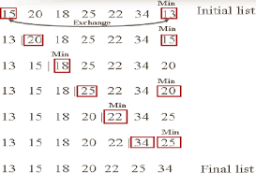

Slide 2
static void sortasc(int a[]) {
int temp;
for (int i = 0; i < a.length; i++) {
for (int j = i + 1; j < a.length; j++) {
if (a[i] < a[j]) {
temp = a[i];
a[i] = a[j];
a[j] = temp;
}
}
System.out.print(" " + a[i]+ " ");
}
}

Slide 3


Slide 4
// Bubble sort in Java
class Main {
// bubble sort
static void bubbleSort(int arr[]) {
int size = arr.length;
// loop over array elements
for (int i = 0; i < size - 1; i++)
// loop to compare array elements
for (int j = 0; j < size - i - 1; j++)
// compare two adjacent elements
if (arr[j] > arr[j + 1]) {
//swap if elements are out-of-order
int temp = arr[j];
array[j] = array[j + 1];
array[j + 1] = temp;
}
}
}

Slide 5
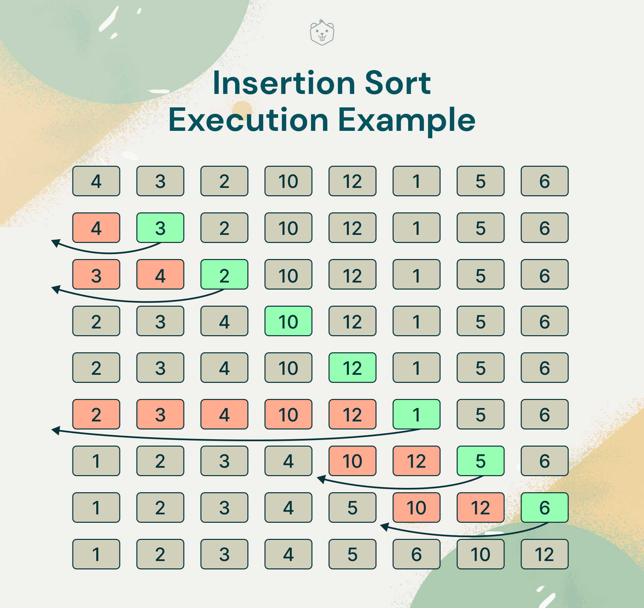

Slide 6
public class InsertionSort {
public static void insertionSort(int[] arr) {
int n = arr.length;
for (int i = 1; i < n; i++) {
int key = arr[i];
int j = i - 1;
while (j >= 0 && arr[j] > key) {
arr[j + 1] = arr[j];
j--;
}
arr[j + 1] = key;
}
}
public static void main(String[] args) {
int[] arr = {64, 34, 25, 12, 22, 11, 90};
insertionSort(arr);
System.out.println("Sorted array:");
for (int value : arr) {
System.out.print(value + " ");
}
}
}

Slide 7
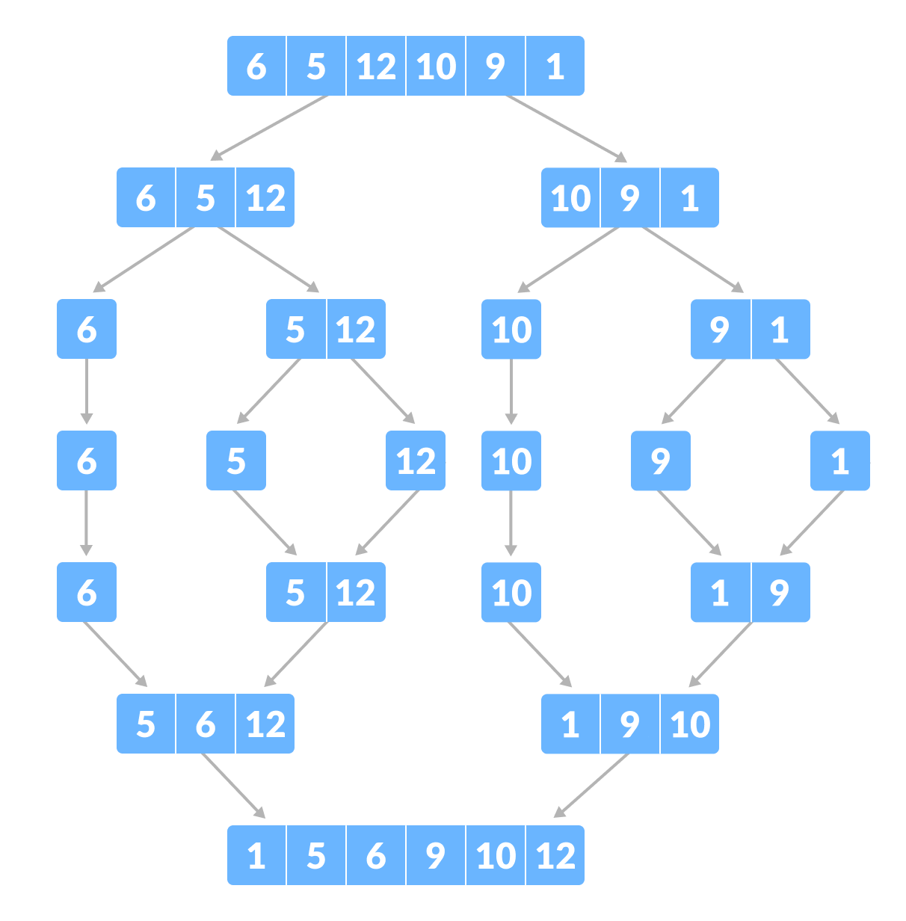

Slide 8
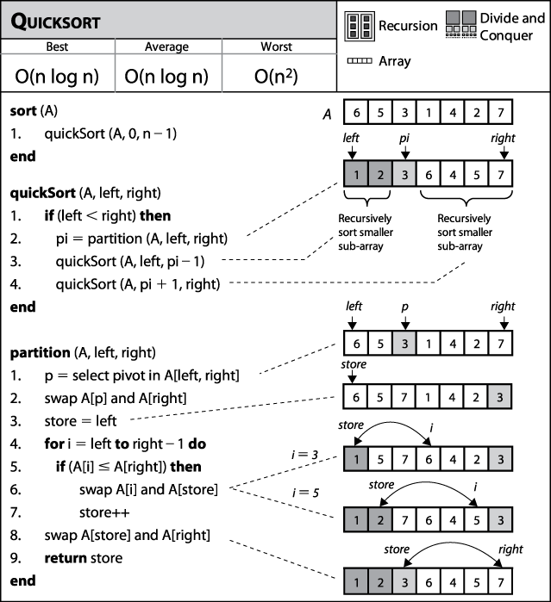

Slide 9
