Slide 2
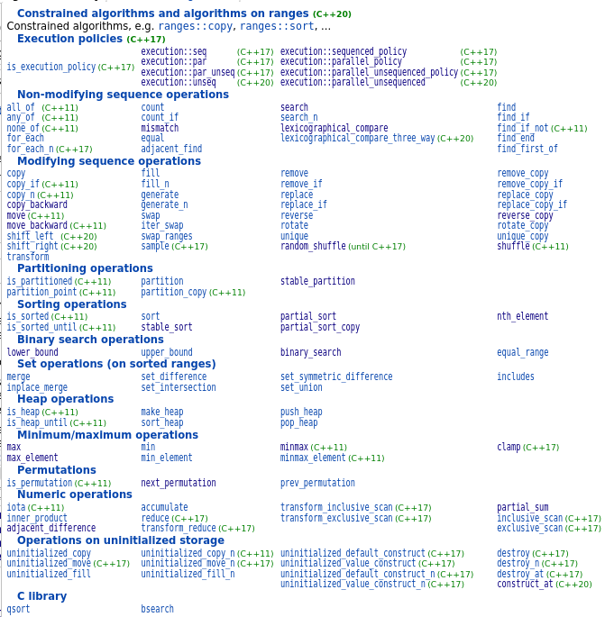
algorithm

Slide 3
algorithm
copy, copy_n
copy_if, copy_if_n
copy_backward
fill, fill_n
for_each, for_each_n
remove, remove_if
remove_copy, remove_copy_if
search, search_n
includes
mismatch
find, rfind
find_first_of, find_end
replace, replace_if
replace_copy, replace_copy_if

Slide 4
algorithm
search, search_n
mismatch
find, find_if, find_if_not
find_first_of, find_end
lexicographical_compare
equal
min, max, minmax, clamp
min_element, max_element, minmax_element
any_of, all_of, none_of
count, count_if
move, move_backward
swap_ranges

Slide 5
algorithm
next_permutation, prev_permutation
is_permutation
merge, inplace_merge
set_difference, set_symmetric_difference
set_union, set_intersection
includes
unique, unique_copy
transform, transform_n
generate, generate_n
iota
accumate, reduce, transform_reduce
inner_product
exclusive_scan, transform_exclusive_scan
inclusive_scan, transform_inclusive_scan
partial_sum

Slide 6
algorithm
binary_search
lower_bound, upper_bound, equal_range
nth_element, partition_point
partition, stable_partition, partition_copy
partial_sort, partial_sort_copy
sort, stable_sort
is_sorted, is_sorted_until
adjacent_difference
adjacent_find
swap_ranges
shuffle, sample
shift_left, shift_right
rotate, rotate_copy
reverse, reverse_copy

