Slide 1

Hpotter
Final Presentation

Slide 2

HPotter Spring 2020
Scrum Master: Tanner
Product Owner: Jon
Dev Team: Birt, Megan, Judith, Josh, Kenji
Presenter: Emily and Birt

Slide 3
Project Proposal
Executive Summary
HPotter is a honeypot designed by Dr. Beaty. It is a network-attached system set up as a decoy to lure cyber attackers and to detect, deflect or study hacking attempts.
Description of the problem
Make the honeypot custom to each victim server. Currently is hard to collect data from. Could use a more developed user interface.

Slide 4
Minimum Viable Product
In order
Clean up SSH
Dynamic Firewall
Thread pools
GraphQL (query manipulation language for API)
Notes:
How we planned on addressing MVP goals

Slide 5
Risks and Constraints
Runs on virtualbox or minimal hardware (like a raspberry pi)
Getting up to speed with everything that is already done.
Must run lightly for small hardware like raspberry pi.
Dealing with live cyber attacks

Slide 6
Tools Used
Project management tools
JIRA
Time management tools
Toggl
Life cycle
SCRUM
Test Driven Development (TDD)
Python driven unit test

Slide 7
MVP Goals Met
Clean up SSH
Dynamic Firewall
GraphQL
Thread pools

Slide 8
Additional Contributions
In order
Documentation for GraphQL
Freeboard
Telnet
Unit tests
Continuous Integration

Slide 9

Hpotter Demo

Slide 10
Organizational
16 user stories
Issue key | Summary:
HS-60-Merge Branches and resolve merge conflicts for demo
HS-27-Build a User Interface
HS-41-Create formatted time sheet in excel for time burndowns.
HS-31-Review with Dr. Beaty and discuss next steps
HS-30-Create POC for Dr. Beaty's review
HS-22-Create Google Doc for Team Members to input sprint hours
HS-08-Presenter Generates .choices file for easy presentation
HS-12-Put a draft together highlighting critical parts of our process.
HS-10-Create and org and fork HPotter from that
HS-09-Implement Code Coverage(CodeCov.io)
HS-01-Implement Travis-CI
HS-34-Demo reflection for Dr. Beaty and get feedback
HS-32-Prepare Slides and practice presentation
HS-42-Create diagram based on Beatys drawn pictures of HPotter
HS-51-Implement the ability for Command Line Arguments
HS-40-Create slides for demo day. Also connect with other team members about showing work we have done, so we can show our progress.

Slide 11
Telnet stories
8 user stories
Issue key | Summary:
HS-04-Get Telnet Working Again
HS-17-Have telnet allow all credentials into debian as root
HS-50-extract creds with regex and write to DB
HS-46-set timeout for sockets listening to docker containers
HS-02-Create a config.yml file
HS-26-Specify in plugins.yml a path to a cert and key file.
HS-24-Create custom Docker image with telnet preinstalled
HS-15-Uses Debian docker image instead of Apache

Slide 12
Threadpools / Dynamic Firewalls
7 user stories
Issue key | Summary:
HS-48-Implement Thread pools
HS-05-Implement Dynamic Firewalls in HPotter
HS-23-Create Chain Commands for Dynamic Firewalls
HS-49-Create process limit
HS-62-Write Unit test for ListenThread
HS-63-Write Unit test for Container Thread
HS-43-Generalize one way thread to deal with multiple port

Slide 13
SSH Stories
6 user stories
Issue key | Summary:
HS-03-Remove Destination IP out of tables.py
HS-47-Capture Credentials with SSH
HS-06-Clean Up SSH
HS-53-Get SSH hooked up in the one way threads.
HS-13-plugins/ssh.py should call the containerthread instead of fake shell(line 118)
HS-25-Disallow port forwarding in ssh.py

Slide 14
Front end/Dashboard
10 user stories
Issue key | Summary:
HS-29-Check into GeckoBoard as dashboard builder
HS-28-Check into Freeboard.io as dashboard builder
HS-16-Look into SQLAlchemy reflections to pull schema
HS-36-Meet with Jon about queries
HS-11-Connecting JSON server Changing path env variables
HS-39-Test dashboards, and determine which works best for HPotter
HS-14-Build GraphQL api for hpotter database
HS-37-Use iptc.easy instead of the iptc package directly
HS-35-serve the api using python http builtin
HS-33-get reflection to extract table data

Slide 15
Data Analytics Report
USER STORIES COMPLETED:
45 total
USER STORIES
INCOMPLETE
6
Of those 45:
15 - Organization/Demo
6 - Threadpools/Firewalls
8 - Telnet
6 - SSH
10 - Front End
INCREASED COVERAGE:
27.22%

Slide 16
Left in Backlog:
HS-44- GEOIP connections with latitude and longitude
HS-7- Research Feasibility for implementing potter in more places

Slide 17
As shown here our demo-branch finally passes. This is the branch containing all our progress/features whereas the rest are all over the place
Continuous Integration
Documenting code coverage took a back seat
for us for the majority of the semester.
The more challenging, unknown tasks took precedence
(for maintainer Dr. beaty, and us)
ssh
threadpools
dynamic firewalls
etc.

Slide 18
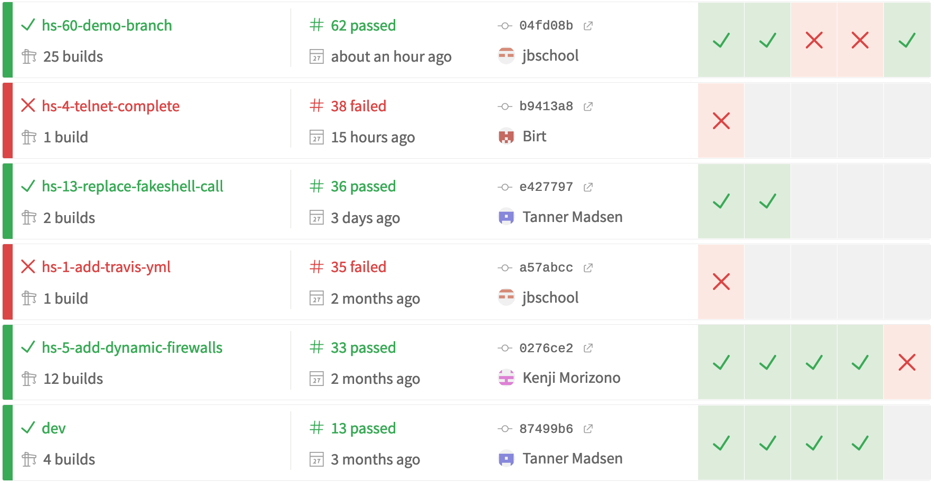
As shown here our demo-branch finally passes. This is the branch containing all our progress/features whereas the rest are all over the place
TravisCI

Slide 19
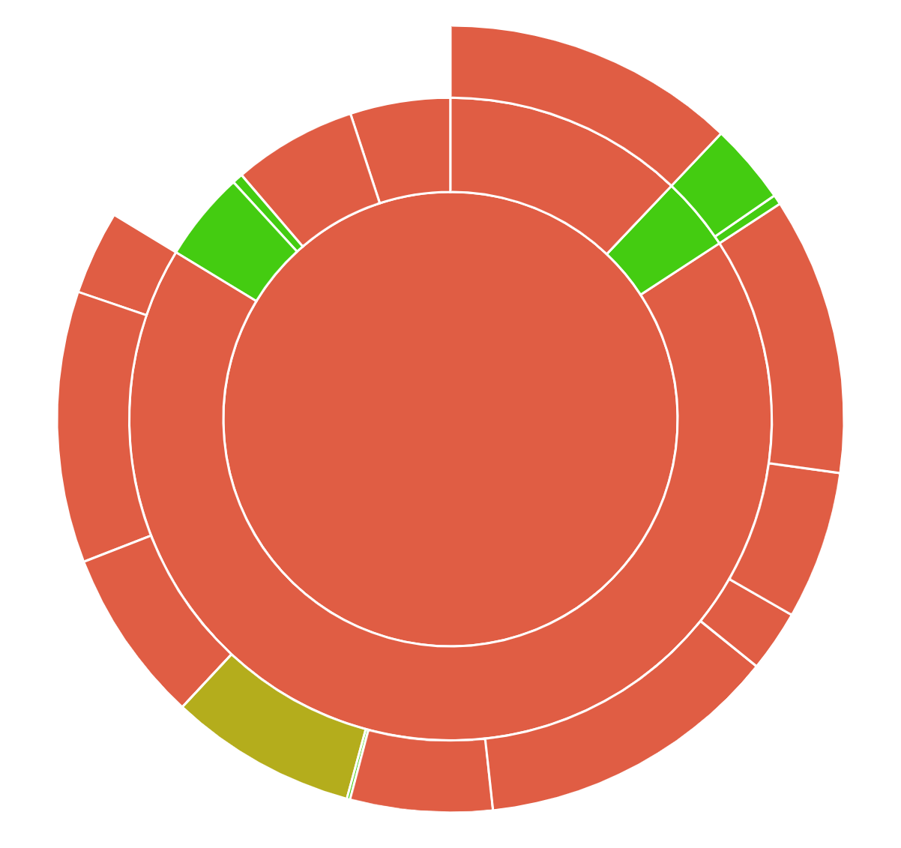
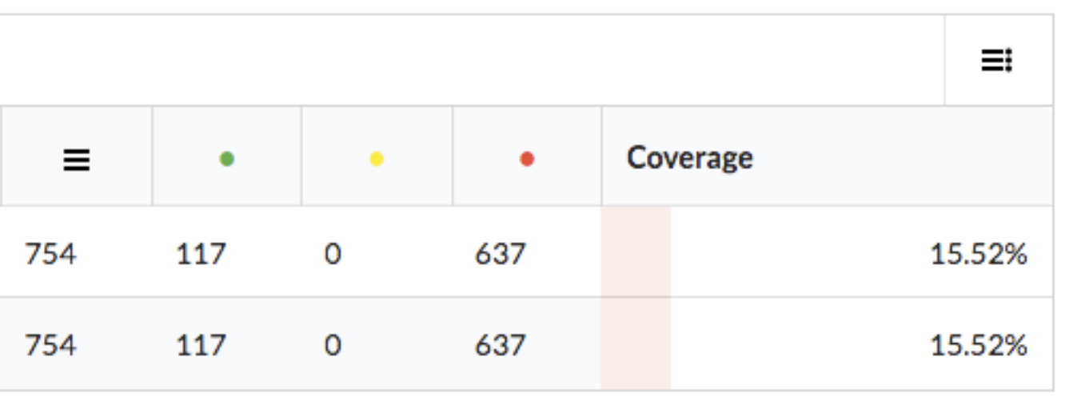
Code coverage took a back seat for us for the majority of the semester.
For the majority of the semester this is what that looked like.
The more challenging, unknown tasks took precedence (for maintainer Dr. beaty, and us)
ssh
threadpools
dynamic firewalls
etc.
Code Coverage
Starting 15.52%

Slide 20
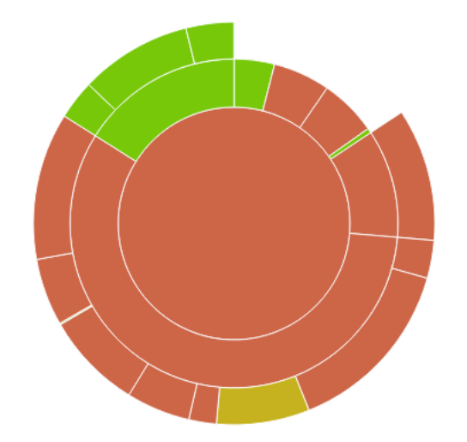
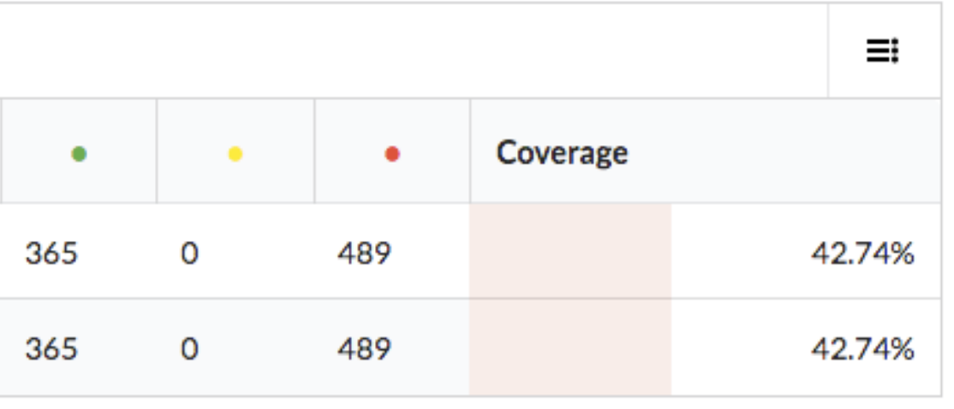
Code Coverage
Current 42.74%

Slide 21
What went well:
Improved code coverage
Paired Programming
(by bouncing ideas and theoretical solutions around)
Meetings with client to understand most important goals
Working with new architecture
Semester-long communication & team-building

Slide 22
What went poorly:
Velocity ratings
Getting pull requests approved
Continuous integration: up until a few days ago
CodeCov
Travis CI
Last minute change of workflow
merging features progress for demo

Slide 23
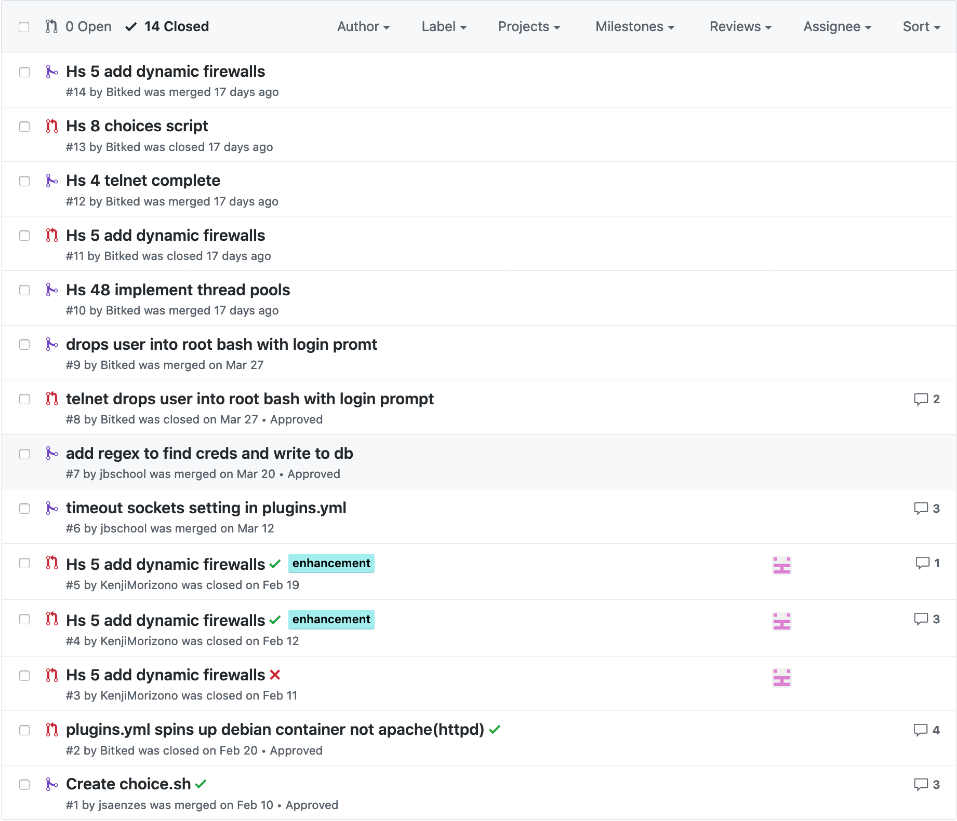
We started out the semester using Github pull-request feature but we quickly figured out we needed a better feedback loop in-team rather than depending on github comments.
Eventually all the pull requests were closed
We probably can delete this slide don’t need it..
GITHUB
0 - merged pull requests
14 - closed pull requests
0 - PRs for most recent features like threadpools/ ssh
Notes:
ended up not using Pull requests, which was a time sink

Slide 24
What we learned:
GraphQL
Docker
Linux
Python virtual environments
Sockets
Unit Tests/ Mocking
Project Management
Threadpools/ Firewalls

Slide 25
Team times - Semester
Emily – 179
Josh – 159.01
Megan – 151.5
Evan – 196.28
Tanner – 166.45
Jon – 185.32
Kenji – 132.82
Judith – 158.77

Slide 26
Thanks!
Questions?

Slide 27
5 Points Template
Synthesize learning through critical analysis and logical thinking
Apply theoretical constructs to practical applications
Critique philosophical tenets and current practices
Integrate and refine oral and/or written skills
Verify their expertise

Slide 28
How I, Tanner, met:
Synthesize learning through critical analysis and logical thinking
I learned how to lead a software team as scrum master.
Learned how to to be the facilitator for an agile development team, and devised how to create thorough, and precise goals for the team to meet our goals.
I learned about sockets, threadpools, SSH, telnet, and how to communicate with our customer for what ideas would fit best in our project.
Apply theoretical constructs to practical applications
Applied newly learned concepts and methodologies that would allow the team to self organize and make changes in an agile environment.
Applied research into how to make HPotter a lightweight project that would run on small pieces of hardware, and be applicable for various uses.
Learned how to use docker in Linux, VM’s, and Python threads, and how each piece fit in HPotter.
Critique philosophical tenets and current practices
I considered the social and personal values of running a Honeypot.
I thought about the positive impacts the project could hold when being used for research purposes and the helpful remediation steps it could guide if a system was attacked with an unknown piece of malware.
Integrate and refine oral and/or written skills
I consistently checked in with every member of the team to see where they were blocked and how I could help them finish their work.
Met with the customer on a regular basis to communicate their need, and process how this information was exchanged with the team, and broken out into small pieces of work.
Held each team member accountable for their work, and tried to create a positive and productive working environment.
Verify their expertise
Helped provide an implementation of Telnet and SSH.
Removed fake shell call.
Acted as scrum master as I created work for the team, and ensured that every team member had work at all times.
I was available for the team at any time to communicate and give guidance for their work.
Constantly kept backlog of work updated.
Reviewed almost every PR and process doc to make sure it would fulfill the project MVP and requirements.

Slide 29
How I, Jon, met:
Synthesize learning through critical analysis and logical thinking
Learned GraphQL and applied previous concepts to construct dynamic schema API server in Python
Added value through code and consultation on Linux, Docker, Python, GraphQL, databases, sockets, architecture, TLS, HTTP, etc. including exploring, choosing, and implementing various options.
Apply theoretical constructs to practical applications
Applied new and familiar concepts in architecture, networking, and operating systems to implement GraphQL, telnet, and ssh components of HPotter
Made abstract Scrum SDLC concrete with documented policies such as “Jira issue # in branch name”
Critique philosophical tenets and current practices
Considered the social and ethical concerns of building a honeypot before joining the team
Working to document safe setup of HPotter out of concern that improper config may harm users
Integrate and refine oral and/or written skills
Repeatedly met with all stakeholders and documented in writing development practices and processes to ensure all stakeholders had clear understanding and path to move forward together
Documented and communicated in meetings implementation and use of LJordan GraphQL API
Frequent meetings with stakeholders to ensure buy-in and verify value and direction
Verify their expertise
Implemented dynamically generated GraphQL API from arbitrary database schema
Pair programmed and contributed successful ideas to solve challenges in telnet and ssh implementations
Applied a wide variety of technologies to contribute to visible progress on goals and minimum viable product

Slide 30
How I, Birt, met:
Synthesize learning through critical analysis and logical thinking
Devised personal plans for appropriate steps to be taken in order to accomplish given software solution
Learned more about linux, and other technologies commonly used to manage sockets.
Apply theoretical constructs to practical applications
Recalled past and new knowledge on python, threads, VMs, Linux, and Docker to assess appropriate solutions or review/ test my own and teammate’s software features
Critique philosophical tenets and current practices
Questioned HPotters design implementations for leveraging linux and docker and its impacts in society and security
Integrate and refine oral and/or written skills
Routinely performed standups in front of class and presented the technical portion of our demos and met with stakeholders on clarity of the progress made and what comes next
Often communicated with others about their progress to assist in accurately reflecting sprint progress on demos and sought clarification or suggestions.
Co-Developed organization sheets for time tracking, providing more efficient method to track team progress.
Verify their expertise
Provided a functional implementation of Telnet and SSH by using existing skills, new insights, and a variety of contributions in discussions, and paired programming from team and maintainer.
Evaluated teams progress in meeting MVP demonstrated in final presentation with help from team and other technical demos having used and tested the technologies used by the team in order to accurately reflect our work accomplished.

Slide 31
How I, Megan, met:
Synthesize learning through critical analysis and logical thinking
Participating in meetings to better understand product.
Compared different options for a front-end dashboard, knowing the needs of the client.
Apply theoretical constructs to practical applications
Gained knowledge from team members and research as to correctly implement KPI’s on chosen dashboard.
Critique philosophical tenets and current practices
By listening to the needs of the client, we determined the best option for the dashboard.
Integrate and refine oral and/or written skills
Communicated with team members to understand aspects of the project to integration and
Participated in class stand ups to keep team
Verify their expertise
Implemented Travis and code cov..
Previously never having worked on any front-end, I learned a lot about queries and communicating with a database.

Slide 32
How I, Judi, met:
Synthesize learning through critical analysis and logical thinking
Presented different solutions for a dashboard by conducting research and selecting the most currently viable option.
Apply theoretical constructs to practical applications
Used researched knowledge on graphql and json to implement dashboard queries.
Critique philosophical tenets and current practices
Questioned how the previous front end was implemented and what needed to change.
Integrate and refine oral and/or written skills
Documentation for Freeboard (README file). Which ties into being able to explain what the code does to others and how it is set up.
Standups assisted with the ability to articulate blockers and start a conversation about what needs to be done and solutions that can be found.
Verify their expertise
Worked on understanding/implementing code not only for a Dashboard but also throughout different areas of HPotter that were interconnected.

Slide 33
How I, Josh, met:
Synthesize learning through critical analysis and logical thinking
Apply theoretical constructs to practical applications
Critique philosophical tenets and current practices
Integrate and refine oral and/or written skills
Verify their expertise

Slide 34
How I, Kenji, met:
Synthesize learning through critical analysis and logical thinking
Analyzed steps need to resolve a given story point
Constructed a clear roadmap on what steps would be done when
Considered any issues introduced by the solutions to a given story point
Apply theoretical constructs to practical applications
Used semaphores in the first working solution for thread-pools
Application of the iptc.easy structure to the needs of HPotter’s dynamic firewalls
Critique philosophical tenets and current practices
Analyzed current issues with the code and its testability when writing unit tests
Integrate and refine oral and/or written skills
Standups and explaining to interested group members how certain solutions worked (e.g. dynamic firewalls code was a package that took Python and parsed it to iptables commands) or why certain code decisions were made
Verify their expertise
Provided a functioning solution to thread-pools and dynamic firewall

Slide 35
How I, Emily, met:
Synthesize learning through critical analysis and logical thinking
The project we chose was challenging and addressed a real-world problem. I presented our progress every other week and built key skills that will carry over to my career.
Apply theoretical constructs to practical applications
There were many times I and my group asked ourselves “will this goal actually be possible within the realm of what can be coded?” and for much of it, we were able to bring that into being. With the front end portion, there was a struggle to find a place to host the website that not only met our needs, but was free. Finding one and getting it to work was very difficult, but I am proud of what we accomplished there.
Critique philosophical tenets and current practices
I was wary of elements of this project - like how the final product would show IP Addresses that attempted to attack the machine. But my team made a good point - these people are malicious attackers, and the IP Addresses being shown are helpful pieces of information. There were many other ethical dilemmas I faced throughout this semester regarding this project, as the nature of the project raises many ethical questions as they currently exist.
Integrate and refine oral and/or written skills
I have always been good at these, but I improved them through the semester through presentations and keeping in contact with my team - especially when we went on quarantine and we had to communicate through text even better than before.
Verify their expertise
My strengths lie in places besides coding, which I communicated to my team in the beginning.. I was there to help with presentations and however the scrum master needed help. There were weeks, especially near the end of the semester, where I was the front end scrum master.

