Slide 1

Hpotter
Sprint #2

Slide 2

Hello!
We are working on Hpotter
An increasingly dynamic Honeypot built in Python.
Team Members: Tanner, Kenji, Emily, Judith, Josh, Jon, Evan, Megan

Slide 3
Our Sprint #2 goals
Create a config.yml file
Plugins/ssh.py should call the container thread instead of fake shell
Get Telnet working again
Create Google Doc for Team Members to input sprint hours
Start researching a UI
Build GraphQL API for Hpotter database
Create chain commands for dynamic firewalls
Connect JSON server – changing path env variables

Slide 4
Major goals we finished
Things we created
Google doc for time entry
Lifelong friendships
Other things we created
Chain commands for dynamic firewalls
GraphQL API for DB
Things we researched
User Interface for Hpotter – demo to follow
Things we fixed
Connected JSON server
Other things we fixed
Telnet
My parents relationship (jk, I wish)
What we didn’t quite get done
Plugins and ssh.py need to call the container thread
Config.yml file

Slide 5
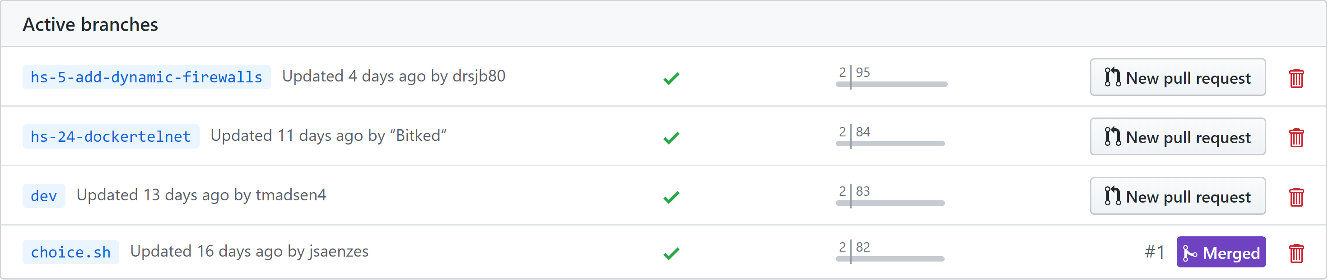

Slide 6
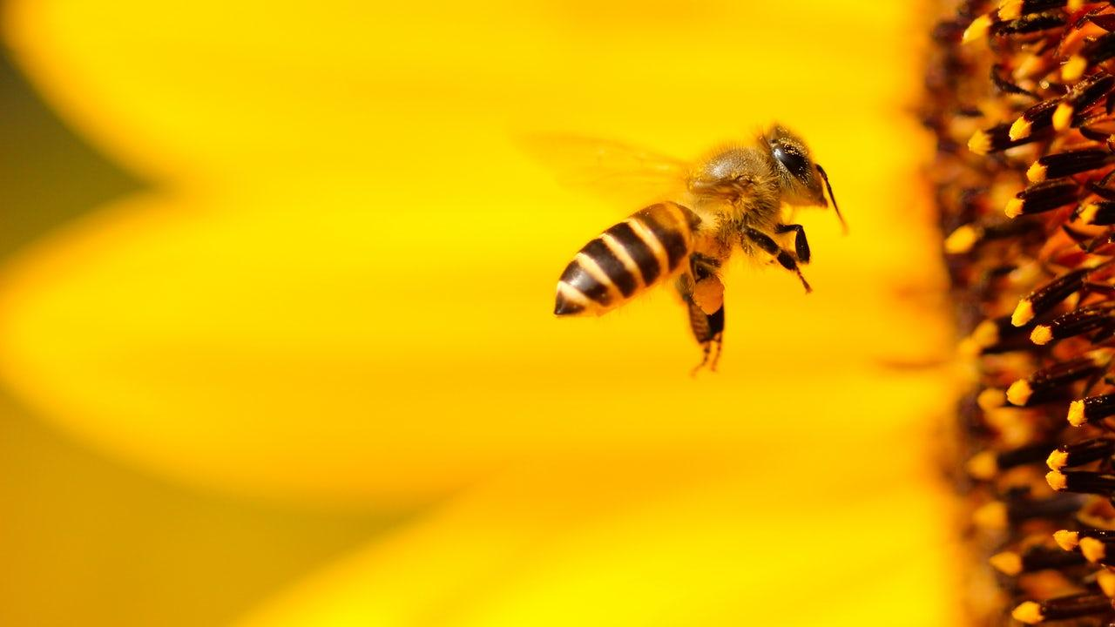
Hpotter Demo – we didn’t break it!

Slide 7
Hpotter Analytics
2
Machine Learning and Data Analytics

Slide 8
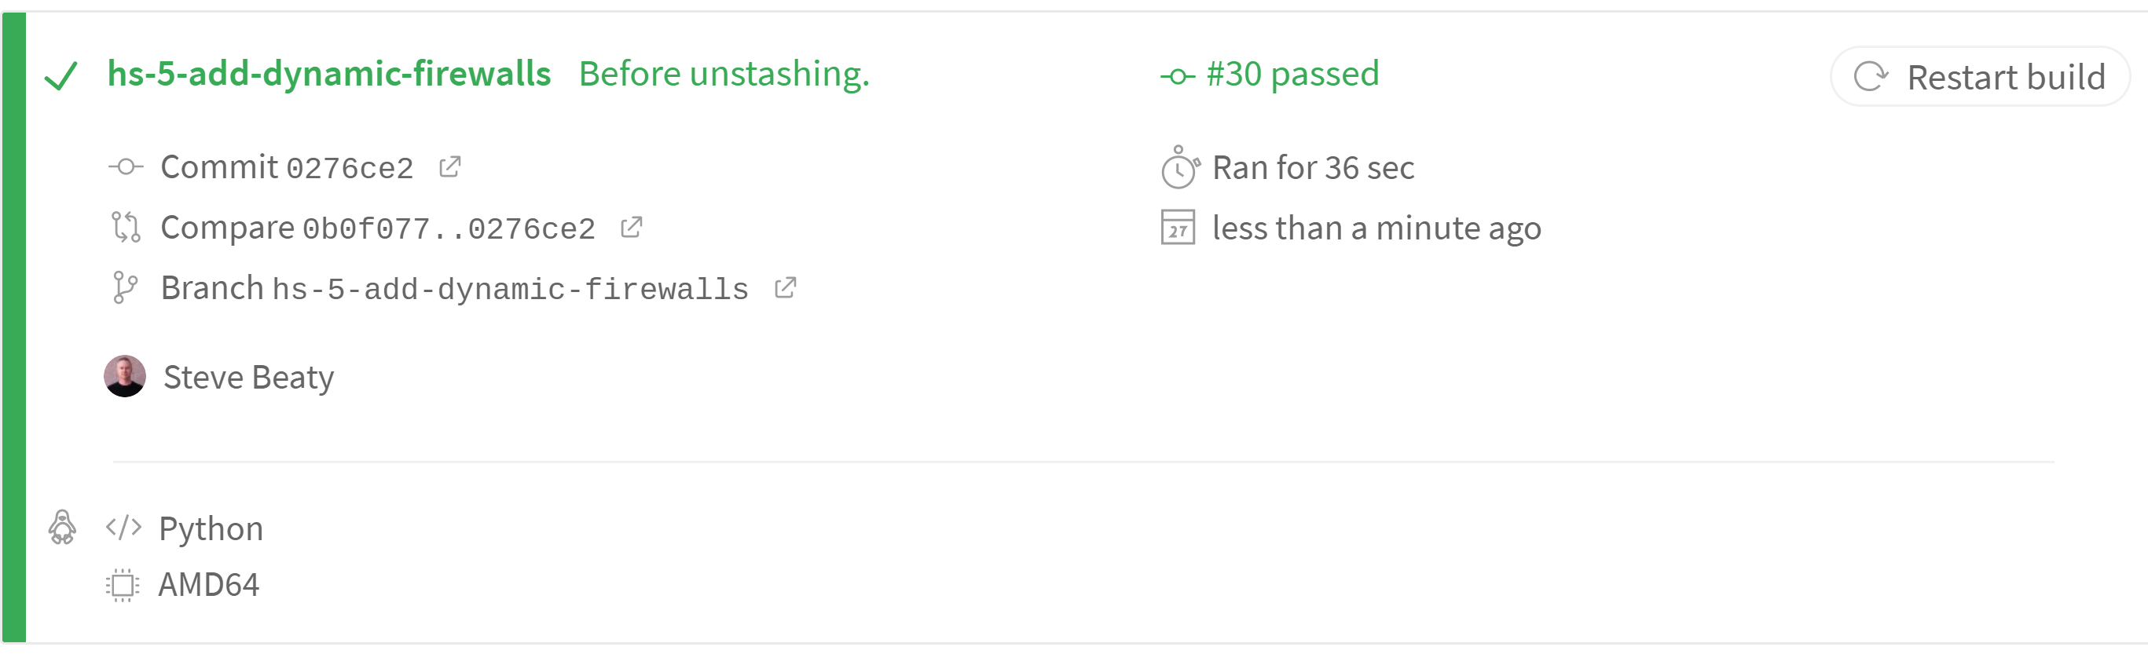

Slide 9
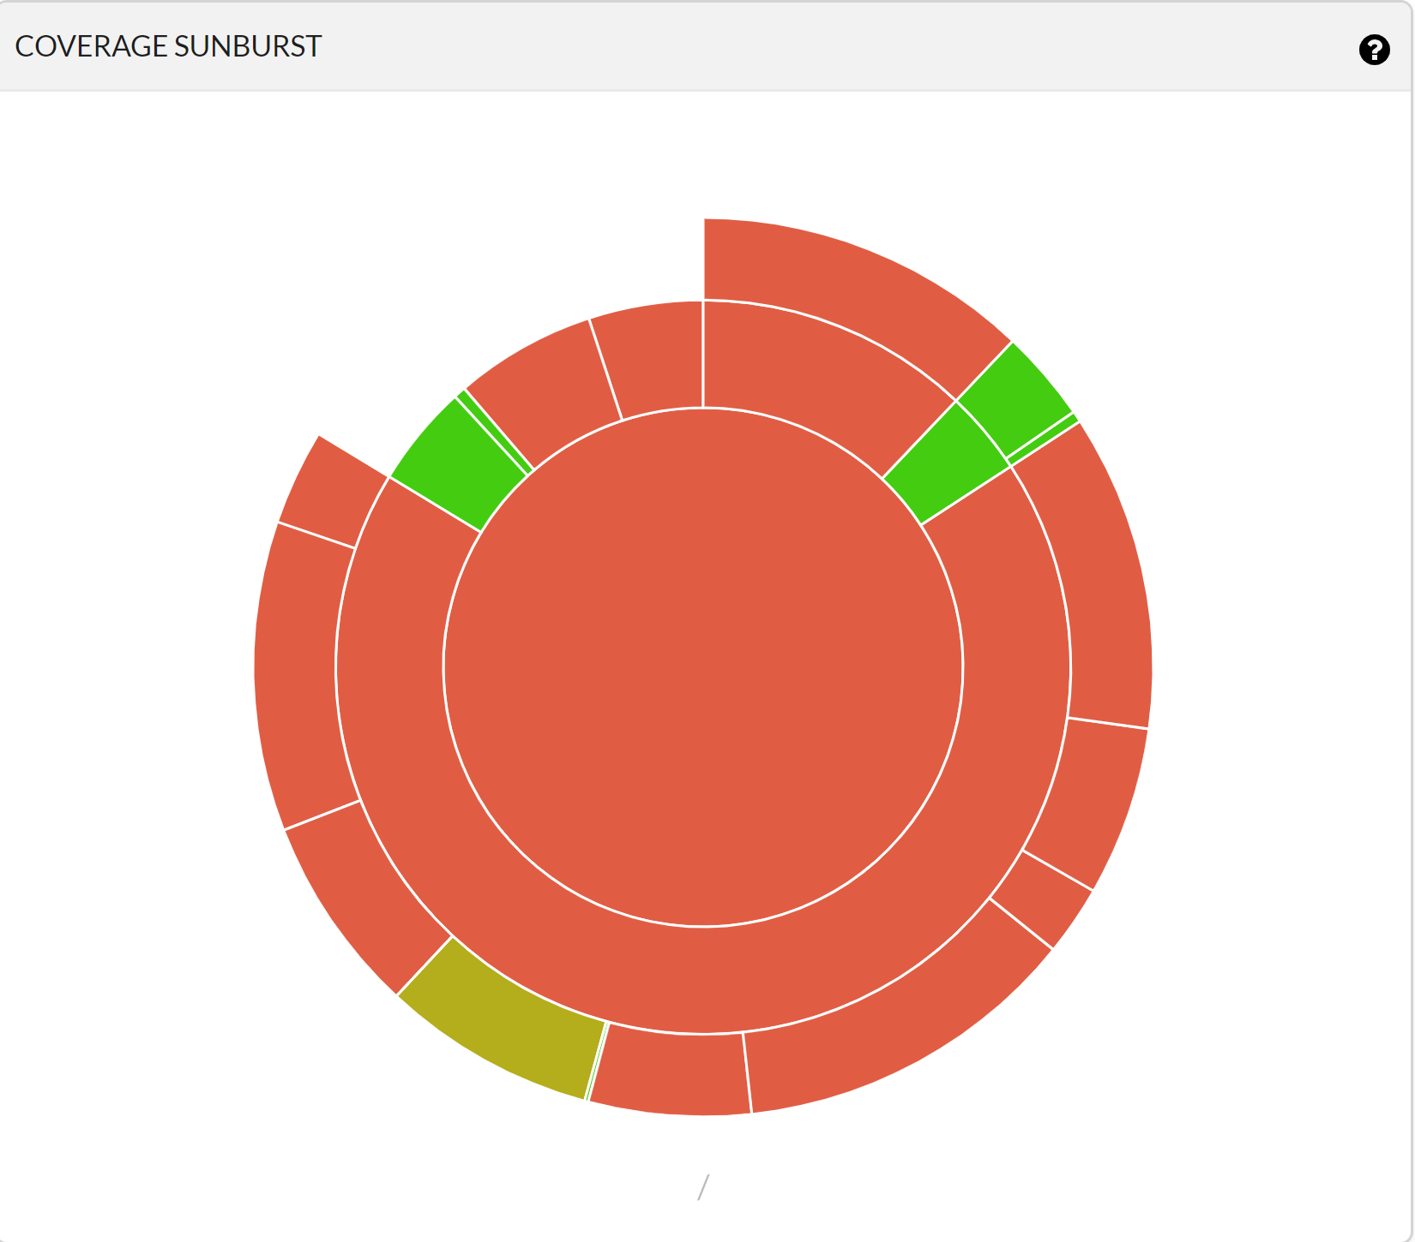



Slide 10
Hpotter Dash
Demo - GeckoBoard

Slide 11
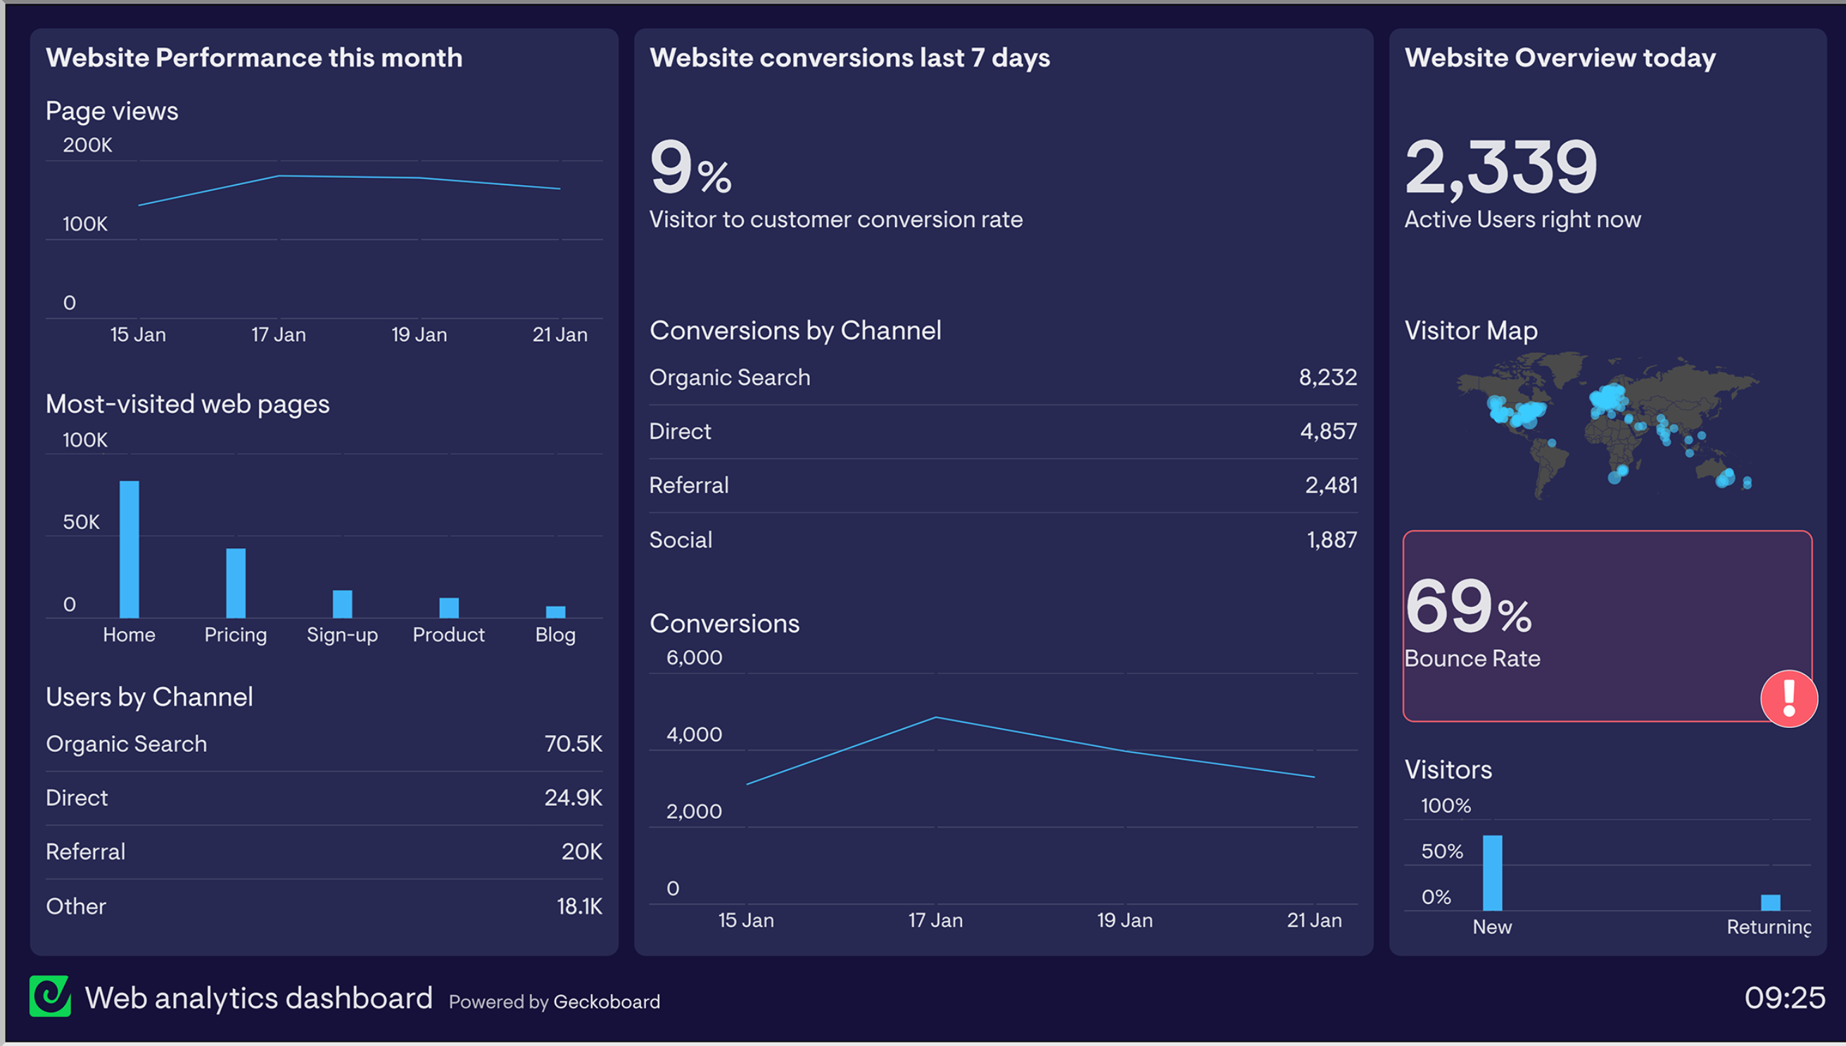

Slide 12
Things we want to include on GeckoBoard
Key Performance Indicators
Meter of number, attacks per minute hour day
Possibly a drop down for each
Top 10 credentials
HPotter Traffic
Scans that turn into attacks or scans and both attacks
Top 10 IP Addresses
Maps
Map with pins as we have right now and maybe heat maps
Google Maps link

Slide 13
Where we improved
Code
We better understood what we were working on
We can more clearly see the next steps that are requried
Team
We had more frequent team meetings
We trust each other more as we get to know one another
Planning
We were better able to estimate the story points per user story

Slide 14
Where we still need to improve
Code
Get everyone up to speed on expectations and next steps
Team
Communication can always be improved
I would like to have a meeting that is solely about getting acquainted
Planning
This last sprint, user stories were still being added a week into it. We should more clearly lay out user stories earlier on

Slide 15
Thanks!
Questions?

Slide 16
Team times
Emily – 10
Josh – 10
Megan –
Evan – 14.21
Tanner – 13.1
Jon – 31.91
Kenji – 11.275
Judith – 7.55

