Slide 1

Hpotter
Sprint #3

Slide 2

HPotter Spring 2020
Scrum Master: Tanner
Product Owner: Jon
Dev Team: Evan, Megan, Judith, Josh, Kenji
Presenter: Emily

Slide 3
Our Sprint #3 goals
Create a config.yml file
ssh.py should call the container thread instead of fake shell
Finish tasks for Telnet
Build a UI
Implement GraphQL API for Hpotter database
Create a diagram to show how Hpotter works
Create a burndown time sheet for communication
Research Python Thread Pools

Slide 4
Tasks This Sprint:
Things we fixed
My dog
ADDITIONS:
Created timesheet burn down
GraphQL API for DB
Implemented Netcat for ssh
Config.yml
Custom docker images
Removed fakeshell for containerthread
GraphQL connected to FreeBoard
RESEARCH:
GraphQL
Geckoboard
Freeboard
Telnet
Paramiko for ssh
netcat
Threadpools
FOR NEXT SPRINT:
clean up ssh
Better UI
Threadpools + dynamic firewalls
Unit testing!!!!!
WORK IN BACKLOG TO FINISH:
Credentials written to database for telentd + ssh
Flowchart for hpotter architecture

Slide 5
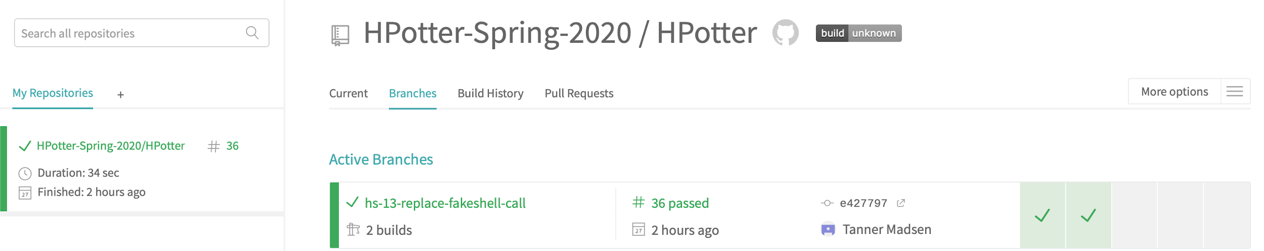

TravisCI for Current Branches:

Slide 6
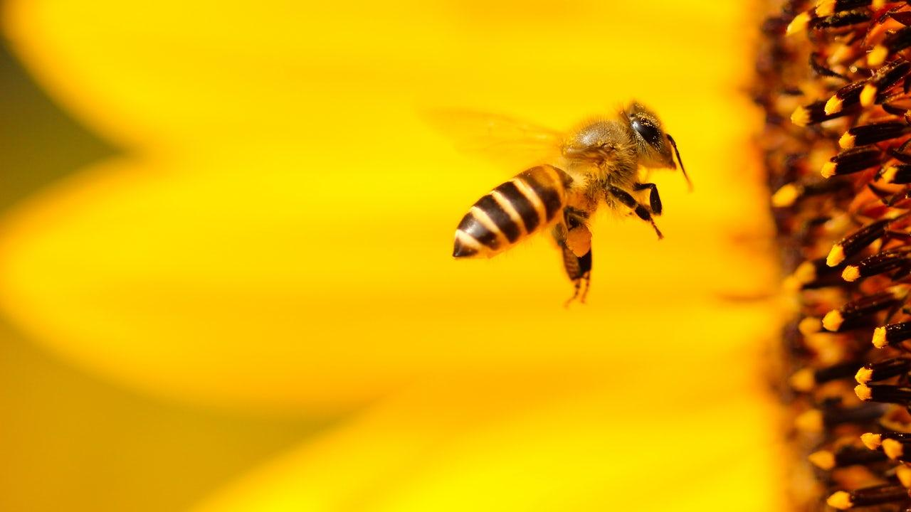
Hpotter Demo

Slide 7
Hpotter Analytics
PLANNED FUTURE USER STORIES IN BACKLOG:
10
USER STORIES FOR THIS SPRINT: 16 IN PROGRESS:
4
DONE:
12

Slide 8
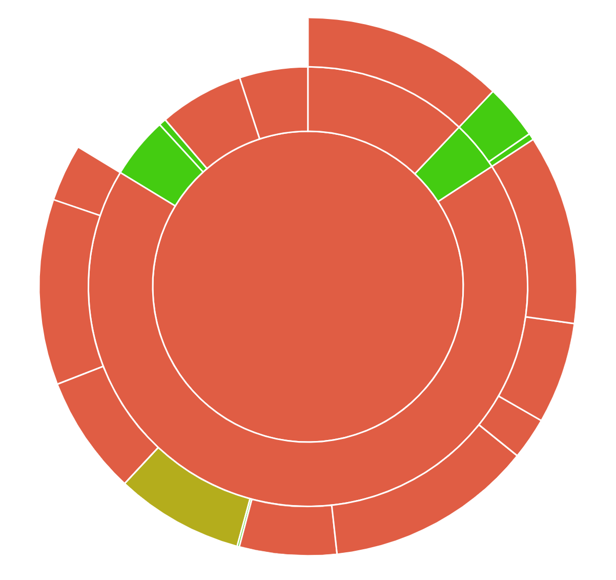
Code Coverage
Completing customers(Dr. Beaty) priority tasks like Telnet, SSH, and Dynamic Firewalls before moving on to unit tests.

Slide 9
Hpotter DashBoard
FreeBoard.io was chosen as our UI dashboard
Utilizing GraphQL API to communicate from Hpotter database to dashboard We currently have API talking to FreeBoard.io

Slide 10
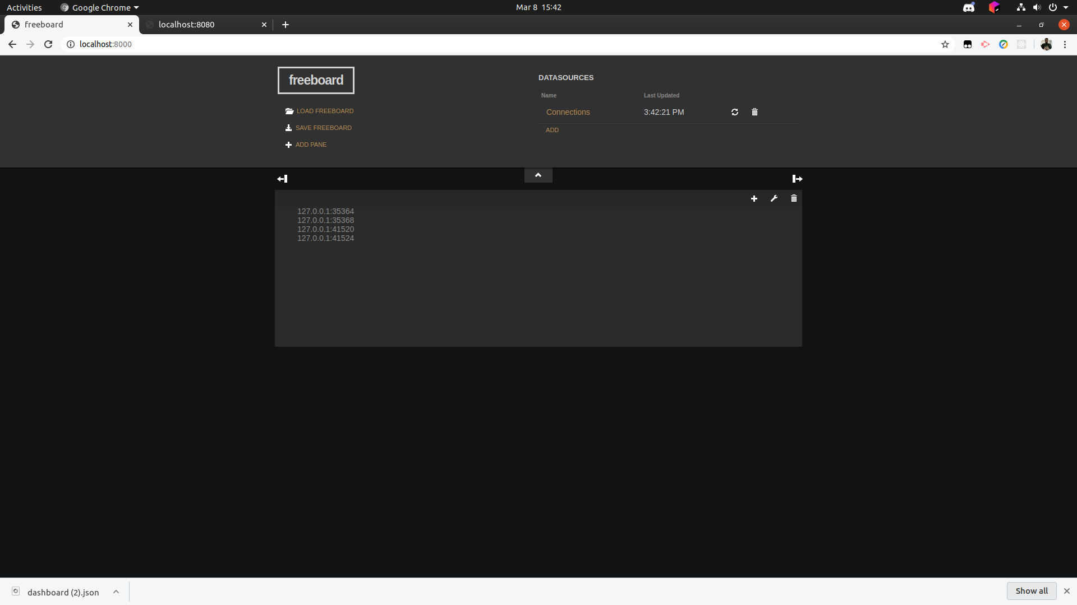

Slide 11
What we did well:
Made important design decisions
Paired programming
Good communication
Completed a lot of work
Workflow
What we want to stop doing:
What we want to continue:
Stop underestimating the amount of time it will take for user stories
Being so BOSS
Leaving Emily in the dark
Break things into smaller tasks
Paired Programming
Communication
Research
Team meetings

Slide 12
Thanks!
Questions?

Slide 13
Team times
Emily – 16
Josh – 11
Megan – 9
Evan – 28.15
Tanner – 19.1
Jon – 32.18
Kenji – 11.53
Judith – 16.1

