Slide 1

Hpotter
Sprint #4

Slide 2

HPotter Spring 2020
Scrum Master: Tanner
Product Owner: Jon
Dev Team: Birt, Megan, Judith, Josh, Kenji
Presenter: Emily and Birt

Slide 3
Sprint #4 Goals
Finish Telnet
Finish Dynamic Firewalls
Implement Threadpools
Start SSH
Finish Diagram
UI (using graphQL)

Slide 4
Telnet Completed:
Telnet
User Stories:
hs-4-telnet-complete
Get Telnet Working again
Have telnet allow all credentials into debian as root
Set timeout for sockets listening to docker containers
Extract creds with regex and write to DB

Slide 5
Dynamic Firewalls Completed:
Things we fixed
My dog
Dynamic Firewalls
User Stories:
hs-5-add-dynamic-firewalls
Use iptc.easy instead of the iptc package directly
Removed Output Chain Rules
Created rules for the forward chain
Create threadpool class object using max_threadscreate threadpool class object using max_threads
Added max_threads rule into plugins.yml file
Threadpools implemented - stops multiple containers

Slide 6
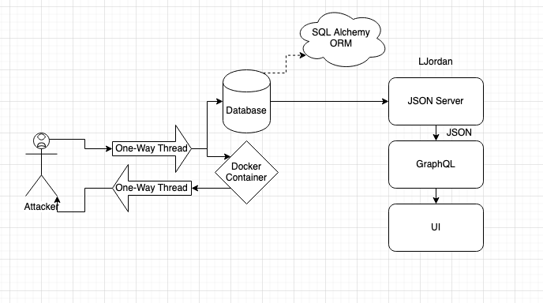
Diagram

Slide 7

Hpotter Demo

Slide 8
NOT Completed:
Things we fixed
My dog
Threadpools Testing (special cases)
connections are still being made (maybe that is alright?)
Moved SSH to next sprint
Unforeseen delays
Broken into smaller tasks
Build a UI
Freeboard.IO maintainability issues
Considered Redash however memory issues freeze VM

Slide 9
Next Sprint:
FOR NEXT SPRINT:
Paramiko for SSH
Clean up dead code in SSH
Disallow port forwarding (paramiko must be done first)
Specify a random generated ticket or user end specified ticket for SSH
Complete Testing on dynamic firewalls
Finish thread pools
Resolve UI issues and get a working dashboard.

Slide 10
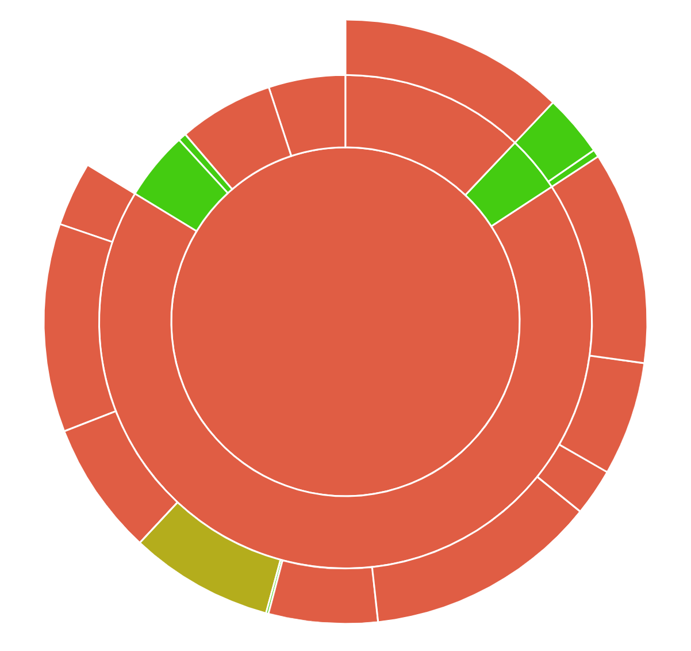
Code Coverage
Completing Dr. Beaty’s priority tasks first;
Telnet (Finished)
Dynamic Firewalls (Finished)
Threadpools
SSH (Sprint 5)
Then start writing unit tests.

Slide 11
What went well:
Paired programming
Testing each others branches
Not sidetracked from task at hand
Organization with corresponding user stories to Github branches
No dead branches

Slide 12
What we learned:
Threadpool is subclass of Pool class
Port Forwarding -L (local), -R (remote)
PAM (pluggable authentication module)
to manage Debian authentication
we found alternative using /.bashrc

Slide 13
What went poorly:
Communicating progress with Scrum Master
Not creating enough User Stories
More communication to add subtasks under user stories is needed

Slide 14
Thanks!
Questions?

Slide 15
Team times
Emily – 10
Josh – 13.13
Megan – 6.5
Evan – 17
Tanner – 13.86
Jon – 12.13
Kenji – 19.3
Judith – 19.39

