Slide 1

Hpotter
Sprint #5

Slide 2

HPotter Spring 2020
Scrum Master: Tanner
Product Owner: Jon
Dev Team: Birt, Megan, Judith, Josh, Kenji
Presenter: Emily and Birt

Slide 3
Sprint #5 Goals
Get SSH hooked up in the one way threads
Implement Threadpools
Capture credentials with SSH
Add KPI’s to Freeboard
Fix Travis
Clean up SSH

Slide 4
Goals Completed:
Dynamic Firewalls completed
Testing for Threadpools
Capturing credentials with SSH using Paramiko
SSH hooked up in the one way threads
Discovered code to be changed or removed to clean up SSH

Slide 5
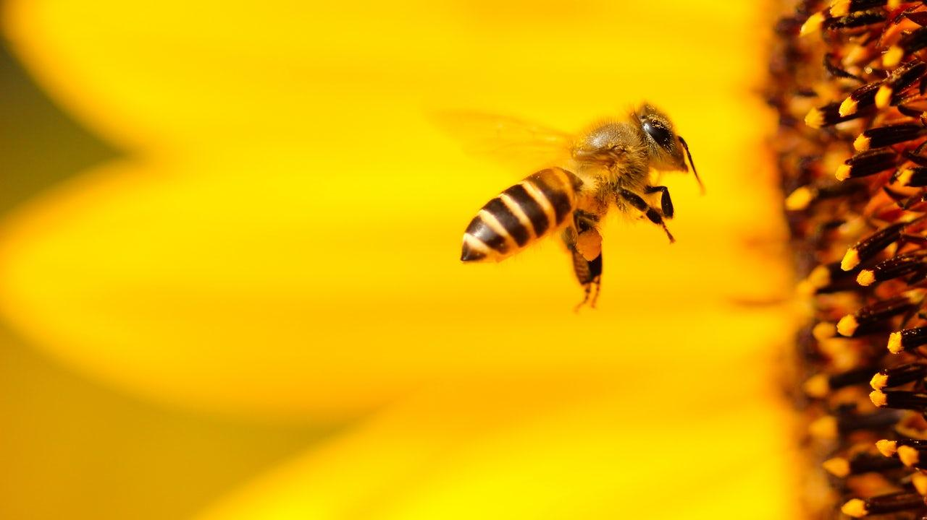
Hpotter Demo

Slide 6
NOT Completed:
Things we fixed
My dog
SSH container restricted root shell access
Working proof of concept (need feedback from Dr. Beaty)
Adding KPI’s to FreeBoard.
Travis.ci is still broken

Slide 7
Next Sprint:
FOR NEXT SPRINT:
Complete SSH to accept all credentials into root bash shell container whilst simplifying excess code
Implement Key Performance Indicators(KPI’s) in Freeboard
Clean up dead code in repo
Unit Testing
Fix Travis.ci

Slide 8
What went well:
Paired programming
Reviewing PR’s
Constant team meetings
Communicating blockers
Helping other team members understand concepts and code

Slide 9
What went poorly:
Ran into some issues with code implementation.
Time restricted with everything going on in the world
Adam, your mic is really loud :(

Slide 10
What we learned:
How Paramiko handles ssh protocol
(asynchronous key-exchange and other hand-shaking that happens is decryptable by hpotter, then a private session key is created and leaves all further data undecryptable because the user holds the newly created key, not hpotter)
Testing dynamic firewalls with Threadpools (Using secured docker container and pinging available DNS, and brute force spinning up multiple containers)

Slide 11
Thanks!
Questions?

Slide 12
Team times
Emily – 13
Josh – 11.32
Megan – 16
Evan – 19.5
Tanner – 12.72
Jon – 5.67
Kenji – 7.94
Judith – 14.07

