Slide 1

Hpotter
Sprint #

Slide 2

Hello!
We are working on Hpotter
An increasingly dynamic Honeypot built in Python.

Slide 3
Our Sprint # goals
Our Backend Team: “Hpotter-server”
Major Contributors this sprint: Name, name, name
Goals,
Goals,
More goals,
Woo some goals here too

Slide 4
Our Sprint # goals
Our Frontend Team: “Hpotter-app”
Major Contributors this sprint: Name, name, name
Goals,
Goals,
More goals,
Woo some goals here too

Slide 5
### Commits
# Pull Requests
# Tickets
That’s a lot of lines of code
And a lot of headaches
Huge success!

Slide 6
Hpotter-server
1
Our intrepid backend

Slide 7
Big Sprint Goal here
The Single biggest sprint goal for this sprint for this team

Slide 8
Other major goals we finished
Learned about Falco
Man was that cool we learned so much and honestly? It’ll change everything
Dreamed about Falco
Its silken API, its smooth curves, the sweet promises it whispers into our ears.
Talked about Falso
Nothing huge has ever been done alone. We have to talk about changes this major
Researched Falco
There is a wealth of information out there about this revolutionary product. We must learn it all.
Worked on Falco
It was hard, it took blood, sweat, and tears, but research it we did.
Failed to implement Falco
… Whoops.

Slide 9
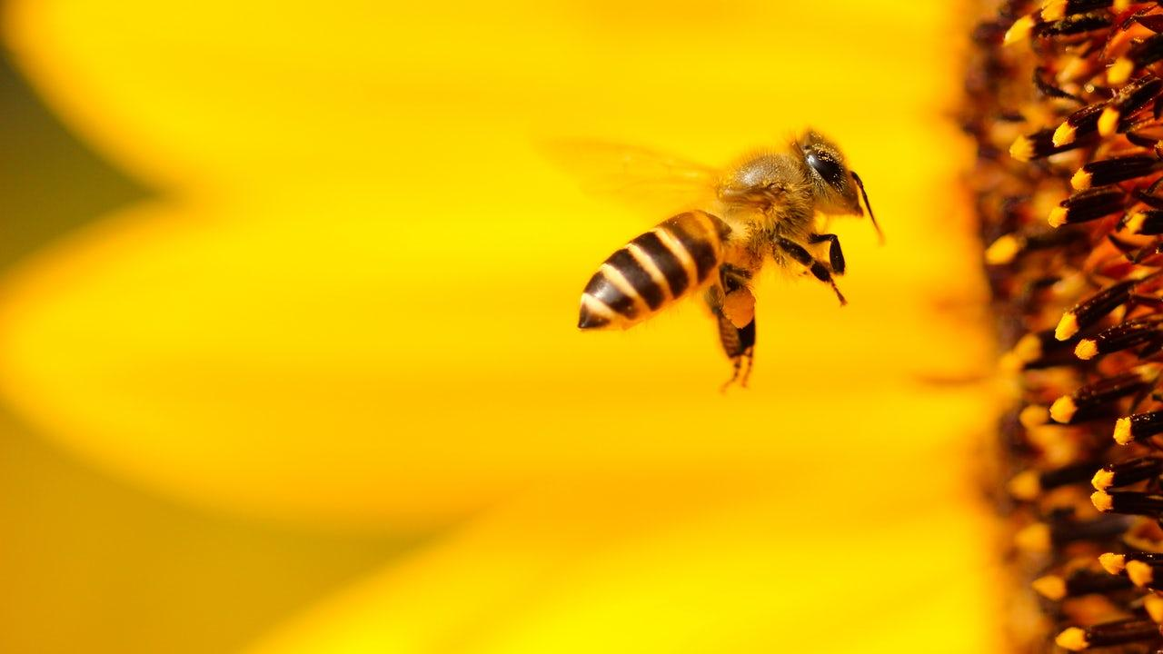
Hpotter-server
Demo

Slide 10
Hpotter-app Analytics
2
Machine Learning and Data Analytics

Slide 11
Big Sprint Goal here
The Single biggest sprint goal for this sprint for this team

Slide 12
Other major goals we finished
Learned about Falco
Man was that cool we learned so much and honestly? It’ll change everything
Dreamed about Falco
Its silken API, its smooth curves, the sweet promises it whispers into our ears.
Talked about Falso
Nothing huge has ever been done alone. We have to talk about changes this major
Researched Falco
There is a wealth of information out there about this revolutionary product. We must learn it all.
Worked on Falco
It was hard, it took blood, sweat, and tears, but research it we did.
Failed to implement Falco
… Whoops.

Slide 13
Hpotter-app ML
Demo

Slide 14
Hpotter-app Dashboard
3
Our glorious frontend

Slide 15
Big Sprint Goal here
The Single biggest sprint goal for this sprint for this team

Slide 16
Other major goals we finished
Learned about Falco
Man was that cool we learned so much and honestly? It’ll change everything
Dreamed about Falco
Its silken API, its smooth curves, the sweet promises it whispers into our ears.
Talked about Falso
Nothing huge has ever been done alone. We have to talk about changes this major
Researched Falco
There is a wealth of information out there about this revolutionary product. We must learn it all.
Worked on Falco
It was hard, it took blood, sweat, and tears, but research it we did.
Failed to implement Falco
… Whoops.

Slide 17
Hpotter-app Dash
Demo

Slide 18
Where we improved
Yellow
Is the color of gold, butter and ripe lemons. In the spectrum of visible light, yellow is found between green and orange.
Blue
Is the colour of the clear sky and the deep sea. It is located between violet and green on the optical spectrum.
Red
Is the color of blood, and because of this it has historically been associated with sacrifice, danger and courage.

Slide 19
Where we still need to improve
Yellow
Is the color of gold, butter and ripe lemons. In the spectrum of visible light, yellow is found between green and orange.
Blue
Is the colour of the clear sky and the deep sea. It is located between violet and green on the optical spectrum.
Red
Is the color of blood, and because of this it has historically been associated with sacrifice, danger and courage.

Slide 20
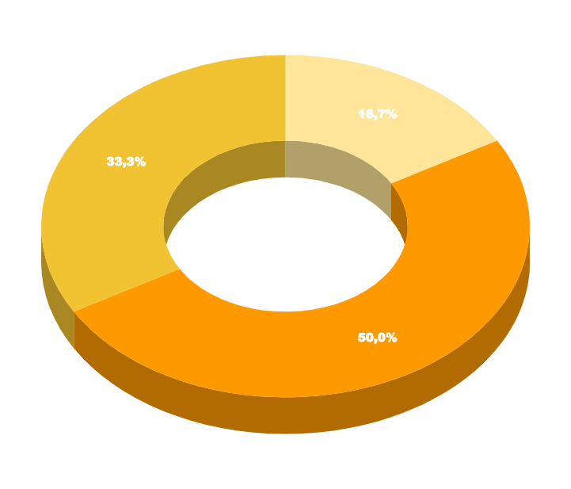
Tyler really likes graphs so he can put them here, duplicate this slide

Slide 21
Thanks!
Questions?

