Slide 1
Sea level prediction using Neural Networks
Olalekan ABOUBAKAR (Ola)

Slide 2
About Me
I'm a Principal Data Scientist
I'm here as the Facebook Developer Circle co-lead in NYC
I have 15 years of experience in Software Engineering and Machine Learning
I have a Masters in EE but professionally I've been more a computer scientist/mathematician
You can find me on LinkedIn and Twitter at @olatulekan

Slide 3
The Github Repo
https://github.com/ampaho/h2hacks_workshop

Slide 4
What is a Prediction?
A prediction (Latin præ-, "before," and dicere, "to say"), or forecast, is a statement about a future event. A prediction is often, but not always, based upon experience or knowledge. There is no universal agreement about the exact difference between the two terms; different authors and disciplines ascribe different connotations. (Contrast with estimation.)

Slide 5

A few words about Facebook Developer Circle NYC
visit devc.nyc or find the Developer Circle NYC on Facebook Groups

Slide 6
What is a Prediction?
A prediction (Latin præ-, "before," and dicere, "to say"), or forecast, is a statement about a future event (or an unseen event). A prediction is often, but not always, based upon experience or knowledge. There is no universal agreement about the exact difference between the two terms; different authors and disciplines ascribe different connotations. (Contrast with estimation.)

Slide 7
Prediction using Scientific Theories
In an attempt to predict the future or unseen past events, scientists formed two main fields: rule based systems and machine learning
I do the latter. And that's what we'll doing in this workshop
They both take ideas and theories from Mathematics, Physics, Philosophy, Neuroscience, Electrical Engineering, Computer Science, Statistics, etc..
Machine Learning is the more scalable, hence the more adapted
It has applications in just about everything: camera, photo apps, social media, e-commerce, wearables, TVs, healthcare, car, etc. It's literally EVERYWHERE.

Slide 8
Prediction using Machine Learning (ML)
High-level ML architecture
Type of Neural Network
Training Data
(Information,
Knowledge)
Train the model
(Calculus, Linear Algebra)
Prediction
Classification vs Regression
Labelled vs Unlabelled
Data to Predict
Future vs Unseen

Slide 9
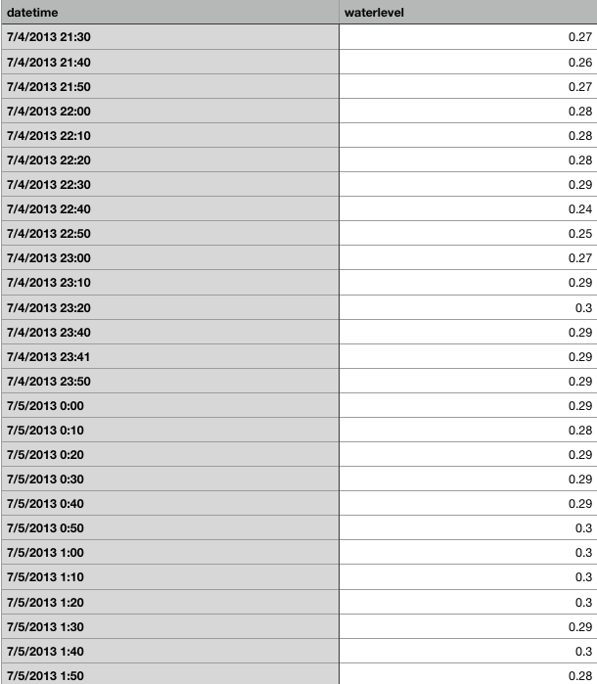
The Data

Slide 10
Prediction using Machine Learning
Prediction vs Forecasting
Training Data
(Information,
Knowledge)
Train the model
(Calculus, Linear Algebra)
Prediction
Future Data
Unseen Data
Forecast
Prediction

Slide 11
QA: Are we predicting or forecasting the sea level?

Slide 12
Prediction using Machine Learning
Labelled vs Unlabelled
Training Data
Train the model
(Calculus, Linear Algebra)
Prediction
Labelled data
Unlabelled data
Unsupervised learning
Future Data
Unseen Data
Supervised learning

Slide 13
QA: Are we doing Supervised or Unsupervised Learning?

Slide 14
Prediction using Machine Learning
Classification vs Regression
Regression
Classification
Training Data
Train the model
(Calculus, Linear Algebra)
Prediction
Classes
Real value
Future Data
Unseen Data

Slide 15
QA: Are we doing Regression or Classification?

Slide 16
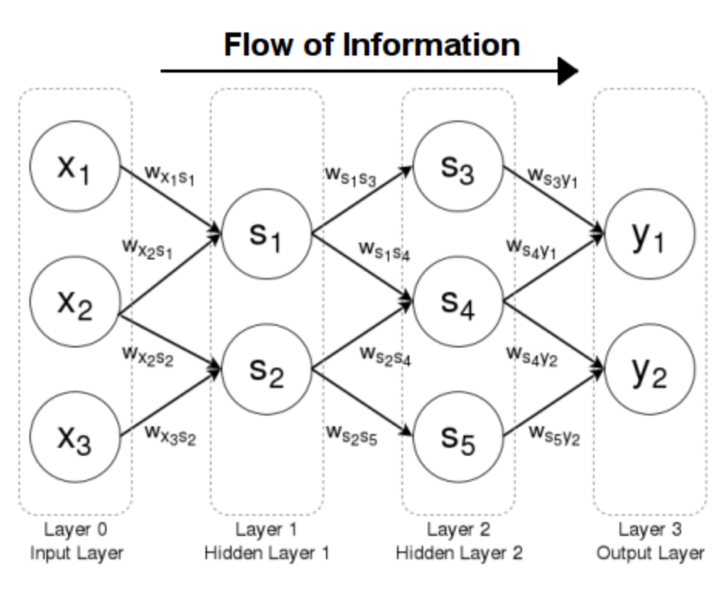
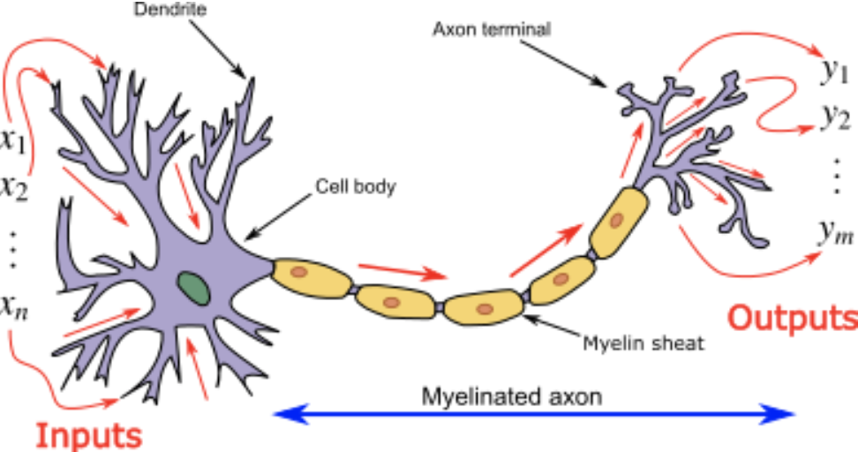
Neural Networks ≅ Artificial Neural Networks
Artificial neural networks (ANN) or connectionist systems are computing systems that are inspired by, but not identical to, biological neural networks that constitute animal brains. Such systems "learn" to perform tasks by considering examples, generally without being programmed ...
Artificial Neural Network (brilliant.org)
Biological Neural Network (wikipedia.org)

Slide 17
Types of Neural Networks and Deep Learning
Feed-forward Neural Network: very flexible and general. Can be used for mosts tasks and datasets. Unidirectional so mostly recommended for tabular datasets
Recurrent Neural Network: mostly used for sequence data: textual data (novels, articles, lab reports, etc..) or time series data (sea levels, temperature, stock market, etc.. )
Convolutional Neural Network: originally created for computer vision (image related tasks). But can be adapted for sequence data as well
Deep Learning is when you have many hidden layers. The more layers you have the better you can model your input; but this means your model needs to see more variants of your inputs, which means more data.

Slide 18
Prediction using Machine Learning
Feed-forward vs Reccurent vs Convolutional Neural Network
Training Data
Train the model
(Calculus, Linear Algebra)
Prediction
Future Data
Unseen Data

Slide 19
QA: What type of Neural Network to Use for Sea Level Prediction?

Slide 20
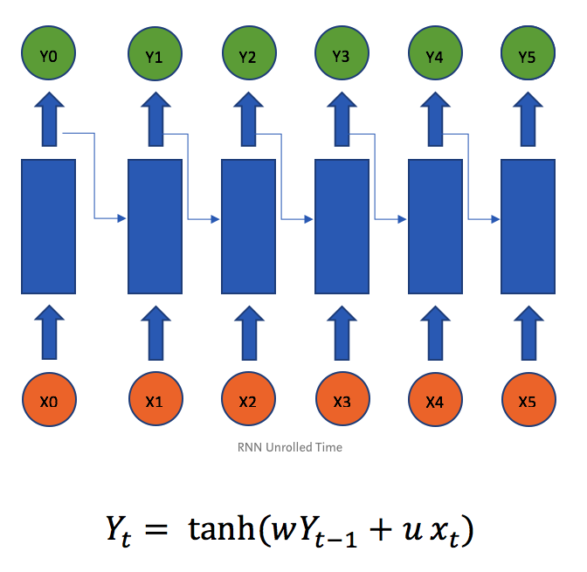
RNN for Time series data

