Slide 1
Computer Architectures
MIPS Control
Zhu Wen-Jun
Institute of Computer

Slide 2
Outline
Datapath Review
Controller Implementation

Slide 3
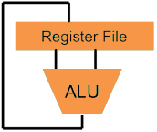
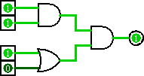
Great Idea #1: Levels of Representation/Interpretation
Higher-Level Language Program (e.g. C)
temp = v[k];
v[k] = v[k+1];
v[k+1] = temp;
Compiler
lw $t0, 0($2)
lw $t1, 4($2)
sw $t1, 0($2)
sw $t0, 4($2)
Assembly Language Program (e.g. MIPS)
Assembler
0000 1001 1100 0110 1010 1111 0101 1000
1010 1111 0101 1000 0000 1001 1100 0110
1100 0110 1010 1111 0101 1000 0000 1001
0101 1000 0000 1001 1100 0110 1010 1111
Machine Language Program (MIPS)
We are here
Machine Interpretation
Hardware Architecture Description (e.g. block diagrams)
Architecture Implementation
Logic Circuit Description (Circuit Schematic Diagrams)

Slide 4
Hardware Design Hierarchy
system
Today
datapath
control
code registers
state registers
combinational logic
multiplexer
comparator
register
logic
switching networks

Slide 5
Outline
Datapath Review
Controller Implementation

Slide 6
Datapath Review
Part of the processor; the hardware necessary to perform all operations required
Depends on exact ISA, RTL of instructions
Major components:
PC and Register File (RegFile holds registers)
Instruction and Data Memory
ALU for operations (on two operands)
Extender (sign/zero extend)

Slide 7
Five Stages of the Datapath
rd
Register
File
ALU
PC
instruction
memory
rs
Data
memory
rt
+4
imm
MUX
1. Instruction
Fetch
1. Instruction
Fetch
2. Decode/
Register Read
2. Decode/
Register Read
3. Execute
3. Execute
4. Memory
4. Memory
5. Register
Write
5. Register
Write

Slide 8
Datapath and Control
Route parts of datapath based on ISA needs
Add MUXes to select from multiple inputs
Add control signals for component inputs and MUXes
Analyze control signals
How wide does each one need to be?
For each instruction, assign appropriate value for correct routing

Slide 9
MIPS-lite Instruction Fetch
nPC_sel
zero
4
Addr
Adder
Instruction
0
Instruction
Memory
32
MUX
PC
Adder
1
PC Ext
CLK
imm16
Instr Fetch Unit

Slide 10
MIPS-lite Datapath Control Signals
ExtOp: 0 → “zero”; 1 → “sign”
ALUsrc: 0 → busB; 1 → imm16
ALUctr: “ADD”, “SUB”, “OR”
nPC_sel: 0 → +4; 1 → branch
MemWr: 1 → write memory
MemtoReg: 0 → ALU; 1 → Mem
RegDst: 0 → “rt”; 1 → “rd”
RegWr: 1 → write register
RegDst
rd
rt
nPC_sel
Instr
Fetch
Unit
1
0
CLK
RegWr
rs
rt
ALUctr
5
5
5
zero
MemtoReg
RW
RA
RB
busA
32
MemWr
busW
RegFile
=
ALU
32
32
busB
0
0
CLK
32
32
WrEn
Addr
Data
Memory
imm16
Extender
1
Data In
1
16
32
ALUSrc
CLK
ExtOp

Slide 11
Outline
Datapath Review
Controller Implementation

Slide 12
Processor Design Process
Five steps to design a processor:
1. Analyze instruction set → datapath requirements
2. Select set of datapath components & establish clock methodology
3. Assemble datapath meeting the requirements
4. Analyze implementation of each instruction to determine setting of control points that effects the register transfer
5. Assemble the control logic
Formulate Logic Equations
Design Circuits
Processor
Input
Control
Memory
Datapath
Output
Now

Slide 13
Purpose of Control
Instr
Memory
Instruction<31:0>
<31:26>
<25:21>
<20:16>
<15:11>
<5:0>
<0:15>
opcode
rs
rt
rd
funct
imm16
Controller
nPC_sel
RegWr
RegDst
ExtOp
ALUSrc
ALUctr
MemWr
MemtoReg
Datapath

Slide 14
MIPS-lite Instruction RTL
Instr Register Transfer Language
addu R[rd]←R[rs]+R[rt]; PC←PC+4
subu R[rd]←R[rs]–R[rt]; PC←PC+4
ori R[rt]←R[rs]+zero_ext(imm16); PC←PC+4
lw R[rt]←MEM[R[rs]+sign_ext(imm16)]; PC←PC+4
sw MEM[R[rs]+sign_ext(imm16)]←R[rs]; PC←PC+4
beq if(R[rs]==R[rt]) then PC←PC+4+[sign_ext(imm16)||00] else PC←PC+4

Slide 15
MIPS-lite Control Signals (1/2)
Instr Control Signals
addu ALUsrc=RegB, ALUctr=“ADD”, RegDst=rd, RegWr, nPC_sel=“+4”
subu ALUsrc=RegB, ALUctr=“SUB”, RegDst=rd, RegWr, nPC_sel=“+4”
ori ALUsrc=Imm, ALUctr=“OR”, RegDst=rt, RegWr, ExtOp=“Zero”, nPC_sel=“+4”
lw ALUsrc=Imm, ALUctr=“ADD”, RegDst=rt, RegWr, ExtOp=“Sign”, MemtoReg, nPC_sel=“+4”
sw ALUsrc=Imm, ALUctr=“ADD”, MemWr, ExtOp=“Sign”, nPC_sel=“+4”
beq ALUsrc=RegB, ALUctr=“SUB”, nPC_sel=“Br”

Slide 16
MIPS-lite Control Signals (2/2)
See MIPS
func
10 0000
10 0010
n/a
Green Sheet
op
00 0000
00 0000
00 1101
10 0011
10 1011
00 0100
add
sub
ori
lw
sw
beq
RegDst
1
1
0
0
X
X
ALUSrc
0
0
1
1
1
0
MemtoReg
0
0
0
1
X
X
Control Signals
RegWrite
1
1
1
1
0
0
MemWrite
0
0
0
0
1
0
nPC_sel
0
0
0
0
0
1
ExtOp
X
X
0
1
1
X
ALUctr<2:0>
Add
Subtract
Or
Add
Add
Subtract
All Supported Instructions
Now how do we implement this table with CL?

Slide 17
Generating Boolean Expressions
Idea #1: Treat instruction names as Boolean variables!
opcode and funct bits are available to us
Use gates to generate signals that are 1 when it is a particular instruction and 0 otherwise
Examples:
beq = op[5]’∙op[4]’∙op[3]’∙op[2]∙op[1]’∙op[0]’
Rtype = op[5]’∙op[4]’∙op[3]’∙op[2]’∙op[1]’∙op[0]’
add = Rtype∙funct[5]∙funct[4]’∙funct[3]’ ∙funct[2]’∙funct[1]’∙funct[0]’

Slide 18
Generating Boolean Expressions
Idea #2: Use instruction variables to generate control signals
Make each control signal the combination of all instructions that need that signal to be a 1
Examples:
MemWrite = sw
RegWrite = add + sub + ori + lw
What about don’t cares (X’s)?
Want simpler expressions; set to 0!
Read from row of table

Slide 19
Controller Implementation
Use these two ideas to design controller:
opcode
funct
add
“OR” Logic
RegDst
“AND” Logic
ALUSrc
sub
MemtoReg
ori
RegWrite
lw
MemWrite
sw
nPC_sel
Generate instruction signals
Generate control signals
ExtOp
beq
ALUctr[0]
ALUctr[1]

Slide 20
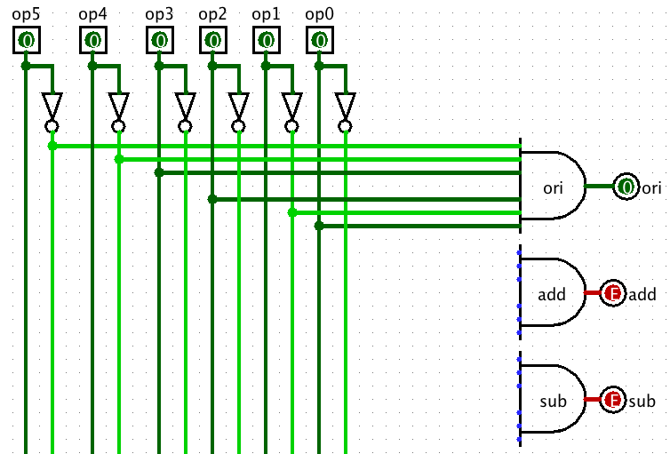
AND Control Logic in Logisim
Notes:
Logisim file called “Control Plane MIPS.circ”

Slide 21
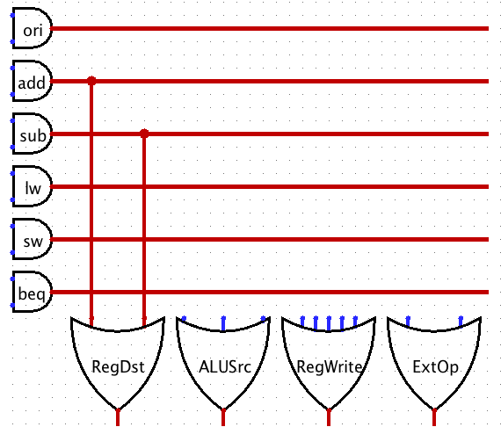
OR Control Logic in Logisim

Slide 22

Great Idea #1: Levels of Representation/Interpretation
Higher-Level Language Program (e.g. C)
temp = v[k];
v[k] = v[k+1];
v[k+1] = temp;
Compiler
lw $t0, 0($2)
lw $t1, 4($2)
sw $t1, 0($2)
sw $t0, 4($2)
CALL HOME, WE’VE MADE HARDWARE/SOFTWARE CONTACT!!!
Assembly Language Program (e.g. MIPS)
Assembler
0000 1001 1100 0110 1010 1111 0101 1000
1010 1111 0101 1000 0000 1001 1100 0110
1100 0110 1010 1111 0101 1000 0000 1001
0101 1000 0000 1001 1100 0110 1010 1111
Machine Language Program (MIPS)
Machine Interpretation
Hardware Architecture Description (e.g. block diagrams)
Architecture Implementation
Logic Circuit Description (Circuit Schematic Diagrams)

