Slide 1
HWP1
Hardware Programming
Introduction to digital systems
And structured digital design

Slide 2
Goal of this course
Learn to describe digital circuits with VHDL and implement them in an FPGA.

Slide 3
Instructors
Ron Verhagen VeRon@hr.nl
Harry Broeders BroJZ@hr.nl

Slide 4
Organization
Compulsory attendance
HWP1 structure:
  Lecture
    Five lectures: Tuesday: 1.5-hours p/w
  Lab exercise
    Full-time: Friday: 2.5 hours Online p/w
  Homework
    56.5 hours total
    Theory from the book
      “Circuit Design with VHDL” (Third Edition)
      Volnei A. Pedroni
      ISBN 978-0-262-04264-2
    Preparing assignments / writing code
    Making simulations at home / outside regular class times

Slide 5
Planning: theory
First week
  Introduction digital systems
  Introduction to FPGAs
  Structured digital Design
  Modelling concepts in VHDL
Second week
  Introduction VHDL
  Design verification
  Code structure and data types
Third week
  Combinational versus sequential design
  Concurrent and sequential code
  Signals and variables
Fourth week
  Components
  Generics
Fifth week
  Designing state machines

Slide 6
Planning: lab assignments
In the course manual you will find instructions on submitting
your assignments.
Week | Deadlines | Retake
1 | - | -
2 | 1 (deadline) | -
3 | 2 (deadline) | 1 (deadline)
4 | 3 (deadline) | 2 (deadline)
5 | 4 (deadline) | 3 (deadline)
6 | 5 (deadline) | 4 (deadline)
7 |  | 5 (deadline)
8 | Final assignment
 |  | Retake (HT1)

Slide 7
Earning your grade
In the course manual you will find the the following
 | Action | Completed
Step 1 | Complete all 5 Labs before starting on your final assignment | Yes
Step 2 | Final Assignment (FA) ingredients: | % (leerdoel)
2.1 | Architecture (schematics and drawings) with basic ** functionality | 20% (LD1)
2.2 | VHDL code of all architectural functions and justification in report | 40% (LD2,LD3)
2.3 | A functional VHDL Test Bench | 20% (LD4)
2.4 | A working FPGA prototype with the basic** functionality | 20% (LD5)
 | ** basic functionality (complexity) may be expanded to include additional features for a higher grade. This is agreed upon before starting this assignment. Basic functionality = 6
HT1 | Retake

Slide 8
Agenda
Introduction to digital systems and FPGAs
Structured digital design
Modelling concepts in VHDL

Slide 9
Computing realization
Software programmed processors: software flexibility, fixed instructions and performance is limited.
Application Specific Integrated Circuits (ASIC): expensive, time consuming, best performance.
Reconfigurable computing: high flexibility, good performance and fills the gap between hardware and software. This is the domain of FPGAs.

Slide 10
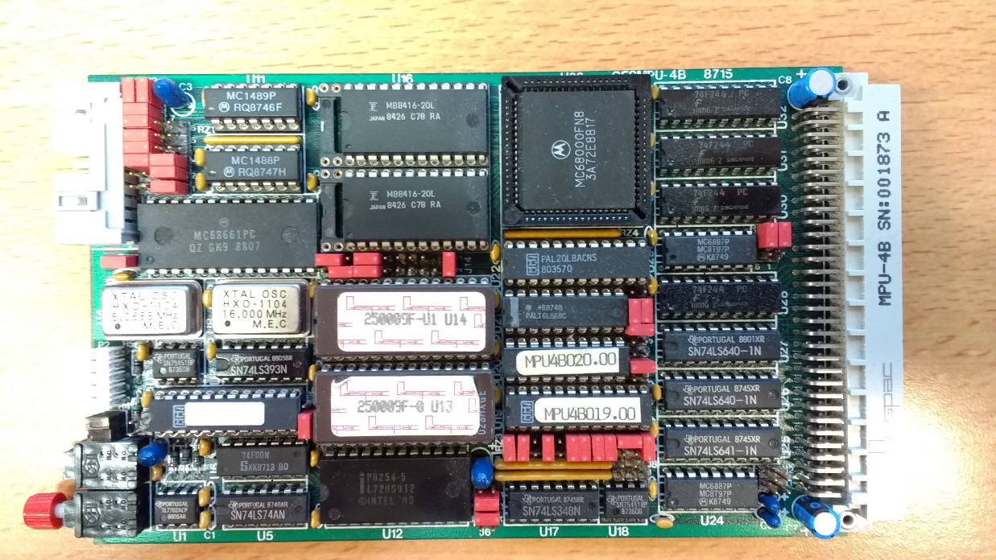
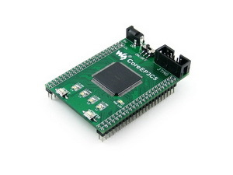
Digital Logic: 1980’s vs today FPGA
Field-programmable Gate Array (FPGA)

Slide 11
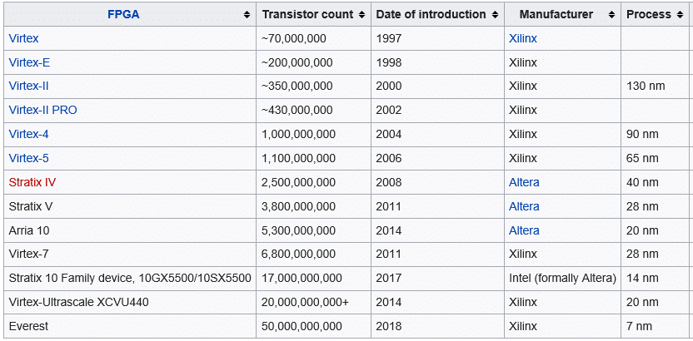
Transistor count for key FPGA families
Source: https://www.napatech.com/road-to-fpga-reconfigurable-computing/ 2018

Slide 12
Comparison
Field-programmable Gate Array (FPGA)
semiconductor versions of the Swiss Army Knife.
Microcontrollers vs. FPGA’s
Microcontroller | FPGA
Programming languages (C, C++, Assembly) Optimized for general purpose computing | Programming Languages VHDL, Verilog, Open Computing Language; Or use Schematics
Control over the Software; 10’s to 100’s of cores. | Control over the Hardware; Hardware timed execution; millions of progammable digital logic cells.
Predefined instruction set and datapath widths | No predefined instruction set or datapath widths
Reprogrammable - unlimited | Reconfigurable - unlimited

Slide 13
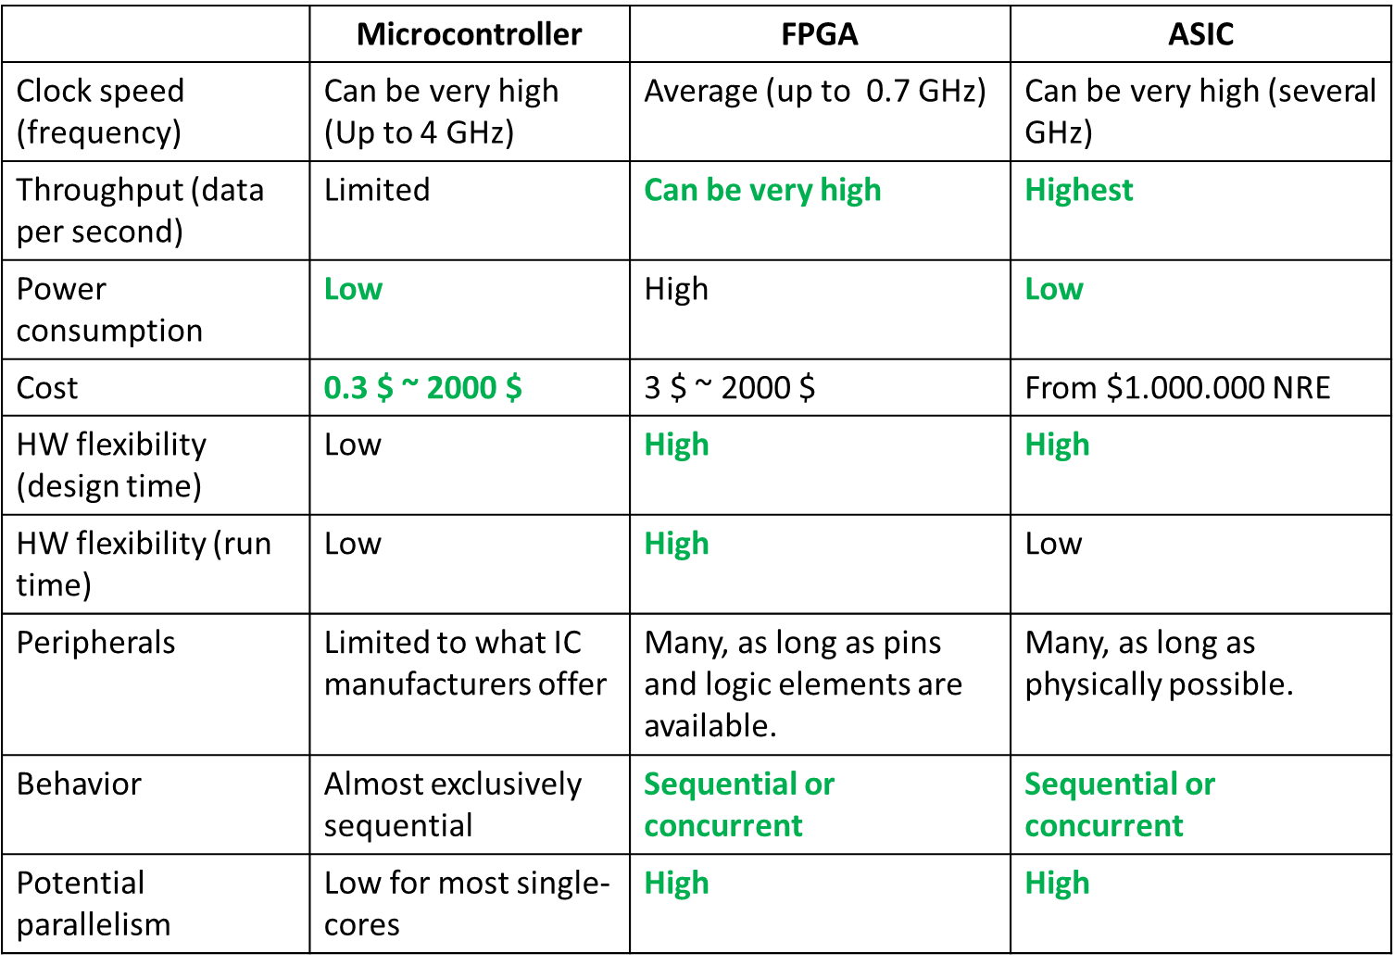

Slide 14
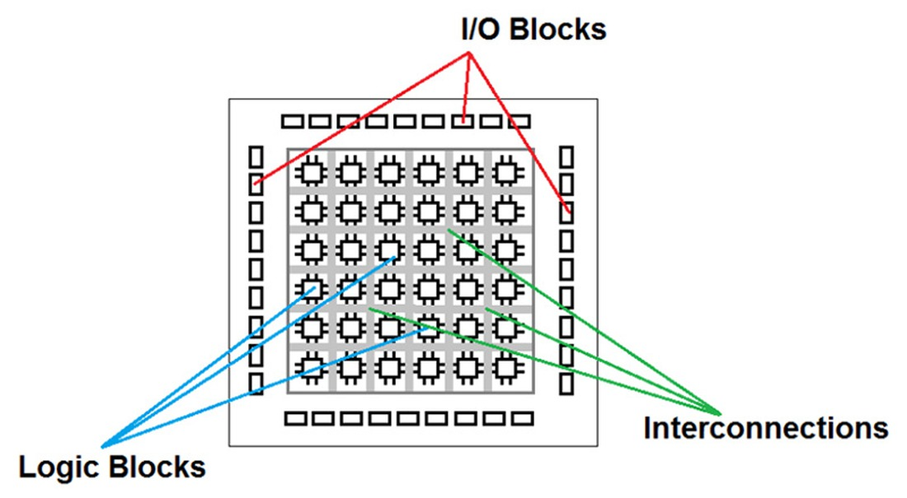
Technology
Digital component.
3 building blocks:

Slide 15
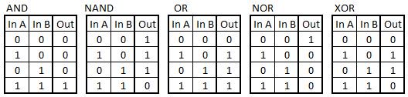
Technology – Logic Blocks
A basic logic building block is the Logic Element
Synthesis (programmed into the LUT)
LUT
A | B | C…F | OUTPUT
0 | 0 | X | 0
0 | 1 | X | 1
1 | 0 | X | 1
1 | 1 | X | 0
Logic Element
Output
If we bypass the flip-flop using the multiplexer, what is the function of this Logic Element?

Slide 16
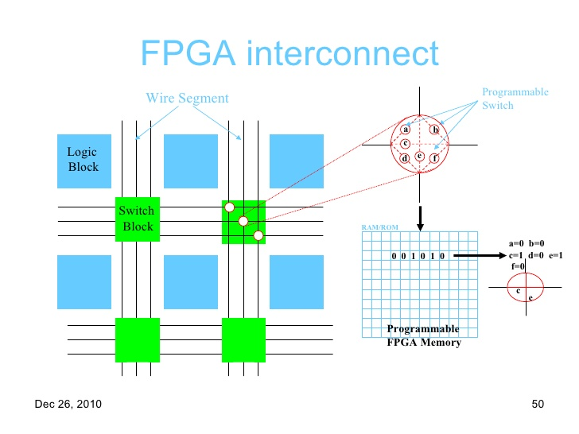
Technology - Interconnections

Slide 17
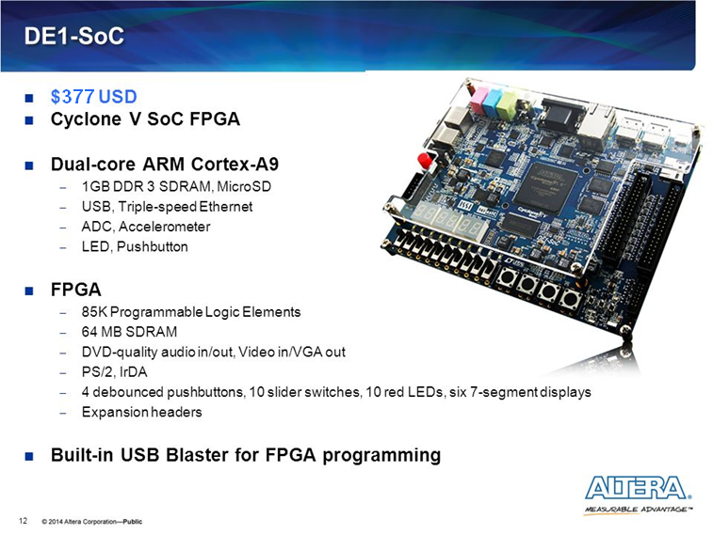
THE DE1 development BoarD

Slide 18
Agenda
Introduction to digital systems and FPGAs
Structured digital design
Modelling concepts in VHDL

Slide 19
Structured digital design
Determine the function you want to perform
  Architecture
Find a method to implement and test the function
  Implementation
  Simulation (TDD)
Use tools to materialize the method
  Realization
Verify your design
  Evaluation

Slide 20
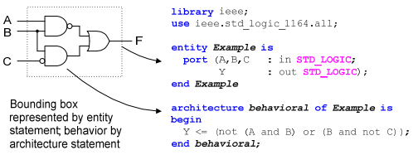
Example VHDL code
Y
Import the necessary libraries
Create an entity block.
  One per design
  Interface in and out of design unit
3. Describe architecture block
  Defines how the entity operates using Structural or Behavioral code.

Slide 21
From VHDL to FPGA
ENTITY inverter IS
PORT (a: IN STD_LOGIC;
b: OUT STD_LOGIC);
END inverter;
=
A
B
ARCHITECTURE voorbeeld OF inverter IS
BEGIN
b <= NOT(a);
END voorbeeld;
=
a
b

Slide 22
Structural decomposition
Top-down design: no constraints on the availability of hardware
Bottom-up design: design is conditioned by what’s available (e.g., the number of gates)
Typical dimensions for the Digital Design Space: speed, chip area (cost), power

Slide 23
Agenda
Introduction to digital systems and FPGAs
Structured digital design
Modelling concepts in VHDL

Slide 24
Simplified VHDL Design Flow
SYNTHESIS
Specifications
Whatever the final circuit inferred from the code is,
Its operation should always be verified by means of
Simulations.
VHDL code
Generate RTL functional Netlist
RTL functional Simulation
Analysis & Synthesis
Generate post synthesis functional Netlist
Post Synthesis functional Simulation
Place and Route
Generate post fitting Timing Netlist
Post fitting Timing Simulation
Generate Programming File
Download to Physical Device

Slide 25
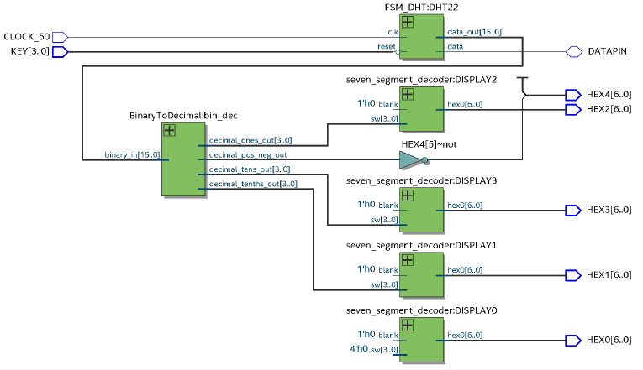
From VHDL to FPGA
Synthesize
  Simulate (Analysis & Elaboration)
  Compiles code into RTL (Register Transfer Level) schematic. Always take a look at this
Specifications
VHDL code
Analysis & Synthesis
Place and Route
Generate Programming File
Download to Physical Device

Slide 26
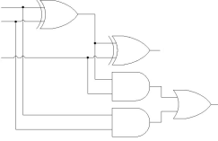
From VHDL to FPGA
Place and Route
  How to configure the FPGA elements to become the functional equivalent of the RTL schematic?
  Find the optimal paths through the FPGA
  Timing analysis
Generate bitstream
  Contains the setting of every switch in the FPGA
Specifications
VHDL code
Analysis & Synthesis
Place and Route
Place and Route
...to behave like this?
How to get this ...
Generate Programming File
Download to Physical Device

Slide 27
Modeling concepts in VHDL
Two abstract models to describe your design in VHDL
Behavioral Model:
  Defines how outputs are computed as function of inputs
  Can make use of a “process”
Structural Model:
  Uses pre-defined components to make a structure
  Wider use of “portmap”

Slide 28
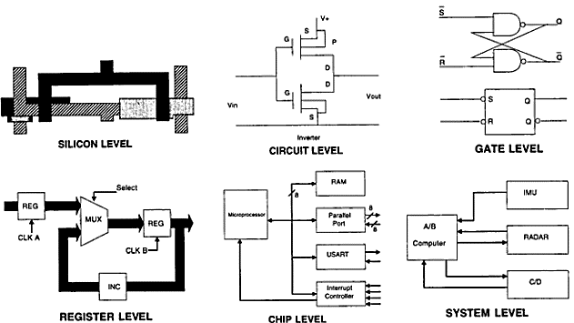
Modeling abstractions
Figure adapted from VHDL Design Representation and Synthesis.

Slide 29
Design verification
Check if your realization matches your expectations.
In VHDL we use test benches to verify the results.
In this course you will create test benches to verify your designs.
In (simple) simulations we don’t know if the actual design meets timing constraints. We will discuss this later.

Slide 30
Homework
Covered today:
  Introduction to digital design and FPGAs
  Structured design
  Modeling concepts in VHDL
Team up with another student
Start working on the laboratory
https://nandland.com/fpga-101/
https://fpgatutorial.com/vhdl/
Useful:
  Chapter 5 “Introduction to VHDL”
  Chapter 6 “Code Structure and Composition”
Next week:
  Chapter 7 and 8 “Predefined and User-Defined Data Types”
  Chapter 9 “Operators and Attributes”
  Chapter 18 “Introduction to Simulation with Testbenches”

Slide 31
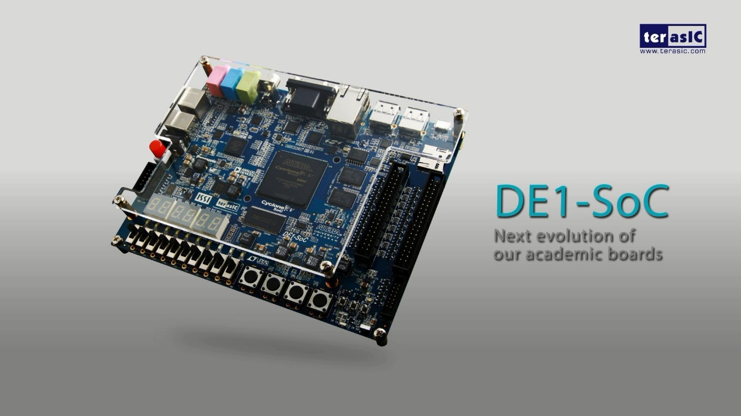
First week: Lab
Introductory Assignment 1
  Getting to know Quartus
  Getting to know ModelSim
  Getting to know the DE1 SoC development and Education Board

