Slide 1
Real-Time Systems (RTS1) Introduction

Slide 2
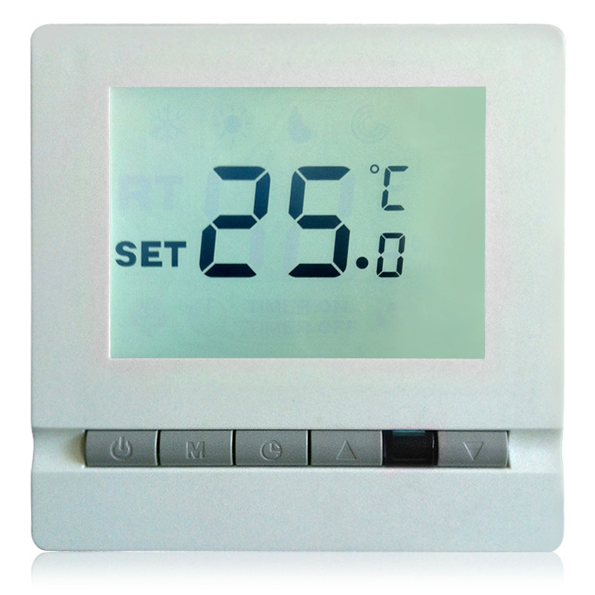
What is an embedded system?
Traditional
  Specific purpose
  Very limited resources
  Very limited interface

Slide 3
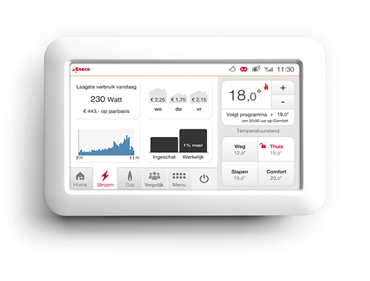
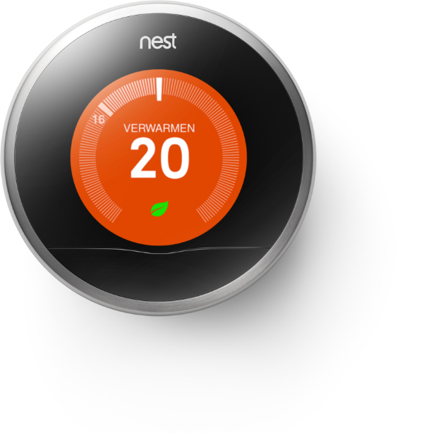
What is an embedded system?
Modern
  Limited set of purposes
  Bigger but still limited resources
  Intuitive interface
  Connected to the IoT

Slide 4
Problem with modern applications
Reading out multiple sensors to drive multiple actuators while performing multiple algorithms while responding within a set period of time
One CPU / Microcontroller
Limited I/O
Limited processing power
Limited time
Creating suitable software that is independent of the type and number of sensors and actuators allowing precise control over the use of time

Slide 5

What is a real-time system?
  System for which the response times for unpredictable inputs must be predictable.
  System for which the output must not only be correct but also on the right time.

Slide 6
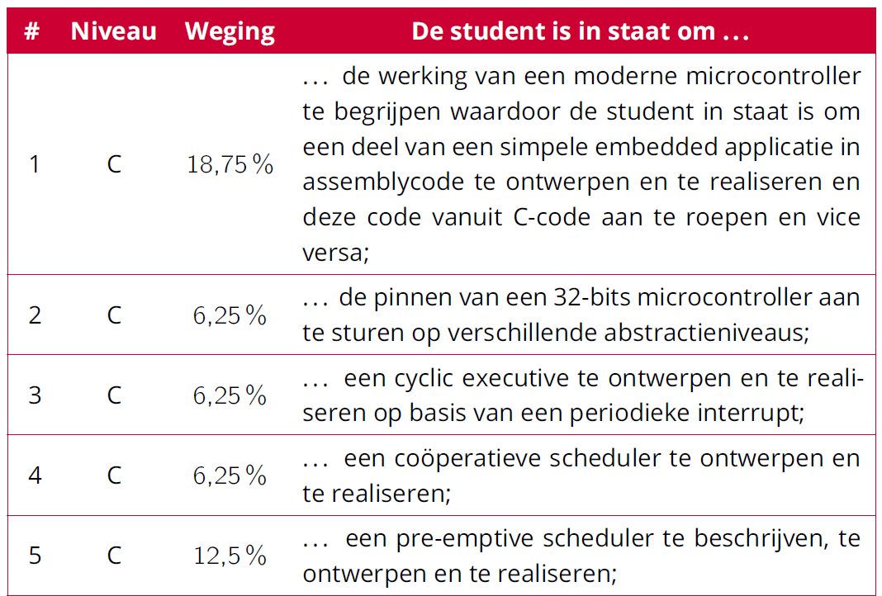
Leerdoelen RTS1

Slide 7
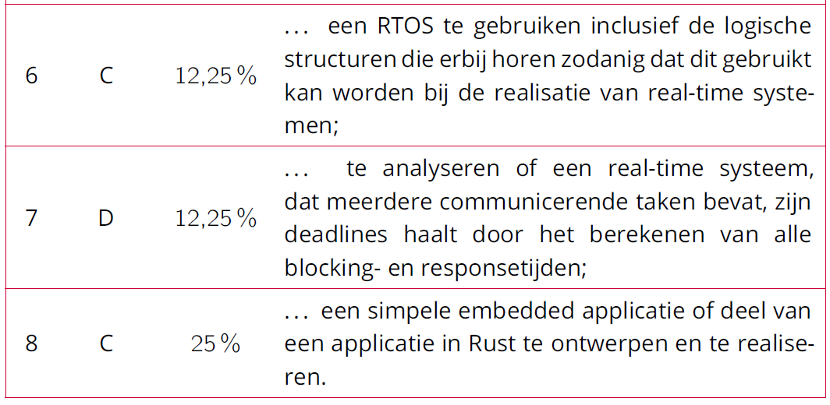
Leerdoelen RTS1
Zie Cursushandleiding_RTS1

Slide 8

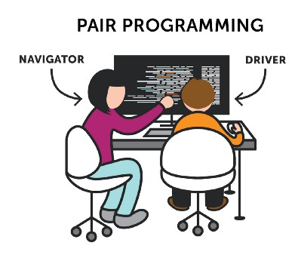
Pair programming
You work, and are graded, in pairs
pairing is done by the instructors
Lessons:
Off- and online
https://medium.com/@tomspencer_uk/pair-programming-and-problem-solving-4531ef3bf171

Slide 9
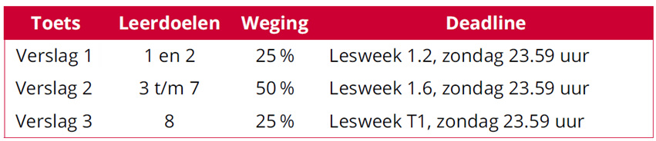
Toetsing
Zie Cursushandleiding_RTS1

Slide 10
Planning
Week 1: Inleiding microcontrollerarchitectuur en STM32F411E-DISCO
Week 2: Microcontrollerarchitectuur en programmeren in C
Week 3: Cyclic executive en coöperatieve scheduler
Week 4: Pre-emptive scheduler
Week 5: FreeRTOS en pthreads
Week 6: Schedulability en response time analyses
Week 7: Inleiding Rust
Week 8: Embedded Rust

Slide 11
Studielast
6 studiepunten
=
2 dagen werk per week!

