Slide 1
RTS1 Week 1

Slide 2
Leerdoelen Week 1 Theoriedeel
Leerdoelen week 1 theoriedeel. Je leert:
de ARM Cortex processor familie kennen;
een vereenvoudigde versie van de ARMv7-M architectuur, de LEGv7-M architectuur, kennen;
een vereenvoudigde versie van de Thumb instructieset, de Pinky instructieset, kennen;
assembleertaalprogramma’s te schrijven in Pinky;
Pinky assembly om te zetten naar machinecode (encoden);
Pinky machinecode om te zetten naar assembly (decoden).
Studiemateriaal: De LEGv7 architectuur en de Pinky instructieset

Slide 3
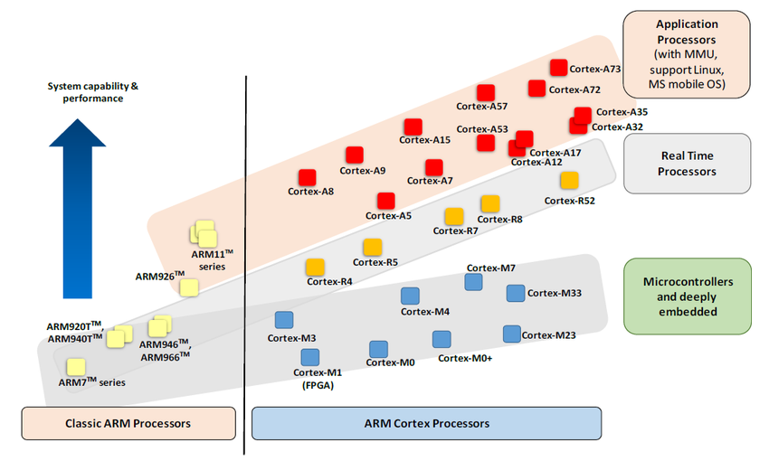
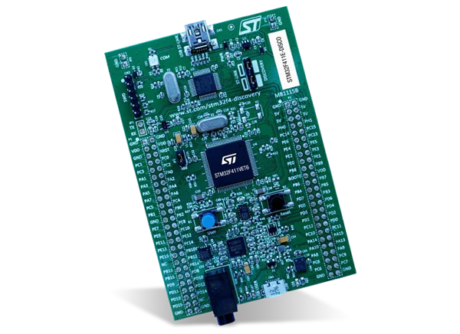
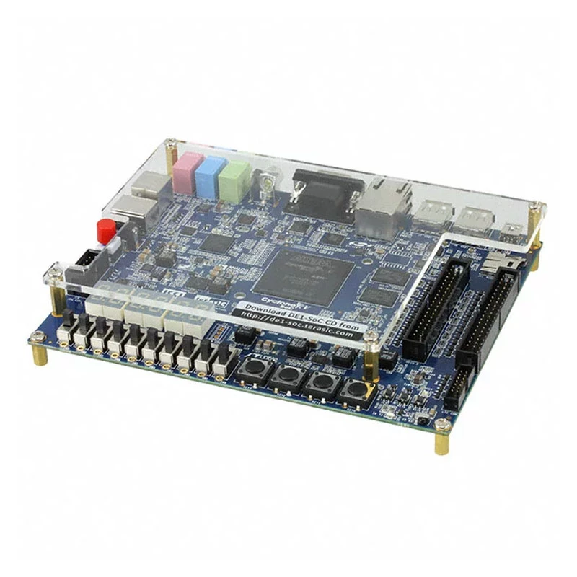
ARM Cortex Processor Family

Slide 4

Source Reference
The material in this presentation is inspired by chapter 2 of the book:
  Computer Organization and Design
    The Hardware / Software Interface
      ARM Edition
      David A. Patterson, John L. Hennessy
      ISBN: 9780128017333
Main differences:
  The book uses ARMv8 Cortex-A , I use ARMv7 Cortex-M
  The book uses ARM instructions, I use Thumb instructions

Slide 5
Agenda
Instruction Set
Operations and Operands
Representing Instructions in the Computer
Logical Operations
Instructions for Making Decisions
LEGv7 Addressing for 32-bits Literals
Supporting Functions in Computer Hardware

Slide 6
Agenda
Instruction Set
Operations and Operands
Representing Instructions in the Computer
Logical Operations
Instructions for Making Decisions
LEGv7 Addressing for 32-bits Literals
Supporting Functions in Computer Hardware

Slide 7
Instructions: The language of the computer
  How to tell a computer what to do?
  Bits are the letters of the computer
  Instructions are the words of the computer
    An instruction is a collection of bits
  The instruction set is the vocabulary of the computer
    An instruction set is a collection of instructions

Slide 8
Instruction Set
  The repertoire of instructions of a computer
  Different computers have different instruction sets
    But with many aspects in common

Slide 9
The ARMv7 Thumb Instruction Set
  A subset, called LEGv7 Pinky, used as the example throughout these lessons
  Commercialized by ARM Holdings (www.arm.com)
  Large share of embedded core market
    Applications in consumer electronics, network/storage equipment, cameras, printers, …
  Typical of many modern ISAs
    See De LEGv7 architectuur en de Pinky instructieset

Slide 10
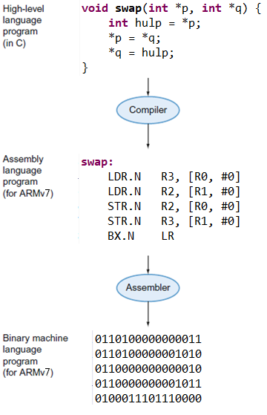
Levels of Program Code
  High-level language
    Level of abstraction closer to problem domain
    Provides for productivity and portability
  Assembly language
    Textual representation of instructions
  Hardware representation
    Binary digits (bits)
    Encoded instructions and data

Slide 11
Agenda
Instruction Set
Operations and Operands
Representing Instructions in the Computer
Logical Operations
Instructions for Making Decisions
Supporting Functions in Computer Hardware
LEGv7 Addressing for 32-bits Literals

Slide 12
Arithmetic Operations
  Add and subtract, three operands
    Two sources and one destination
  ADDS.N a, b, c // a gets b + c
  SUBS.N a, b, c // a gets b - c
  S means that the instruction is updating condition flags (N = Negative, Z = Zero, V = oVerflow, C = Carry) in the Program Status Register
  N means Narrow (16-bits instruction)

Slide 13
Arithmetic Example
C code:
f = (g + h) - (i - h);
Compiled LEGv7 Pinky code:
ADDS.N t0, g, h
SUBS.N t1, i, h
SUBS.N f, t0, t1
Processor does not work with variables but with registers

Slide 14
Memory Hierarchy
The ALU can only operate on values that are inside the registers
Not directly from the main memory!
Need to LOAD stuff from main memory

Slide 15
Register Operands
  Arithmetic instructions use register operands
  LEGv7 has an 8 × 32-bits register file
    Use for frequently accessed data
    32-bits data is called a “word”
      8 x 32-bits general purpose registers R0 to R7

Slide 16
LEGv8 Registers

Slide 17
Program Status Register
  Consists of three overlapping registers
    Application Program Status Register (APSR)
    Interrupt Program Status Register (IPSR)
    Execution Program Status Register (EPSR)
  T bit indicates that Thumb (Pinky) instructions are executed

Slide 18
Arithmetic Example
C code:
f = (g + h) - (i - h);
  f, g, h, i in R4, R5, R6, R7
Compiled LEGv7 Pinky code:
ADDS.N R0, R5, R6
SUBS.N R1, R7, R6
SUBS.N R4, R0, R1

Slide 19
Arithmetic Example (Alternative)
C code:
f = (g + h) - (i - h);
  f, g, h, i in R4, R5, R6, R7
Compiled LEGv7 Pinky code:
ADDS.N R4, R5, R6
SUBS.N R4, R4, R7
ADDS.N R4, R4, R6
No temporary use of registers needed

Slide 20
Memory Operands
  Main memory used for composite data
    Arrays, structures, dynamic data
  To apply operations
    Load values from memory into registers
    Store result from register to memory
  Memory is byte addressed
    Each address identifies an 8-bit byte
  LEGv7 does not require words to be aligned in memory, except for instructions (must be halfword aligned) and the stack (must be word aligned)
    But unaligned loads/stores take 2 (halfword, not word aligned) or 3 (not halfword aligned) clock cycles extra

Slide 21
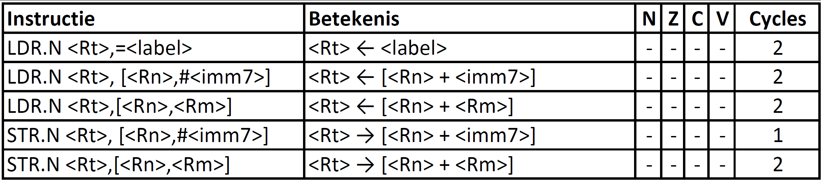
Load / Store instructions
#<imm7> is a 7-bits unsigned immediate offset (0 t/m 127) that is dividable by 4

Slide 22
Arithmetic Example (Alternative)
C code:
int a[] = {1,2,3,4,5,6,7,8,9};
a[8] = h + a[3];
  h in R4, base address of a in R5
Compiled LEGv7 Pinky code:
LDR.N R0, [R5, #12]
ADDS.N R1, R4, R0
STR.N R1, [R5, #32]

Slide 23
Registers versus Memory
  Registers are faster to access than memory
  Operating on memory data requires loads and stores
    More instructions to be executed
  Compiler must use registers for variables as much as possible
    Only spill to memory for less frequently used variables
    Register optimization is important!

Slide 24
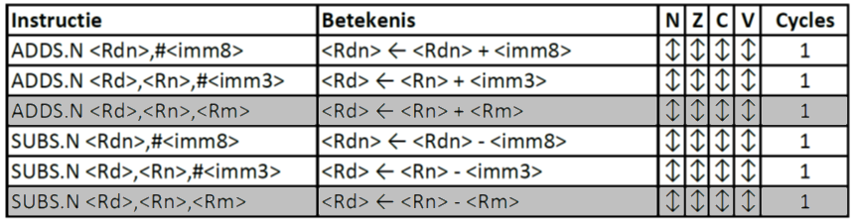
Immediate Operands
  Constant data specified in an instruction
    <imm3> = 0 t/m 7, <imm8> = 0 t/m 255
  Make the common case fast
    Small constants are common
    Immediate operand avoids a load instruction

Slide 25
Signed and Unsigned Numbers
  I skip this part of the lecture because I assume you already now this stuff.
  You maybe have to study it yourself!

Slide 26
Unsigned Binary Integers
>>
Range: 0 to +2^{n} – 1
Example
  0000 0000 0000 0000 0000 0000 0000 1011₂
  = 0 + … + 1×2³ + 0×2² +1×2¹ +1×2⁰
  = 0 + … + 8 + 0 + 2 + 1 = 11₁₀
Using 32 bits
  0 to +4,294,967,295

Slide 27
2s-Complement Signed Integers
>>
Range: –2^{n – 1} to +2^{n – 1} – 1
Example
  1111 1111 1111 1111 1111 1111 1111 1100₂
  = –1×2³¹ + 1×2³⁰ + … + 1×2² +0×2¹ +0×2⁰
  = –2,147,483,648 + 2,147,483,644 = –4₁₀
Using 32 bits
  –2,147,483,648 to +2,147,483,647

Slide 28
2s-Complement Signed Integers
>>
  Bit 31 is sign bit
    1 for negative numbers
    0 for non-negative numbers
  –(–2^{n – 1}) can’t be represented
  Non-negative numbers have the same unsigned and 2s-complement representation
  Some specific numbers
    0: 0000 0000 … 0000
    –1: 1111 1111 … 1111
    Most-negative: 1000 0000 … 0000
    Most-positive: 0111 1111 … 1111

Slide 29
Signed Negation
>>
  Complement and add 1
    Complement means 1 → 0, 0 → 1
  Example: negate +2
    +2 = 0000 0000 … 0010_{two}
    –2 = 1111 1111 … 1101_{two} + 1
    –2 = 1111 1111 … 1110_{two}

Slide 30
Sign Extension
>>
  Representing a number using more bits
    Preserve the numeric value
  Replicate the sign bit to the left
    c.f. unsigned values: extend with 0s
  Examples: 8-bit to 16-bit
    +2: 0000 0010 => 0000 0000 0000 0010
    –2: 1111 1110 => 1111 1111 1111 1110

Slide 31
Agenda
Instruction Set
Operations and Operands
Representing Instructions in the Computer
Logical Operations
Instructions for Making Decisions
LEGv7 Addressing for 32-bits Literals
Supporting Functions in Computer Hardware

Slide 32
Representing Instructions
  Instructions are encoded in binary
    Called machine code
  LEGv7 Pinky instructions
    Encoded as 16-bit instruction words
    Small number of formats encoding operation code (opcode), register numbers, …
    Regularity!

Slide 33
Hexadecimal
>>
  Base 16
    Compact representation of bit strings
    4 bits per hex digit
0 | 0000 | 4 | 0100 | 8 | 1000 | C | 1100
1 | 0001 | 5 | 0101 | 9 | 1001 | D | 1101
2 | 0010 | 6 | 0110 | A | 1010 | E | 1110
3 | 0011 | 7 | 0111 | B | 1011 | F | 1111
  Example: ECA8
    1110 1100 1010 1000

Slide 34
Arithmetic instructions encoding
  Instruction fields
    Opcode (b₁₅ – b₉): operation code
    Rm (b₈ – b₆): the second register source operand
    Rn (b₅ – b₃): the first register source operand
    Rd (b₂ – b₀): the register destination

Slide 35
Arithmetic instructions encoding
  Encode into LEGv7 machine language:
  ADDS.N R0, R5, R6
  SUBS.N R1, R7, R6
  SUBS.N R4, R0, R1

Slide 36
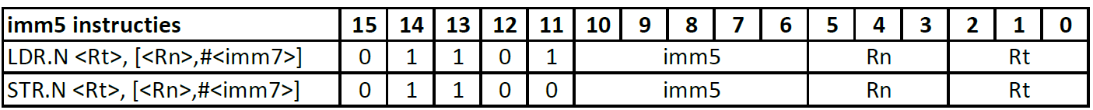
Load / Store instructions encoding
Rn: base register
Rt: destination (load) or source (store) register
#<imm7> is a 7-bits unsigned immediate offset (0 t/m 127) that must be divisble by 4
imm5 = <imm7> / 4

Slide 37
Load / Store instructions encoding
  Encode into LEGv7 machine language:
  LDR.N R0, [R5, #12]
  ADDS.N R1, R4, R0
  STR.N R1, [R5, #32]

Slide 38
Agenda
Instruction Set
Operations and Operands
Representing Instructions in the Computer
Logical Operations
Instructions for Making Decisions
LEGv7 Addressing for 32-bits Literals
Supporting Functions in Computer Hardware

Slide 39
Logical Operations
  Instructions for bitwise manipulation
Operation | C | LEGv7 Pinky
Shift left | << | LSLS.N
Shift right | >> (unsigned) | LSRS.N
Bit-by-bit AND | & | ANDS.N
Bit-by-bit OR | | | ORRS.N
Bit-by-bit EXOR | ^ | EORS.N
  Useful for extracting and inserting groups of bits in a word

Slide 40
Shift Operations
  <imm5>: (0 – 31) how many positions to shift
  Shift left logical
    Shift left and fill with 0 bits, shift through C-flag
    LSL by i bits multiplies by 2^{i}
  Shift right logical
    Shift right and fill with 0 bits, shift through C-flag
    LSR by i bits divides by 2^{i} (unsigned only)

Slide 41
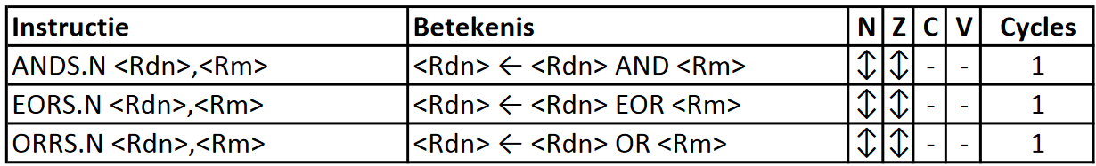
Logical Bitwise Operations

Slide 42
AND Operations
>>
  Useful to mask bits in a word
    Set some bits to 0, leave others unchanged
  ANDS.N R4,R5
R4
01010101 10101010 00110011 11001100
R5
11111111 00000000 00000000 11110000
R4
01010101 00000000 00000000 11000000

Slide 43
OR Operations
>>
  Useful to include bits in a word
    Set some bits to 1, leave others unchanged
  ORRS.N R4,R5
R4
01010101 10101010 00110011 11001100
R5
11111111 00000000 00000000 11110000
R4
11111111 10101010 00110011 11111100

Slide 44
EOR Operations
>>
  Differencing operation
    Invert (flip) some bits, leave others unchanged
  EORS.N R4,R5
R4
01010101 10101010 00110011 11001100
R5
11111111 00000000 00000000 11110000
R4
10101010 10101010 00110011 00111100

Slide 45
Shift Example
C code:
// f = (g + h) - (i - h);
f = g + 2*h - i;
  f, g, h, i in R4, R5, R6, R7
Compiled LEGv7 Pinky code:
LSLS.N R0, R6, #1
ADDS.N R1, R5, R0
SUBS.N R4, R1, R7

Slide 46
Move Instruction
MOVS.N <Rd>, <Rm>
Is encoded as:
LSLS.N <Rd>, <Rm>, #0
MOVS.N <Rd>, <Rm> is a pseudo instruction
It doesn’t have its own machine code

Slide 47
Agenda
Instruction Set
Operations and Operands
Representing Instructions in the Computer
Logical Operations
Instructions for Making Decisions
LEGv7 Addressing for 32-bits Literals
Supporting Functions in Computer Hardware

Slide 48
Conditional Operations
  Branch to a labeled instruction if a condition is true
    Otherwise, continue sequentially
  CBZ.N register, L1
    if (register == 0) branch forward to instruction labeled L1:
  CBNZ.N register, L1
    if (register != 0) branch forward to instruction labeled L1:
  B.N L1
    branch unconditionally to instruction labeled L1:
CBZ = Compare and Branch if Zero

Slide 49
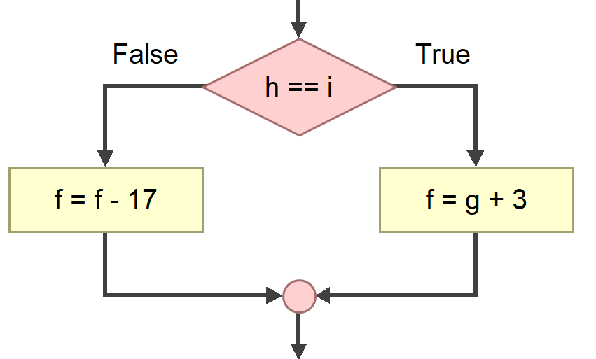
Compiling If Statements
  C code:
  if (h == i) f = g + 3;
  else f = f - 17;
    f, g, h, i in R4, R5, R6, R7
Compiled LEGv7 Pinky code:
SUBS.N R0, R6, R7
CBNZ.N R0, else
ADDS.N R4, R5, #3
B.N endif
else: SUBS.N R4, #17
endif:
Branch is performed by adding an offset to PC
Assembler calculates offsets

Slide 50
Encoding Branch Instructions
Encode the following LEGv7 Pinky code:
SUBS.N R0, R6, R7
CBNZ.N R0, else
ADDS.N R4, R5, #3
B.N endif
else: SUBS.N R4, #17
endif:
See Appendix B De LEGv7 architectuur en de Pinky instructieset

Slide 51
Compiling Loop Statements
  C code:
  int i = 0;
  while (save[i] == k) i += 1;
    i in R4, k in R5, address of save in R6
Compiled LEGv7 Pinky code:
MOVS.N R4, #0
while: LSLS.N R0, R4, #2
LDR.N R1, [R6, R0]
SUBS.N R2, R1, R5
CBNZ.N R2, endwhile
ADDS.N R4, R4, #1
B.N while
endwhile:
Branch is performed by adding an offset to PC
Assembler calculates offsets

Slide 52
Better Compiling Loop Statements
  C code:
  int i = 0;
  while (save[i] == k) i += 1;
    i in R4, k in R5, address of save in R6
Compiled LEGv7 Pinky code:
MOVS.N R4, #0
while: LDR.N R0, [R6, R4]
SUBS.N R1, R0, R5
CBNZ.N R1, endwhile
ADDS.N R4, R4, #4
B.N while
endwhile: LSRS.N R4, #2
One less instruction in loop

Slide 53
More Conditional Operations
  Condition codes, set from instruction with S-suffix (ADDS, ANDS, SUBS, ….)
    negative (N): result had 1 in MSB
    zero (Z): result was 0
    overflow (V): result sign overflowed
    carry (C): result had carryout from MSB
  Use CMP.N, then conditionally branch:
    B.EQ (equal)
    B.NE (not equal)
    B.LT (less than, < signed), B.LO (lower, < unsigned)
    B.LE (less than or equal, ≤ signed), B.LS (lower or same, ≤ unsigned)
    B.GT (greater than, > signed), B.HI (higher, > unsigned)
    B.GE (greater than or equal, ≥ signed), B.HS (higher or same, ≥ unsigned)
CMPS.N would have been a better name

Slide 54
Signed versus Unsigned
  Signed comparison ≠ Unsigned comparison
  Example
    R0 = 1111 1111 1111 1111 1111 1111 1111 1111
    R1 = 0000 0000 0000 0000 0000 0000 0000 0001
    R0 ? R1 signed
      –1 < +1
    R0 ? R1 unsigned
      +4294967295 > +1
<
>

Slide 55
B<c>.N condities

Slide 56
Conditional Example
C code:
int a, b;
if (a > b) a += 1;
  a, b in R4, R5
Compiled LEGv7 Pinky code:
CMP.N R4, R5
BLE.N exit
ADDS.N R4, #1
exit:
Note: condition in B<c>.N is complement of condition in if

Slide 57
Conditional Example
C code:
unsigned int a, b;
if (a > b) a += 1;
  a, b in R4, R5
Compiled LEGv7 Pinky code:
CMP.N R4, R5
BLS.N exit
ADDS.N R4, #1
exit:

Slide 58
Agenda
Instruction Set
Operations and Operands
Representing Instructions in the Computer
Logical Operations
Instructions for Making Decisions
LEGv7 Addressing for 32-bits Literals
Supporting Functions in Computer Hardware

Slide 59
Load 32-bit literal in register
MOVS.N Rd, #<imm8> can be used to load an 8-bits unsigned constant in Rd.
How to load a 32-bits constant in Rd with a 16-bits instruction?
Literal addressing mode:
  LDR.N R6, =0x1234567
Is encoded as:
  LDR.N R6, [PC, #offset]
  //...
  .word 0x1234567 // literal section
Instead of a constant, a label can be used (to load an address)
Note: offset is 10-bits unsigned which should be dividable by 4

Slide 60
Agenda
Instruction Set
Operations and Operands
Representing Instructions in the Computer
Logical Operations
Instructions for Making Decisions
LEGv7 Addressing for 32-bits Literals
Supporting Functions in Computer Hardware

Slide 61
Subroutine (Function) Calling
Steps required:
Place parameters in registers R0 to R3
Transfer control to function
Acquire local storage for function
Perform function’s operations
Place result in register R0 for caller
Return to place of call (address in LR)

Slide 62
Function Call Instructions
  Function call: Branch with Link and eXchange
  LDR.N R4, =FunctionLabel
  BLX.N R4
    Address of following instruction put in LR (Link Register)
    Jumps to target address
  Function return: Branch and eXchange
  BX.N LR
  Copies LR to program counter
    Can also be used for computed jumps
      e.g., for case/switch statements or jump to function pointers

Slide 63

T-bit
When the PC is loaded (e.g. by BLX or BX) bit 0 is copied to the T-bit.
This way the processor can switch (eXchange) between the Thumb and ARM instruction sets.
ARM Cortex-M only supports Thumb and raises an exception when T is 0.

Slide 64
Register Usage
  R0 to R3: temporary registers
    Used to pass arguments to functions and pass return value
    Not preserved by the callee
  R4 to R7: saved registers
    If used, the callee saves and restores them
Callee = function which is called
ARM Call Convention
Should we follow this convention?

Slide 65
Leaf Function Example
  C code:
  int leaf_example(int g, int h, int i, int j) {
  int f;
  f = (g + h) - (i - j);
  return f;
  }
Compiled LEGv7 Pinky code:
.thumb_func
leaf_example:
ADDS.N R0, R0, R1
SUBS.N R2, R2, R3
SUBS.N R0, R0, R2
BX.N LR

Slide 66
Leaf Function Example
  C code:
  int leaf_example(int g, int h, int i, int j) {
  int f;
  f = (g + h) - (i - j);
  return f;
  }
Compiled LEGv7 Pinky code:
.thumb_func
leaf_example:
ADDS.N A1, A1, A2
SUBS.N A3, A3, A4
SUBS.N A1, A1, A3
BX.N LR
R0 to R3 may also be called A1 to A4

Slide 67
Leaf Function Call Example
  C code:
  int a, b, c, d;
  //...
  a = leaf_example(b, c, d, c);
    a to d in R4 to R7
Compiled LEGv7 Pinky code:
MOVS.N R0, R5
MOVS.N R1, R6
MOVS.N R2, R7
MOVS.N R3, R6
LDR.N R4, =leaf_example
BLX.N R4
MOVS.N R4, R0

Slide 68
Leaf Function Call Example
  C code:
  int a, b, c, d;
  //...
  a = leaf_example(b, c, d, c);
    a to d in R4 to R7 (V1 to V4)
Compiled LEGv7 Pinky code:
MOVS.N A1, V2
MOVS.N A2, V3
MOVS.N A3, V4
MOVS.N A4, V3
LDR.N V1, =leaf_example
BLX.N V1
MOVS.N V1, A1
R4 to R7 may also be called V1 to V4

Slide 69
Leaf Function Example
  C code:
  int leaf_example(int g, int h, int i, int j) {
  int f = (g + h) - (i + j);
  // more code which needs g, h, i and j
  return f;
  }
Compiled LEGv7 Pinky code:
.thumb_func
leaf_example:
ADDS.N R4, R0, R1
SUBS.N R5, R2, R3
// more code which needs R0, R1, R2 and R3
SUBS.N R0, R4, R5
BX.N LR
Does not conform to ARM ABI
What’s wrong?
Where to temporary store R4 and R5?

Slide 70
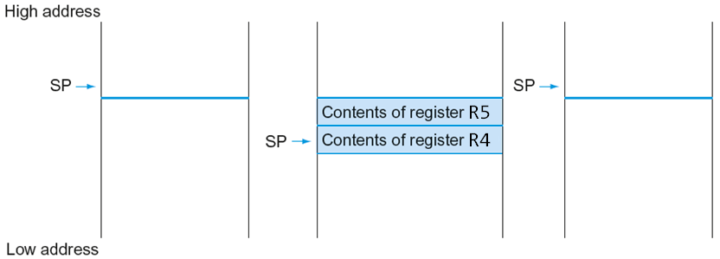
Local Data on the Stack
Before function call
During function call
After function call

Slide 71
Leaf Function Example
Compiled LEGv7 Pinky code:
.thumb_func
leaf_example:
PUSH.N {R4, R5}
ADDS.N R4, R0, R1
SUBS.N R5, R2, R3
// more code which needs R0, R1, R2 and R3
SUBS.N R0, R4, R5
POP.N {R4, R5}
BX.N LR

Slide 72
Leaf Function Example
  C code:
  unsigned int gcd(unsigned int a, unsigned int b) {
  while (a != b) {
  if (a > b) {
  a = a – b;
  }
  else {
  b = b – a;
  }
  }
  return a;
  }
Compiled LEGv7 Pinky code:
https://en.wikipedia.org/wiki/Euclidean_algorithm

Slide 73
Leaf Function Example
Compiled LEGv7 Pinky code:
.thumb_func
gcd: CMP.N R0, R1
BEQ.N end
BLS.N else
SUBS.N R0, R0, R1
B.N gcd
else: SUBS.N R1, R1, R0
B.N gcd
end: BX.N LR

Slide 74
Non-Leaf Function Example
  C code:
  bool is_coprime(unsigned int a, unsigned int b) {
  return gcd(a, b) == 1;
  }
Compiled LEGv7 Pinky code:
.thumb_func
is_coprime:
LDR.N R2, =gcd
PUSH.N {LR}
BLX.N R2
CMP.N R0, #1
BEQ.N end
MOVS.N R0, #0
end: POP.N {PC}
https://en.wikipedia.org/wiki/Coprime_integers

Slide 75
More examples to study @Home

Slide 76
Encoding Functions
Encode the following LEGv7 Pinky code:
LDR.N R4, =leaf_example
BLX.N R4
MOVS.N R4, R0
end: B.N end
.thumb_func
leaf_example:
ADDS.N R0, R0, R1
SUBS.N R2, R2, R3
SUBS.N R0, R0, R2
BX.N LR
See Appendix B De LEGv7 architectuur en de Pinky instructieset

Slide 77
Decode
Decode the following LEGv7 Pinky machine code
0110100000000011
0110100000001010
0110000000000010
0110000000001011
0100011101110000
Can you guess which function this is?
See Appendix C De LEGv7 architectuur en de Pinky instructieset

Slide 78
Decode
Decode the following LEGv7 Pinky machine code
1bf0
b908
1cec
e001
002c
3c11
See Appendix C De LEGv7 architectuur en de Pinky instructieset

Slide 79
Recursive Function Example
  C code:
  unsigned int fib(unsigned int n) {
  if (n < 2) {
  return n;
  }
  return fib(n-1) + fib(n-2);
  }
Compiled LEGv7 Pinky code:
https://en.wikipedia.org/wiki/Fibonacci_number

Slide 80
Recursive Function Example
.thumb_func
fib: CMP.N R0, #2
BHS.N endif
BX.N LR
endif: PUSH.N {R4, R5, R6, LR}
LDR.N R4, =fib
MOVS.N R5, R0
SUBS.N R0, #1
BLX.N R4
MOVS.N R6, R0
MOVS.N R0, R5
SUBS.N R0, #2
BLX.N R4
ADDS.N R0, R0, R6
POP.N {R4, R5, R6, PC}
372135 clock cycles to calculate fib(20)

Slide 81
Recursive Function Example
.thumb_func
fib: LDR.N R1, =fib_r
.thumb_func
fib2_r: CMP.N R0, #2
BHS.N endif
BX.N LR
endif: PUSH.N {R0, R4, LR}
SUBS.N R0, #1
BLX.N R1
MOVS.N R2, R0
LDR.N R0, [SP, #0]
SUBS.N R0, #2
BLX.N R1
ADDS.N R0, R0, R2
POP.N {R2, R4, PC} // R2 is dummy
328357 clock cycles to calculate fib(20)

Slide 82
Better Non-Recursive fib(n)
.thumb_func
fib: CMP.N R0, #2
BLO.N end
endif: SUBS.N R3, R0, #1
MOVS.N R2, #0
MOVS.N R1, #1
loop: ADDS.N R0, R1, R2
MOVS.N R2, R1
MOVS.N R1, R0
SUBS.N R3, #1
BNE.N loop
end: BX.N LR
121 clock cycles to calculate fib(20)
Geef de C code voor unsigned int fib(unsigned int n)

Slide 83
Volgende les…
Theorie:
Hardware implementatie van een vereenvoudigde versie van de LEGv7-M architectuur
Deze implementatie versnellen door het toepassen van:
  een pipeline
  branch prediction
  cache geheugen
Lab:
Aansturen van leds op verschillende abstractieniveaus.

Slide 84
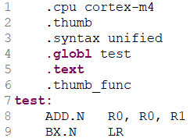

Aan de slag!
Aan de slag met Opdrachten_Week_1.pdf

