Slide 1
RTS1 Week 2

Slide 2
Leerdoelen Week 2 Theoriedeel
Leerdoelen week 2 theoriedeel. Je leert:
hoe een vereenvoudigde versie van de ARMv7-M architectuur, de LEGv7-M architectuur, in hardware geïmplementeerd kan worden;
deze implementatie versnelt kan worden door het toepassen van:
  een pipeline;
  branch prediction;
  cache geheugen.

Slide 3

Source Reference
The material in this presentation is inspired by chapter 4 of the book:
  Computer Organization and Design
    The Hardware / Software Interface
      ARM Edition
      David A. Patterson, John L. Hennessy
      ISBN: 9780128017333
Main differences:
  The book uses ARMv8 Cortex-A , I use ARMv7 Cortex-M
  The book uses ARM instructions, I use Thumb instructions

Slide 4
Agenda
A one cycle implementation of LEGv7-M
A pipelined implementation of LEGv7-M
Branch prediction
Cache memory

Slide 5
Agenda
A one cycle implementation of LEGv7-M
A pipelined implementation of LEGv7-M
Branch prediction
Cache memory

Slide 6
Introduction
CPU performance factors
  Instruction count
    Determined by Instruction Set Architecture (ISA) and compiler
  Clocks per instruction (CPI) and Cycle time
    Determined by CPU hardware
We will examine two LEGv7-M implementations
  A simplified version
  A more realistic pipelined version
Simple subset of Pinky instruction set, shows most aspects
  Memory reference: LDR, STR
  Arithmetic/logical: ADDS, SUBS, EORS, ANDS, ORRS
  Control transfer: CBZ

Slide 7
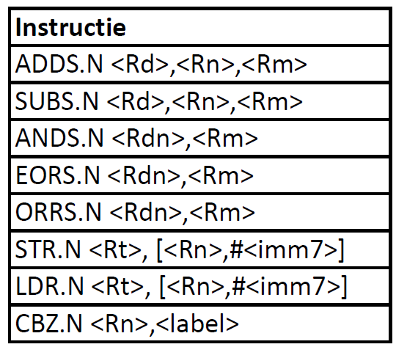
Pinky subset to implement
R(egister)-type
M(emory)-type
C(ompare)B(ranch)-type

Slide 8
Instruction Execution
  PC → instruction memory, fetch instruction
  Register numbers → register file, read registers
  Depending on instruction type:
    Use Arithmetic and Logic Unit (ALU) to calculate
      Arithmetic or logic result for Register-type (ADDS, SUBS, EORS, ANDS, ORRS)
      Memory address for Memory-type instructions (LDU, STU)
      Register equals zero for CB-type (CBZ)
    For CB-type (CBZ) calculate branch target address
    Access data memory for M-type (LDU, STU)
    Write to register file for R-type (ADDS, SUBS, EORS, ANDS, ORRS) and load (LDR)
  PC ← PC + 2 or PC ← Branch target address

Slide 9
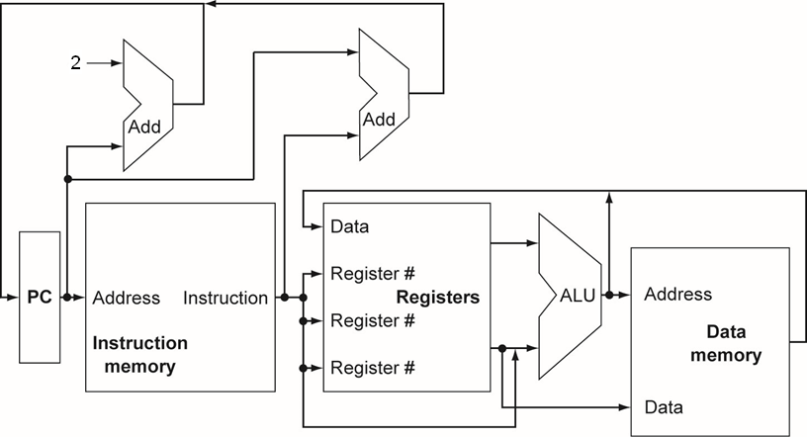
CPU Overview
What’s wrong?
Details will follow…

Slide 10
Can’t join output signals
Can’t just join wires together
  Use multiplexers

Slide 11
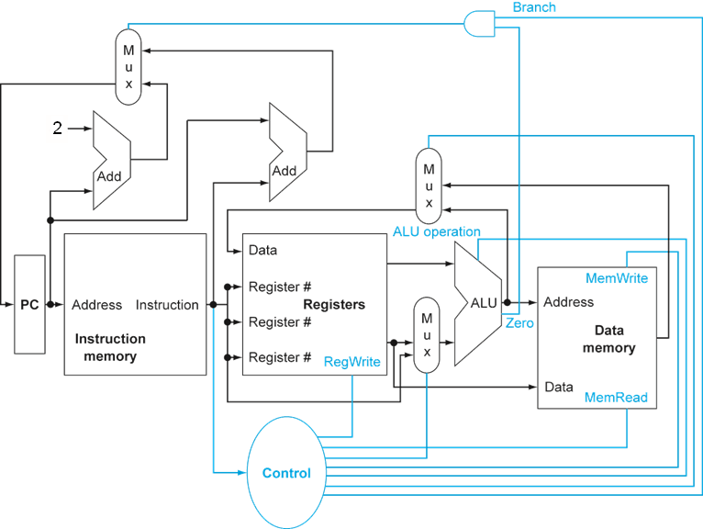
Control
Details will follow…

Slide 12
Logic Design Basics
>>
Information encoded in binary
  Low voltage = 0, High voltage = 1
  One wire per bit
  Multi-bit data encoded on multi-wire buses
Combinational element
  Operate on data
  Output is a function of input
State (sequential) elements
  Store information

Slide 13
Combinational Elements
>>
AND gate
Y = A & B
A
Y
B
Arithmetic/Logic Unit
Y = F(A, B)
Adder
Y = A + B
A
+
Y
B
A
ALU
Y
B
Multiplexer
Y = S ? I1 : I0
I0
M
u
x
F
Y
I1
S

Slide 14
Sequential Elements
>>
Register: stores data in a circuit
  Uses a clock signal to determine when to update the stored value
  Edge-triggered: update when Clk changes from 0 to 1
Clk
D
Q
D
Clk
Q

Slide 15
Sequential Elements
>>
Register with write control
  Only updates on clock edge when write control input is 1
  Used when stored value is required later
Clk
D
Q
Write
Write
Clk
D
Q

Slide 16
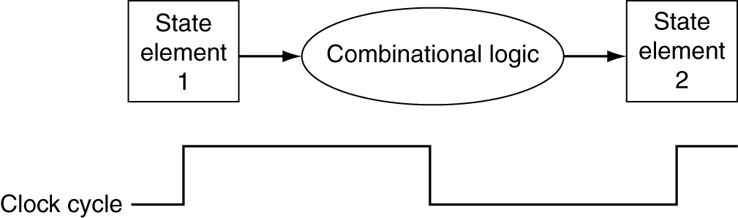
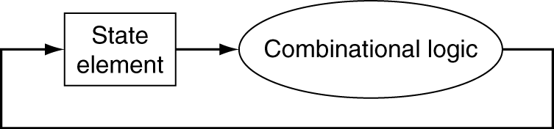
Clocking Methodology
>>
Combinational logic transforms data during clock cycles
  Between clock edges
  Input from state elements, output to state element
  Longest delay determines clock period

Slide 17
Building a Datapath
Datapath
  Elements that process data and addresses in the CPU
    Registers, ALUs, mux’s, memories, …
We will build a LEGv7-M datapath incrementally
  Refining the overview design

Slide 18
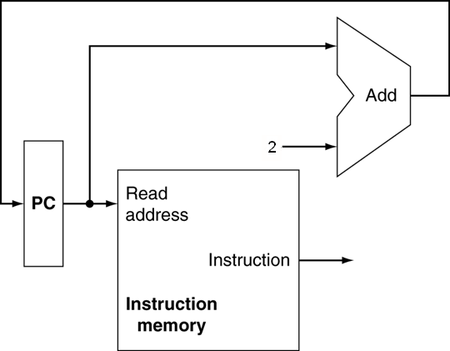
Instruction Fetch
Increment by 2 for next instruction
32-bit register

Slide 19
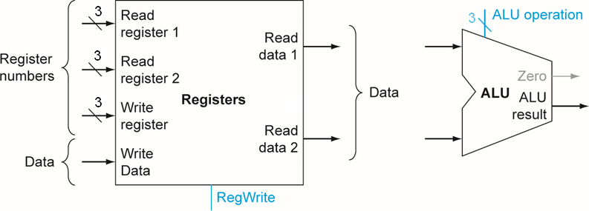
R-type Instructions ADDS, SUBS, ANDS, ORRS
  Read two register operands
  Perform arithmetic/logical operation
  Write register result

Slide 20
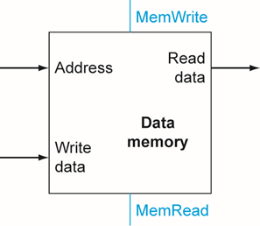
M-type Instructions LDR, STR
  Read register operands
  Calculate address using 5-bit offset
    Shift left 2 places (word displacement)
    Use ALU
  LDR: Read memory and update register
  STR: Write register value to memory

Slide 21
CB-type Instruction CBZ
  Read register operand
  Compare operand to zero
    Use ALU pass input and check Zero output
  Calculate target address
    6-bit displacement field
    Shift left 1 place (half word displacement)
    Add to PC

Slide 22
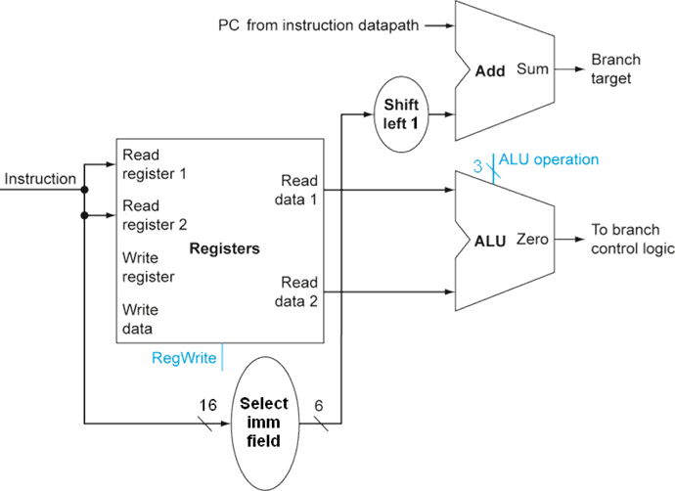
CB-type Instruction CBZ
Just
re-routes wires

Slide 23
Composing the Elements
First-cut data path does an instruction in one clock cycle
  Each datapath element can only do one function at a time
  Hence, we need separate instruction and data memories
Use multiplexers where alternate data sources are used for different instructions

Slide 24
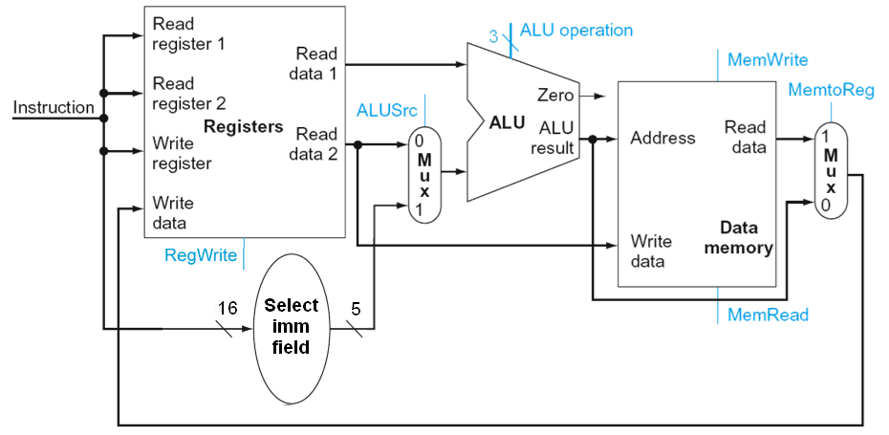
M-Type/D-Type Datapath
ADDS, SUBS, ANDS, EORS, ORRS, LDR, STR
Shift left 2
Just
re-routes wires

Slide 25
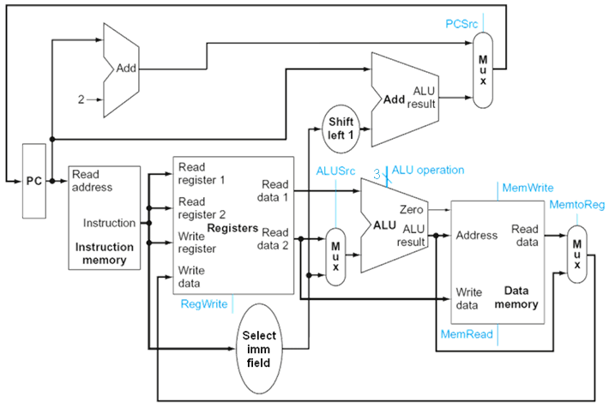
Full Datapath
ADDS, SUBS, ANDS, EORR, ORRS, LDR, STR, CBZ
Shift left 2

Slide 26
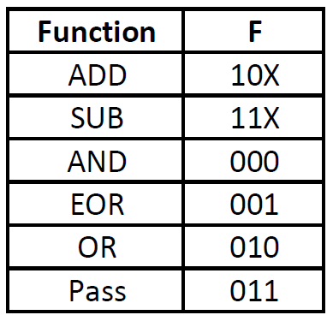
ALU Control
ALU used for
  R-type ADDS, SUBS, ANDS, EORS, ORRS:
    Function depends on opcode
  M-type LDR, STR:
    Function = add
  CB-type CBZ:
    Function = pass
A
zero
ALU
Y
B
F
Coding of F is not random, will be explained later

Slide 27
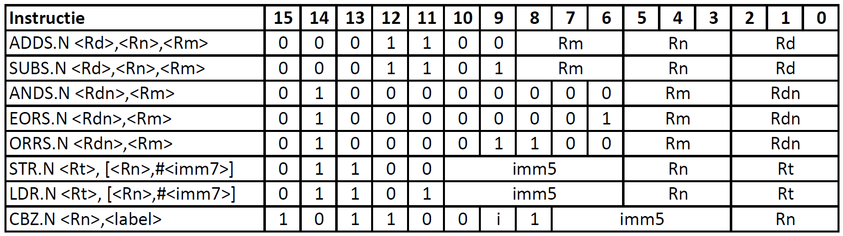
ALU Control
How to determine instruction type from opcodes?

Slide 28
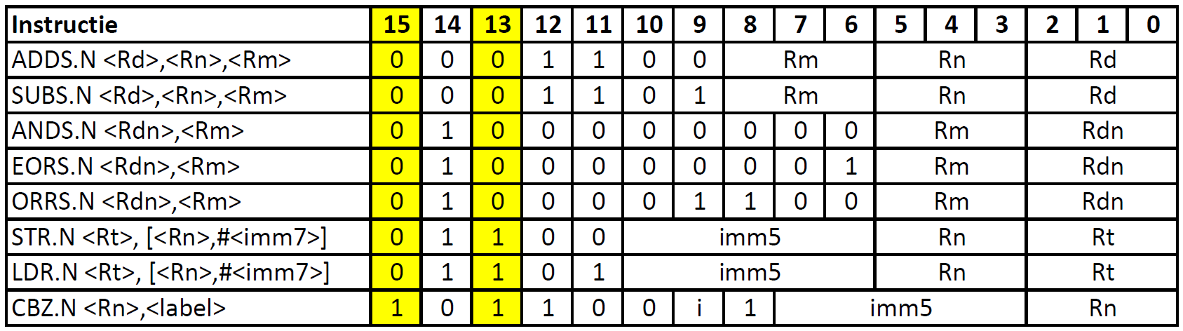
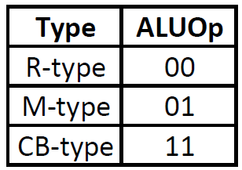
ALU Control
Determine instruction type from opcodes

Slide 29
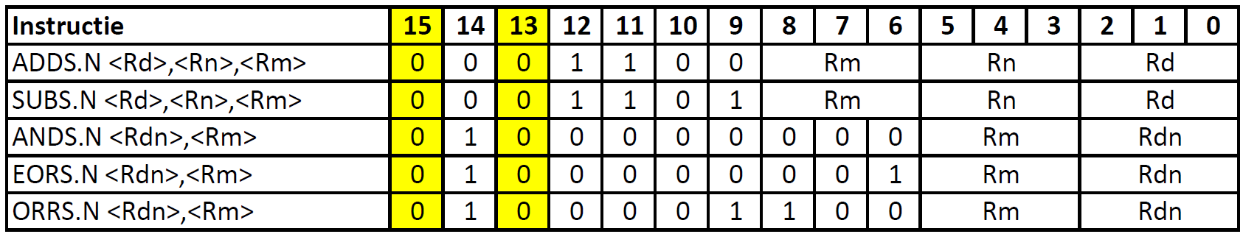
ALU Control
How to determine F for R-type from opcodes?

Slide 30
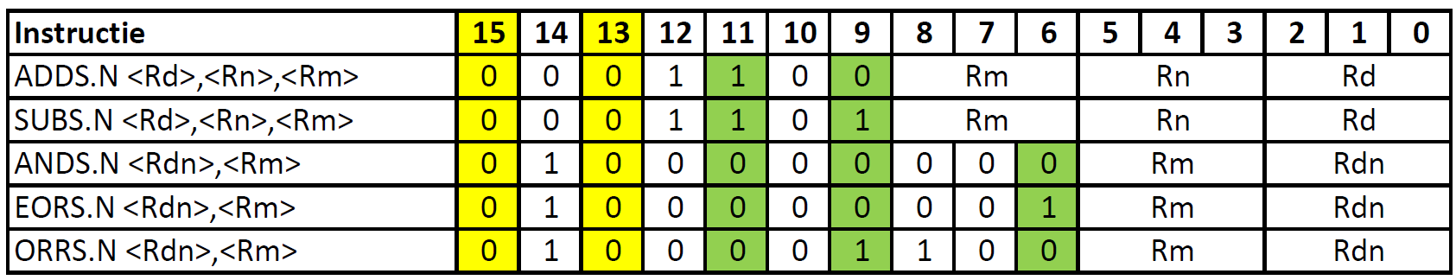
ALU Control
Determine F for R-type from opcodes
Only remaining code

Slide 31
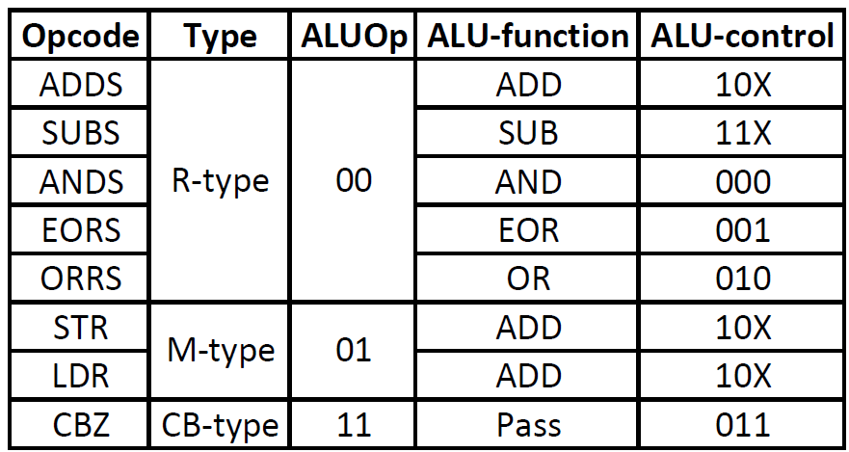
ALU Control
2-bit ALUOp derived from opcode
  Combinational logic derives ALU control (F)

Slide 32
The Main Control Unit
All control signals are derived from machine codes
n
m
n
m
n
m
m
Make decoding simpler:
Exchange Rm and Rn for logic instructions
Use Rm for CBZ (ALU should pass input B)

Slide 33
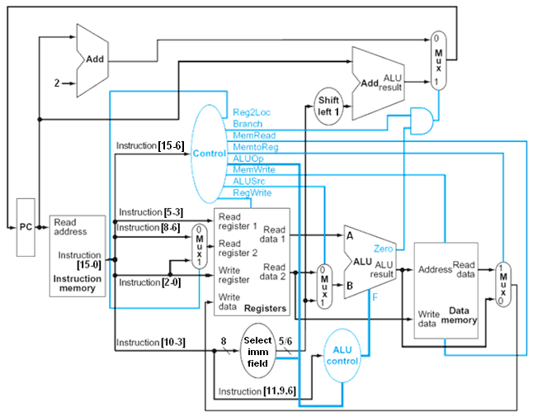
Datapath With Control
Shift left 2

Slide 34
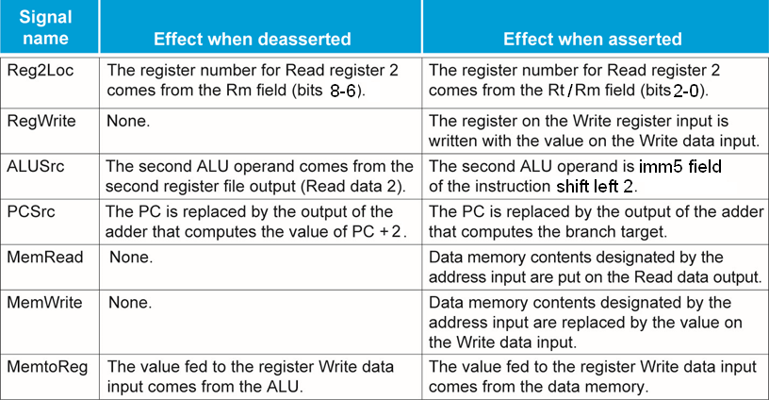
Control signals

Slide 35
Exercise
What are the values of control signals generated by the control for the instructions:
SUBS R0, R1, R2
ANDS R0, R1
LDR R0, [R1, #4]
STR R0, [R1, #8]
CBZ R0, label

Slide 36
Exercise
When silicon chips are fabricated, defects in materials (e.g., silicon) and manufacturing errors can result in defective circuits. A very common defect is for one signal wire to get “broken” and always register a logical 0. This is often called a “stuck-at-0” fault.
Which instructions fail to operate correctly:
if the MemToReg wire is stuck at 0?
if the ALUSrc wire is stuck at 0?
if the Reg2Loc wire is stuck at 0?

Slide 37
Implementing B-type (B)
  Branch uses half word (16-bit) offset
  PC ⬅ PC + (sign extended offset) x 2
  Need an extra control signal decoded from opcode

Slide 38
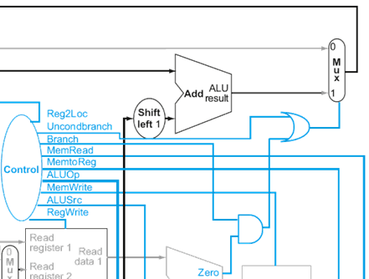
Datapath With B Added
Changes:
The imm8 two’s complement offset must be sign extended to 31 bits when B instruction is detected

Slide 39
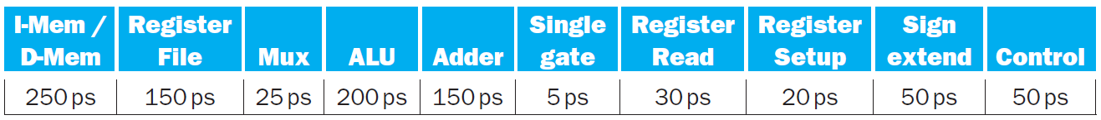
Exercise
Problems in this exercise assume that the logic blocks used to implement a processor’s datapath have the following latencies:
Select imm field
“Register read” is the time needed after the rising clock edge for the new register value to appear on the output. This value applies to the PC only. “Register setup” is the amount of time a register’s data input must be stable before the rising edge of the clock. This value applies to both the PC and Register File.
Although the control unit as a whole requires 50 ps, it so happens that we can extract the correct value of the Reg2Loc control wire directly from the instruction. Thus, the value of this control wire is available at the same time as the instruction. Explain how we can extract this value directly from the instruction. Hints: Exchange the inputs of the mux. Carefully examine the opcodes.

Slide 40
Exercise
Problems in this exercise assume that the logic blocks used to implement a processor’s datapath have the following latencies:
Select imm field
What is the latency of an R-type instruction (i.e., how long must the clock period be to ensure that this instruction works correctly)?
What is the latency of LDR? (Check your answer carefully. Many students place extra muxes on the critical path.)
What is the latency of STR? (Check your answer carefully. Many students place extra muxes on the critical path.)
What is the latency of CBZ?
What is the latency of B?
What is the minimum clock period for this CPU?

Slide 41
Performance Issues
  Longest delay determines clock period
    Critical path: load instruction
    Instruction memory → register file → ALU → data memory → register file
  Not feasible to vary period for different instructions
  Violates design principle
    Making the common case fast
  We will improve performance by pipelining

Slide 42
Agenda
A one cycle implementation of LEGv7-M
A pipelined implementation of LEGv7-M
Branch prediction
Cache memory

Slide 43
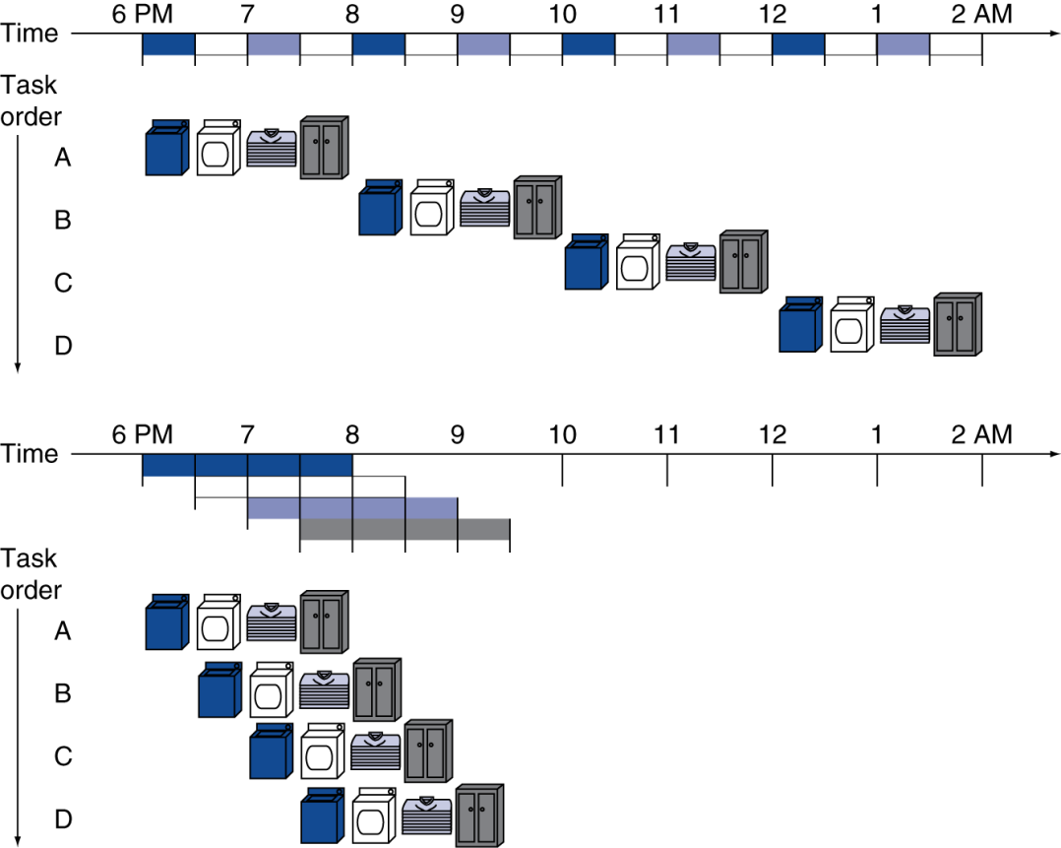
Pipelining Analogy
  Pipelined laundry: overlapping execution
    Parallelism improves performance
Speedup?
    Four loads:
      Speedup
      = 8/3.5 = 2.3
    Non-stop:
      Speedup
      = 2n/0.5n + 1.5 ≈ 4
      = number of stages

Slide 44
LEGv7M Pipeline
Five stages, one step per stage
  IF: Instruction fetch from memory
  ID: Instruction decode & register read
  EX: Execute operation or calculate address
  MEM: Access memory operand
  WB: Write result back to register
ARMv7 Cortex-M4 Pipeline has only three stages

Slide 45
Cortex-M4 Pipeline
Bron: Arm Cortex-M4 Datasheet

Slide 46
Pipeline Performance
Assume time for stages is
  100 ps for register read or write
  200 ps for other stages
Compare pipelined datapath with single-cycle datapath
Instr | Instr fetch | Register read | ALU op | Memory access | Register write | Total time
LDR | 200ps | 100 ps | 200ps | 200ps | 100 ps | 800ps
STR | 200ps | 100 ps | 200ps | 200ps |  | 700ps
R-format | 200ps | 100 ps | 200ps |  | 100 ps | 600ps
CBZ | 200ps | 100 ps | 200ps |  |  | 500ps

Slide 47
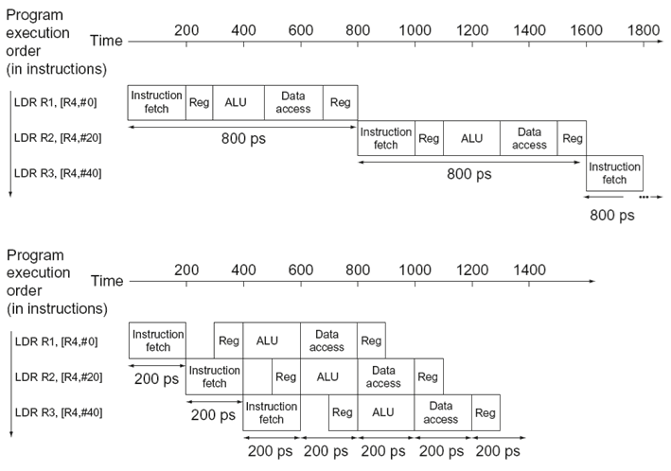
Pipeline Performance
Single-cycle (T_{c}= 800ps)
Pipelined (T_{c}= 200ps)

Slide 48
Pipeline Speedup
If all stages are balanced
  i.e., all take the same time
  Time between instructions_{pipelined}
  = Time between instructions_{nonpipelined}
  Number of stages
If not balanced, speedup is less
Speedup due to increased throughput
  Latency (time for each instruction) does not decrease

Slide 49
Pipelining and ISA Design
LEGv7-M ISA designed for pipelining
  All instructions are 16-bits
    Easier to fetch and decode in one cycle
    c.f. x86: 1- to 17-byte instructions
  Few and regular instruction formats
    Can decode and read registers in one step
  Load/store addressing
    Can calculate address in 3rd stage, access memory in 4th stage
  Alignment of memory operands
    32-bit Memory access takes only one cycle

Slide 50
Hazards
Situations that prevent starting the next instruction in the next cycle
  Structure hazards
    A required resource is busy
  Data hazard
    Need to wait for previous instruction to complete its data read/write
  Control hazard
    Deciding on control action depends on previous instruction

Slide 51
Structure Hazards
Conflict for use of a resource
  In LEGv7-M pipeline with a single memory
    Load/store requires data access
    Instruction fetch would have to stall for that cycle
      Would cause a pipeline “bubble”
  Hence, pipelined datapaths require separate instruction/data memories (Harvard architecture)
    Or separate instruction/data caches

Slide 52
Structure Hazards
Conflict for use of a resource
  In LEGv7-M the registers are used in stages ID (read) and WB (write)
  Assumed time for stages is
    100 ps for register read or write
    200 ps for other stages
  Hence, write and read can be combined in one pipeline slot
    write in first 100 ps, read in last 100 ps

Slide 53
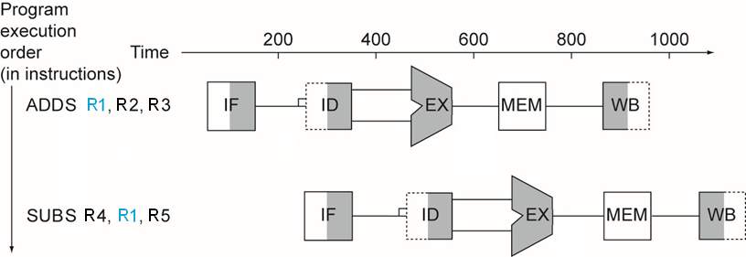
Data Hazards
An instruction depends on completion of data access by a previous instruction
  ADDS R1, R2, R3
  SUBS R4, R1, R5
Data can not move backward in time!

Slide 54
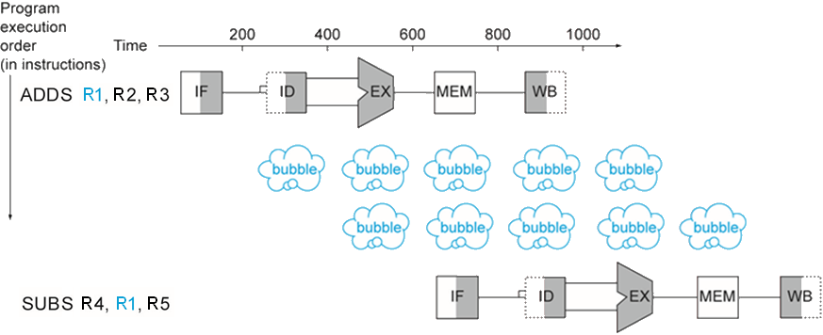
Stalling (aka insert bubbles)
Wait for the data to be stored in a register
  Requires extra control logic
Data now moves forward in time!

Slide 55
Exercise
Were must the processor insert bubbes (NOPs) when the following code is run on the pipeline:
ADDS R1, R2, R3
ADDS R4, R1, R2
ADDS R5, R1, R6
ADDS R7, R1, R4

Slide 56
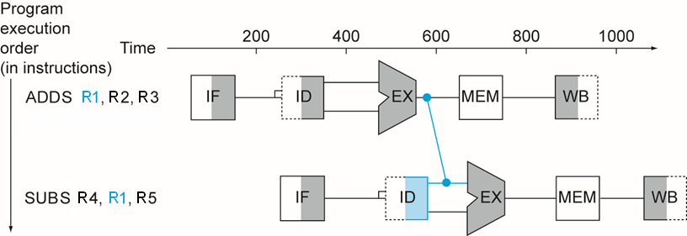
Forwarding (aka Bypassing)
Use result when it is computed
  Don’t wait for it to be stored in a register
  Requires extra connections in the datapath and extra control logic

Slide 57
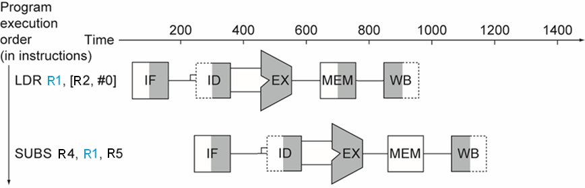
Load-Use Data Hazard
Can’t always avoid stalls by forwarding
  If value not computed when needed
  Can’t forward backward in time!

Slide 58
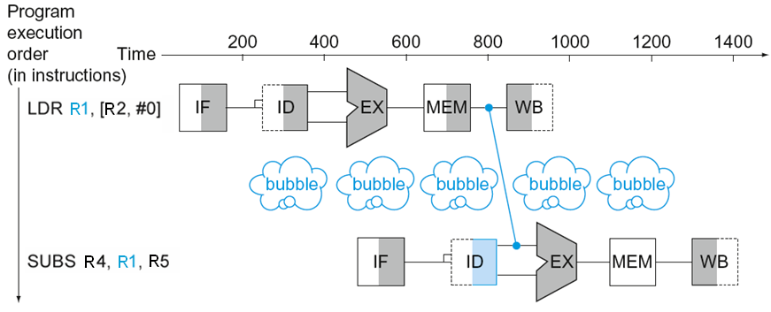
Load-Use Data Hazard
Can’t avoid stalls by forwarding
  Stall can be limited to one cycle by using forwarding.

Slide 59
Code Scheduling to Avoid Stalls
Reorder code to avoid use of load result in the next instruction
C code for A[3]=A[0]+A[1]; A[4]=A[0]+A[2]; // A in R0
LDR R1, [R0,#0]
LDR R2, [R0,#4]
ADDS R3, R1, R2
STR R3, [R0,#12]
LDR R4, [R0,#8]
ADDS R5, R1, R4
STR R5, [R0,#16]
LDR R1, [R0,#0]
LDR R2, [R0,#4]
LDR R4, [R0,#8]
ADDS R3, R1, R2
STR R3, [R0,#12]
ADDS R5, R1, R4
STR R5, [R0,#16]
stall
stall
9 cycles
7 cycles

Slide 60
Control Hazards
Branch determines flow of control
  Fetching next instruction depends on branch outcome
  Pipeline can’t always fetch correct instruction
    Still working on ID stage of branch
In LEGv7-M pipeline
  Need to compare registers and compute target early in the pipeline
  Add hardware to do it in ID stage

Slide 61
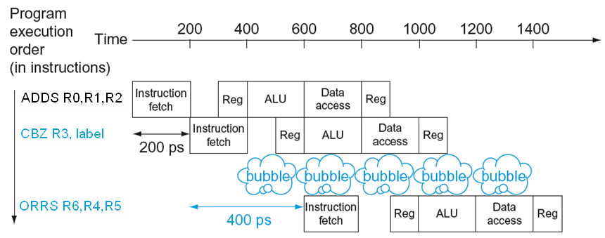
Stall on Branch
Wait until branch outcome determined before fetching next instruction

Slide 62
Agenda
A one cycle implementation of LEGv7-M
A pipelined implementation of LEGv7-M
Branch prediction
Cache memory

Slide 63
Branch Prediction
Longer pipelines can’t readily determine branch outcome early
  Stall penalty becomes unacceptable
Predict outcome of branch
  Only stall if prediction is wrong
In LEGv7-M pipeline
  Can predict branches not taken
  Fetch instruction after branch, with no delay

Slide 64
More-Realistic Branch Prediction
Static branch prediction
  Based on typical branch behavior
  Example: loop and if-statement branches
    Predict backward branches taken
    Predict forward branches not taken
Dynamic branch prediction
  Hardware measures actual branch behavior
    e.g., record recent history of each branch
  Assume future behavior will continue the trend
    When wrong, stall while re-fetching, and update history

Slide 65
Dynamic Branch Prediction
In deeper and superscalar pipelines, branch penalty is more significant
Use dynamic prediction
  Branch prediction buffer (aka branch history table)
  Indexed by recent branch instruction addresses
  Stores outcome (taken/not taken)
  To execute a branch
    Check table, expect the same outcome
    Start fetching from fall-through or target
    If wrong, flush pipeline and flip prediction

Slide 66
1-Bit Predictor: Shortcoming
Inner loop branches mispredicted twice!
outer: …
…
inner: …
…
BNE inner
…
BNE outer
Mispredict as taken on last iteration of inner loop
Then mispredict as not taken on first iteration of inner loop next time around

Slide 67
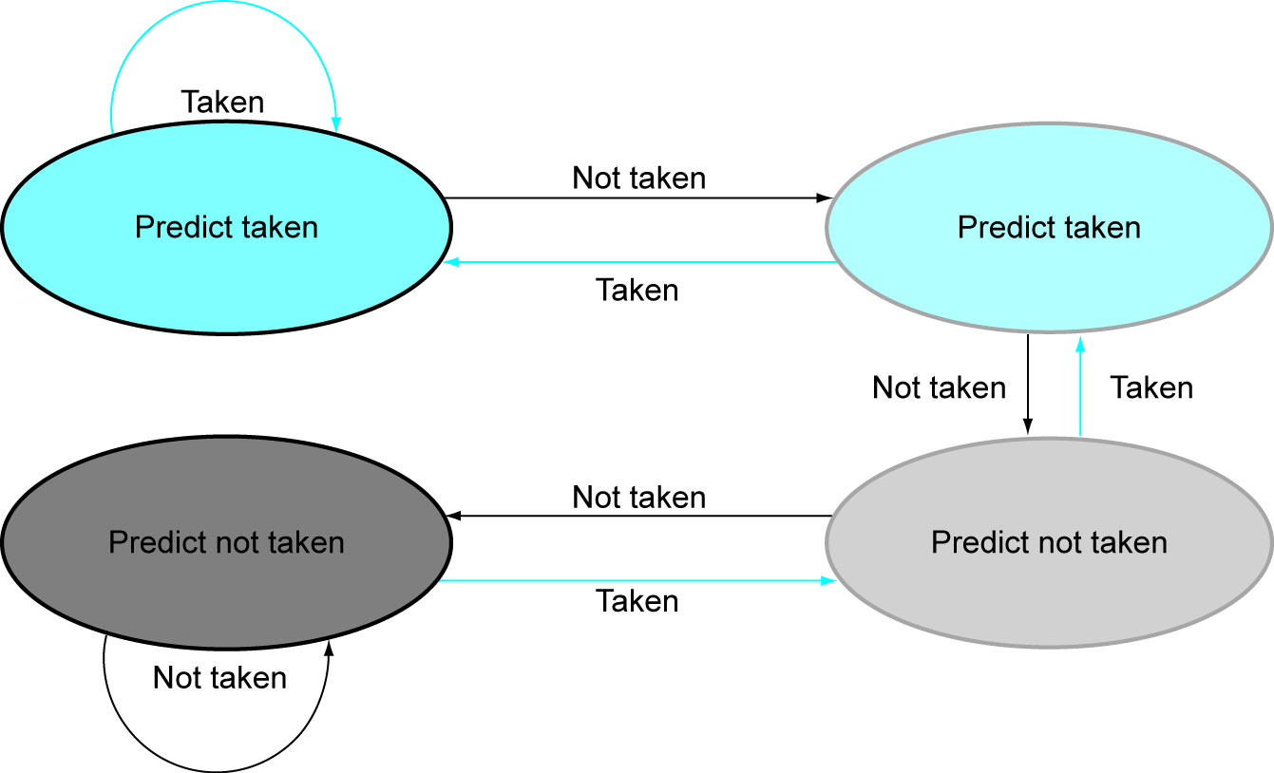
2-Bit Predictor
Only change prediction on two successive mispredictions

Slide 68
Calculating the Branch Target
Even with predictor, still need to calculate the target address
  1-cycle penalty for a taken branch
Branch target buffer
  Cache of target addresses
  Indexed by PC when instruction fetched
    If hit and instruction is branch predicted taken, can fetch target immediately

Slide 69
Agenda
A one cycle implementation of LEGv7-M
A pipelined implementation of LEGv7-M
Branch prediction
Cache memory

Slide 70
Principle of Locality
  Programs access a small proportion of their address space at any time
  Temporal locality
    Items accessed recently are likely to be accessed again soon
    e.g., instructions in a loop, induction variables
  Spatial locality
    Items near those accessed recently are likely to be accessed soon
    E.g., sequential instruction access, array data
https://en.wikipedia.org/wiki/Induction_variable

Slide 71
Example of Locality
int A[1024];
int B[1024];
int C[1024];
for (int i = 0; i < 1024; i++) {
A[i] = B[i] + C[i];
}
Where is the temporal locality (if any)?
Where is the spatial locality (if any)?

Slide 72
Taking Advantage of Locality
In many modern processors the processor is (much) faster than RAM.
Memory hierarchy
  Copy more recently accessed (and nearby) items from main memory to smaller faster memory
  Cache memory attached to CPU

Slide 73
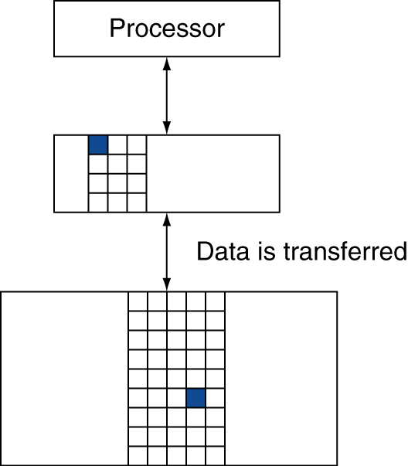
Memory Hierarchy Levels
Block (aka line): unit of copying
  May be multiple words
If accessed data is present in upper level
  Hit: access satisfied by upper level
    Hit ratio: hits/accesses
If accessed data is absent
  Miss: block copied from lower level
    Extra time taken: miss penalty
    Miss ratio: misses/accesses
    = 1 – hit ratio
  Then accessed data supplied from upper level
Why?
cache
main

Slide 74
STM32F411VET6
Max clock speed = 100 MHz
No cache needed for RAM.
Contains Adaptive real-time memory accelerator for Flash memory section 3.4.2 of RM0383
  To release the processor full performance, the accelerator implements an instruction prefetch queue and branch cache which increases program execution speed from the 128-bit Flash memory.
  I-code bus (instructions): cache 64 lines of 128 bits
  D-code bus (literals): cache 8 lines of 128 bits

Slide 75
Advanced computer architecture
SIMD instructions, Arm Cortex-M4
Superscalar Wikipedia
Out of order execution Wikipedia
Speculative execution Wikipedia
Simultaneous multithreading (SMT) Wikipedia
Multi-core Wikipedia
Cyclone V FPGA (HWP01+CSC10) contains Arm Cortex-A9
which contains many of the features mentioned above

Slide 76
Volgende les…
Scheduling.

Slide 77

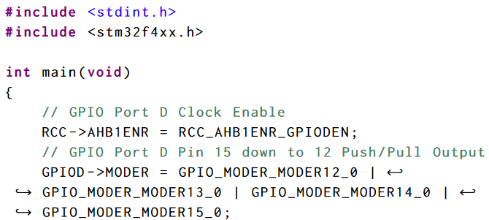
Aan de slag!
Aan de slag met Opdrachten_Week_2.pdf

