Slide 1
Real-Time Systems
RTS1
Minor Embedded Systems
Week 3
Cooperative Scheduling
versd@hr.nl
brojz@hr.nl

Slide 2
Planning RTS1
Week 3: Cooperative Scheduling
Week 4: Pre-emptive Scheduling
Week 5: Using Free-RTOS + POSIX
Week 6: Schedulability Analyses, Priority Assignment

Slide 3
Overview
Scheduling
  Problem
  Goal
  Possible solution

Slide 4
Scheduling
Problem
  Multiple processes require CPU time
    Some processes need it asap
    Some processes just need to happen at some point in time
  Multiple processes require bandwidth
    USB, Serial, SPI ....
    Prioritization?
Goal
  Create a framework that’ll ease (CPU) time management
  Easy to add new processes and to share resources

Slide 5
Cooperative Solution
Superloop ‘scheduler’
  Systick
Cooperative scheduler

Slide 6
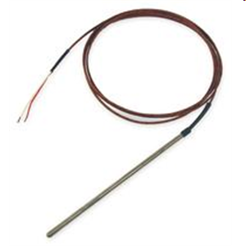
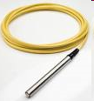
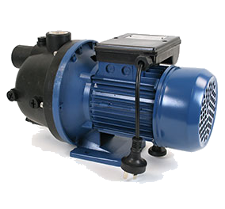
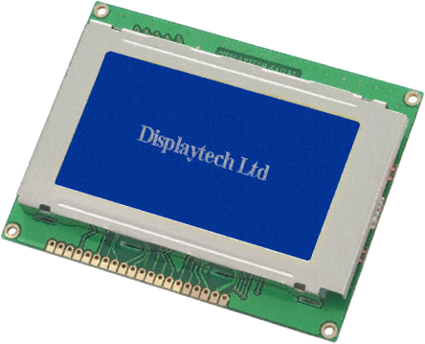
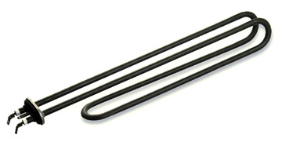
Voorbeeld embedded system
thermocouple
pressure transducer
ADC
ADC
T
P
S
DAC
Switch
Screen
pump/valve
heater

Slide 7
Software Architecture
What is the biggest flaw with this architecture?
  NO control over time
    Not deterministic
      e.g. sample time of T and P depends on execution times
    No response time promises
    Wasting CPU cycles
T = temperature control
P = pressure control
S = screen update
T
P
S
T
P
S
T
P
S
time

Slide 8

Superloop Construct
Simple, deterministic
Fixed time scheduling using SysTick
Sleep until next SysTick (save energy)
T
P
S
T
P
S
time
SysTick
SysTick

Slide 9
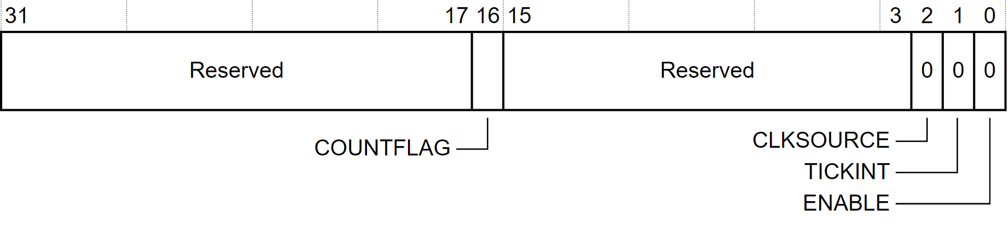
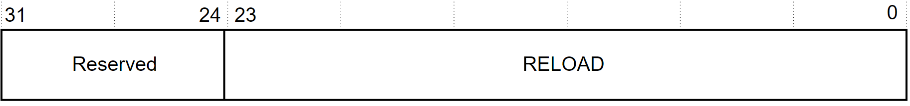
Systick
Peripheral as part of the ARM CPU core
Meant to be used by an OS
Simple timer
  24 bits (16777216 ticks)
  Own high priority interrupt
  Has a ‘reload’ register

Slide 10
Superloop Construct
Should we run every task every tick?
T
P
S
T
P
S
time
SysTick
SysTick

Slide 11
Voorbeeld embedded system
thermocouple
pressure transducer
ADC
ADC
T
P
S
DAC
Switch
Screen
pump/valve
heater

Slide 12
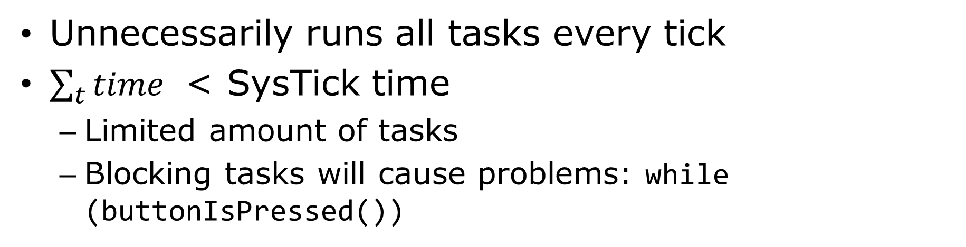
Superloop Construct
Unnecessarily runs all tasks every tick
$\sum_{t}{time}$ < SysTick time
  Limited amount of tasks
  Blocking tasks will cause problems: while (buttonIsPressed())
T
P
S
T
P
S
time
SysTick
SysTick

Slide 13
‘Complex’ Cooperative Scheduler
Cooperative:
  Task finishes
  then transfers control back to the scheduler
No fights over concurrent use of hardware
Perfect for small amount of tasks
Easy to maintain
Adaption to simple version:
  Each task gets its own period (e.g. 400 SysTicks)
  Each task could have a priority, state, etc

Slide 14
Difference
T
P
S
T
P
S
T
P
S
T
P
S
time
SysTick
P
S
P
T
P
P
T
time
SysTick

Slide 15
Overview
Tasklist
  Structure (struct) for each task
  Ordered by priority
  Only execute task when ready
Use SysTick to determine which task is READY
Use main loop to execute all ready tasks.
Sleep until next SysTick

Slide 16
Interim : Function pointer
Syntax
  void func(int);
  void (*pointerNaarFunc)(int);
To run
  pointerNaarFunc = &func;
  (*pointerNaarFunc)(42);
To run (alternative)
  pointerNaarFunc = func;
  pointerNaarFunc(42);

Slide 17
Suspending a task
Implementing a delay using SysTick
  Change state to WAITING
  Initialize a counter, or add to the existing period
  Decrement the counter each tick
  When reached zero, put into ready mode

Slide 18
Scheduling
The process of selecting the task to execute next
  What if 3 tasks are READY at the same time?
  Which one will be selected first?
Scheduling algorithms
  FIFO (Round robin)
  Priority based

Slide 19
FIFO – Scheduling Algorithm
Tasks are run in order of task-creation
  Add most important tasks first
  Add less important tasks later
Pro
  Easy!
  No overhead in selecting
Con
  Fixed solution, pre-determined at compile time
  Tasks created run-time are always last

Slide 20
Priority based – Scheduling Algorithm
Use ‘priority’ number over position in task list
  Highest priority task goes first of all READY tasks
Pro
  Ability to work with more tasks
  Possible to change priority real time
  Most demanding tasks run first
Cons
  Means either sorting a list or traversing it
    Increases scheduling time

Slide 21
Next week
Pre-emptive scheduling

