Slide 1
RTS1 Week 4

Slide 2
Planning RTS1
Week 3: Cooperative Scheduling
Week 4: Pre-emptive Scheduling
Week 5: Using an RTOS
Week 6: Schedulability Analyses, Priority Assignment
Week 7/8: Introduction (embedded) Rust

Slide 3
Overview
Scheduling
  Problem
  Goal
  Possible solution

Slide 4
Scheduling
Problem
  Multiple processes require CPU time
    Some processes need it asap
    Some processes just need to happen at some point in time
  Multiple processes require bandwidth
    USB, Serial, SPI ....
    Prioritization?
Goal
  Create a framework that’ll ease (CPU) time management
  Easy to add new processes and to share resources

Slide 5
Demo
Demonstration of pre-emptive project

Slide 6
Cooperative versus Pre-emptive scheduling
Cooperative
  Tasks run sequentially
  High priority tasks have to wait till last task finishes
  Easy to set up
  Low overhead scheduler
Pre-emptive (Multi-tasking)
  Important tasks always finish first
  Danger of starvation and using hardware concurrently
  More overhead on resources(RAM) and CPU time

Slide 7
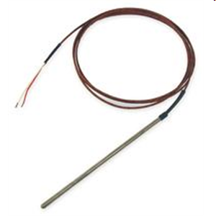

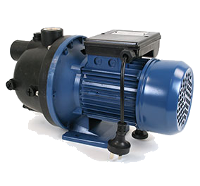
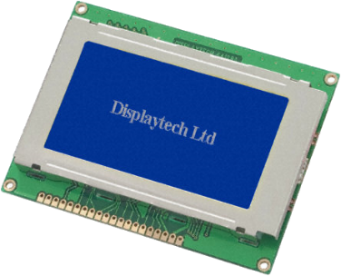
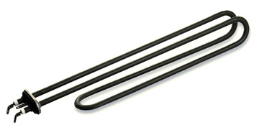
Embedded system example
thermocouple
pressure transducer
ADC
ADC
T
P
S
DAC
Switch
Screen
pump/valve
heater

Slide 8
Pre-emption
Interrupting a task to execute a different task
Cooperative
Preemptive
Scheduler decides next task and can interrupt existing
Context switch, switches the tasks
T
P
S
T
P
S

Slide 9
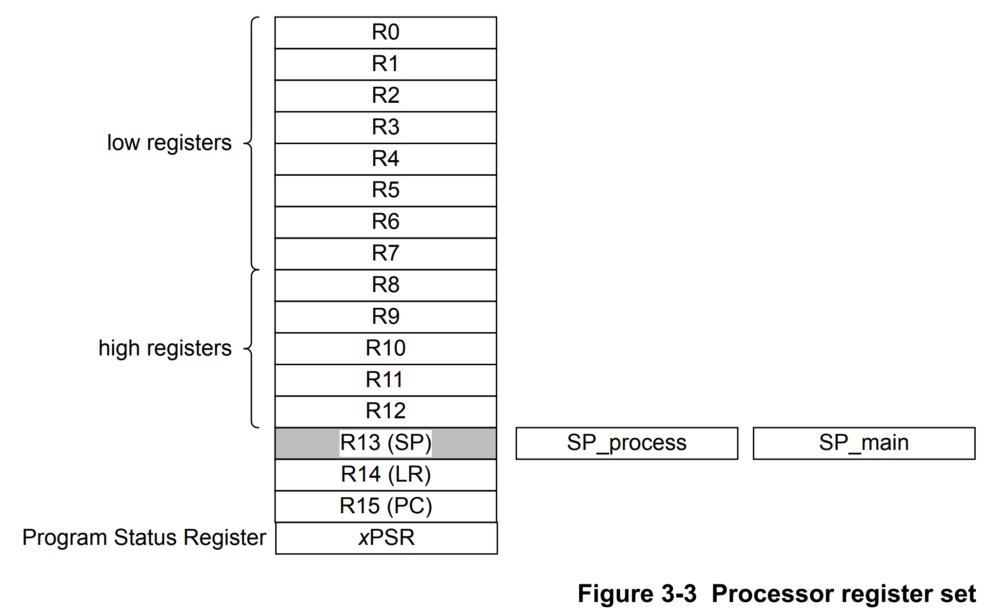
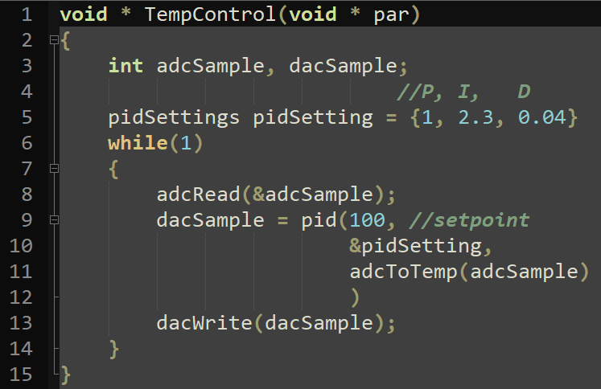
Context switch
What is context?
  What memory is used by code?
    Stack
    Heap (dynamic memory)
    CPU registers
Stack and CPU registers describe the context of a task

Slide 10
OS support in Cortex M4
Banked stack pointers
Privileged and non-privileged operation modes
Advanced interrupt controller (NVIC)
  Has several interrupts specifically for RT kernels
  Fault handlers
Memory Protection Unit (MPU)

Slide 11
Banked stack pointers
R13 can contain
  the Process Stack Pointer (PSP)
  the Main Stack Pointer (MSP)
MSP is default
PSP can be used for separating tasks from the OS
  Normal tasks do not share their stack with the kernel! Much safer.
  Can only be used outside of interrupts
  Set using SPSEL bit in CONTROL register
Thus far all we have used is the MSP

Slide 12
Memory usage in a RTOS
OS
Each task gets own chunk of memory
  The OS uses the MSP
  The tasks use the PSP
    When a new task is selected, the PSP points to the stack of that task.
    Basically, a form of ‘Time division multiplexing’
    The scheduling algorithm picks the next task/stack
MSP
Task 1
Task 2
PSP
OS/SysTick
MSP
OS/SysTick
MSP
Task N
Task1
PSP
Task2
PSP
Task3
PSP

Slide 13
Banked stack pointers
Two assembly instructions for accessing special registers
  MRS (move special register value to normal register)
    E.g. MRS R0, PSP ; move PSP value to R0
  MSR (Move normal register value to special register)
    E.g. MSR PSP, R0 ; move R0 value to PSP
And CMSIS functions
  __get_PSP(void)
  __set_PSP(uint32_t topOfStack)

Slide 14
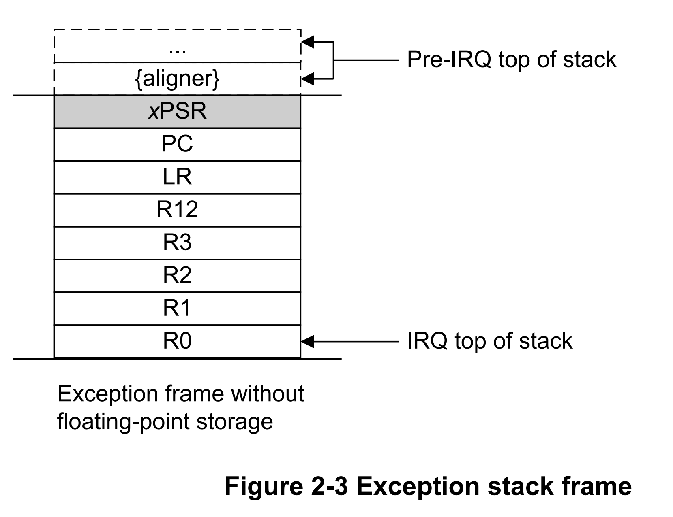
Exception entry
On exception several registers are automatically pushed to the current stack pointer
The CPU writes an EXC_RETURN value to the LR which determines if the MSP or PSP stack was in use
C functions are allowed to use R0-R3 and R12 inside an exception.

Slide 15
Exception return
The CPU checks the EXC_RETURN value in the LR which determines if the MSP or PSP stack is used
The CPU pops the stackframe from the MSP or PSP
The stack used determines the value for the program counter and link register and thus where code execution continues

Slide 16
Exception flowchart
Exception entry
0xFFFFFFF9
LR
0xFFFFFFFD
push stack frame to SP
pop stack frame from MSP
MSP
SP
PSP
run ISR
pop stack frame from PSP
LR = 0xFFFFFFF9
LR = 0xFFFFFFFD
Exception return
SP = MSP

Slide 17
Example OS
OS/SysTick
MSP
OS/SysTick
MSP
LR = EXC_RETURN_MSP
LR = EXC_RETURN_PSP
Init
MSP
Task1
PSP
Task2
PSP

Slide 18
Operation modes
Security by:
  Separating stacks
  Separating access levels between kernel and tasks.
    nPRIV bit in CONTROL register
Handler mode
  Used by exceptions
Privileged Thread mode
  OS intialisation
  OS kernel
Unprivileged Thread mode
  Used by tasks
  Tasks have limited access to memory
  MPU can be used to change access
Uses MSP
Handler mode
privileged
Interrupt request
Interrupt request
nPRIV = 0
nPRIV = 1
Thread mode
privileged
Return
with MSP or PSP
Thread mode
unprivileged
nPRIV = 1

Slide 19
Operation modes
Abstraction
  Only OS can access important peripherals like Systick, NVIC, DMA, MPU, etc
  Tasks need to use the OS system calls to request changes
Kernel
Tasks
SVC Handler
Drivers
Important Peripherals
Unprivileged
privileged

Slide 20
OS Interrupts
Systick
  Used by OS to periodically update everything
PendSV (Pendable Service Call)
  Used by OS to request a context switch
  Software bit triggers this interrupt
  Lowest priority
SVC (SuperVisor Call)
  Used by tasks to request a service from the OS

Slide 21
Supervisor call
Assembly call
  SVC #x
    Parameter X defines which action the OS performs, first byte of instruction
    Interrupt occurs immediately
    You can get and return parameters with stacked registers like normal function call
Exception entry
Check used stack pointer
Use PC to find used instruction
Get parameter from first byte of instruction

Slide 22
PendSV - Context switch
R0-R3,R12,LR,PC,XPSr get pushed to current stack
Push {R4-R11} CPU registers to PSP, update stack pointer
Pick new task and change PSP
Pop {R4-R11} from new PSP, update stack pointer
R0-R3,R12,LR,PC,XPSr get popped from current stack

Slide 23
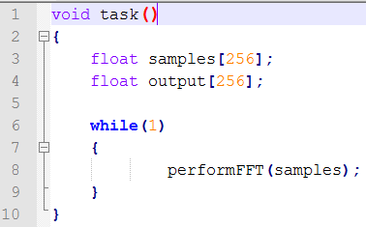
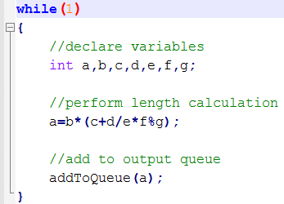
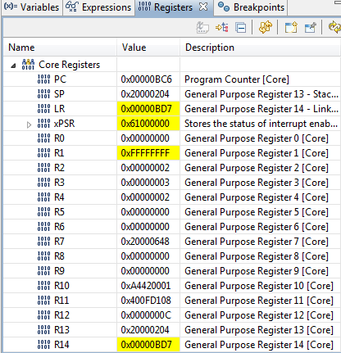
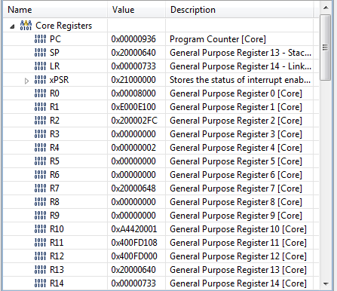
Switching context
Enter exception (PendSV)
Save context (CPU registers) to stack
Switch stack to new task
Load context from stack to CPU
Leave exception using new stack
save context ->

Slide 24
Memory Protection Unit
Can set memory locations
  Inaccessible
  Read only
  Non-executable
Possible use-case in RTOS
  Limit access to certain peripherals
  Only allow access to own task memory (and thus stack)
    Downside?
  Make RAM segments non-executable to prevent injection-type attacks
FreeRTOS-MPU - ARM Cortex-M3 and ARM Cortex-M4 Memory Protection Unit support in FreeRTOS
Why ARM MPU Has Become an Outcast in Embedded Systems

Slide 25
Pre-emptive scheduling
Priority based
  Scheduler decides and update states of tasks
  When high priority task comes alive, it interrupts lower priority tasks
  When all tasks are suspended, the idle task can run
Round robin
  Every task gets equal CPU time
  When all tasks are suspended, the idle task can run
Demo
  Instructor demonstrates algorithms

Slide 26
Problems with pre-emptive scheduling
Starvation
  Low priority tasks don’t get cpu time
    Possible solution: Aging
Sharing resources
  Tasks can’t use hardware ‘simultaneously’
  Waiting for hardware to come available can cause deadlock or priority inversion
    Next week

Slide 27
Walkthrough VersdOS

Slide 28
Next Week
Free-RTOS
  What is it
  Problems and challenges with
  Threads and IPC (Inter Process Synchronization)
  POSIX API overview
  Read assignment 5 before next week’s lesson!

Slide 29
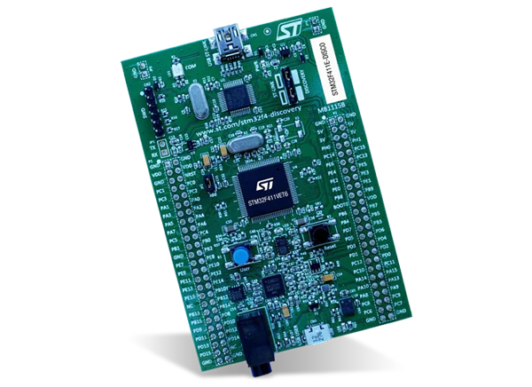

Aan de slag!
Aan de slag met Opdrachten_Week_4.pdf

