Slide 1
RTS1 Week 5

Slide 2
Overview
  Tasks
    Creation / Deletion
    Parameter passing
  Multitasking problems
    Situation / Problem
    Solution

Slide 3
Multitasking
“An environment where program execution can be interrupted and continued at any time in any location”
Questions
  How to design such a system and promise timing?
  How to prevent data corruption?
  How to communicate between tasks?

Slide 4


POSIX
POSIX
Portable Operating System Interface (POSIX) is a standard API for Operating Systems.
  Many OS partially comply with this standard. For example: Linux, Android, OSX, VxWorks, QNX Neutrino, free-RTOS etc.
Tasks (threads) are dynamically created by using API calls.
Semaphores and mutexes can be used to synchronize tasks.
Message Queues can be used to communicate between tasks.

Slide 5
Pthread Example (1 of 2)
void *print1(void *par) {
for (int i = 0; i < 10; i++) {
usleep(100000);
printf("print1\n");
}
return NULL;
}
void *print2(void *par) {
for (int i = 0; i < 10; i++) {
usleep(200000);
printf("print2\n");
}
return NULL;
}

Slide 6
Pthread Example (2 of 2)
Uitvoer:
print1
print2
print1
print1
print2
print1
print1
print2
print1
print1
print2
print1
print1
print2
print1
print2
print2
print2
print2
print2
void *main_thread(void *arg) {
pthread_attr_t pta;
pthread_attr_init(&pta);
pthread_attr_setstacksize(&pta, 1024);
pthread_t t1, t2;
pthread_create(&t1, &pta, &print1, NULL);
pthread_create(&t2, &pta, &print2, NULL);
pthread_join(t1, NULL);
pthread_join(t2, NULL);
pthread_attr_destroy(&pta);
return NULL;
}
Source: pthread.c

Slide 7
Pthread with Parameter Example (1 of 2)
typedef struct {
char *msg;
useconds_t us;
} par_t;
void *print(void *par) {
par_t* p = par;
for (int i = 0; i < 10; i++) {
usleep(p->us);
printf(p->msg);
}
return NULL;
}

Slide 8
Pthread with Parameter Example (2 of 2)
Uitvoer:
print1
print2
print1
print1
print2
print1
print1
print2
print1
print1
print2
print1
print1
print2
print1
print2
print2
print2
print2
print2
void *main_thread(void *arg) {
pthread_attr_t pta;
pthread_attr_init(&pta);
pthread_attr_setstacksize(&pta, 1024);
pthread_t t1, t2;
par_t p1 = {"print1\n", 100000};
par_t p2 = {"print2\n", 200000};
pthread_create(&t1, &pta, &print, &p1);
pthread_create(&t2, &pta, &print, &p2);
pthread_join(t1, NULL);
pthread_join(t2, NULL);
pthread_attr_destroy(&pta);
return NULL;
}
Source: pthread_par.c

Slide 9
Problem with Shared Memory
Source: pthread_shared.c
volatile int aantal = 0;
void *teller(void *par) {
for (int i = 0; i < 100000; i++) {
aantal++;
}
return NULL;
}
//…
pthread_create(&t1, &pta, &teller, NULL);
pthread_create(&t2, &pta, &teller, NULL);
pthread_create(&t3, &pta, &teller, NULL);
What is the final value of aantal?

Slide 10
Problem with Shared Memory
  The operation aantal++ is not atomic (in machine code).
    For example, R4 contains the address of aantal:
    LDR.N R0, [R4, #0]
    ADD.N R0, R0, #1
    STR.N R0, [R4, #0]
  What is the minimal and the maximal final value of aantal?
    Minimum = 1000000
    Maximum = 3000000
What happens when a task switch occurs at this moment?

Slide 11
Data Corruption
Situations: Task A and B use a shared global variable
(just demonstrated)
Task C and D are both using the same peripheral
(e.g., UART port)
Goal: Preventing concurrent use of a resource by multiple tasks
Solution: Using tokens to represent resources. Allow a limited number of tasks to get the same token at the same time.

Slide 12
Solution?
  There are solutions which use shared variables
  (2 flags and 1 turn variable) and busy waiting.
    Dekker’s algorithm: http://en.wikipedia.org/wiki/Dekker's_algorithm
    Peterson’s algorithm: http://en.wikipedia.org/wiki/Peterson's_algorithm
  Busy waiting costs clock cycles!
  OSes offer solutions without busy waiting.

Slide 13
IPC Inter Process (Task) Communication
  Shared variable based
    Dekker’s or Peterson’s algorithm
      Busy waiting (inefficient)
    Spinlock
      Busy waiting (inefficient)
    Mutex
    Semaphore
    Monitor
      Mutex combined with Conditional variables
    Barrier
    Read Write Lock
    Event Groups
  Message based
    Message Queue

Slide 14


Mutex
  Simple way to create a mutual exclusive so-called critical section.
    Only one task can be in the critical section.
  Mutex has a lock (take) and a unlock (give) function.
    OS ensures that these functions are atomic!
    At the start of the critical section the mutex
    must be locked (taken) and at the end of
    the critical section the mutex must be
    unlocked (given).

Slide 15
Task States
Lock mutex m which is unlocked
ready
running
Lock mutex m which is already locked
Unlock mutex m
Blocked on m

Slide 16

Mutex
  When a task t tries to lock mutex m which is already locked by another task, task t is blocked on m.
  We also say:
    Task t waits for mutex m.
    Task t sleeps until mutex m is unlocked.
  Order of unblocking (waking up):
    general purpose OS: FIFO
    real-time OS: highest priority

Slide 17
Mutex with Shared Memory
int aantal = 0;
pthread_mutex_t m;
void *teller(void *par) {
for (int i = 0; i < 100000; i++) {
pthread_mutex_lock(&m);
aantal++;
pthread_mutex_unlock(&m);
}
return NULL;
}
Source: mutex.c

Slide 18
Data Corruption
DANGER
  Priority inversion
    Low priority task has mutex locked
    High priority task is blocked due to mutex
    Solution: priority inheritance
  Deadlock
    Task A has resource 1 locked and wants to lock resource 2
    Task B has resource 2 locked and wants to lock resource 1
Will be discussed in week 6!

Slide 19
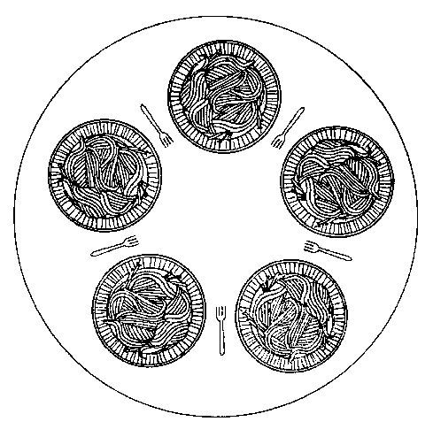
Deadlock (Example)
  There are 5 philosophers.
  The life of a philosopher consists of:
    Thinking;
    Eating.
  Each philosopher has one plate and one fork.
    To eat a philosopher needs two forks.

Slide 20
Dining Philosophers
pthread_mutex_t dinner_fork[5];
void *philosopher(void *par) {
int i = *(int*)par;
while (1) {
printf("philosopher %d is sleeping\n", i);
usleep(100000 * (rand() % 5 + 1));
printf("philosopher %d (tries to) picks up left fork\n", i);
pthread_mutex_lock(&dinner_fork[i]);
printf("philosopher %d (tries to) picks up right fork\n", i);
pthread_mutex_lock(&dinner_fork[(i + 1) % 5]);
printf("philosopher %d is eating\n", i);
usleep(100000 * (rand() % 5 + 1));
pthread_mutex_unlock(&dinner_fork[i]);
printf("philosopher %d lies down left fork\n", i);
pthread_mutex_unlock(&dinner_fork[(i + 1) % 5]);
printf("philosopher %d lies down right fork\n", i);
}
return NULL;
}

Slide 21
Dining Philosophers
pthread_t t[5];
int tid[5];
for (int i = 0; i < 5; i++)
{
tid[i] = i;
pthread_create(&t[i], &pta, &philosopher, &tid[i]);
}
This program can come to a hold (deadlock)! How?
Solution? See homework assignment hereafter.
Source: pthread_philosophers.c

Slide 22
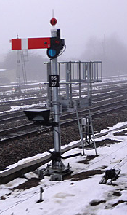
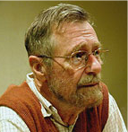
Counting Semaphore
  Operations:
    Psem (prolaag (probeer te verlagen), take, wait):
    wait (block, sleep) if count == 0 else decrement count.
    Vsem (verhoog, signal, give, post):
    unblock a waiting task if count == 0 else increment count.
  Order of unblocking (wake up):
    general purpose OS: FIFO
    real-time OS: highest priority
Edsger Dijkstra

Slide 23
Homework
  Solve the problem of the dining philosophers by using a semaphore to ensure that no more than 4 philosophers will be able to sit at the table at the same time.
Solution: Create semaphore with initial count of 4 in main.
Now each philosopher must take a semaphore after sleeping and must give the semaphore before sleeping again.
The semaphore counts the number of available chairs at the table and a philosopher requires a chair to sit at the table.

Slide 24
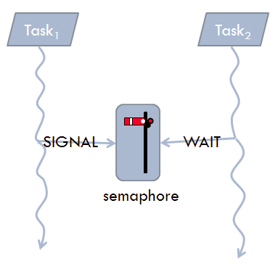
Semaphore versus Mutex
  Mutex can only be used for mutual exclusion (task which takes the mutex should also give the mutex (back)).
  Semaphore can also be used for other synchronization purposes.
  Homework:
    Task a consists of two sequential parts a1 and a2.
    Task b consists of two sequential parts b1 and b2.
    Task c consists of two sequential parts c1 and c2.
    Make sure (using a semaphore) that the parts b2 and c2 are always executed after part a1 has been executed.
post
wait

Slide 25
IPC Inter Process (Task) Communication
  Shared variable based
    Dekker’s or Peterson’s algorithm
      Busy waiting (inefficient)
    Spinlock
      Busy waiting (inefficient)
    Mutex
    Semaphore
    Monitor
      Mutex combined with Conditional variables
    Barrier
    Read Write Lock
    Event Groups
  Message based
    Message Queue

Slide 26
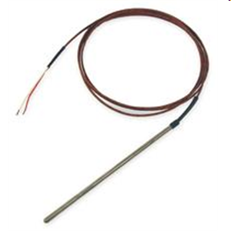
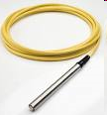

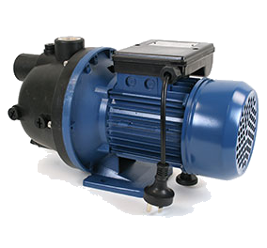
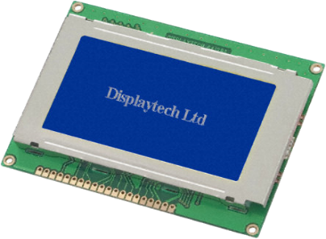

Communication between Threads
thermocouple
pressure transducer
ADC
ADC
T
P
S
DAC
Switch
Screen
pump/valve
heater

Slide 27
Message Queue Example (1 of 2)
void *main_thread(void *arg) {
mqd_t mqdes;
struct mq_attr mqAttrs;
mqAttrs.mq_maxmsg = 3;
mqAttrs.mq_msgsize = sizeof(intb;
mqAttrs.mq_flags = 0;
mqdes = mq_open("/ints", O_RDWR | O_CREAT, 0666, &mqAttrs);
pthread_t tp, tc;
pthread_attr_t attr;
pthread_attr_init(&attr);
pthread_attr_setstacksize(&attr, 1024);
pthread_create(&tp, &attr, &producer, &mqdes);
pthread_create(&tc, &attr, &consumer, &mqdes);

Slide 28
Message Queue Example (2 of 2)
void *producer(void *p) {
mqd_t mq = *(mqd_t *)p;
for (int i = 0; i < 10; i++) {
mq_send(mq, (char *)&i, sizeof(i), 0);
}
return NULL;
}
void *consumer(void *p) {
mqd_t mq = *(mqd_t *)p;
for (int i = 0; i < 10; i++) {
int msg;
mq_receive(mq, (char *)&msg, sizeof(msg), NULL);
printf("%d\n", msg);
}
return NULL;
}
Source: mqueue.c

Slide 29

Kennisclips
Er zijn kennisclips over bovenstaande onderwerpen te vinden op: https://hrelektrotechniek.bitbucket.io/pthread/
  Daarin wordt de CC3220S van TI gebruikt i.p.v. de STM32F411E-DISCO maar dat maakt niet zo veel uit.

Slide 30
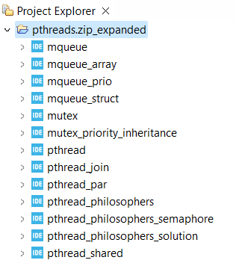
Example projects
All example projects can be found at:
https://github.com/HR-ELEKTRO/rts1/wiki/pthreads

Slide 31
Next week …
Schedulability en response time analyses

Slide 32
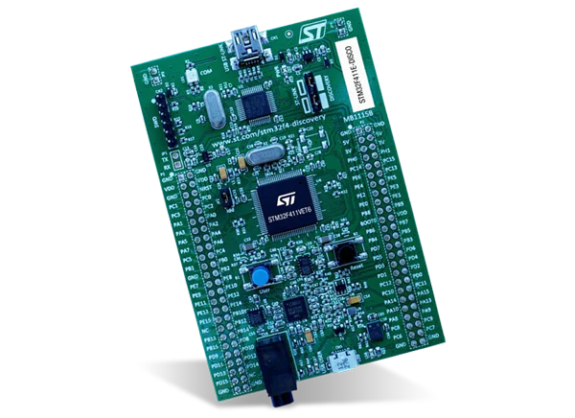

Aan de slag!
Aan de slag met Opdrachten_Week_5.pdf

