Slide 1
RTS1 Week 6

Slide 2
Planning
Week 1: Introduction microcontroller architecture and STM32F411E-DISCO
Week 2: Microcontroller architecture and programming in C
Week 3: Cyclic executive and cooperative scheduler
Week 4: Pre-emptive scheduler
Week 5: FreeRTOS and pthreads
Week 6: Schedulability and response time analyses
Week 7: Introduction Rust
Week 8: Embedded Rust

Slide 3
Free study material
  Chapters 3 and 4 of: Ken Tindell and Hans Hansson, Real Time Systems by Fixed Priority Scheduling, Uppsala University, 1997.
  Chapter 12 of: Edward A. Lee and Sanjit A. Seshia, Introduction to Embedded Systems, A Cyber-Physical Systems Approach, Second Edition, MIT Press, ISBN 978-0-262-53381-2, 2017.
  Original papers:
    C. L. Liu and J. W. Layland, Scheduling Algorithms for Multiprogramming in a Hard Real-Time Environment, JACM, Volume 20, Number1, pages 46 to 61, 1973
    M. Joseph and P. Pandya, Finding Response Times in a Real-Time System, The Computer Journal, Volume 29, Number 5, pages 390-395, 1986

Slide 4
Task scheduling
  In how many ways can you schedule 10 tasks (without preemption)?
  Choose one to start with (10 possibilities)
  Choose another to go second (9 possibilities)
  …
  Total of 10x9x8x7x6x5x4x3x2x1 = 10! = 3628800 possible schedules

Slide 5
Scheduling tasks
  N tasks can be scheduled in N! different ways
    For example, 10 tasks: 3628800 possible schedules
    With preemption there are many more possibilities
  The chosen schedule must meet all timing requirements
  A scheduling scheme (=plan) consists of:
    An algorithm to find the “best” schedule
    A method to predict the “worst-case” behavior of this schedule

Slide 6
Scheduling tasks… When do we do it?
  Static: the schedule is determined before the tasks are started
    All task, their worst-case execution times and deadlines should be known beforehand
    Using response time analysis, it is possible to prove that all deadlines are met.
    All response times are predictable!
    Not able to react on “unforeseen” situations
  Dynamic: the schedule is determined when the tasks are running.
    Behavior is less predictable
    Can respond dynamically to unforeseen circumstances (e.g., a calculation that takes longer than expected)

Slide 7
Scheduling Real-Time systems
  Almost always a static scheduling method is used
  Most commonly used : Preemptive Priority Based scheduling
    On each moment in time the ready task with the highest priority is running
    Scheduling scheme:
      An algorithm to assign a priority to each task
      A method to predict the “worst-case” behavior of this schedule given the assigned priorities and to prove that all timing requirements are met

Slide 8
Scheduling - Simple model
  The number of task is known: N
  All tasks are periodical, and all period times are known: T_{i}
  The tasks are independent from each other (no synchronization nor communication)
  System overhead is neglected
  The deadline of each task is equal to its period time: D_{i} = T_{i}
  The worst-case execution time of each task is known: C_{i}
This model is too simple (but difficult enough). Later we will look at realistic models.

Slide 9
Cyclic executive (Super loop)
  The schedule is determined upfront and is explicitly programmed.
  Example:
// Set timer to wake-up CPU every 25 ms
while (1) {
sleep_until_wake_up(); a(); b(); c();
sleep_until_wake_up(); a(); b(); d(); e();
sleep_until_wake_up(); a(); b(); c();
sleep_until_wake_up(); a(); b(); d();
}
Taak | T | C
a | 25 | 10
b | 25 | 8
c | 50 | 5
d | 50 | 4
e | 100 | 2
How to determine the schedulability?
How to find a schedule?

Slide 10
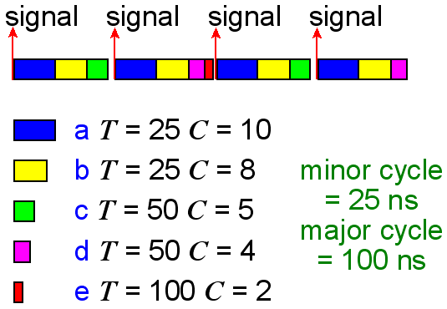
Cyclic executive (Super loop)
signal = systick
Utilization
U = 10/25+8/25+5/50+4/50+2/100
= 0,92
What is the maximum utilization in the general case?
If C_{e} = 4 then U = 0,94 and the task set is not schedulable!
Minor cycle = gcd(T₁, T₂, … T_{n}). Major cycle = lcm(T₁, T₂, … T_{n}).
How to determine the schedulability?
How to find a schedule?

Slide 11
Cyclic executive (Super loop)
  Characteristics:
    There are no real tasks, only ordinary functions
    Shared memory can be used for communication without protection (mutex is not needed)
    All T ’s should be a multiple of the minor cycle time
    System is deterministic (predictable)
  Issues:
    Tasks with large differences in T ’s result in a large major cycle
    Sporadic tasks (interrupts) can not be included!
    Poorly maintainable, adaptable and expandable
    Determining the schedule is NP-hard! (read: very, very hard)
  Alternatives:
    Fixed-Priority Scheduling (FPS)
    Earliest Deadline First (EDF)

Slide 12
FPS Fixed-priority Preemptive Scheduling
  Each task runs with a statically determined fixed priority
  This priority is determined by the timing requirements of all tasks
  The scheduling is preemptive:
    When a task with a higher priority becomes ready, the running task will be preempted (interrupted)

Slide 13
RMPA = Rate Monotonic Priority Assignment
  The period time of a task determines the priority of that task
  The shorter the period time the higher the priority
  This (simple) method is optimal!
    if some fixed-priority preemptive schedule exists, then,
    the rate monotonic fixed-priority preemptive schedule is also feasible

Slide 14
FPS-RMPA
Utilization based schedulability test:
N | Test
1 | U ≤ 1.000
2 | U ≤ 0.828
3 | U ≤ 0.780
4 | U ≤ 0.757
5 | U ≤ 0.743
10 | U ≤ 0.718
infinite | U ≤ 0.693
If this test is true, then no deadlines are missed!
If this test is false, then maybe some deadlines are missed!

Slide 15
FPS-RMPA
Utilization based schedulability test for N → ∞:
L'Hôpital's rule

Slide 16
FPS-RMPA Schedulability examples
  Possibilities:
    Does not meet the test and some deadlines are not met
    Does not meet the test but all deadlines are met
    Does meet the test and all deadlines are met
  Meeting the test is sufficient evidence that all deadlines are met. But it is not necessary to satisfy the test in order to meet all deadlines.

Slide 17
FPS-RMPA Response time analysis
  In contrast to the utilization test, this analysis determines the exact response times. So, we can say exactly whether all deadlines are met (and by what margin).
R_{i} appears on the left and the right side of the equation. This equation can not be simply solved (because the ceiling function is not invertible).
R_{i} is the response time of task i
hp(i) is the set of tasks with a higher priority than task i

Slide 18
FPS-RMPA Response time analysis
  The response time of the highest priority task is:
  All other tasks can be preempted. Their response time is:
  Where I_{i} is the maximum “interference” time. This will occur when all tasks with a higher priority than i start at the same time as task i
  The number of times task j with a higher priority than i can preempt task i is given by:
  So, I_{i,j} equals:

Slide 19
FPS-RMPA Response time analysis
  The total maximum interference time is the sum of the maximum interference time of every task with a higher priority:
  Which can be solved by using a recurrence relation:
Start with
= 0 and continue until:
or

Slide 20
FPS-RMPA Response time analysis
Further extension of the analysis method is necessary to include:
  Sporadic tasks
  Tasks with D < T
  Interaction between tasks
  Release jitter
  Tasks with D > T
  Release offsets

Slide 21
FPS-RMPA D < T and Sporadic tasks
  D < T:
    Use DMPA instead of RMPA:
    Use the following stop condition in the response time analysis:
  Sporadic tasks (interrupts):
    Use the minimum time between two “starts” of this task as the period time T = minimum inter-arrival interval
    For most sporadic tasks D < T

Slide 22
Assignment
Assignment_Week_6.pdf

Slide 23
Task States
Lock mutex m which is unlocked
ready
running
Lock mutex m which is already locked
Unlock mutex m
Blocked on m

Slide 24
FPS-DMPO Blocking
  When a task with a lower priority has to wait on a task with a higher priority, the task is preempted.
  A preempted task is added to the ready queue before tasks with the same priority.
  When a task with a high priority has to wait on a task with a lower priority, the task is blocked (priority inversion).
  When a task is unblocked, it is added to the ready queue after tasks with the same priority.
  To predict the real-time behavior of a task, the maximum time a task can be blocked must be predictable (bound blocking).

Slide 25
Priority inversion example
  Four tasks (a, b, c, and d) share two resources (Q and V).
  Each resource can only be used mutually exclusive (so each resource is protected with a mutex).
task | prio | execution | release time
d | 4 | EEQVE | 4
c | 3 | EVVE | 2
b | 2 | EE | 2
a | 1 | EQQQQE | 0
E = task only needs the
processor to run
Q = task needs processor
and resource Q to run
V = task needs processor
and resource V to run

Slide 26
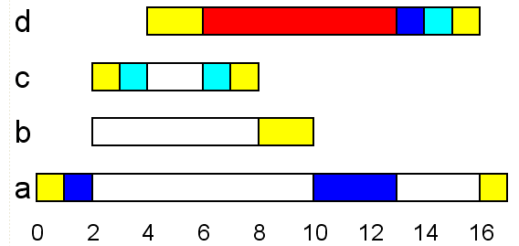
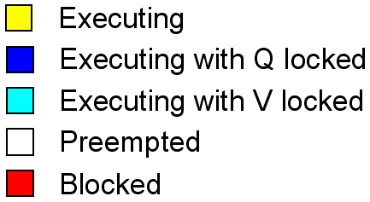
Priority inversion example
Finish this Gantt chart yourself!
t = 1
t = 2
t = 3
t = 4
t = 5
task | prio | execution | release time
d | 4 | EEQVE | 4
c | 3 | EVVE | 2
b | 2 | EE | 2
a | 1 | EQQQQE | 0

Slide 27
FPS-DMPO Priority inversion
  Task d is being blocked by task a, b, and c (all tasks with a lower priority)!
  Blocking (priority inversion) can not be avoided if we use mutual exclusive recourses.
  Blocking can be bounded by using priority inheritance:
    When a task is blocked on a resource, then the task that owns the recourse gets (inherits) the priority of the blocked task.

Slide 28
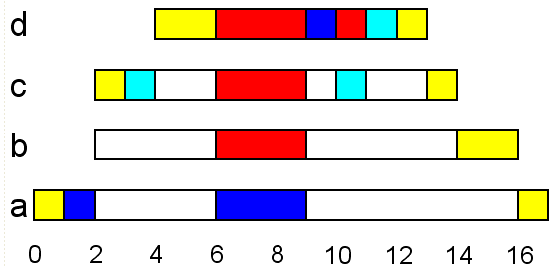
Priority inheritance example
t = 5
Finish this Gantt chart yourself!
task | prio | execution | release time
d | 4 | EEQVE | 4
c | 3 | EVVE | 2
b | 2 | EE | 2
a | 1 | EQQQQE | 0

Slide 29
Blocking Priority inheritance
  The blocked time of each task is now bounded.
  B_{i} = maximum blocking time for task i
  K = total number of resources
  usage(k, i) = Boolean function
    1 if there is a task with a priority lower than P_{i} and a task with a priority higher than or equal to P_{i} (this can be task i itself) which share resource k.
    0 otherwise.
  C_{k} = maximum time for which resource k is locked.

Slide 30
Blocking Response time analyze

Slide 31
Priority inheritance example
Calculate the maximum blocking time (B_{i}) for all tasks in the previous example
task | prio | execution | release time
d | 4 | EEQVE | 4
c | 3 | EVVE | 2
b | 2 | EE | 2
a | 1 | EQQQQE | 0
E = task only needs the processor to run
Q = task needs processor and resource Q to run
V = task needs processor and resource V to run
usage(k, i) = 1 if there is a task with a priority lower than P_{i} and a task with a priority higher than or equal to P_{i} (this can be task i itself) which share resource k.

Slide 32
Solution
task | prio | execution
d | 4 | EEQVE
c | 3 | EVVE
b | 2 | EE
a | 1 | EQQQQE
Table for usage(k, i) and B_{i}
i | k = V | k = Q | B_{i}
d | 1 | 1 | 6
c | 0 | 1 | 4
b | 0 | 1 | 4
a | 0 | 0 | 0
C_{V} = 2, C_{Q} = 4

Slide 33
Blocking Priority inheritance
  Priority inheritance can not be implemented for semaphores and message queues!
    When using a semaphore, it is often not possible to determine which task is causing the blocking (which task will call the post() for which a task blocked on wait() is waiting for)!
    Example: using a semaphore with an initial count value of zero for synchronization purposes.
    When using message passing it is often not possible to determine which task is causing the blocking (which task will perform the send() for which a task blocked on receive() is waiting for)!
  Solution: e.g., Priority Ceiling Protocol
Which task will call post()?
Task 1
Task 2
Task 3
Task 4
wait()
OS can not see into the future. Who can?
post()

Slide 34

Next weeks… Rust
Why Rust?
Performance
  Rust is blazingly fast and memory-efficient: it can power performance-critical services and run on embedded devices.
Reliability
  Rust’s rich type system and ownership model guarantee memory-safety and thread-safety — enabling you to eliminate many classes of bugs at compile-time.
Productivity

Slide 35
Report Week 3 – 6
This report should include two parts:
the relevant source codes of the weekly assignments for week 3 to 5 and a short explanation per assignment, this explanation should also include difficulties and decisions made to finish the assignment;
the elaboration of the calculation task (Dutch: rekenopdracht) you will receive in week 6.

