Slide 1
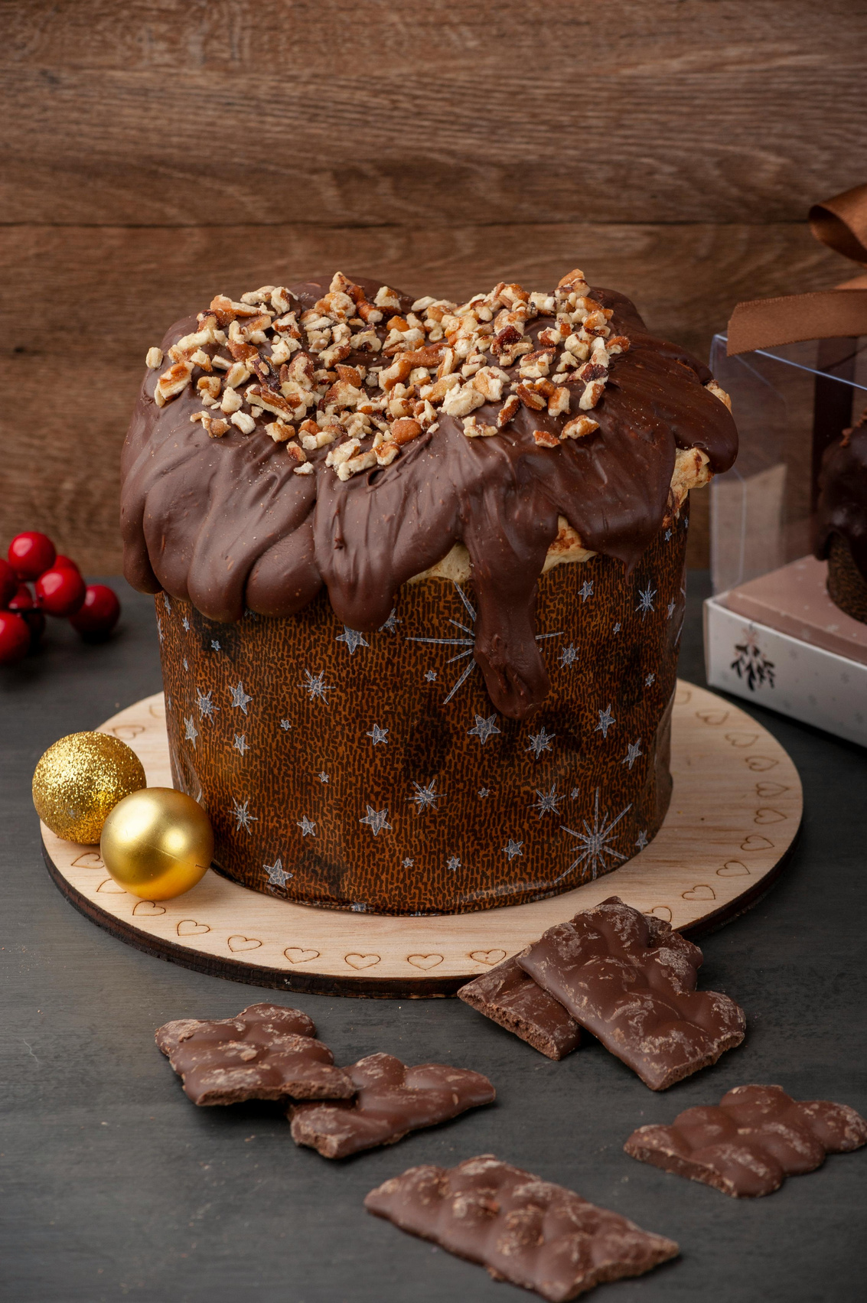
Wonka
Sales Performance
Operational Insights
Wonka
DATA & ANALYTICS DEPARTMENT
CECILE - MARISA - PAULINA - SAMIA
Chocolate Factory
Notes:
Hello everyone, we are Cecile, Marisa, Paulina and Samia, and today we’ll walk you through our analysis of the Wonka Sales Performance to identify where profitability is strong and where the business can scale smarter.

Slide 2


BUSINESS CONTEXT
B2B supplier (chocolate, sugar and other).
PROBLEM
Scaling factories for profitability.
SOLUTION
Reviewing financial figures of: factories, products, customers for profitability.
QUESTIONS
Is our business profitable currently and how do we scale profitability?
Which factory is performing the best vs worst?
Which product is performing the best vs worst?
Which customer is making the most profit vs units ?
Notes:
Our client is a B2B supplier of chocolate and related products.
Their key question is simple: Is our business profitable today, and how can we increase profitability going forward?
To answer this, we examined performance from three angles:
- factories
- products
- customers
Our goal was to understand where profit is actually being generated, and which areas require strategic decisions.

Slide 3
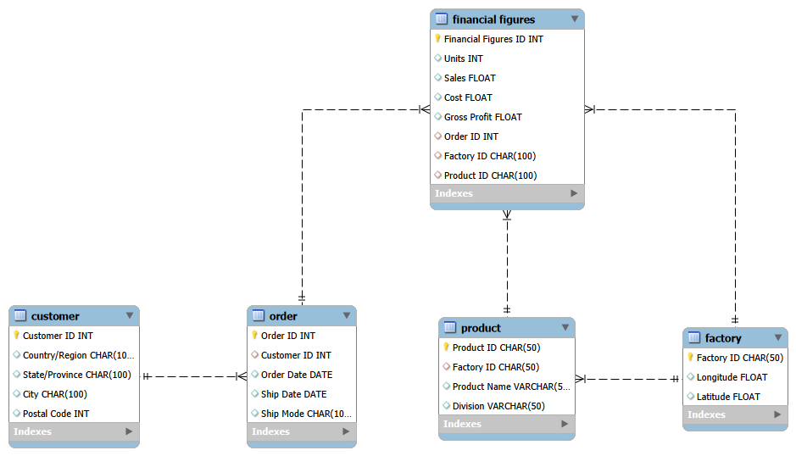

ORDER financial figures
FACTORY financial figures
PRODUCT financial figures
Notes:
This is our ERD schema.
To analyse this, we cleaned and structured the raw dataset into relational tables for Customers, Orders, Products, Factories, and Financial Figures as a bridge.
This allowed us to quantify profitability per factory, per product, and per customer using SQL and Python.

Slide 4
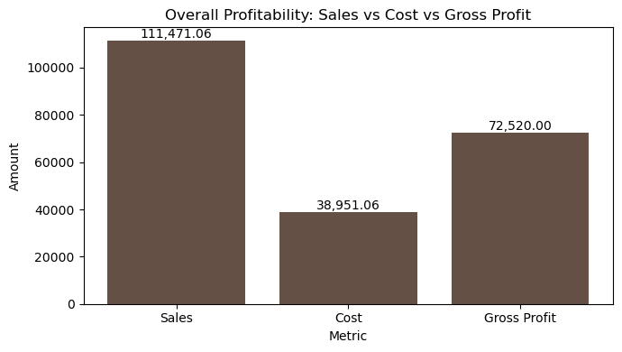
Overall Financial Health
Insight
The business is structurally profitable: all transactions generate positive gross profit (no loss-making rows).
Gross profit represents a large share of sales.
However, profitability alone does not guarantee resilience — profit concentration and margin dependency must be assessed.
Notes:
The million-dollar question is: are we genuinely riding the wellness wave, or just pretending?

Slide 5
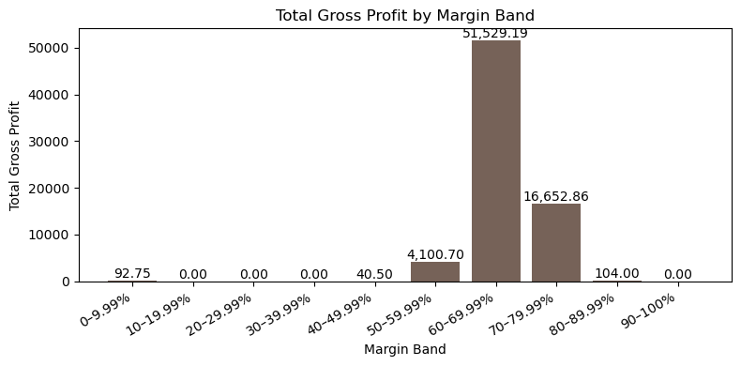
Profit Concentration Across Margin Bands
Insight
Total gross profit is highly concentrated in the 60–69% margin band, which accounts for the majority of profit generation.
The 70–79% margin band shows strong margins but significantly lower volume, limiting its total profit contribution.
Very high margin bands (80%+) exist but are negligible in volume, suggesting niche products or special cases rather than scalable drivers.
Low and mid-margin bands (<50%) contribute almost no profit, despite having some transaction presence.
text
Interpretation
text
Business Impact
Notes:
Key risk:
Profit is dangerously concentrated in the 60–69% margin band, leaving the business highly exposed if this segment experiences any decline in volume or margin.

Slide 6
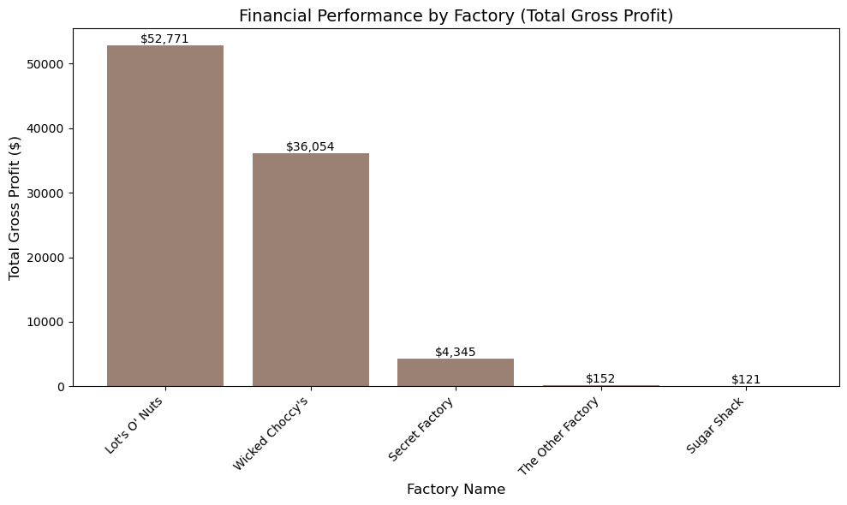
Financial Figure of the Factories
Insight
Lot’s O’ Nuts is the clear market leader followed by Wicked Choccy’s while Secret Factory contributes modestly
Interpretation
there is a huge difference between factories probably due to the products popularity, differences in product appeal, operational efficiency, or market reach between factories.
Business Impact
Risk concentration due to heavy dependence on two factories.
Diversify income streams and reduce vulnerability to operational or market disruptions.
Strategic focus: invest in improvig underperforming factories, or remove them.
Notes:
Our second insight comes from factory performance.
Lot’s O’ Nuts and Wicked Choccy’s dominate the company's profits, while Secret Factory contributes very little.
This concentration is risky. If either top-performing factory faces operational issues, the company’s revenue would be severely impacted.
The company should diversify production or improve underperforming factories to reduce dependency and stabilise profit streams.

Slide 7
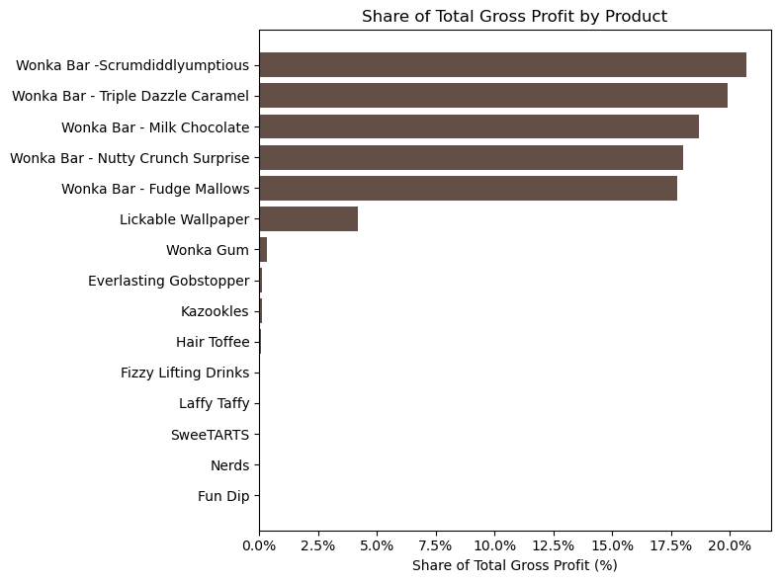
Total Gross Profit & Share of Total Profit by product
Insight
The Wonka Bar product line dominates profitability.
Five Wonka Bar variants each generate 17–21% of total gross profit, far outperforming all other products.
Interpretation
These products combine high demand and high revenue contribution, making them the core profit engine of the business.
Non–Wonka Bar products contribute less than 5% each, indicating low sales volume despite sometimes acceptable margins.
Business Impact
Allocate more production and marketing to top-performing Wonka Bars to maximise returns.
Reevaluate the portfolio of low-contribution products as some may require price adjustments, repositioning, or discontinuation due to minimal financial impact.
Notes:
Now let's move to products.
Here we see that Wonka Bar variants overwhelmingly drive total gross profit.
the others together represent over half of total profitability.
Only a handful of items contribute meaningfully.
Profitability is not evenly spread.
This suggests strong customer preference for Wonka bars and lower traction for other items.
The company should prioritise production, distribution, and marketing of high-profit items while reconsidering low-profit that dilute operational efficiency.

Slide 8
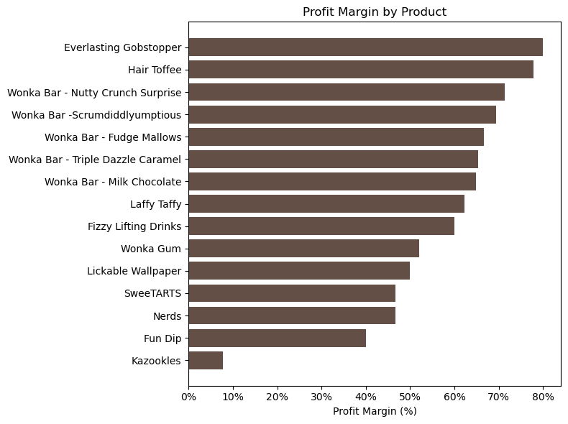
Profit Margin by Product
Insight
Everlasting Gobstopper, Hair Toffee, and several Wonka Bar variants achieve very high profit margins (70–80%).
Products like Kazookles, Fun Dip, and Nerds show significantly lower margins, indicating pricing or cost issues.
Interpretation
High-margin products are extremely efficient, they generate strong profit per unit sold.
Low-margin products may struggle with poor pricing, higher production costs, or low perceived value.
Business Impact
Maintain or slightly increase prices on high-margin products to further capitalise on strong profitability.
Review pricing structures for low-margin items; consider reformulation, cost reduction, or repositioning in the market.
Prioritise production capacity for products that combine both high margin and high total profit.
Notes:
When we look at profit margin, the pattern becomes even clearer.
Products like Everlasting Gobstopper, Hair Toffee, Nutty Crunch Surprise, and Scrumdiddlyumptious deliver margins above 70–80%.
In contrast, Kazookles and Fun Dip barely produce any margin at all.
High margin does not depend on volume. Premium items consistently outperform in profitability efficiency.
The business achieves the best ROI when selling premium products, even if volumes are lower.
Management should consider:
- increasing prices on premium high-margin items,
- reducing or reformulating unprofitable products,
- and shifting marketing focus toward the top margin performers.

Slide 9
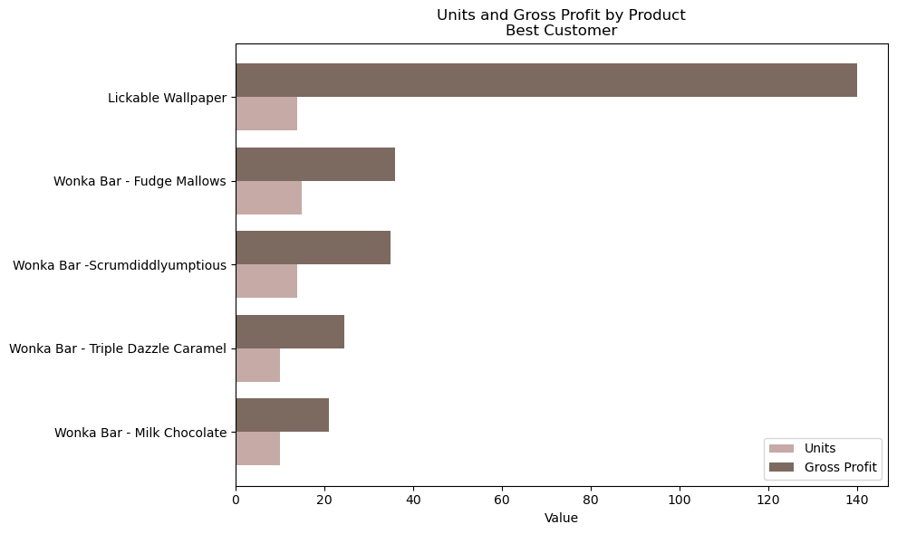
Best Customers profitability vs units
Insights
Lickable Wallpaper drives disproportionate profit for the best customer despite modest unit volume.
Interpretation
Premium products generate far higher margins than staple bars.
Profit is concentrated in one hero item.
Business Impact
Target a few high‑margin products to boost ROI and avoid relying on low‑margin volume.
Notes:
Our customer analysis shows that some customers generate high profit with relatively low unit purchases, because they buy the most profitable items.
Customer segmentation must shift from volume-based to value-based. Identify premium customers and incentivise them with loyalty programs or exclusive offers.

Slide 10
Conclusions
Limitations
Conclusion for Factories Finance
Limitation for Factories
01
01
The diagram shows that profits are heavily concentrated in two factories, creating strong performance but also increasing risk. To ensure sustainable growth, the business should improve or rationalize weaker factories while continuing to support its top performers.
The analysis is limited because it lacks cost structure details, qualitative insights such as customer preferences and product perception, and does not account for differences in factory size or capacity, which may lead to misleading conclusions.
Conclusion for Product Profitability
Limitation for Product
02
02
The analysis shows that profitability is highly concentrated in a small group of premium products, especially Wonka Bar variants. These items generate the majority of total gross profit and consistently deliver high profit margins, regardless of volume.
Product performance may be influences by factores not captured in the data, such as marketing spend, seasonal demand, brand perception or product lifecycle stage. Without visibility into these elements, the analysis reflects financial outcomes but cannot fully explain market dynamics or identify whether low-profit products are inherently weak or simply underpromoted.
Conclusion for Customers
03
Customer profitability does not correlate with purchase volume. Instead, it depends on the mix of products purchased. Some customers generate high profit despite lower quantities because they consistently choose premium, high margin items. This highlights the importance of shifting from a volume-driven approach to a value-driven strategy. Identifying high-volume customer segments will help maximise long-term profitability.
Limitation for Customers
03
Customer-level insights are limited by the lack of demographic, behavioural or industry information. Without understanding who the customers are or why the choose cerain products, it’s challenging to develop tailored customer strategies. The analysis identifies profitability patterns but cannot determine customers motivations or long-term purchasing potential.
Notes:
For our conclusions, bringing everything together:
1. Factory performance is highly uneven, creating operational risk but also opportunity for scaling the best performers.
2. Product profitability is heavily concentrated in a few Wonka Bars.
Expanding this line has the highest ROI.
3. Customer profitability depends more on what they buy, not how much.
We should strategically influence product mix per customer rather than pushing volume.
Limitations-wised, our analysis is strong, but we acknowledge some limitations:
- We lack cost structure per factory, so we can’t fully diagnose why some are unprofitable.
- We don’t have marketing or regional demand data, which likely affects product performance.
- We don’t know each factory’s production capacity, which may constrain output.
- Customer segmentation data is limited, preventing deeper behavioral insights.
Despite these limitations, our findings provide a solid foundation for strategic recommendations

Slide 11
Recommendation
In summary, the business is profitable, but profitability is concentrated in a few products and factories.
Scaling high-margin products, improving or eliminating underperforming factories, and segmenting customers based on profitability are the key levers to sustainable growth.
Notes:
For our conclusions, bringing everything together:
1. Factory performance is highly uneven, creating operational risk but also opportunity for scaling the best performers.
2. Product profitability is heavily concentrated in a few Wonka Bars.
Expanding this line has the highest ROI.
3. Customer profitability depends more on what they buy, not how much.
We should strategically influence product mix per customer rather than pushing volume.
Limitations-wised, our analysis is strong, but we acknowledge some limitations:
- We lack cost structure per factory, so we can’t fully diagnose why some are unprofitable.
- We don’t have marketing or regional demand data, which likely affects product performance.
- We don’t know each factory’s production capacity, which may constrain output.
- Customer segmentation data is limited, preventing deeper behavioral insights.
Despite these limitations, our findings provide a solid foundation for strategic recommendations

Slide 12

Thank You.
Notes:
In summary, the business is profitable, but profitability is concentrated in a few products and factories.
Scaling high-margin products, improving or eliminating underperforming factories, and segmenting customers based on profitability are the key levers to sustainable growth.
Thank you, and we’re happy to take questions

