Slide 1

Computer Science
–Invent the Future–
Notes:
Part 1: Introduction – Learn a bit about computer science Slides 1-7 (Lecture)
Slide 1
Introduce yourself and thank your host for inviting you to visit.
You might tell the class you are excited because it’s a chance to share information about an area of life and work that people don’t know a lot about, but is really powerful and exciting – Computing and Computer Science.
You might ask them about this first slide– what seems “computery” about it?
They might say things like, It looks futuristic, 0’s and 1’s are binary code, the image of the woman might be the basis for CGI (computer-generated imagery) for a movie– don’t go into detail just acknowledge their statements and encourage them to keep wondering aloud about what they hear and see in the presentation.

Slide 2
Today… YOU
Learn a bit about Computer Science
Give it a try!
Examine how your interests & skills connect to CS
Explore paths to careers
Consider next steps
Notes:
Part 1: Introduction – Learn a bit about computer science Slides 1-7 (Lecture)
Slide 2
Say: Here is an agenda for our hour together. [Expand on each a bit ]

Slide 3
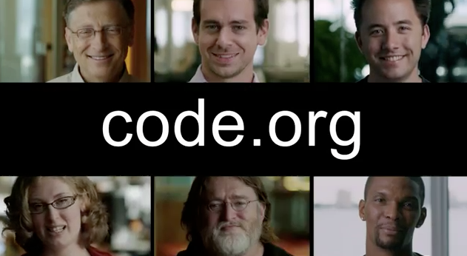
Notes:
Part 1: Introduction – Learn a bit about computer science Slides 1-7 (Lecture)
Slide 3
Say: You saw this video the other day. Who’s this guy? [Chris Bosh]? What do you remember, what resonated with you? Turn to a neighbor and talk for a minute then we’ll discuss it as a group.
Wait for one minute then reconvene. Let kids riff for a minute, comment as appropriate.
Ask: Are any of you already doing some programming?

Slide 4
The computer is incredibly fast, accurate, and stupid. Man is unbelievably slow, inaccurate, and brilliant.
The marriage of the two is a force beyond calculation.
-Leo Cherne
Notes:
Part 1: Introduction – Learn a bit about computer science Slides 1-7 (Lecture)
Slide 4
Say: Consider this quote from Leo Cherne. [pause for kids to read.]
Say: What does Cherne mean? Do you believe you are smarter than a computer? All it takes is learning how to code.

Slide 5
“Everybody in the country should learn how to program a computer... Because it teaches you how to think.”
-Steve Jobs
Notes:
Part 1: Introduction – Learn a bit about computer science Slides 1-7 (Lecture)
Slide 5
Say: Remember this Steve Jobs quote from the Code.org video? Can you imagine how programming a computer teaches you to think? [Kids respond]

Slide 6
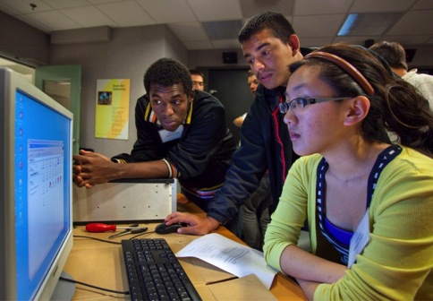
What is Computer Science?
CS is posing a problem in such a way that a computer can help us solve it.
  Communicate
  Solve problems
  Design and imagine
  Share, store, retrieve or manipulate information
Notes:
Part 1: Introduction – Learn a bit about computer science Slides 1-7 (Lecture)
Slide 6
Say: In a nutshell, here’s a definition of CS we’ll operate from today. Read the slide.

Slide 7


What is Computer Science?
CS is designing computing devices and programming them
Notes:
Part 1: Introduction – Learn a bit about computer science Slides 1-7 (Lecture)
Slide 7
Say: All that work goes into making technology that works for us.
Read slide, “CS is designing…”
Then say: Think about cell phones. They are just tiny computers. Any time you change the ring tone or screen background or launch an app you are running a computer program. A layer of software a human programmer wrote interprets your key strokes so the computer changes how it operates.
Have any of you ever wanted to make a phone work better or differently? [responses]. A lot of computer science is about improving technology-- making it faster, smaller or able to do new things. It’s powerful!

Slide 8
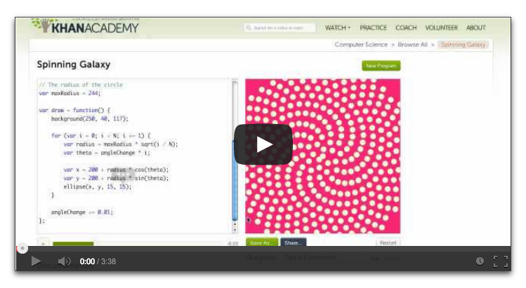
Notes:
PART 2 – See programming in action (web video) - Give it a try (Activity) Slides 8-9
Slide 8
Say: There are lots of ways to get started with CS. We’ll look at more of them later, but here’s a quick look at one. Khan Academy is a website with many free, online courses you can take. In this video, you don’t learn to code from scratch, instead you start by seeing how code works and by manipulating an existing program. This video is an introductory “teaser” to their Computer Science course.
Note: This slide is linked to the online video http://www.khanacademy.org/cs/1-welcome-to-codecanvas/882454257. Click the image and the video will start.
After the video plays encourage comments.

Slide 9
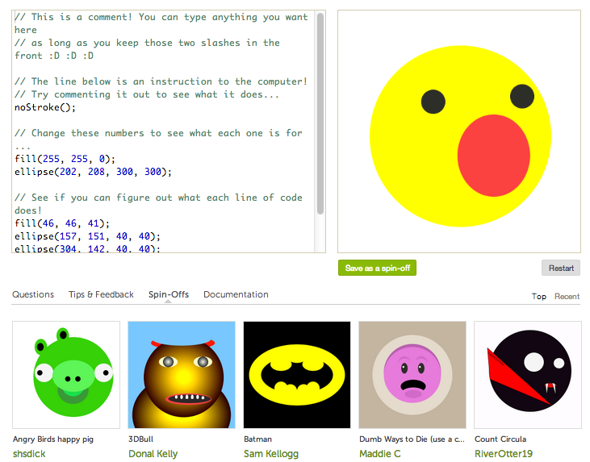
TRY any
http://goo.gl/JRySP
TRY spinning galaxy
http://goo.gl/tVCwa
Notes:
PART 2 – See programming in action (web video) - Give it a try (Activity) Slides 8-9
Slide 9
Say: The video showed a basic computer program– a few lines of code that made the spiral and its color and controlled the animation. Do any of you play the game Rome 2? Guess how many lines of code goes into it? [Let students’ guess] 3 MILLION --enough lines stacked, to reach five times higher than Mt. Everest. Huge teams work on that game, and lots of the coding is automated, but still, that’s a lot of code!
Now it is your turn to see what code does by manipulating an existing program. You’re going to team up and pick any of these that other people programmed [indicate bottom of screen-- first URL: http://goo.gl/JRySP ] or go to the spinning galaxy that was shown in the video [indicate second URL: http://goo.gl/tVCwa ]. You can hit reset to return to the original. You have five minutes to fool with these programs and also browse the Khan CS course a bit if you want.
NOTE: In the middle of the 5 minutes remind kids they can browse around the CS course a bit, look at the different lessons.
After 5 minutes ask kids to simple close the lids on the computers. Ask: Was that fun? Doable? What did you think? Might you come back to it? Ask: Did anyone browse the course?

Slide 10

Notes:
PART 3: Computing is at the heart of everything. (Lecture) Slides 10-18
Slide 10
Let’s talk about WHERE Computer Science shows up in the world.
Poll the class. Say: Some of you might have an idea of what you want to do after school. Anyone care to share?
Say: If you’re interested in topics like these (orange topics on screen) there are a lot of ways to get involved in computing. Let’s dig in to just a few areas.

Slide 11
Computing Connects
music
business
manufacturing
communications
advertising
engineering
accounting
the arts
safety systems
science
Only 50% of tech jobs are at technology companies
criminal justice
recreation
veterinary medicine
sports
agriculture
pharmaceuticals
banking
law
automotive
photography
military
architecture
medicine
entertainment
design
politics
journalism
transportation
health care
Notes:
PART 3: Computing is at the heart of everything. (Lecture) Slides 10-18
Slide 11
Say: You might be surprised to know only half of computing jobs are in high tech companies! You could mash up your interests in other careers with technology and work anywhere.
Ask: Do you see a field here that interests you? Could you imagine how technology might be important to it? (Let student’s reply)

Slide 12
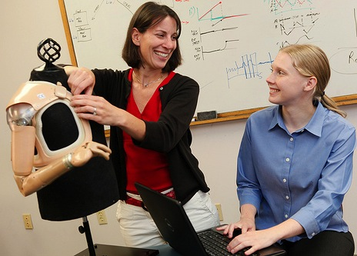
Computing Connects to Other Careers
For instance: Are you interested in health fields? You might want to study…
…robotics and invent digital prostheses
…computer engineering and build the next generation of laser surgical tools
…bioinformatics and design a life-saving drug
Notes:
PART 3: Computing is at the heart of everything. (Lecture) Slides 10-18
Slide 12
Say: Since computing is an applied science, it underpins innovations across whole fields. If you were interested in medicine for example, you could be part of a new innovation in health care.

Slide 13





Computer Science is
information systems
Are you someone who:
Understands relationships?
Likes to do things efficiently?
Is interested in business and connecting people?
Notes:
PART 3: Computing is at the heart of everything. (Lecture) Slides 10-18
Slide 13
INFORMATION SYSTEMS
Say: Computing connects people to businesses and to information and to each other!

Slide 14
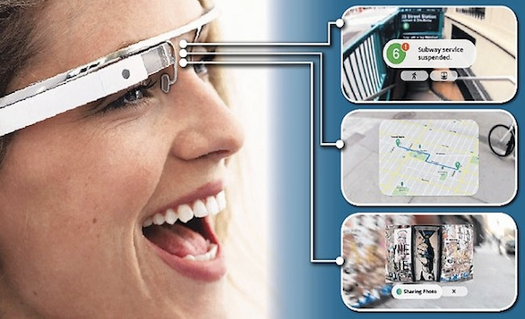
Computer Science is
engineering new products
Do you want to:
Create devices that can do the work for you?
Google Glass
Notes:
PART 3: Computing is at the heart of everything. (Lecture) Slides 10-18
Slide 14
COMPUTER ENGINEERING
Say: Computing is part of designing new products, not just technical ones. But here’s Google Glass, the first wearable computer.

Slide 15
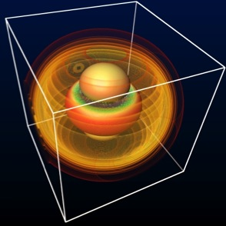
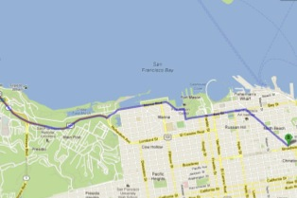

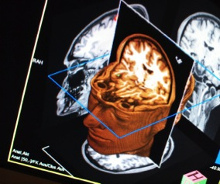
Computer Science is
visualizing and creating imagery
Do you like:
Art?
Science?
Game Design?
Theater?
Movies?
Notes:
PART 3: Computing is at the heart of everything. (Lecture) Slides 10-18
Slide 15
VISUALIZATION AND GRAPHICS
Computing is a big part of visualization and imagery. You’ve seen computer-generated graphics in movies and video games. It’s useful in science, too, to picture a problem or process.

Slide 16
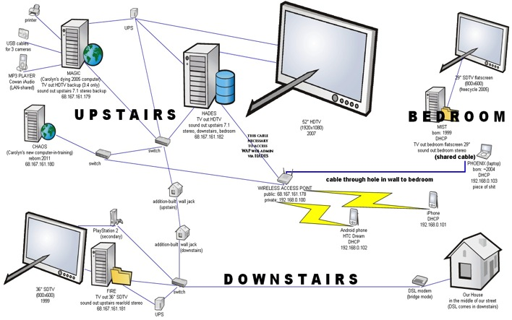
Computer Science is
Infrastructure and Networks
Do you want to help:
Keep computer systems up and running?
Invent new ways for technologies to connect?
Notes:
PART 3: Computing is at the heart of everything. (Lecture) Slides 10-18
Slide 16
INFRASTRUCTURE AND NETWORKS
Computing is also the connections, the networks between computers.

Slide 17

Computer Science is
Computer Forensics and Cyber Security
Do you want to help:
Solve crime?
Keep us safe?
Secure information?
Notes:
PART 3: Computing is at the heart of everything. (Lecture) Slides 10-18
Slide 17
COMPUTER FORENSICS AND CYBER SECURITY
Say: Lots of people work to keep computers safe from hackers. People also use computers to solve crimes.

Slide 18

Computer Science is
Design
Do you want to:
Make models?
Design cars, houses, fashion, anything?
Notes:
PART 3: Computing is at the heart of everything. (Lecture) Slides 10-18
Slide 18
DESIGN and MODELING
Say: People in the arts and architecture rely on design software all the time.
Say: Now let’s talk about how people get into computing

Slide 19
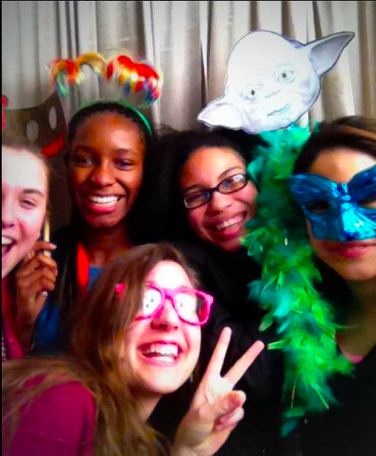
Paths to Careers
How people get started in Computer Science
Notes:
Part 4: Paths to Careers – How people get started in Computer Science Slides 19-24
Slide 19
Say: Let’s talk about how people get started. It varies a lot. Do some of you have programming experience now? Some kids teach themselves, others get started with camps, clubs, classes and competitions. These girls got started in different ways and all met when they got awards for their work in computing.

Slide 20
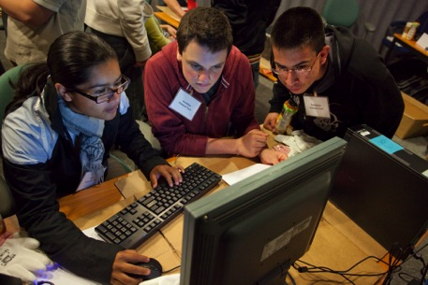
Paths to Careers
What skills does CS require?
Computer Science might be right for you if you have…
Curiosity and imagination
Flexible, creative thinking
Work ethic – make an effort in math and science
Communication skills in order to tackle challenges with others
Notes:
Part 4: Paths to Careers – How people get started in Computer Science Slides 19-24
Slide 20
Point to to the list of skills and say: This is the skill set of people who accomplish a lot through computer science. These skills are essential to working on technical teams and to invent new ways of doing things with computers.
Say: Could you see yourself in computing?

Slide 21

Paths to Careers: How do people get started?
Keep taking Science and Math
Learn Computer Science
A first high school CS course might have you studying…
Human Computer Interactions
Problem Solving
Web Design
Introduction to Programming
Robotics
Computing Applications
Notes:
Part 4: Paths to Careers – How people get started in Computer Science Slides 19-24
Slide 21
NOTE: Discuss with the host in advance what computer science offerings are available and add a second slide following this one.
Say: A course called Exploring Computer Science is being introduced in high schools all around the country now. In Exploring Computer Science and other courses like these, kids are studying many of the topics you see here.

Slide 22
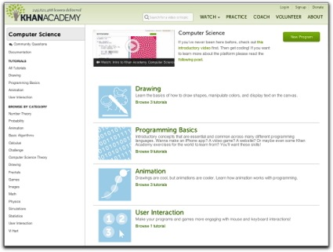
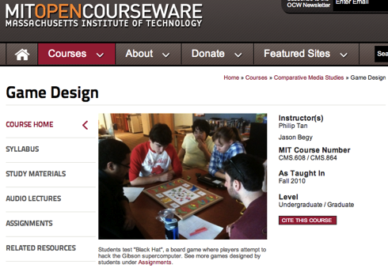
Paths to Careers: How do people get started?
Learn Computer Science
You might study on your own or with buddies…
Take an online class…
Notes:
Part 4: Paths to Careers – How people get started in Computer Science Slides 19-24
Slide 22
Say: You don’t have to wait. You might study on your own or with buddies. You could take an online course like the Khan Academy one we saw, or take this free, online game design course that MIT offers…

Slide 23
Sample First Year College Courses
Purdue University, Indiana
Problem-solving and object-oriented programming
Programming in C
Computer Architecture
University of California, Berkeley
Beauty and Joy of Computing
Introduction to CS Theory
Operating Systems and System Programming
University of Illinois
Little Bits to Big Ideas
Theory of Computation
Introduction to Programming
Notes:
Part 4: Paths to Careers – How people get started in Computer Science Slides 19-24
Slide 23
Explain to students that courses in the CS major vary from school to school but here are first year courses at three Universities. First year community college courses would be similar.

Slide 24
Other Courses
Artificial Intelligence
Design and Analysis of
Probabilistic Systems
Linear Algebra
Software Design
Programming Languages
Critical Thinking in Technology
Networks & Data Communications
E-business/Web Development
Adv. Programming
Computers and Society
Software Project Management
CSI Computer Programming
Network Security and
Hacking Prevention
PC Forensics
The Meaning of Information
Technology
Fundamentals of Digital Design
Theory of Computing
Computer Architecture
Notes:
Part 4: Paths to Careers – How people get started in Computer Science Slides 19-24
Slide 24
Here are additional courses. Notice there are CSI and forensics ones, software design, and artificial intelligence…

Slide 25

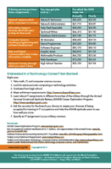
Computing Careers
Among the fastest growing,
stable and flexible
offering good salaries
Examine Pathway Cards. Pair up and read. What do you notice?
Examine careers that connect with your interests at http://goo.gl/MlnCU (type the web address carefully)
Report back
Notes:
Part 5: Paths to Careers (Activity)
Slide 25
THIS SLIDE SUPPORTS TWO ACTIVITIES: 1) Examining the pathways card, 2) Career cruising from URL shown.
1) Say: You have one of three “Pathway” cards. It shows a route to computing by getting a 4-year university degree, military experience, or a 2-year or community college degree. With your partner, examine these cards, front and back, for two or three minutes and talk them over. You can swap with another pair who has a different card if you want.
Reconvene after three minutes or so and ask: What do you notice? Anything interesting here? Questions? Did some match to your interest more than others?
If the Merging Pathways poster is in the room say: There are different ways to get started in CS. The poster shows how the different ways connect. You might want to look at it closer later.
Get ready to go online with URL shown. [http://goo.gl/MlnCU]
2) Say: Next, let’s dig in to some careers information. Think about some of the occupations you saw on the card. Go to this website and examine a few . Talk with your partner as you browse. When you’re done be ready to share what you found.
Share out.

Slide 26

Learn More!
Takeaway Tech information on…
Programming, Robotics and other Computing Activities
Camps, Clubs, Competitions
Computing Careers
Opportunities for Self- Study
Go to: www.ncwit.org/takeaway
Notes:
Part 6: Takeaway Tech
Slide 26
If time allows, give students time to explore computing experiences they can get involved in right now.
Direct them to the URL shown on the slide [www.ncwit.org/takeway] and with a partner, spend 10 minutes browsing.
Encourage them to find several experiences that interest them and to tell their neighbors.

Slide 27

Notes:
END
Slide 27
Say: Thank you for your time. There’s a big world of computing out there and it would be great if you were part of it. Who knows? You could work like these Google employees in Australia! Have fun and see where your interests take you!

