Slide 1
AP_Corrected

Slide 2
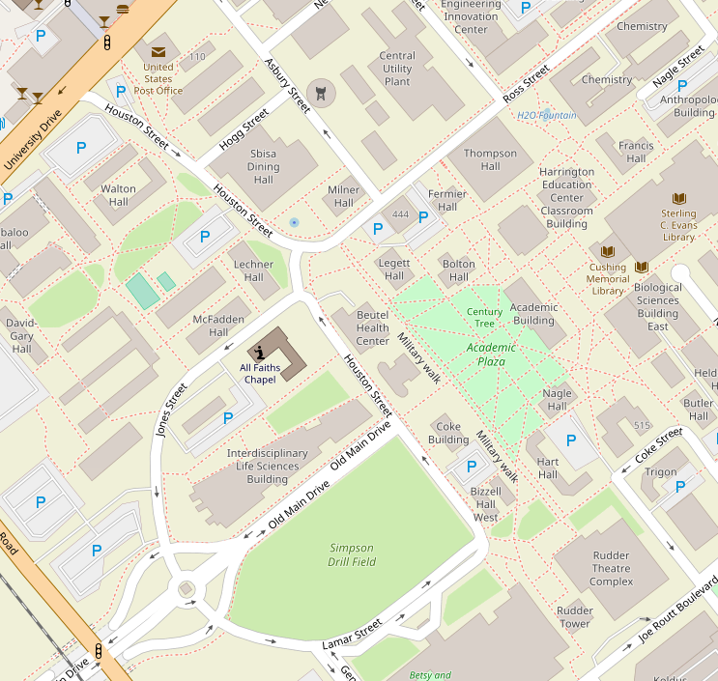
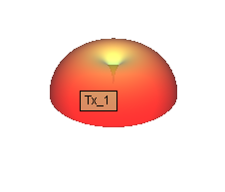

Slide 3
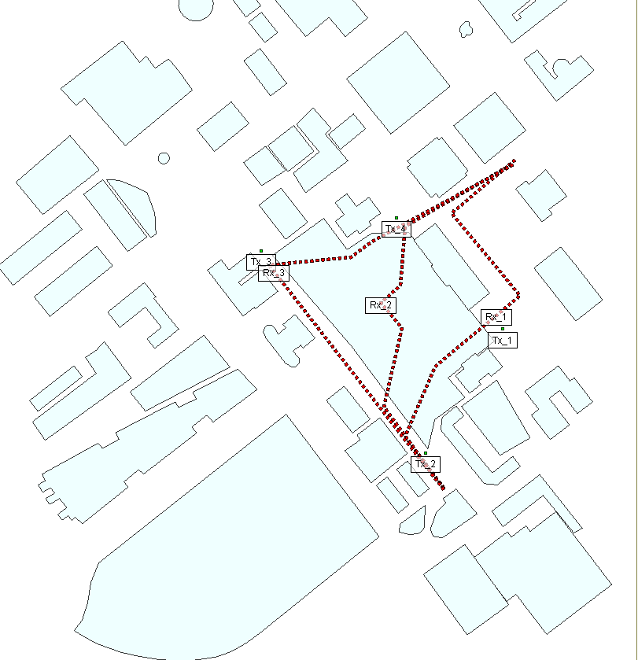
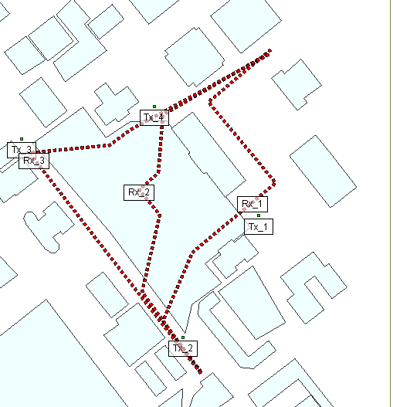
Rx123 and Tx1234

Slide 4
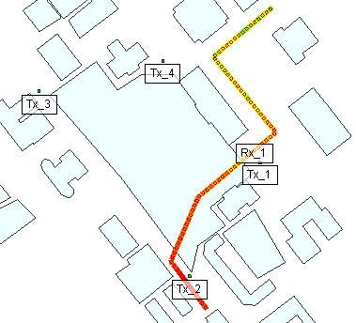
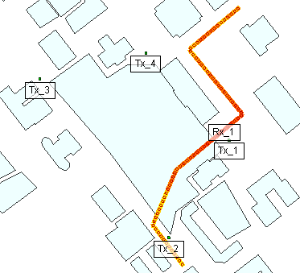
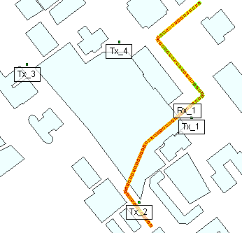
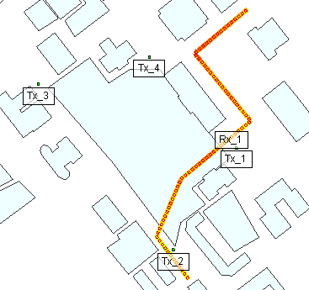
Rx1_O_300 MHz

Slide 5
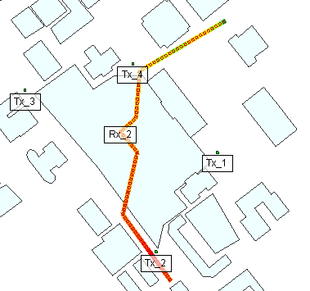
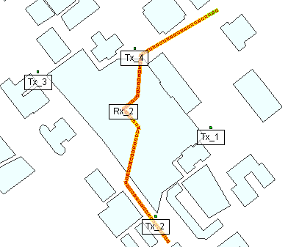
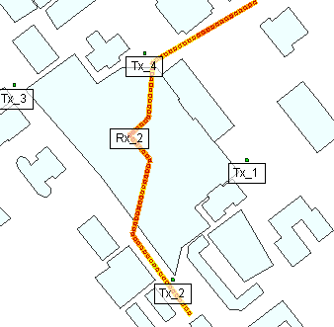
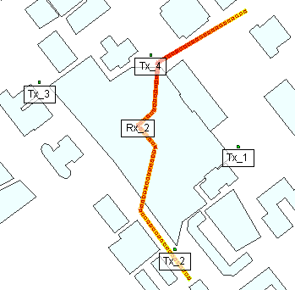
Rx2_O_300 MHz

Slide 6
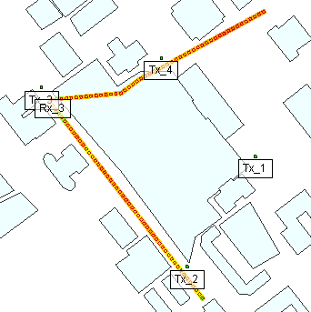
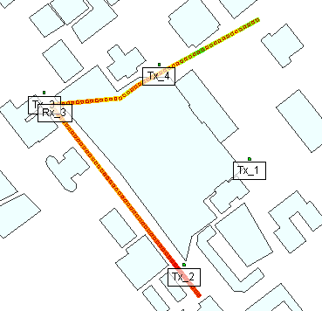
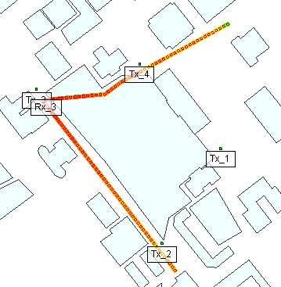
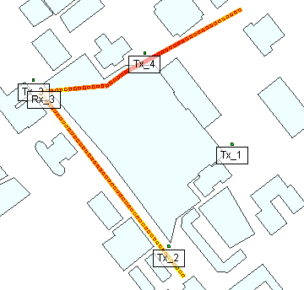
Rx3_O_300 MHz

Slide 7
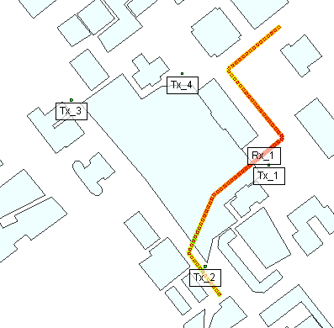
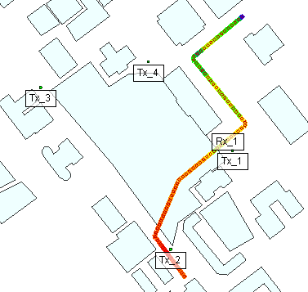
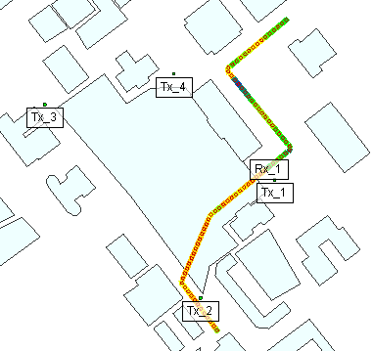
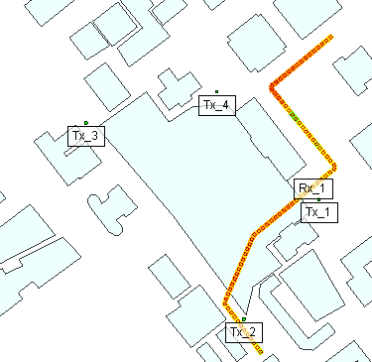
Rx1_O_900 MHz

Slide 8
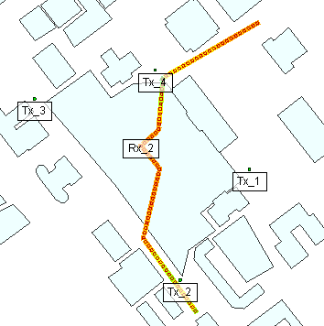
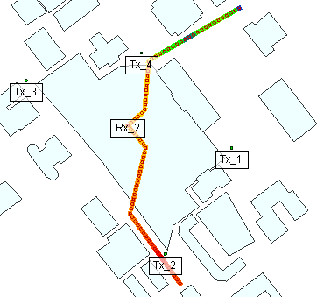
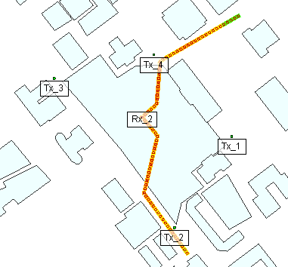
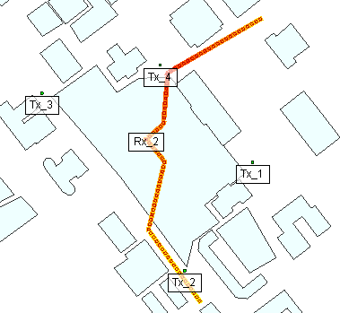
Rx2_O_900 MHz

Slide 9
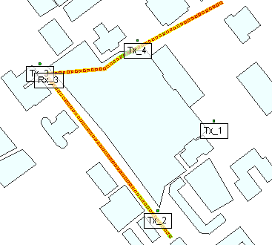
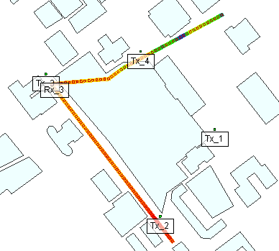
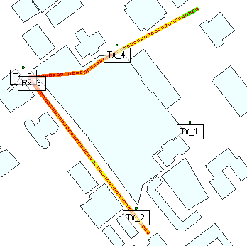
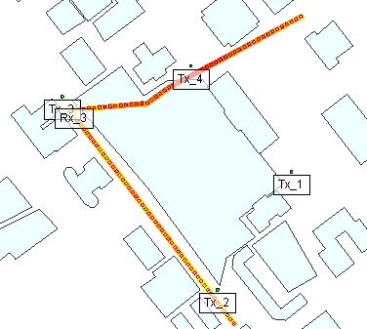
Rx3_O_900 MHz

Slide 10
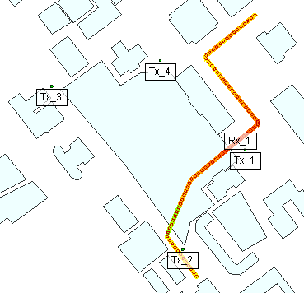
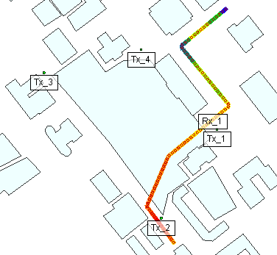
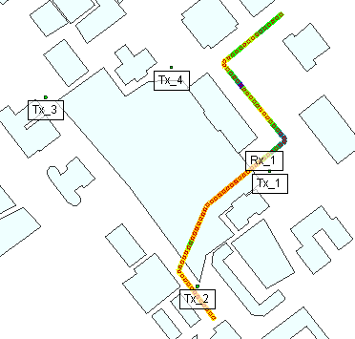
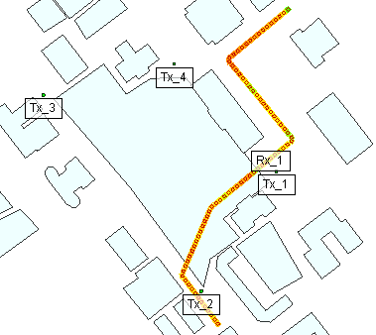
Rx1_O_2.5 GHz

Slide 11
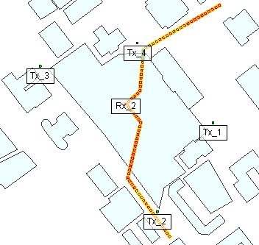
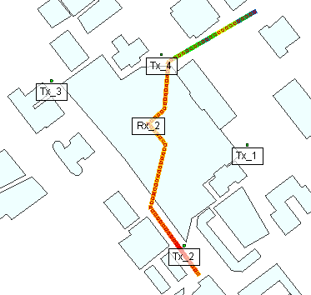
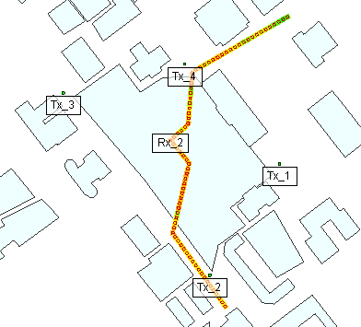
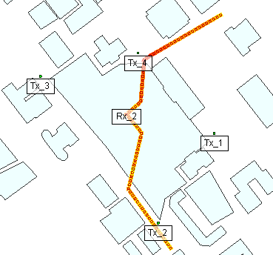
Rx2_O_2.5 GHz

Slide 12
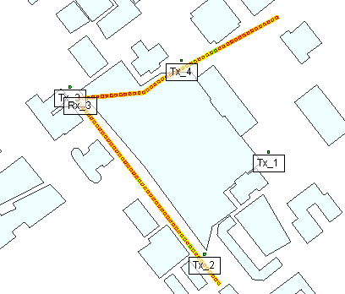
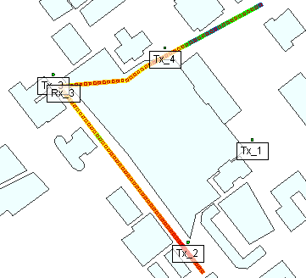
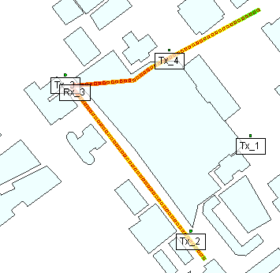
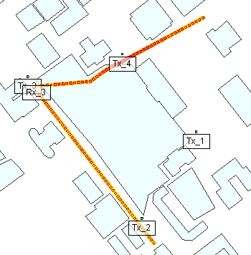
Rx3_O_2.5 GHz

Slide 13
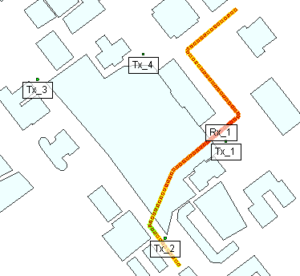
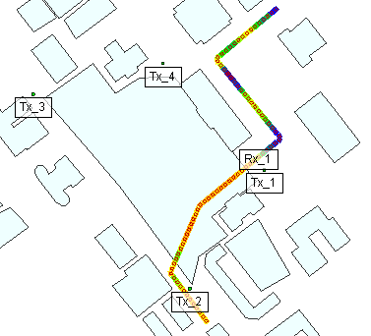
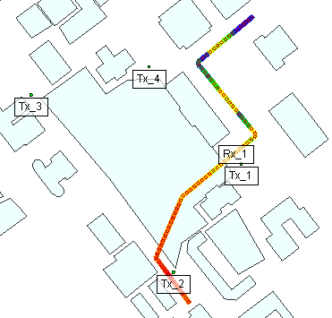
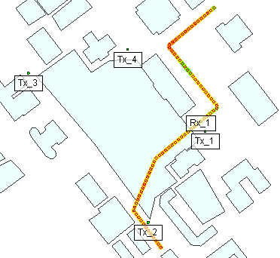
Rx1_O_5.8 GHz

Slide 14
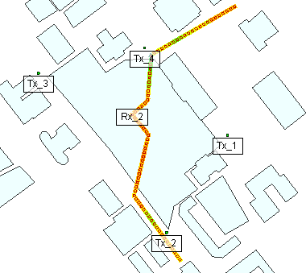
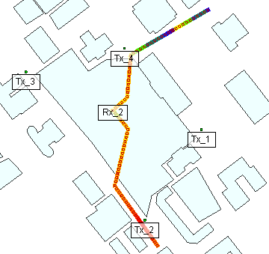
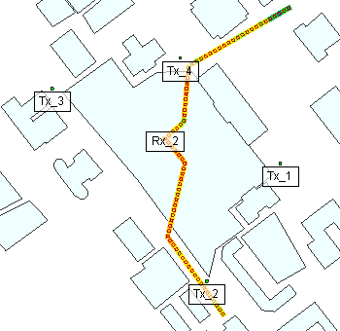
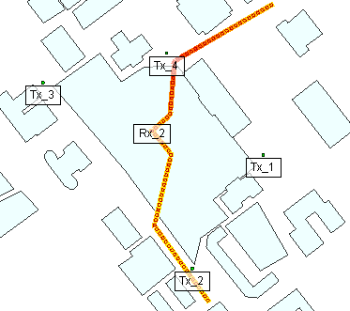
Rx2_O_5.8 GHz

Slide 15
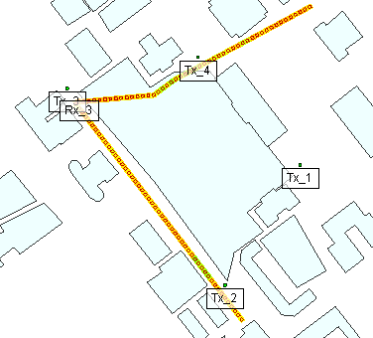
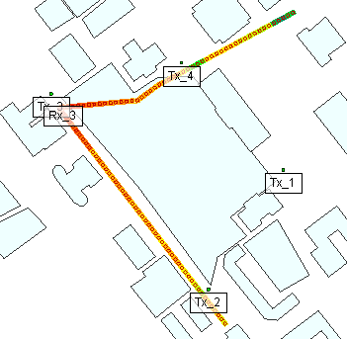


Rx3_O_5.8 GHz

Slide 16




Rx1_H_300 MHz

Slide 17




Rx2_H_300 MHz

Slide 18




Rx3_H_300 MHz

Slide 19




Rx1_H_900 MHz

Slide 20




Rx2_H_900 MHz

Slide 21




Rx3_H_900 MHz

Slide 22




Rx1_H_2.5 GHz

Slide 23




Rx2_H_2.5 GHz

Slide 24




Rx3_H_2.5 GHz

Slide 25




Rx1_H_5.8 GHz

Slide 26




Rx2_H_5.8 GHz

Slide 27




Rx3_H_5.8 GHz

Slide 28




Rx1_OT_300 MHz

Slide 29




Rx2_OT_300 MHz

Slide 30




Rx3_OT_300 MHz

Slide 31
Rx1_OT_900 MHz

Slide 32
Rx2_OT_900 MHz

Slide 33
Rx3_OT_900 MHz

Slide 34




Rx1_OT_2.5 GHz

Slide 35




Rx2_OT_2.5 GHz

Slide 36




Rx3_OT_2.5 GHz

Slide 37
Rx1_OT_5.8 GHz

Slide 38
Rx2_OT_5.8 GHz

Slide 39
Rx3_OT_5.8 GHz

Slide 40




Rx1_OT_900 MHz_2

Slide 41




Rx2_OT_900 MHz_2

Slide 42




Rx3_OT_900 MHz_2

