Slide 1
491 Update
Akshay Jagadeesh

Slide 2
Description
Problem: Determine location in Weisenbaker using Wi-Fi signal strengths, but doing it through machine learning.
Input: Local RSSI values, locations
Output of algorithm: There is x% chance that you are next to room y.

Slide 3
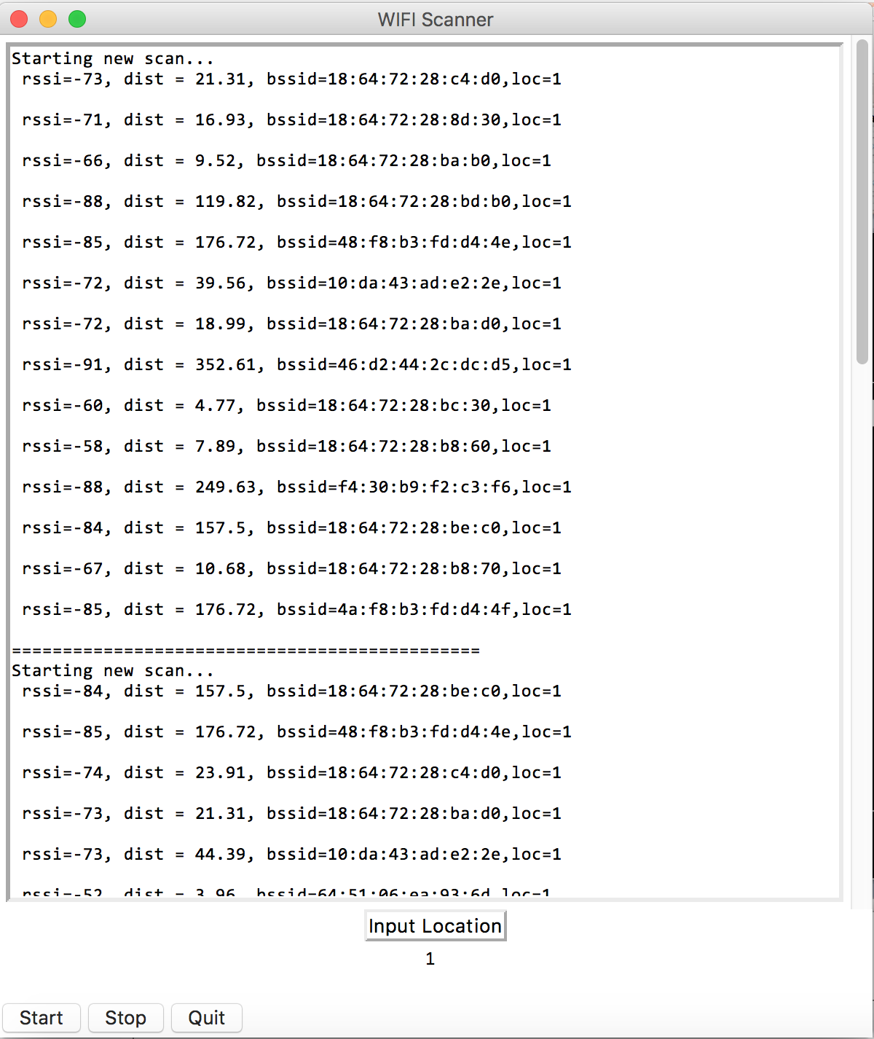
APP

Slide 4
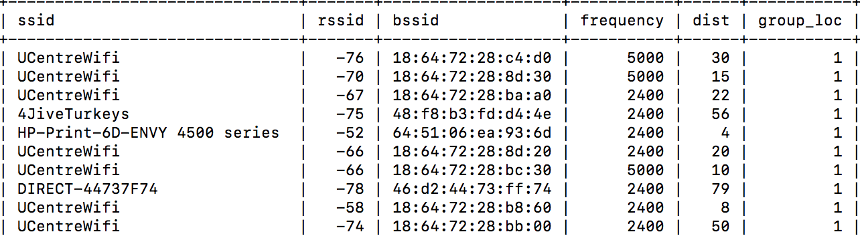
Data Representation

Slide 5
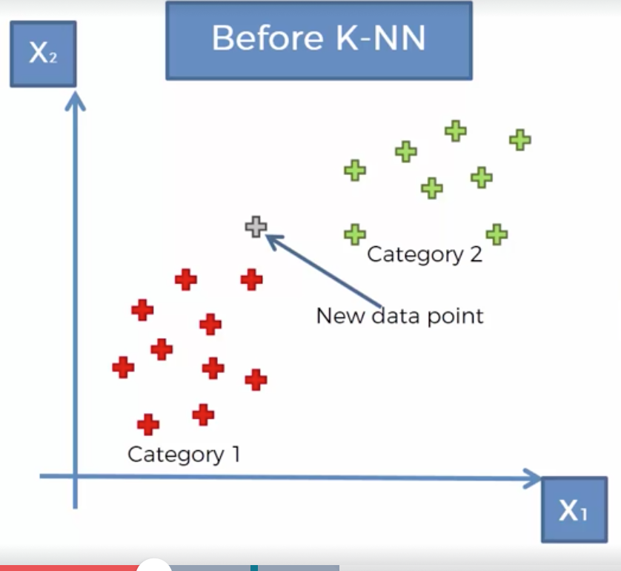
KNN

Slide 6
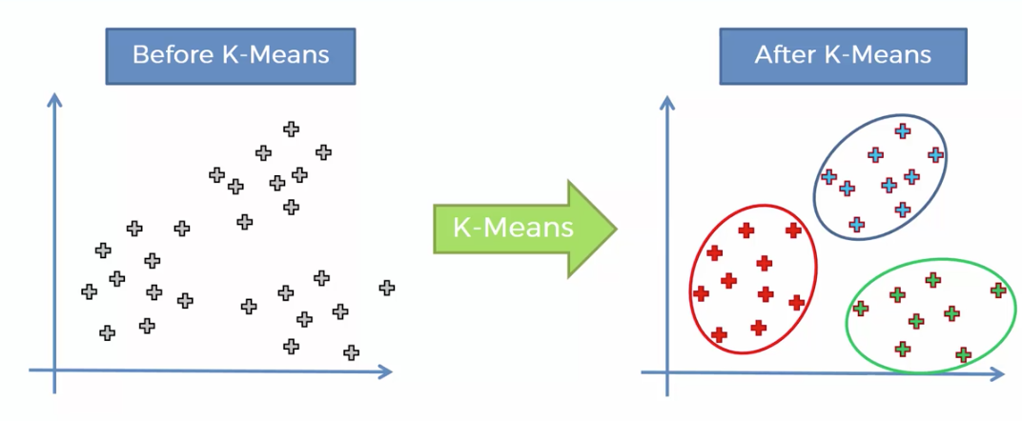
K-means

Slide 7
Current Status
Ongoing: Experimenting with LDA(Linear Discriminant Analysis)
Dropped Distance model
Highest Prediction Percentage accuracy = 44%

Slide 8
Next Goals
Continue to look at LDA.
Look at Tensorflow Libraries

Slide 9
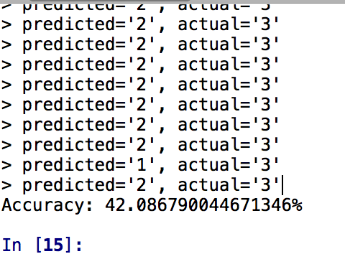
Prediction

Slide 10
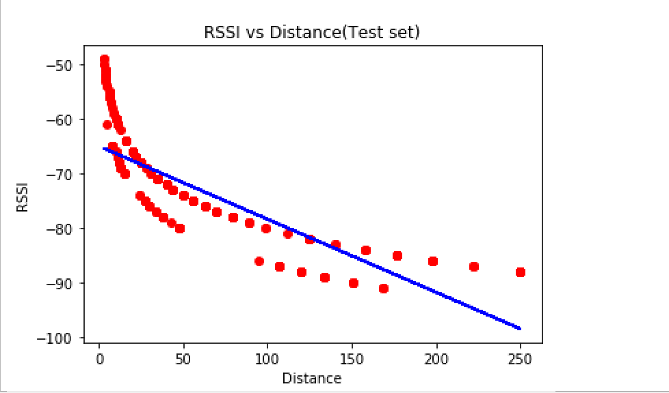
Linear Regression

Slide 11
Outline of Progress
Successfully created Data collection application.

Slide 12
Distance Calculation
Use signal degradation formula
FSPL = Free Space Path loss

Slide 13
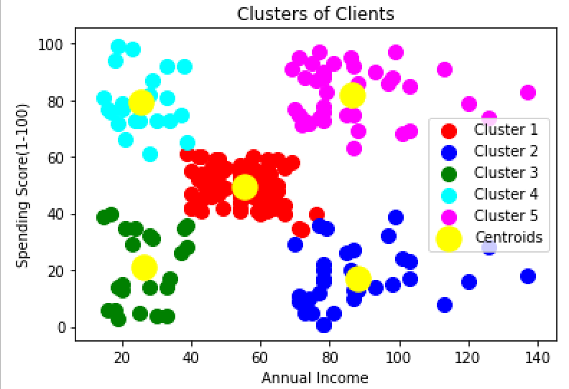
K Clustering example

Slide 14
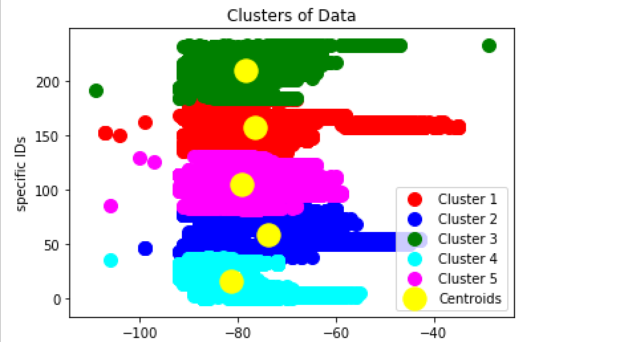
BSSID vs RSSI

Slide 15
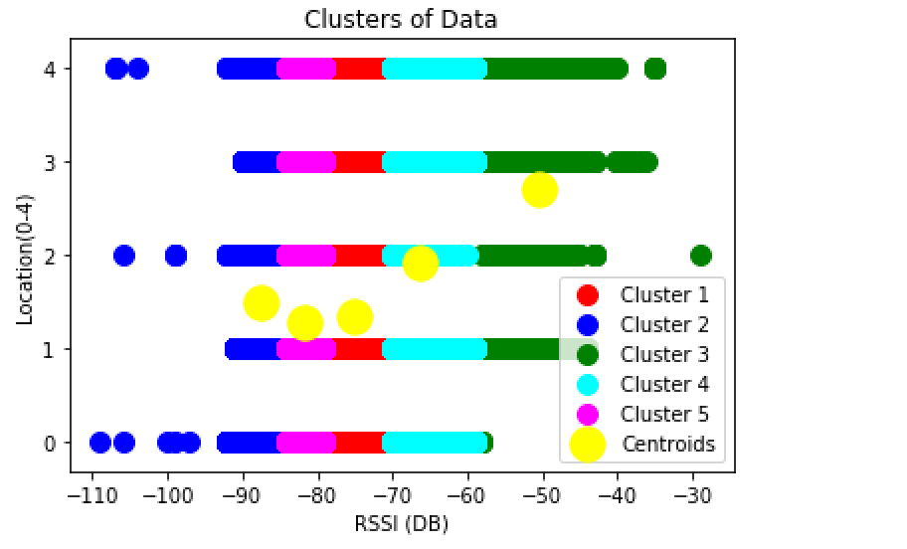
Location vs RSSI

