Slide 1
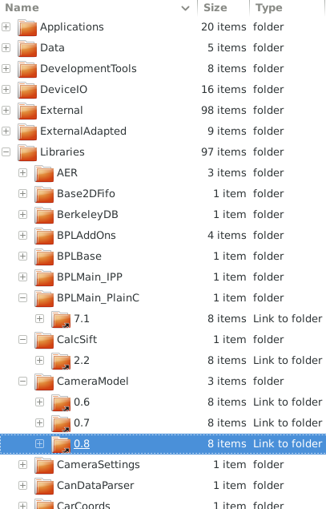
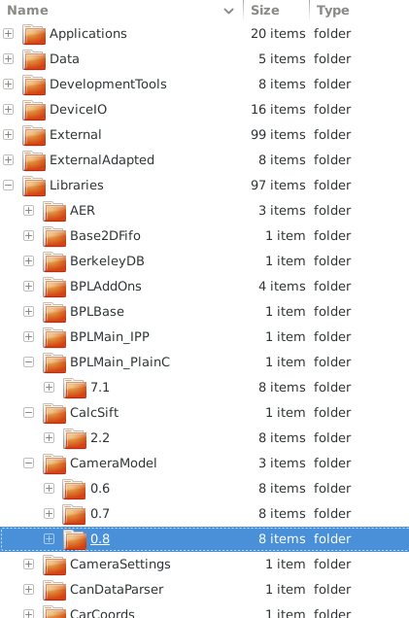
Proxy SIT
(“sandbox”)
Global SIT
(“public”)
Filesystem
symlinks

Slide 2

Proxy SIT
(“sandbox”)
Global SIT
(“public”)
Filesystem
symlinks
after
proxy
installation
no more link

