Slide 1
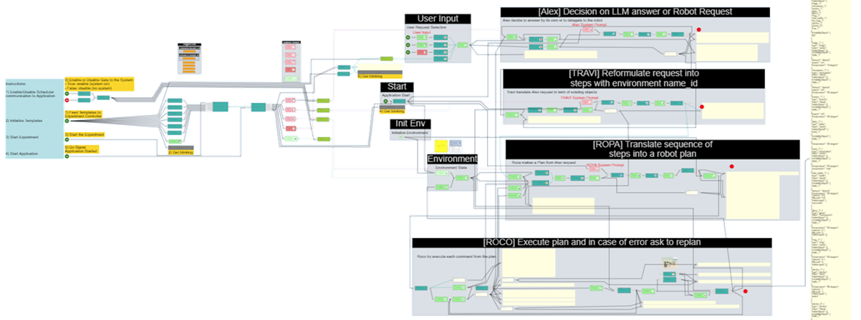
HyperGraph - Easy development of Model-driven Solutions
Be able to easily create applications or systems designed by drawing functional models.
Any type of model possible:
Dataflow
Control flow
Data model (ERD,…)
State Model
CodeFlow
Business process
Domain specific languages
Tool to create set of symbolic elements and assign functional semantic to them
Tool to draw graphs of symbolic elements to make them represent applications or systems models.
Code generator tools to translate models into runnable code in any language or in data files suited for integration in other projects
Run-time engine to execute models directly
Javascript, web technologies
Any target language or data format

