Slide 1
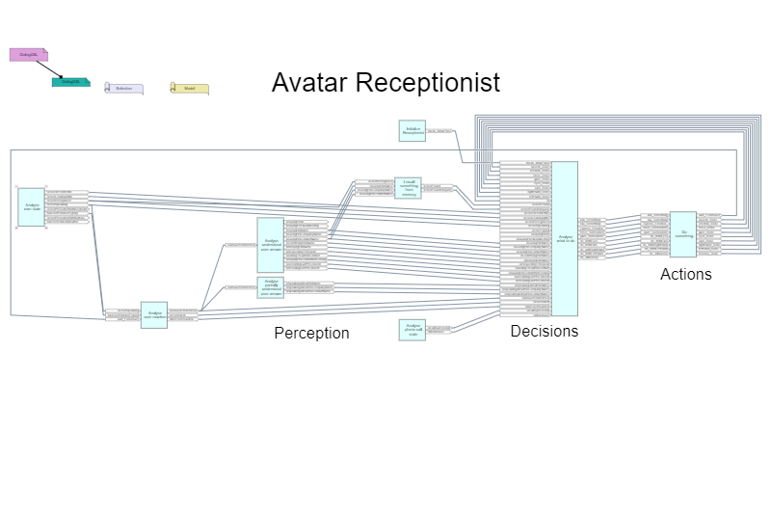

Slide 2
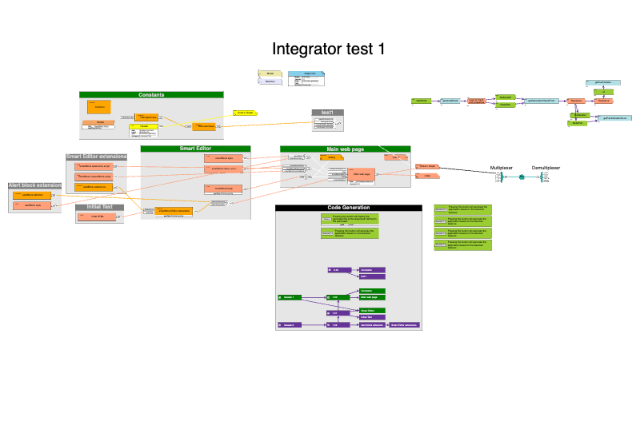

Slide 3
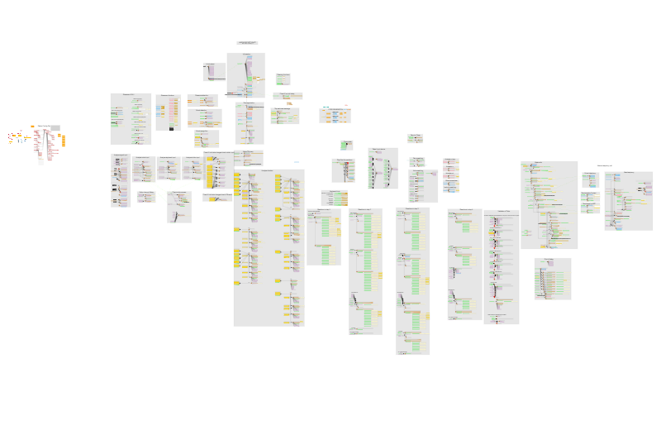

Slide 4
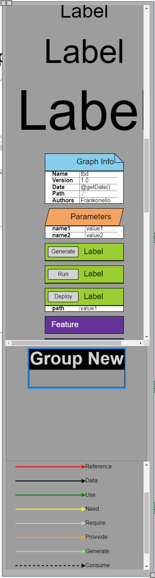

Slide 5
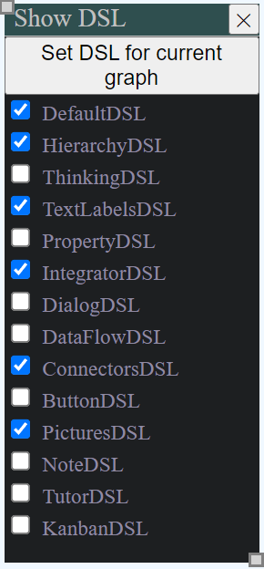

Slide 6
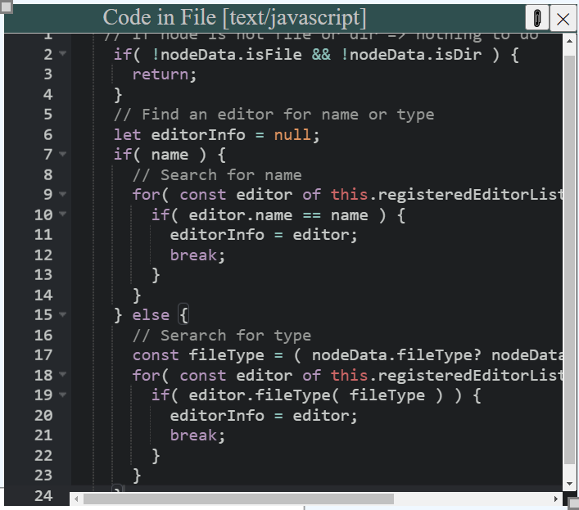

Slide 7
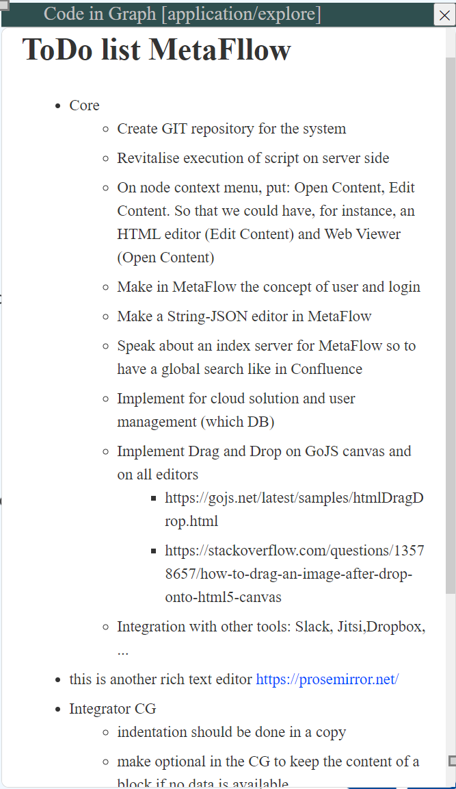

Slide 8
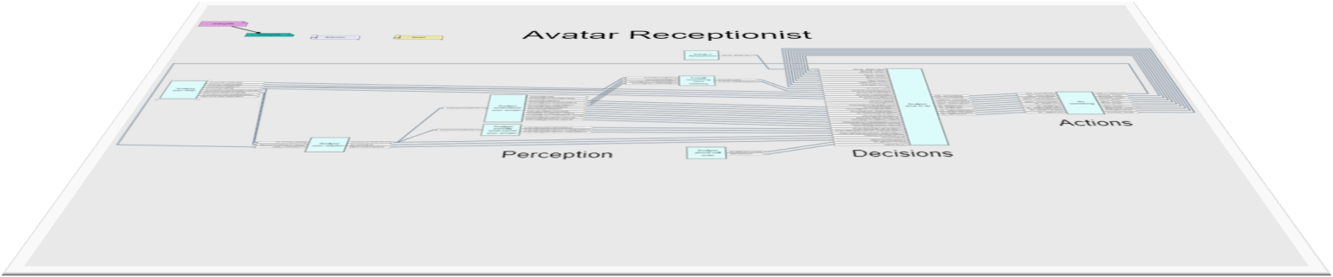
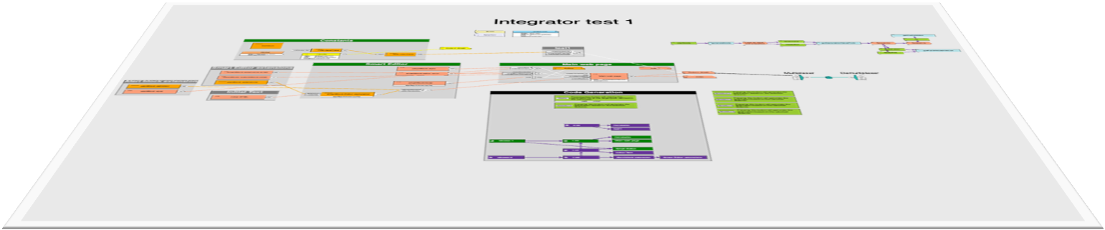
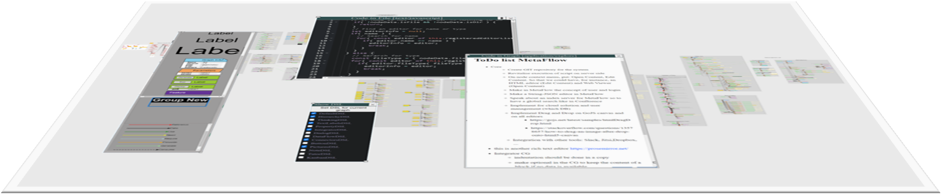
Workspace
Workspace
Workspace

Slide 9
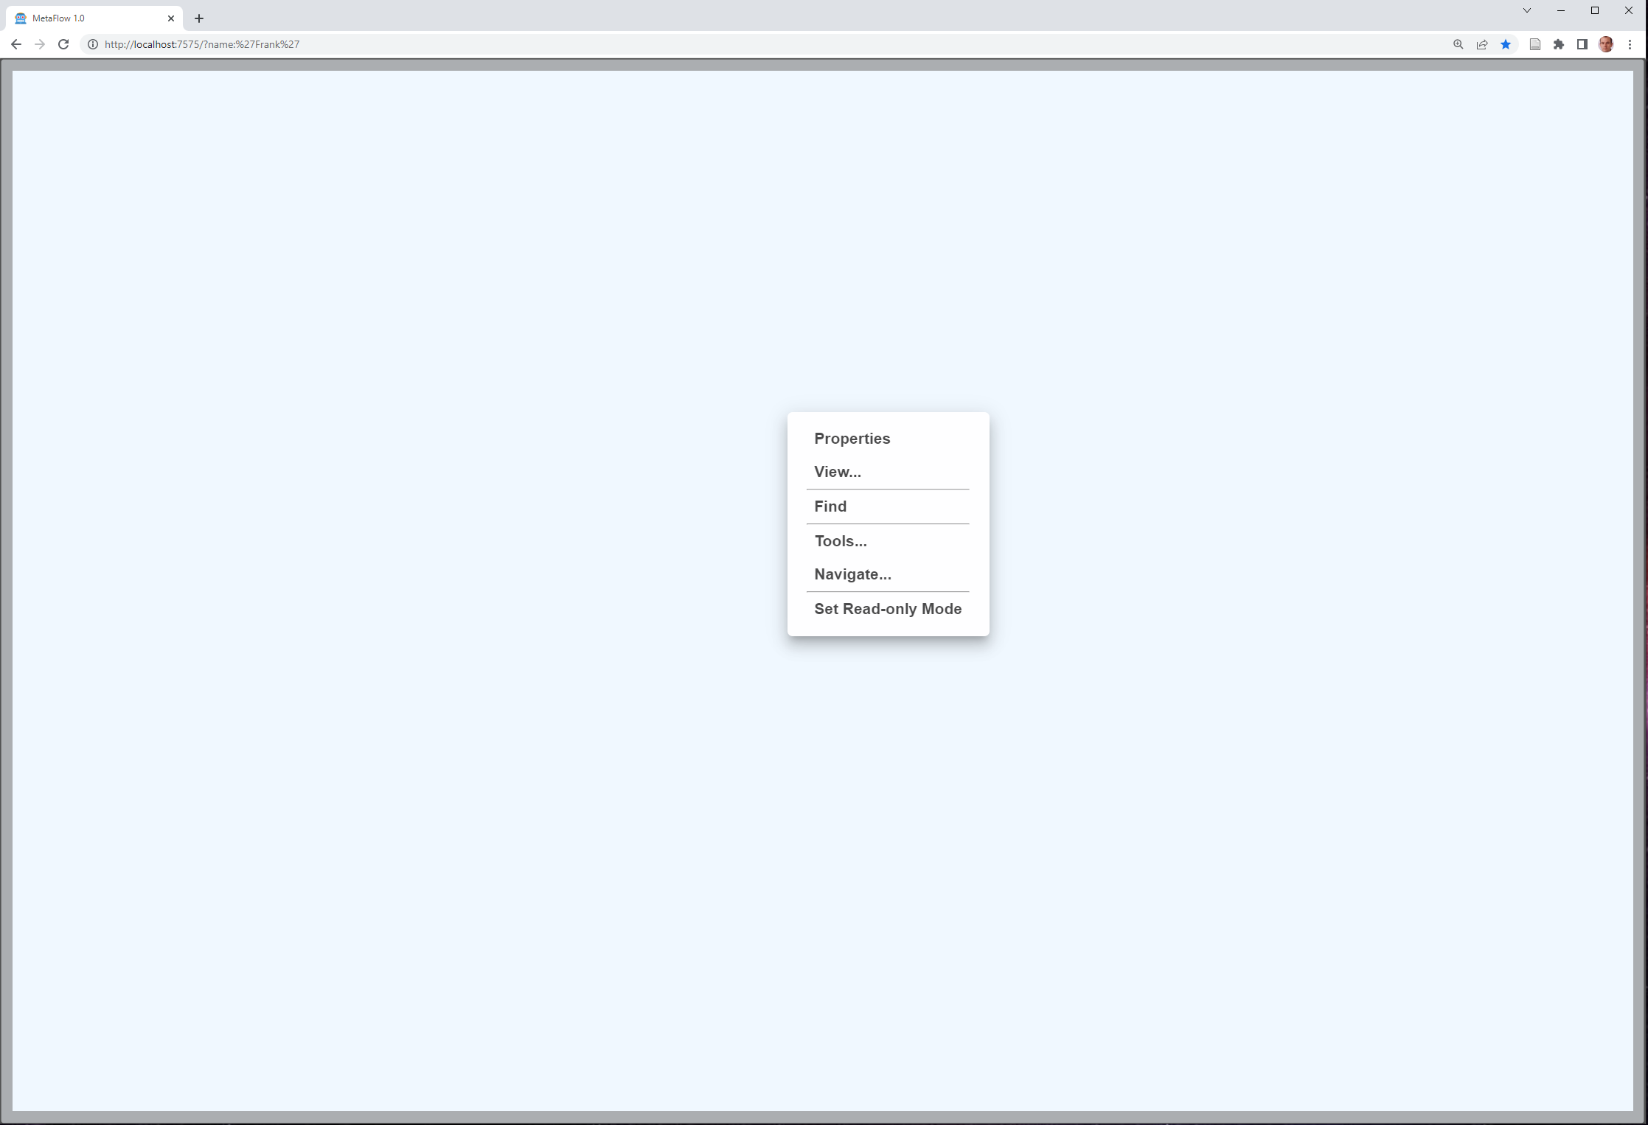

Workspace
Workspace
Workspace
Browser

Slide 10


Workspace
Workspace
Workspace
Browser

Slide 11
DSL
Workspace
Workspace
Workspace
Browser

Slide 12
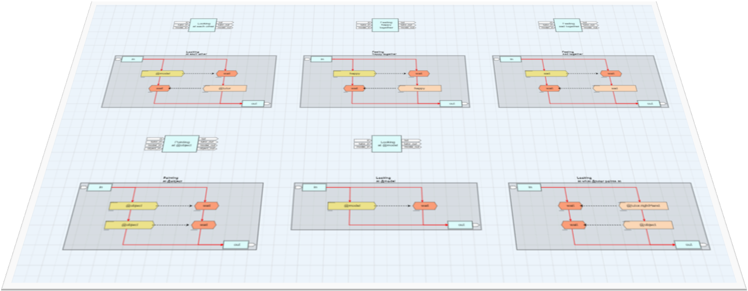
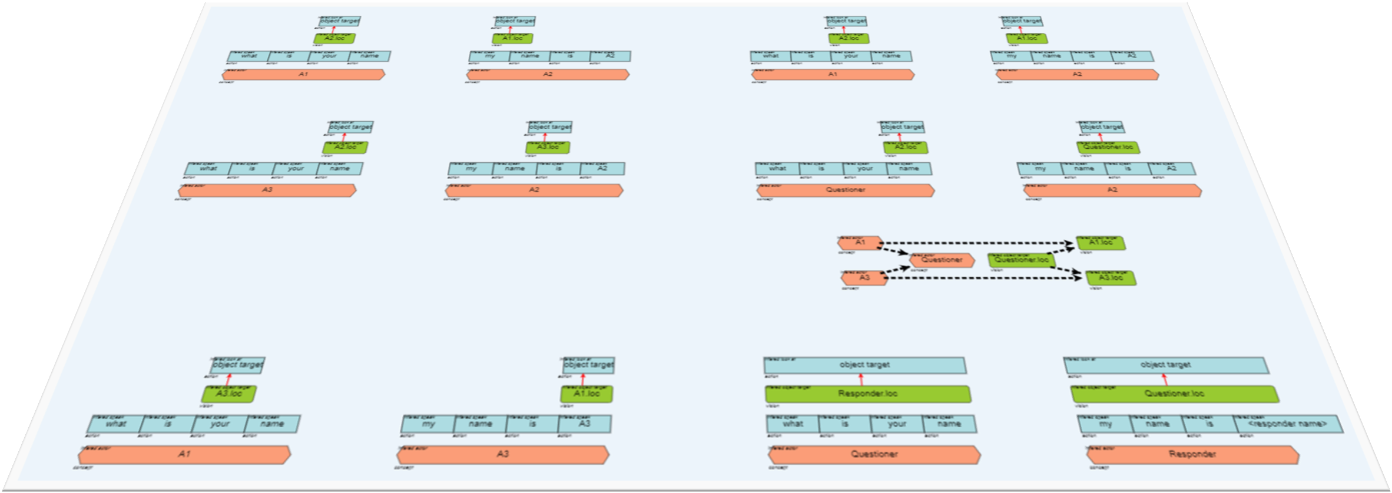
DSL
Workspace
Workspace
Workspace
Workspace
Workspace
Browser

Slide 13

DSL
Workspace
Workspace
Data Model
Workspace
Workspace
Workspace
Browser

Slide 14
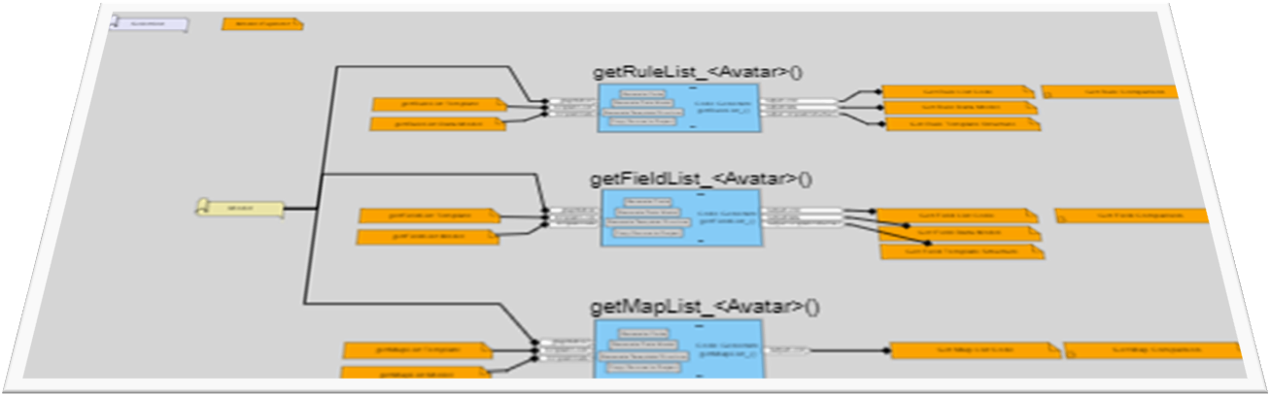
DSL
Workspace
Workspace
Data Model
Code Generation
Workspace
Workspace
Workspace
Workspace
Browser

Slide 15


DSL
Workspace
Workspace
Data Model
Code Generation
Workspace
Workspace
Workspace
Workspace
Code
Doc
Browser
App

Slide 16

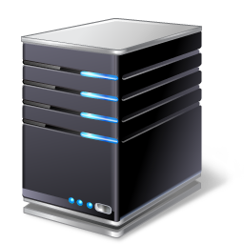

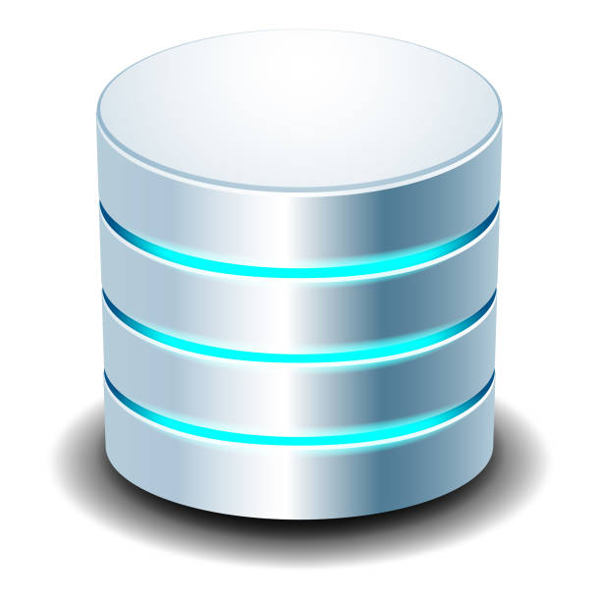
DSL
Workspace
Workspace
Data Model
Code Generation
Workspace
Workspace
Workspace
Workspace
Code
Doc
µServices
Program
Server
Browser
DB
App

Slide 17
DSL
Navigation (Files, Gates) → OS
Brainstorming → Miro,…
DataFlow → ToolBOS, RTMaps,…
CodeFlow
DialogFlow → Avatar Receptionist
Workspace
Workspace
Data Model
Code Generation
Workspace
Workspace
Workspace
Workspace
Code
Doc
µServices
Program
Server
Browser
DB
App

Slide 18
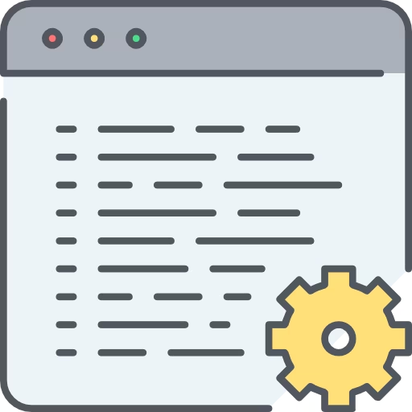

Running
Example
Feature 2
Running
Example
Feature 2
System
Feature 1
Feature 2
Feature 3
Running
System
Running
Example
Feature 3
Running
Example
Feature 1

Slide 19





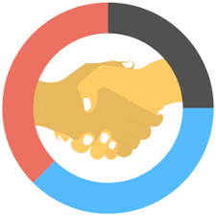




MetaFlow
Investors
European Fundings
Customers
Open
Innovation
Joint Venture
Collaboration
Project
State Fundings

