Slide 1
Tableau

Slide 2
1. Create a story to present all your insights to your team.
2. Show the sales in the south worksheet in your story.
3. Add a caption ‘Sales and profit by year’ to the above story.
4. Duplicate the first caption and show the story for Sales & profit for machine type subcategory.
5. Add a caption ‘"Machine sales and profit by year" for Machine type subcategory .
6. Check your Story mini toolbar around the story point caption.
7. select Blank in the Story pane then, drag your dashboard Regional Sales and Profit onto the canvas and find some meaningful insights.
8. Add a caption "Underperforming items in the South“ in the above story point.
9. Duplicate the above story point and show your result only for north Carolina and all the year.
10. Add a caption ‘Profit in North Carolina, 2018-2021’ to the above story point.
11. Duplicate the above story point and Show the profit in the North Carolina for 2018 and add a caption ‘Profit in North Carolina, 2018’.
12. Similarly show the profit for North Carolina for every year and add the caption.
13. Select Drag to add text , drag it onto your view and enter the
Description for your dashboard and enter a description for your dashboard ‘Introducing machines to the North Carolina market in 2021 resulted in losing a significant amount of money.’
14. From the Story pane, click Blank and drag Negative Profit Bar Chart to the view.
15. right-click the Burlington mark (the bar) and select Annotate > Mark. In the Edit Annotation dialog box that appears, delete the filler text and type: "Machines in Burlington lost nearly $4,000 “.
16. Add a caption "Where are we losing machine profits in North Carolina?“ to above story point.
17. Rename your story as "Improve Profits in the South“ and check in the presentation mode.

Slide 3
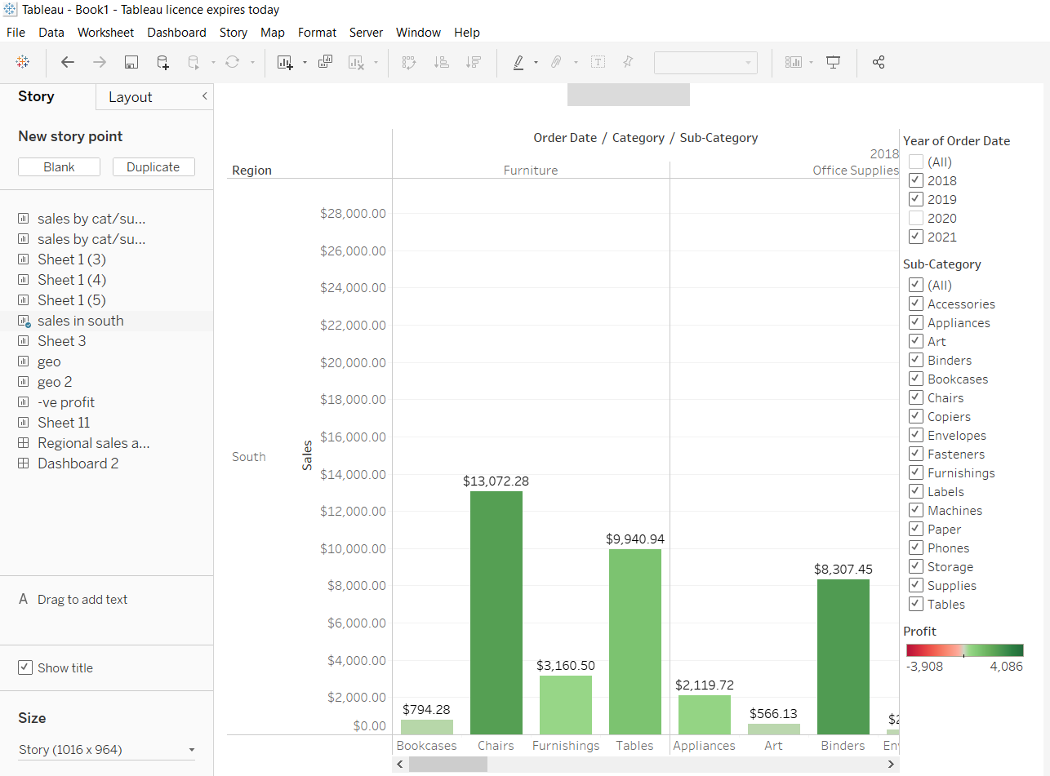
Create a story to present all your insights to your team. Show the sales in the south worksheet in your story.

Slide 4
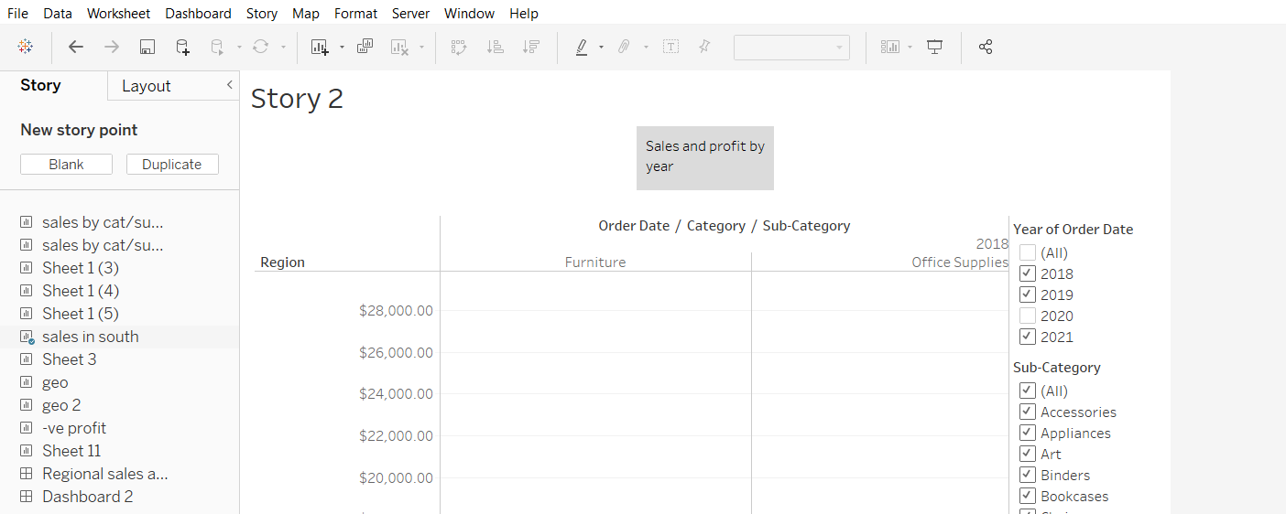
Add a caption ‘Sales and profit by year’ to the above story.

Slide 5
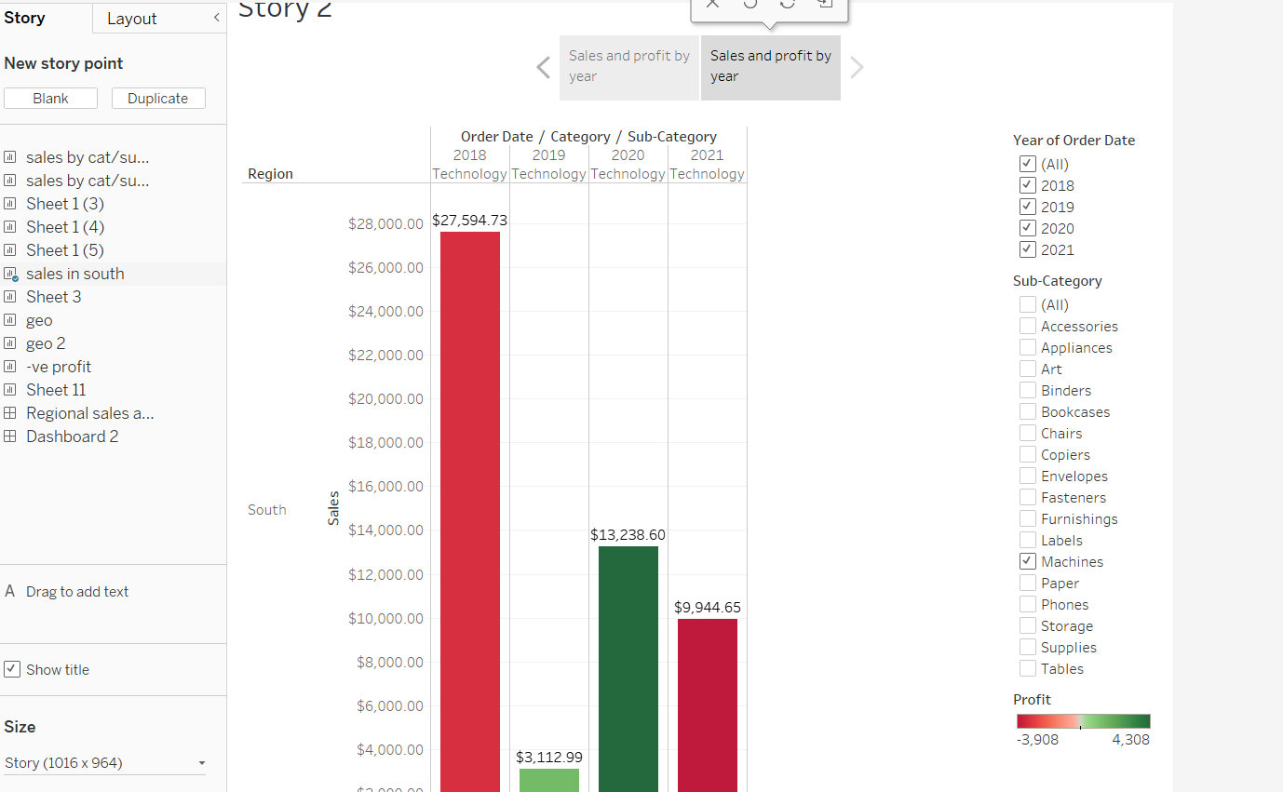
Duplicate the first caption and show the story for Sales & profit for machine type subcategory.

Slide 6
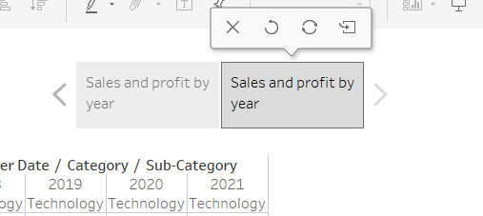
Check your Story mini toolbar around the story point caption.

Slide 7
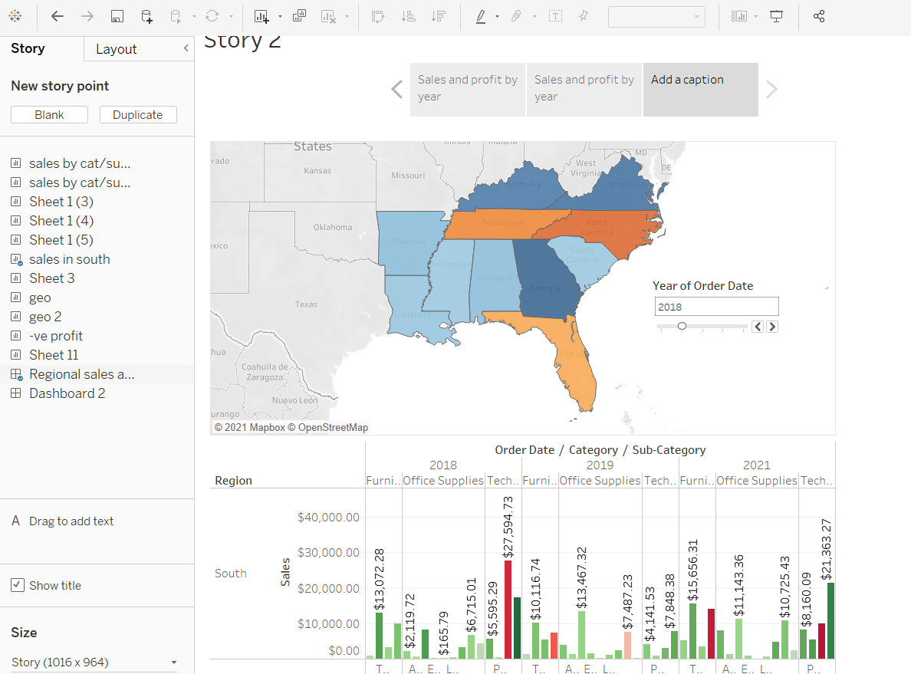
select Blank in the Story pane then, drag your dashboard Regional Sales and Profit onto the canvas and find some meaningful insights.

Slide 8
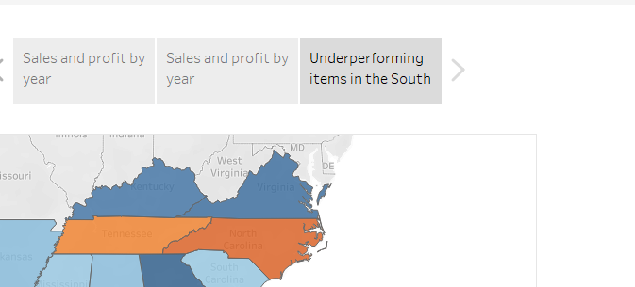
Add a caption "Underperforming items in the South“ in the above story point.

Slide 9
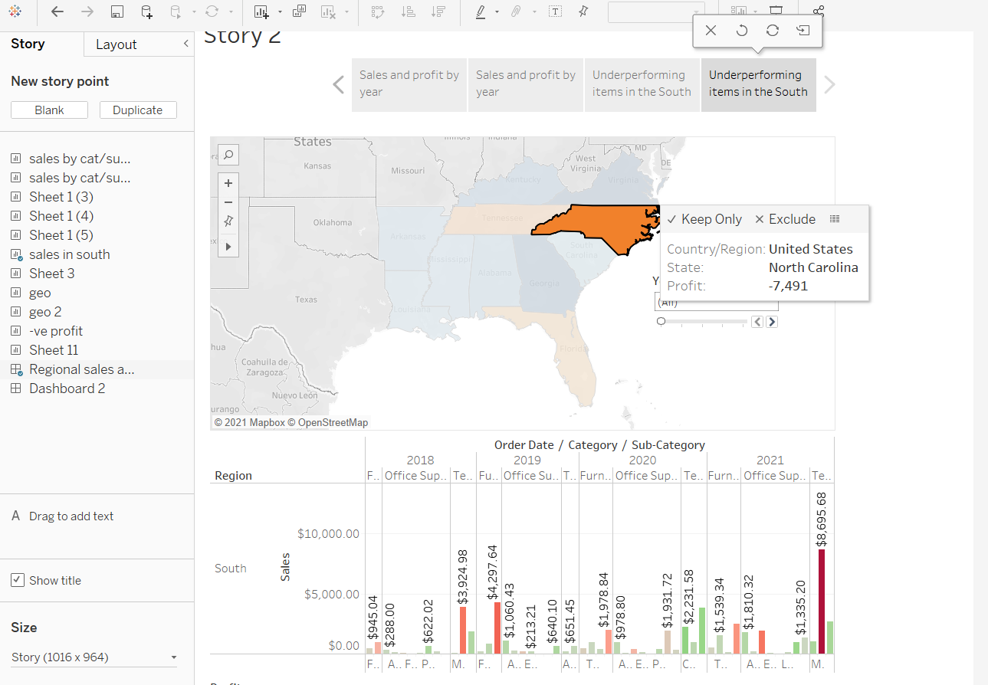
Duplicate the above story point and show your result only for north Carolina and all the year.

Slide 10
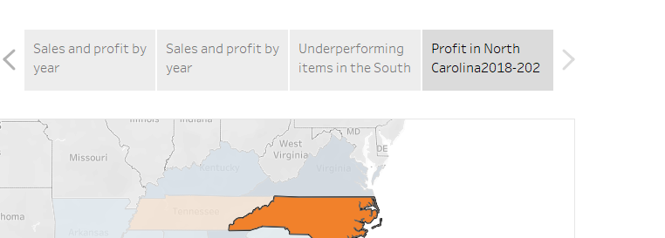
Add a caption ‘Profit in North Carolina, 2018-2021’ to the above story point.

Slide 11
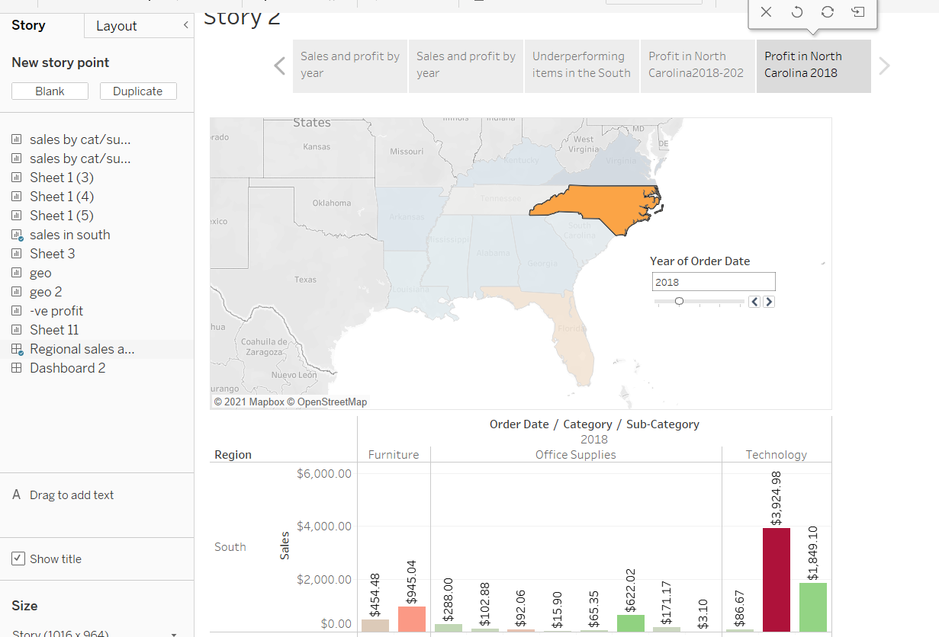
Duplicate the above story point and Show the profit in the North Carolina for 2018 and add a caption ‘Profit in North Carolina, 2018’.

Slide 12
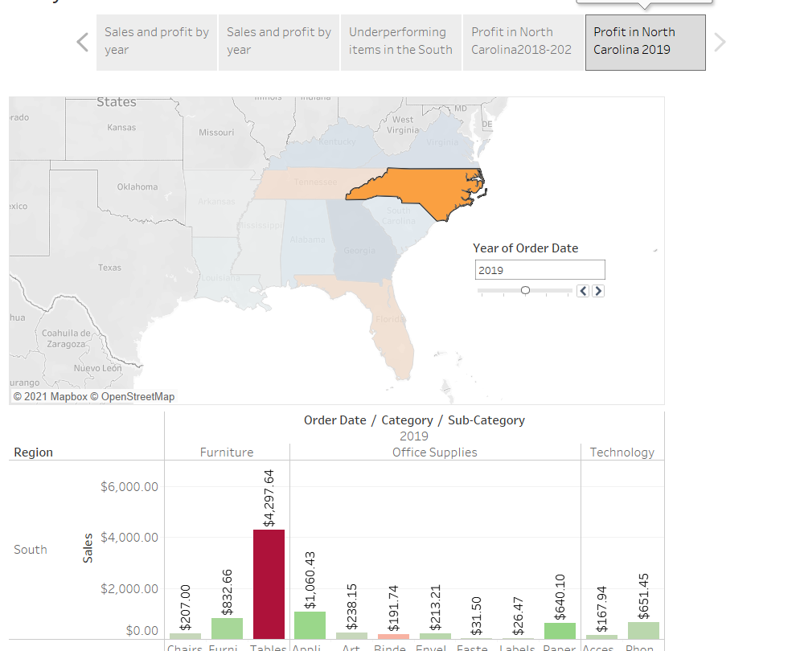
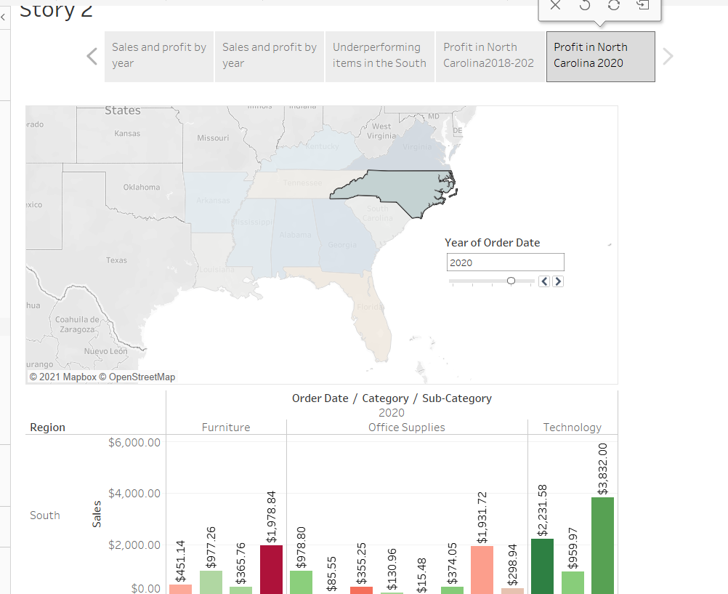
Similarly show the profit for North Carolina for every year and add the caption.

Slide 13
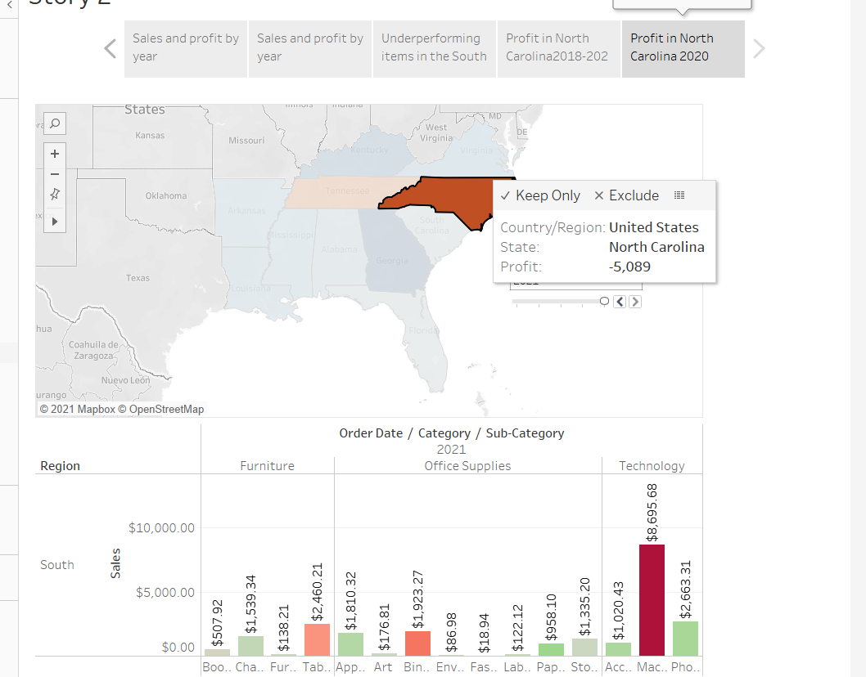

Slide 14
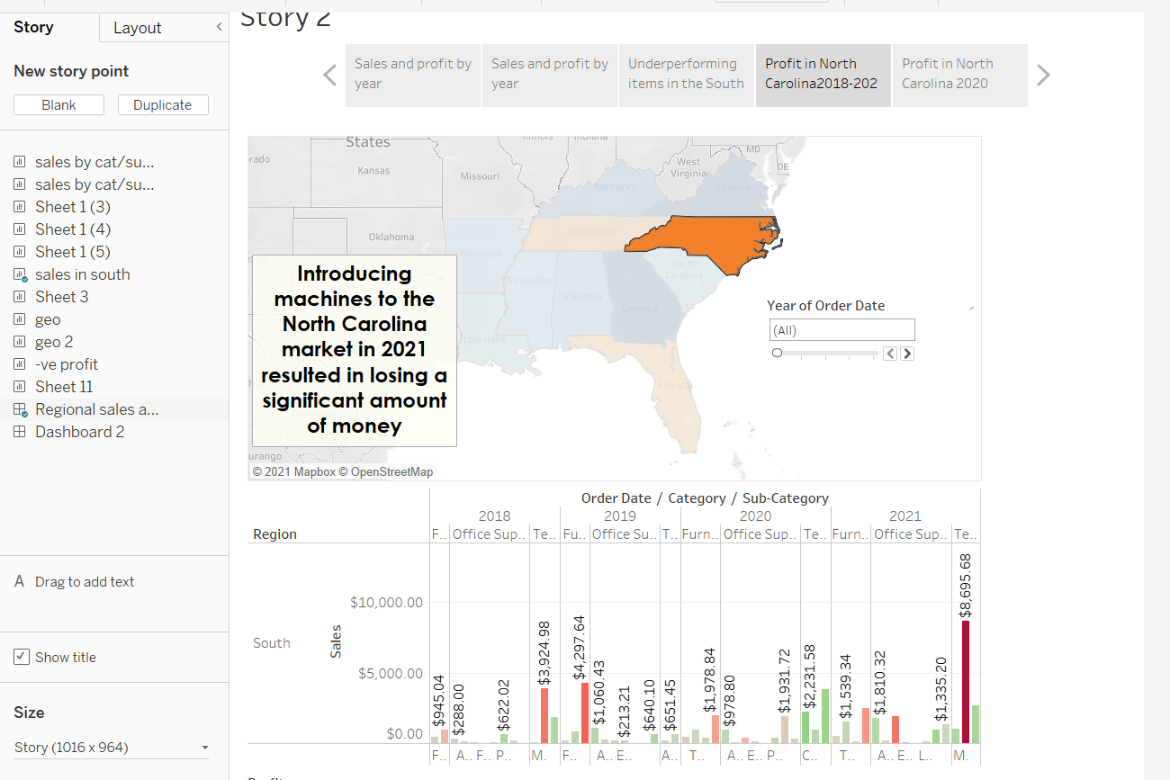
Select Drag to add text , drag it onto your view and enter the
Description for your dashboard and enter a description for your dashboard ‘Introducing machines to the North Carolina market in 2021 resulted in losing a significant amount of money.’

Slide 15
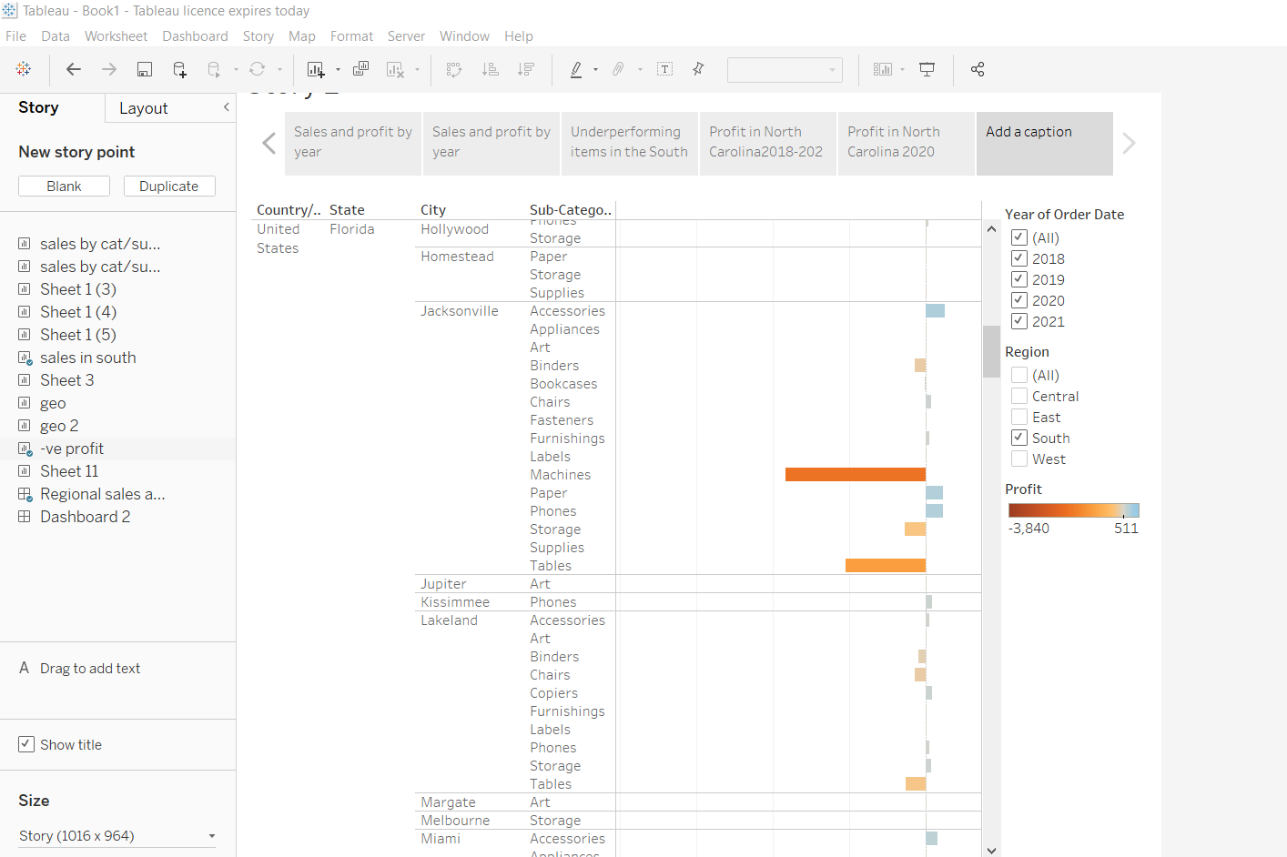
From the Story pane, click Blank and drag Negative Profit Bar Chart to the view

Slide 16
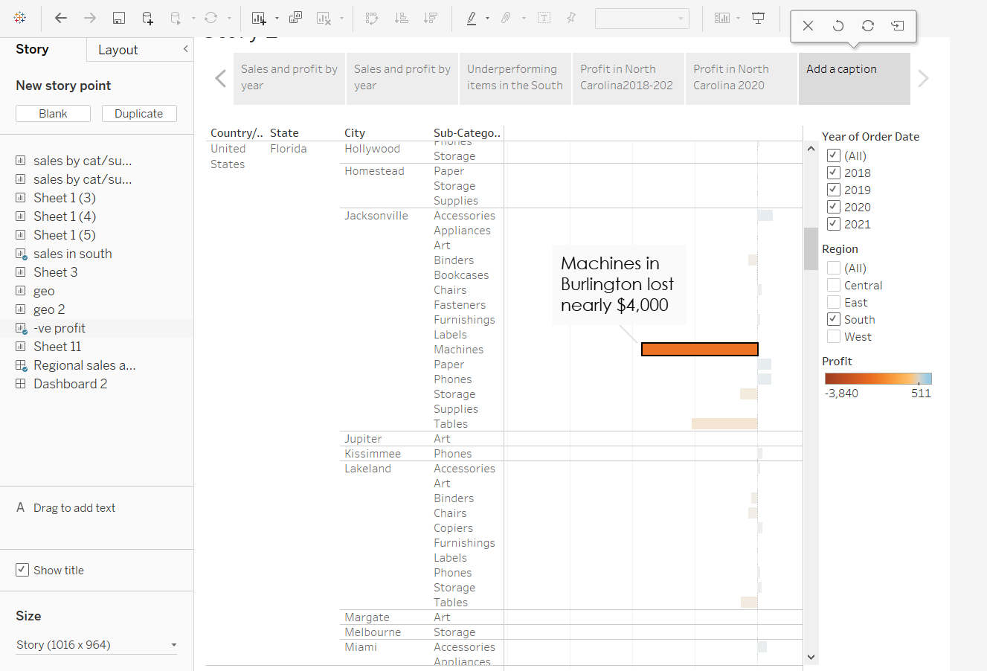
right-click the Burlington mark (the bar) and select Annotate > Mark. In the Edit Annotation dialog box that appears, delete the filler text and type: "Machines in Burlington lost nearly $4,000 “.

Slide 17

Add a caption "Where are we losing machine profits in North Carolina?“ to above story point.

Slide 18
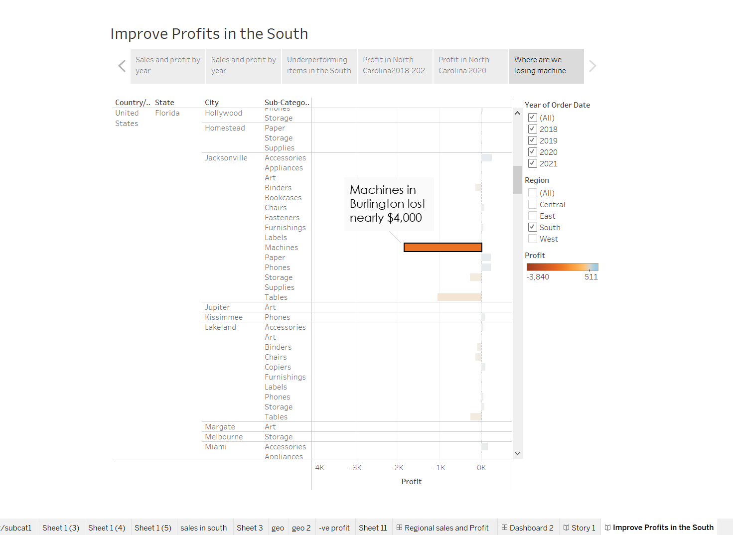
Rename your story as "Improve Profits in the South“ and check in the presentation mode.

