Slide 1


Avatar Lab:
AI powered Text-to-Avatar Platform
G331
By 23BD1A05BB
HRITHIK RAJ

Slide 2






Tech Stack Choices & Reasoning
Next.js
PostgreSQL
MongoDB
Prisma
Chosen for server-side rendering, replacing MERN stack React + Express.
Efficient video storage and reliable relational data management.
Flexible document storage for unstructured data.
Type-safe database ORM for seamless data access.
ngrok
RobustVideoMatting
Enables local inference by exposing local servers securely.
Advanced background removal for realistic video output.

Slide 3
Key Learnings & Project Hurdles
Key Learnings
Project Hurdles
Mastered Next.js SSR and API integration
Deployment challenges and resource limits
Database management with Prisma, PostgreSQL, MongoDB
Steep learning curve for new tech
Knowledge gaps in cloud deployment
Using ngrok for secure local inference
Time constraints affected full deployment
Applied RobustVideoMatting for video processing

Slide 4
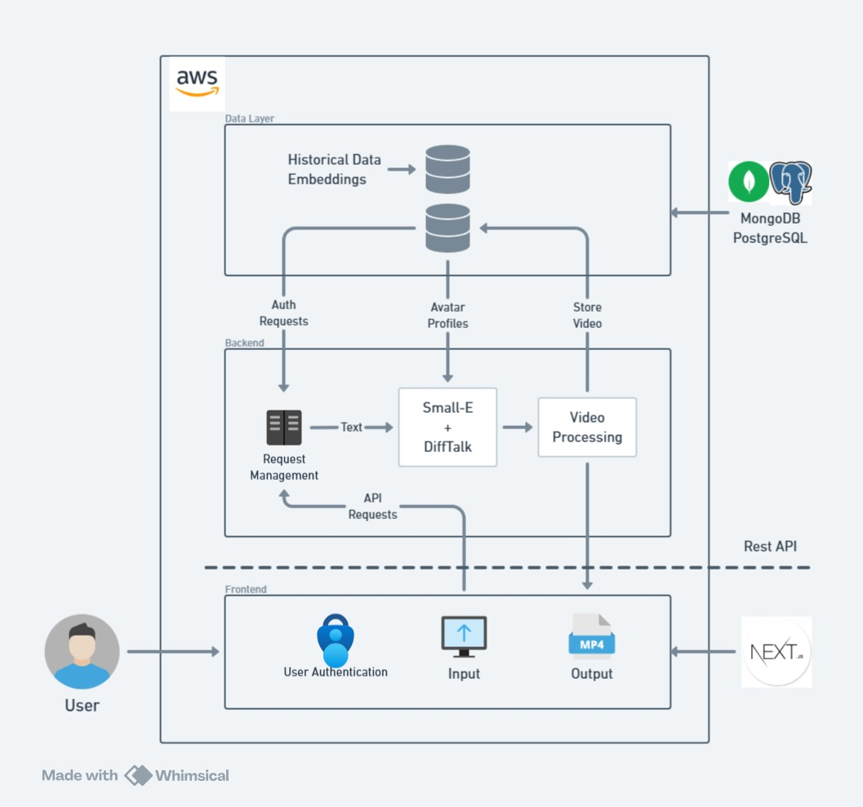
Architecture Changes & Milestone Achievements
Architecture Changes
Replaced DiffTalk with DiffDub model
Integrated ngrok for local server access
Added RobustVideoMatting for background
removal
Implemented Prisma ORM and customized
API
Milestone Status
Core functionality: Achieved successfully
Deployment: Not fully completed

Slide 5
Model Selection & Reasoning
Model
Used
Reason
Alternatives
Notes
SMALL-E
Yes
Efficient, diffusion-based learning
VALL-E
GPU compatible, lightweight
DiffDub
Yes
High-quality talking head synthesis
SyncTalk, SadTalker
Better realism and control
RobustVideoMatting
Yes
Effective background removal
None
Essential for video realism

Slide 6
Summary & Next Steps
Project Successes
Challenges
Next Steps
Core AI pipeline built with efficient tech stack
Deployment and resource constraints remain
Focus on deployment, optimize models, enhance demo

