Slide 1
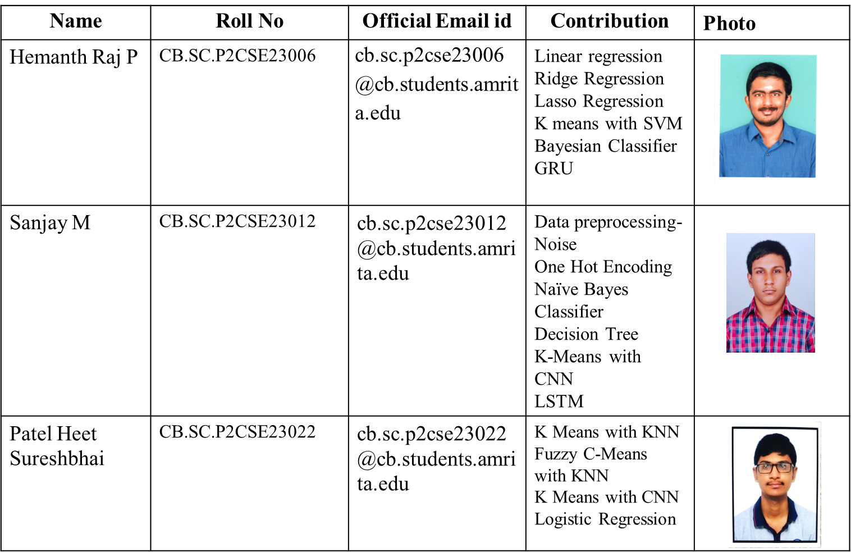
Used Car Prices Prediction

Slide 2
CONTENTS
Conference Papers
Journal Details
Model Diagram
Noise Removal (SMOTE Algorithm)
One Hot Encoding
Linear regression
Logistic regression
Lasso Regression
Ridge Regression
Comparison of Regression models
K-means with KNN
Fuzzy C-means with K-means
K-means with SVM
Baysian Classifier
Naïve Bayes Classifier
Decision tree
Comparison Table for Classifiers
K-means with CNN
AlexNet
LSTM
GRU
Model Evaluation for Parkinson’s Model
References

Slide 3
JOURNAL
S.No | Paper Name | Journal Name | Citation
1 | Object Detection and Used Car Price Predicting Analysis System (UCPAS) Using Machine Learning Technique | Linguistics and Culture Review | Yadav, A., Kumar, E., & Yadav, P. K. (2021). Object detection and used car price predicting analysis system (UCPAS) using machine learning technique. Linguistics and Culture Review, 5(S2), 1131-1147. https://doi.org/10.21744/lingcure.v5nS2.1660.
2 | Machine Learning-Powered Mobile App for Predicting Used Car Prices | Big-data Service and Intelligent Computation | BDSIC 2021, November 19–21, 2021, Xiamen, China © 2021 Association for Computing Machinery. ACM ISBN 978-1-4503-9055-2/21/11. . . $15.00 https://doi.org/10.1145/3502300.3502307
3 | Car Price Prediction | International Conference on Information Management & Machine Intelligence | ICIMMI 2022, December 23, 24, 2022, Jaipur, India © 2022 Copyright held by the owner/author(s). Publication rights licensed to ACM. ACM ISBN 978-1-4503-9993-7/22/12. . . $15.00 https://doi.org/10.1145/3590837.3590864
4 | Pre-owned car price prediction by employing machine learning techniques | Journal of Decision Analytics and Intelligent Computing | Original Scientific Article Journal of Decision Analytics and Intelligent Computing Vol. 3 issue 1, (2023) 167-184https://doi.org/10.31181/jdaic10008102023n

Slide 4
JOURNAL
5 | An Automated Car Price Prediction System Using Effective Machine Learning Techniques | International Conference on Computational Intelligence and Sustainable Engineering Solutions | 2022 International Conference on Computational Intelligence and Sustainable Engineering Solutions (CISES)978-1-6654-8004-8/22/$31.©2022 IEEEDOI:10.1109/CISES54857.2022.9844350
6 | CarPricePrediction:An Application of Machine Learning | International Conference on Inventive Computation Technologies | 2023 International Conference on Inventive Computation Technologies (ICICT)|979-8-3503-9849-6/23/$31.00 ©2023IEEEDOI:10.1109/ICICT57646.2023.10134142
7 | Machine Learning Techniques To Predict The Price Of Used Cars | Second International Conference on Electronics and Sustainable Communication Systems | 2021 Second International Conference on Electronics and Sustainable Communication Systems (ICESC) | 978-1-6654-2867-5/21/$31.00 ©2021 IEEEDOI:10.1109/ICESC51422.2021.9532845
8 | Predicting the Prices of the Used Cars using Machine Learning for Resale | International Students' Conference on Electrical, Electronics and Computer Science | 2023 IEEE International Students' Conference on Electrical, Electronics and Computer Science (SCEECS) | 979-8-3503-9874-8/23/$31.00 ©2023 IEEE | DOI: 10.1109/SCEECS57921.2023.10063133

Slide 5
JOURNAL
9 | Prediction of Used Car Price Based on Supervised Learning Algorithm | International Conference on Networking, Communications and Information Technology | 2021 International Conference on Networking, Communications and Information Technology (NetCIT) | 978-1-6654-0070-1/21/$31.00 ©2021 IEEEDOI:10.1109/NetCIT54147.2021.00036
10 | Used Car Price Prediction using Machine Learning: A Case Study | International Symposium on Signal, Image, Video and Communications | 2022 11th International Symposium on Signal, Image, Video and Communications (ISIVC) | 978-1-6654-8724-5/22/$31.00 ©2022 IEEE | DOI: 10.1109/ISIVC54825.2022.9800719

Slide 6
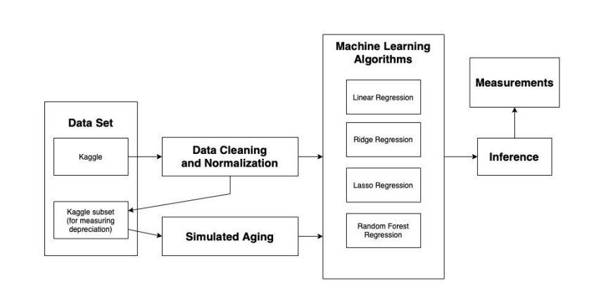
MODEL DIAGRAM

Slide 7
MODEL DIAGRAM
Data Cleaning and Normalization:
The first step in cleaning the dataset provided from Kaggle was to identify variables which will not be useful for training the models. This includes features which are not correlated with price, have too many discrete values to draw inferences from, or have too many missing values.
Machine Learning Algorithms:
The data, after being cleaned and normalized, is split into training and test data using a randomized 80-20 split. This is to ensure that the data used for testing does not contain any of the data used for training.
Inference:
Inference involves using the subset of the data that was reserved for testing (20%) to predict the price based on the features. This step was performed after the dataset was cleaned and normalized, and the models were optimized.
Measurements :
The measurements taken for this study are described in this section. All of the measurements are taken from the same inference data for each model and using the formulas for the various metrics.

Slide 8
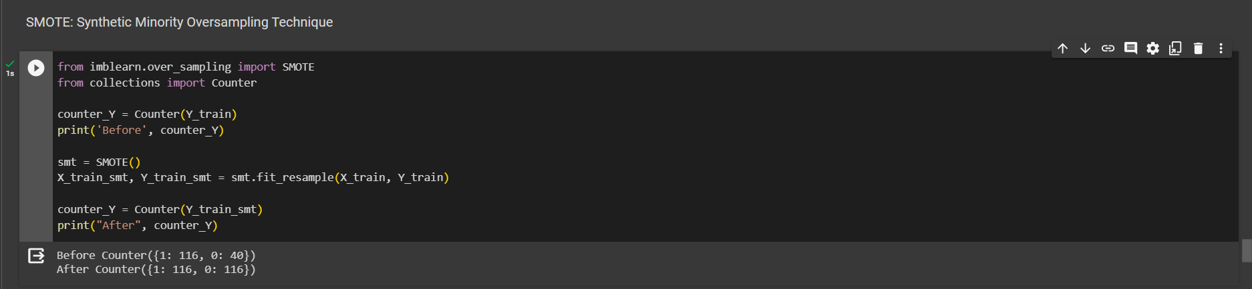
Noise Removal (SMOTE Algorithm)
Synthetic Minority Oversampling Technique - SMOTE is an oversampling technique where the synthetic samples are generated for the minority class. This algorithm helps to overcome the overfitting problem posed by random oversampling. It focuses on the feature space to generate new instances with the help of interpolation between the positive instances that lie together.
Before performing SMOTE, the number of values of each category [1,0] in Y_train is 1: 116 and 0: 40 but after performing SMOTE algorithm on Y_train, the number of values changes to 1: 116, 0: 116.

Slide 9
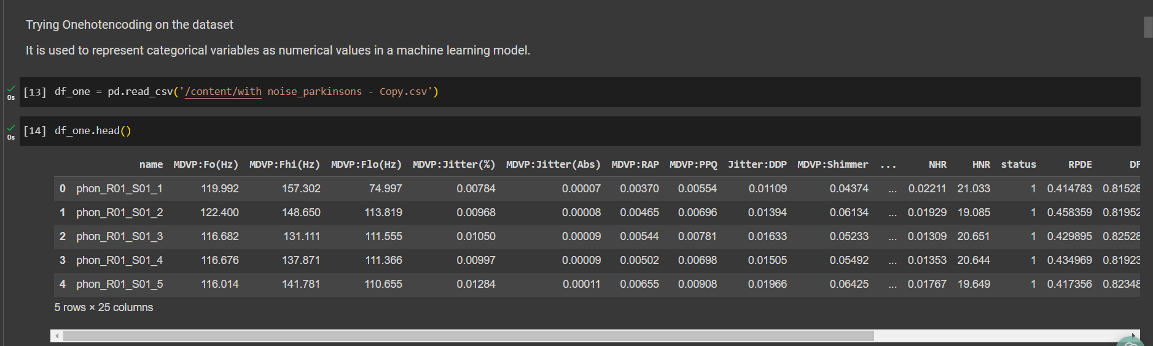
One Hot Encoding
It is used to represent categorical variables as numerical values in a machine-learning model. Before performing One hot encoding the dataset has a categorical column called Name which has string values and we need to change them to numerical value.

Slide 10
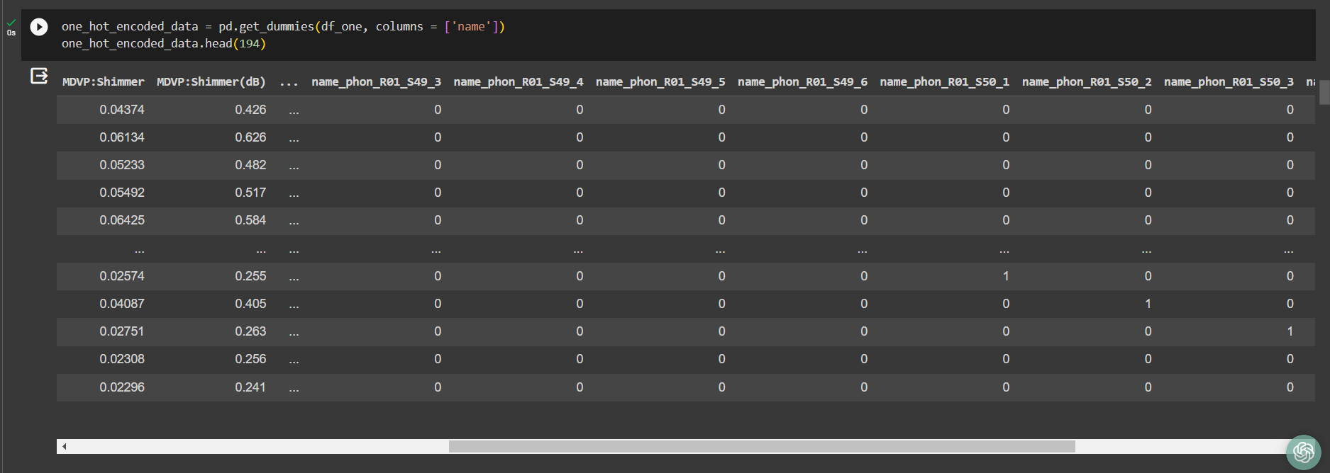
One Hot Encoding
After Performing Onehotencoding the string values of the column [Name] are transformed to categorical value [1,0].

Slide 11
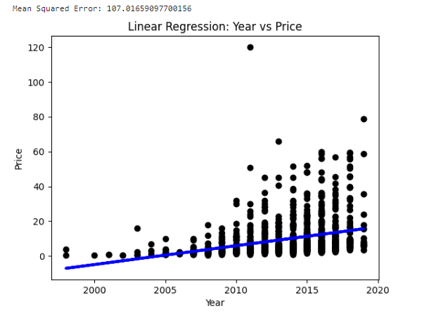
Linear Regression
Parameter Name | Purpose | Value
Test size | To split the dataset into training and testing in a ratio | 0.2
Random State | This parameter sets the seed for the random number generator used by the data splitter. By using a fixed seed, the random splitting process becomes deterministic, allowing for result reproducibility. | 42

Slide 12
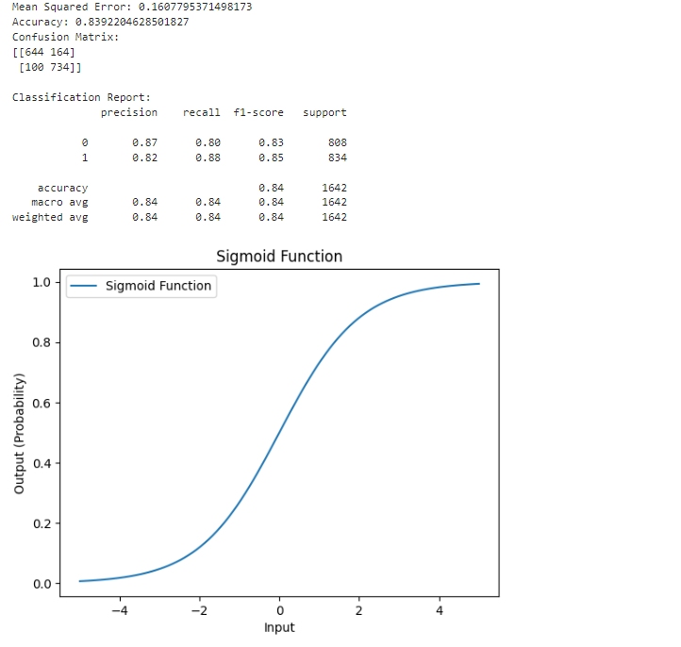
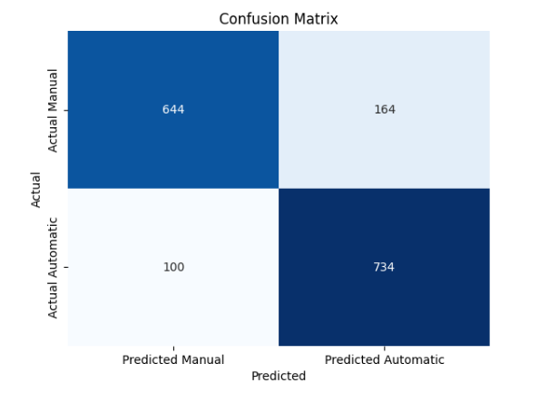
Logistic Regression
Parameter Name | Purpose | Value
Test size | To split the dataset into training and testing in a ratio | 0.2
Random State | This parameter sets the seed for the random number generator used by the data splitter. By using a fixed seed, the random splitting process becomes deterministic, allowing for result reproducibility. | 42

Slide 13
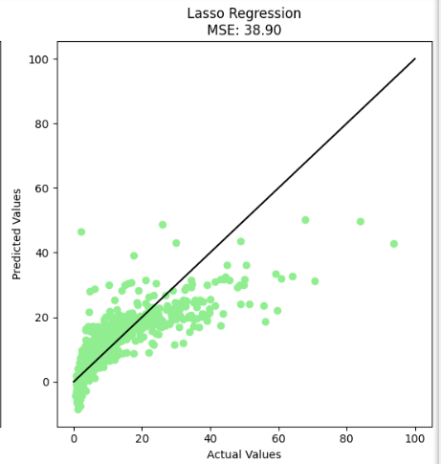
Lasso Regression
Parameter Name | Purpose | Value
Test size | To split the dataset into training and testing in a ratio | 0.2
Random State | This parameter sets the seed for the random number generator used by the data splitter. By using a fixed seed, the random splitting process becomes deterministic, allowing for result reproducibility. | 42

Slide 14
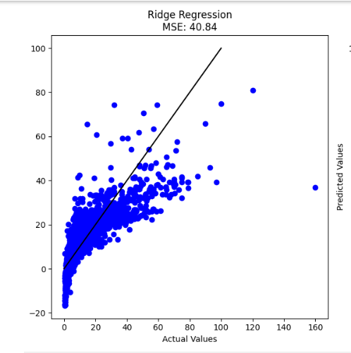
Ridge Regression
Parameter Name | Purpose | Value
Test size | To split the dataset into training and testing in a ratio | 0.2
Random State | This parameter sets the seed for the random number generator used by the data splitter. By using a fixed seed, the random splitting process becomes deterministic, allowing for result reproducibility. | 42

Slide 15
K-means with KNN
Hyperparameter Tuning approach used: Grid Search CV
Parameter Name | Purpose | Value
Test size | To split the dataset into training and testing in a ratio | 0.2
Random State | This parameter sets the seed for the random number generator used by the data splitter. By using a fixed seed, the random splitting process becomes deterministic, allowing for result reproducibility. | 42
No. of Clusters | Number of the centroid which will be formed | 2
Grid Search CV | The grid search explores various alpha values using 5-fold cross-validation. | n_neighbors: 3, 5, 7, 9

Slide 16
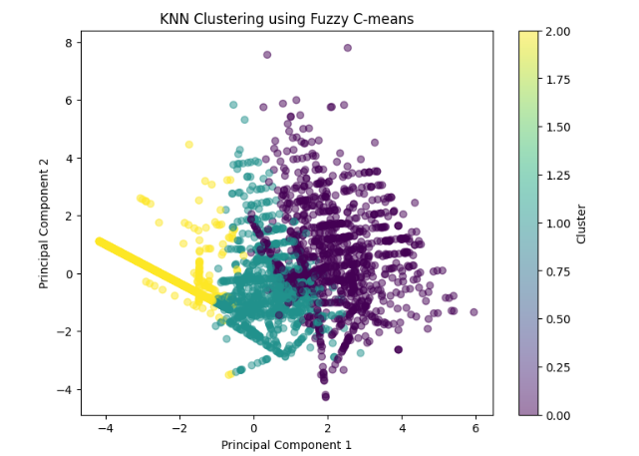
Fuzzy C-means with k-means
Hyperparameter Tuning approach used: Grid Search CV
Parameter Name | Purpose | Value
Test size | To split the dataset into training and testing in a ratio | 0.2
Random State | This parameter sets the seed for the random number generator used by the data splitter. By using a fixed seed, the random splitting process becomes deterministic, allowing for result reproducibility. | 42
No. of Clusters | Number of the centroid which will be formed | 3
Grid Search CV | The grid search explores various alpha values using 5-fold cross-validation. | 'priors': [None, [0.1, 0.9], [0.3, 0.7], [0.5, 0.5], [0.7, 0.3], [0.9, 0.1]]

Slide 17
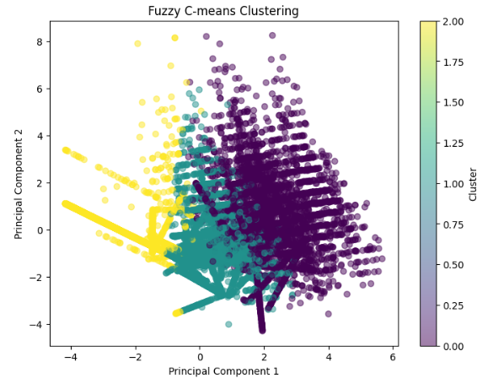
Fuzzy C-means with k-means

Slide 18
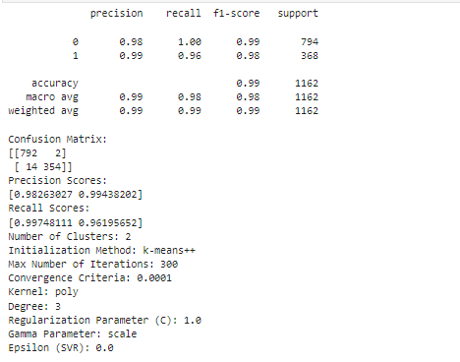
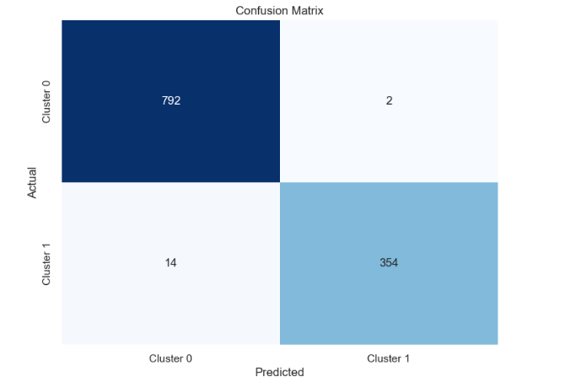
K-means with SVM
Parameter Name | Purpose | Value
Test size | To split the dataset into training and testing in a ratio | 0.2
Random State | This parameter sets the seed for the random number generator used by the data splitter. By using a fixed seed, the random splitting process becomes deterministic, allowing for result reproducibility. | 42
Kernel | kernel is a function that computes the dot product of two data points in a transformed feature space. | Poly
No. of Clusters | Number of the centroid which will be formed | 2

Slide 19
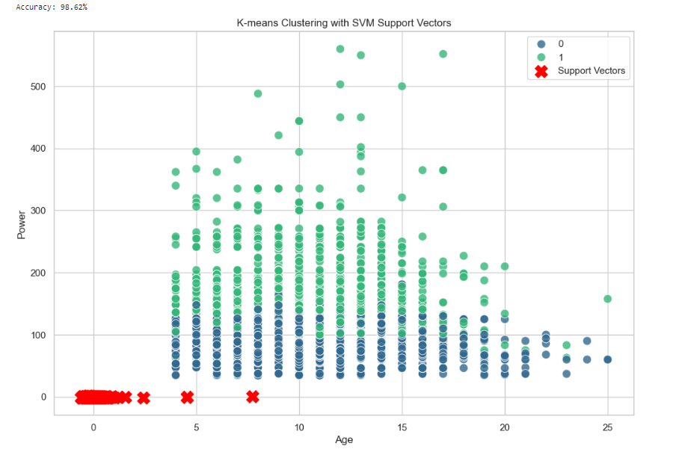
K-means with SVM

Slide 20
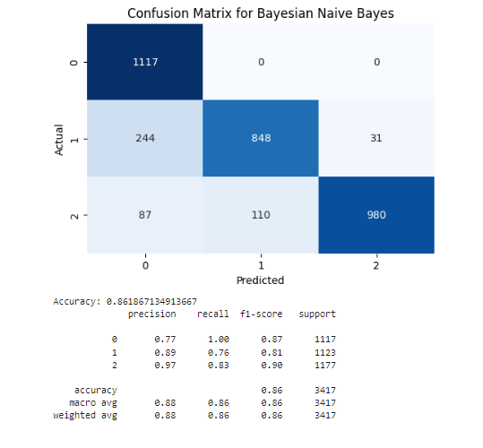
Bayesian Classifier
Parameter Name | Purpose | Value
Test size | To split the dataset into training and testing in a ratio | 0.2
Random State | This parameter sets the seed for the random number generator used by the data splitter. By using a fixed seed, the random splitting process becomes deterministic, allowing for result reproducibility. | 42
Grid Search CV | The grid search explores various alpha values using 5-fold cross-validation. | 'priors': [None, [0.1, 0.9], [0.3, 0.7], [0.5, 0.5], [0.7, 0.3], [0.9, 0.1]]

Slide 21
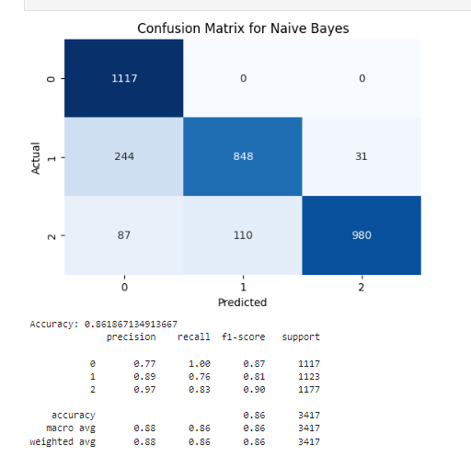
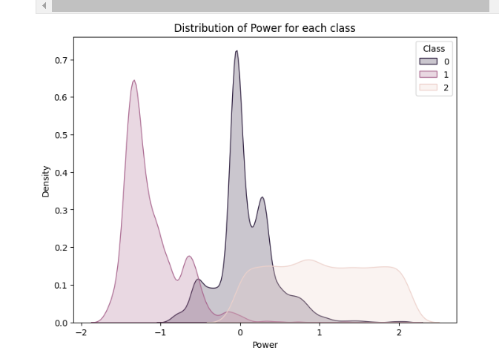
Naïve Bayes Classifier
Parameter Name | Purpose | Value
Test size | To split the dataset into training and testing in a ratio | 0.2
Random State | This parameter sets the seed for the random number generator used by the data splitter. By using a fixed seed, the random splitting process becomes deterministic, allowing for result reproducibility. | 42
Grid Search CV | The grid search explores various alpha values using 5-fold cross-validation. | n_neighbors: 3, 5, 7, 9

Slide 22
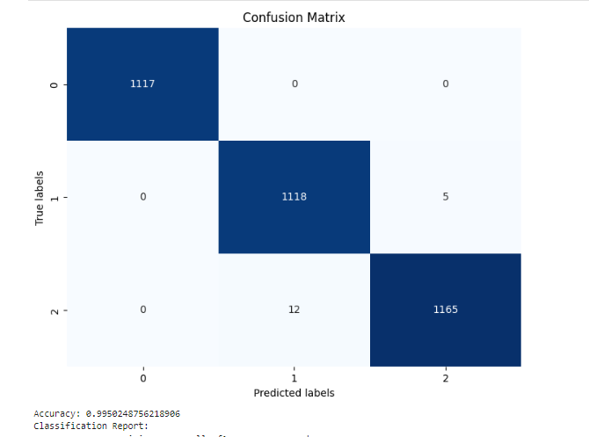
Decision Tree
Parameter Name | Purpose | Value
Test size | To split the dataset into training and testing in a ratio | 0.2
Random State | This parameter sets the seed for the random number generator used by the data splitter. By using a fixed seed, the random splitting process becomes deterministic, allowing for result reproducibility. | 42
Grid Search CV | The grid search explores various alpha values using 5-fold cross-validation. | 'max_depth': [3, 5, 7, 10], 'min_samples_split': [2, 5, 10], 'min_samples_leaf': [1, 2, 4]

Slide 23
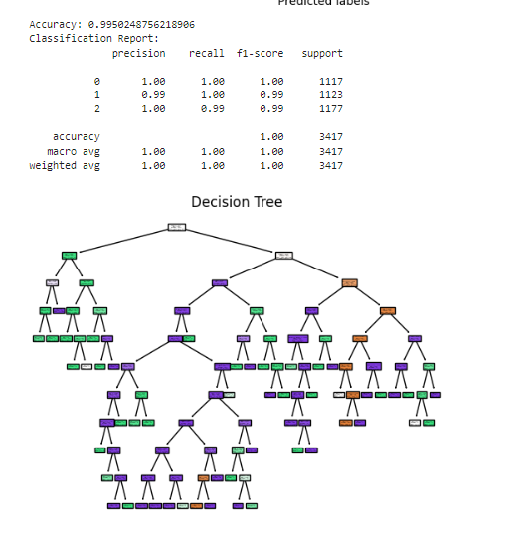
Decision Tree

Slide 24
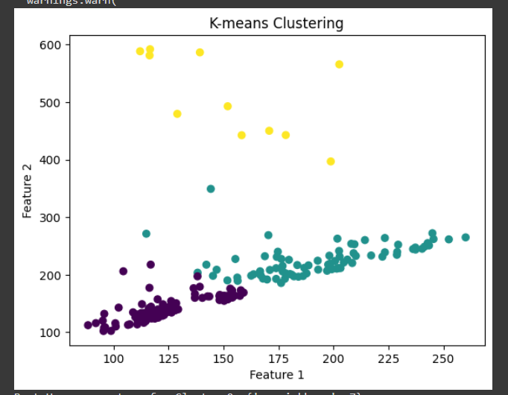
K-means with CNN
S. No | Parameter Name | Value
1 | Epochs | 10
2 | Accuracy | 91.25%
3 | Precision | 0.94
4 | Recall | 0.92
5 | F1 Score | 0.93
6 | Confusion Matrix | [[26 3] [ 4 47]]
7 | Grid Search CV | n_neighbors': [3, 5, 7, 9, 11]

Slide 25
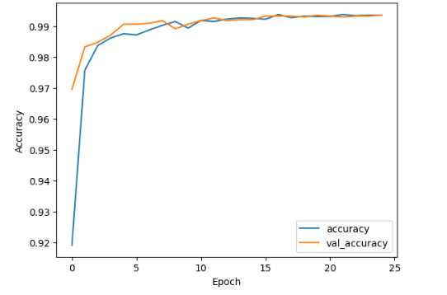
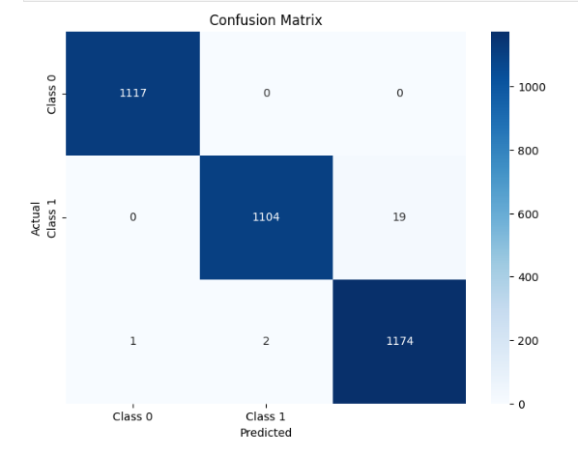
LSTM
S. No | Parameters | Value
1 | Epochs | 25
2 | Accuracy | 99.3
3 | Training Loss | 0.0209
4 | Validation Accuracy | 0.9936
5 | Validation Loss | 0.025
6 | Testing Accuracy | 77.77%
7 | Batch Size | 32
8 | Loss | binary_crossentropy
9 | Optimizer | adam
10 | Activation Function | Sigmoid
11 | LSTM Unit | 100
12 | Learning rate | 0.001
13 | Test size | 0.2

Slide 26
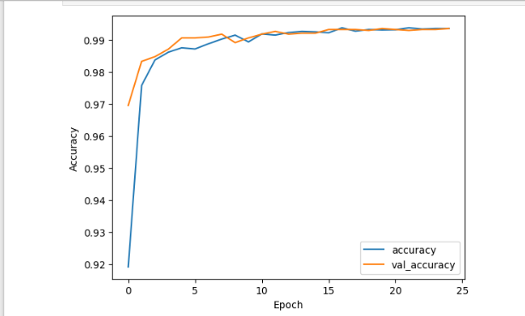
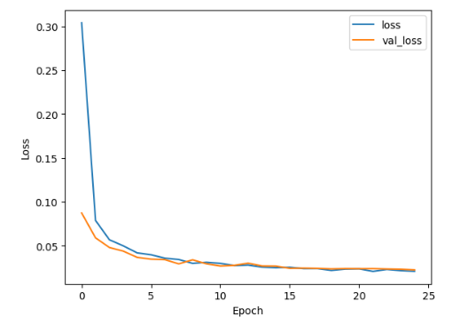
LSTM

Slide 27
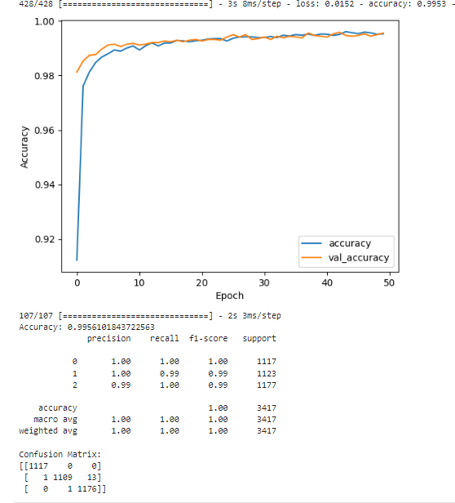
GRU
S. No | Parameters | Value
1 | Epochs | 50
2 | Accuracy | 99.56
3 | Training Loss | 0.0152
4 | Validation Accuracy | 99.56
5 | Validation Loss | 0.0167
6 | Testing Accuracy | 77.77%
7 | Test Loss | 0.32
8 | Batch Size | 32
9 | Loss | binary_crossentropy
10 | Optimizer | adam
11 | Activation Function | softmax
12 | GRU Unit | 100
13 | Learning rate | 0.001
14 | Test size | 0.2

Slide 28
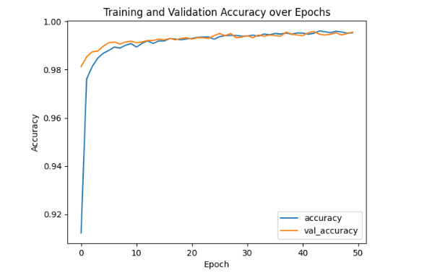
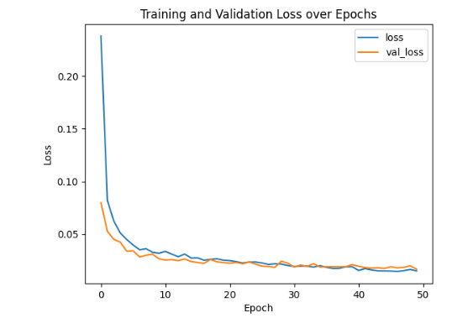
GRU

Slide 29
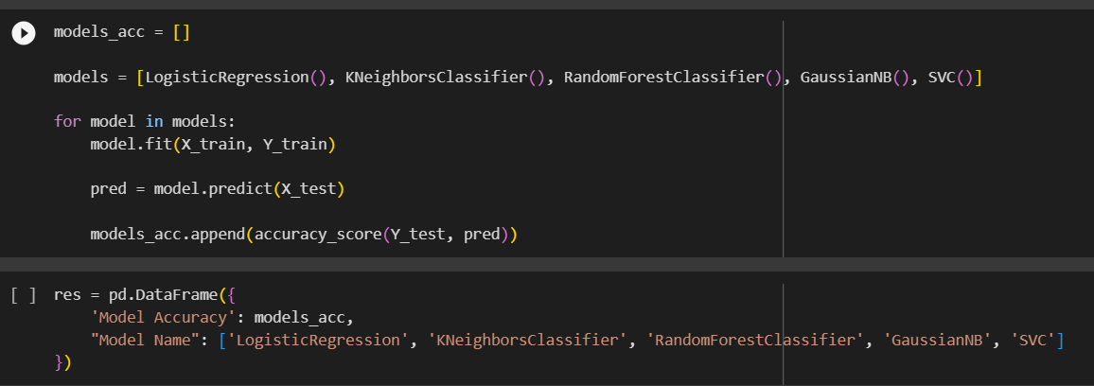
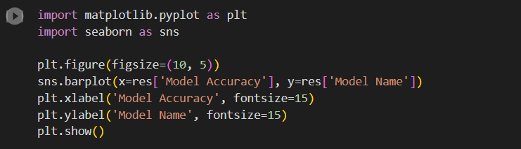
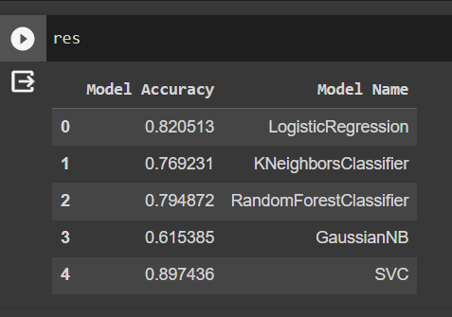
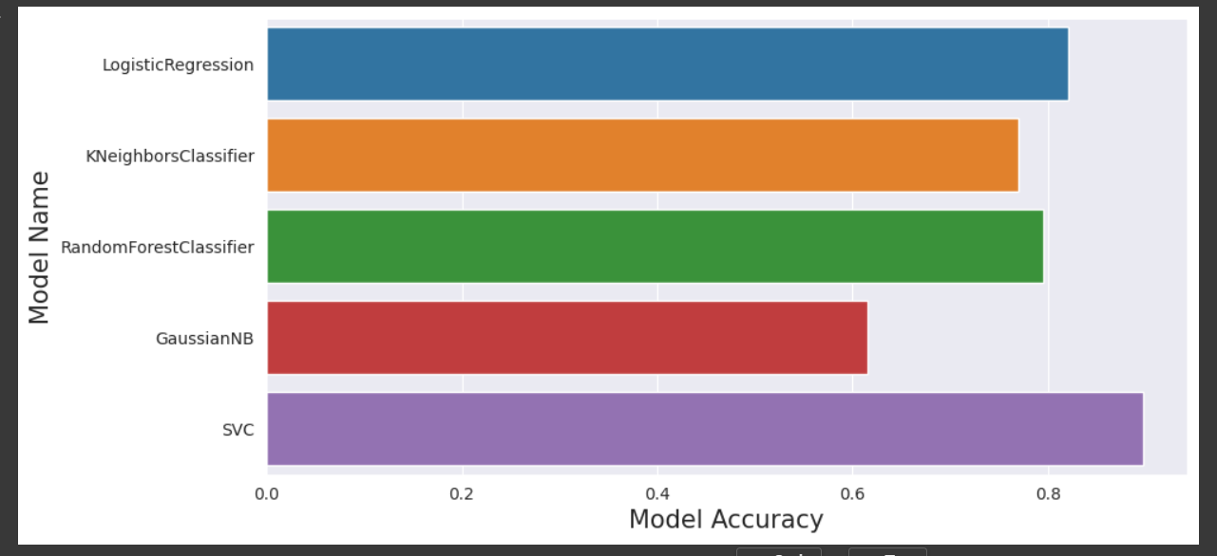
Model Evaluation

Slide 30
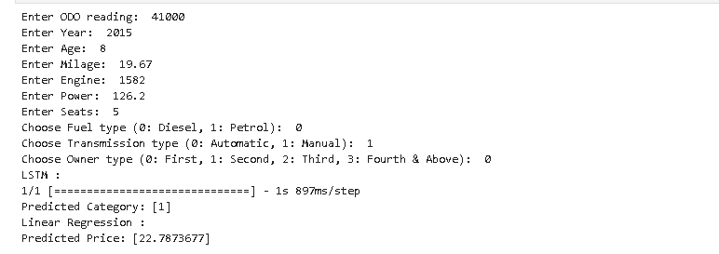
Console based Application
Output:

Slide 31
References
Sanchith Venkatesan, Shivam Handa, and Baskar M. 2023. Car Price Prediction. In Proceedings of the 4th International Conference on Information Management &amp; Machine Intelligence (ICIMMI '22). Association for Computing Machinery, New York, NY, USA, Article 27, 1–6. https://doi.org/10.1145/3590837.3590864
Naser Shanti, Akram Assi, Hamza Shakhshir, and Adnan Salman. 2022. Machine Learning-Powered Mobile App for Predicting Used Car Prices. In Proceedings of the 2021 3rd International Conference on Big-data Service and Intelligent Computation (BDSIC '21). Association for Computing Machinery, New York, NY, USA, 52–60. https://doi.org/10.1145/3502300.3502307
Cui B, Ye Z, Zhao H, Renqing Z, Meng L, Yang Y. Used Car Price Prediction Based on the Iterative Framework of XGBoost+LightGBM. _Electronics_. 2022; 11(18):2932. https://doi.org/10.3390/electronics11182932
C. Jin, "Price Prediction of Used Cars Using Machine Learning," 2021 IEEE International Conference on Emergency Science and Information Technology (ICESIT), Chongqing, China, 2021, pp. 223-230, doi: 10.1109/ICESIT53460.2021.9696839.

Slide 32
References
B. Hemendiran and P. N. Renjith, "Predicting the Prices of the Used Cars using Machine Learning for Resale," 2023 IEEE International Students' Conference on Electrical, Electronics and Computer Science (SCEECS), Bhopal, India, 2023, pp. 1-5, doi: 10.1109/SCEECS57921.2023.10063133.
F. Wang, X. Zhang and Q. Wang, "Prediction of Used Car Price Based on Supervised Learning Algorithm," 2021 International Conference on Networking, Communications and Information Technology (NetCIT), Manchester, United Kingdom, 2021, pp. 143-147, doi: 10.1109/NetCIT54147.2021.00036.
S. Shaprapawad, P. Borugadda and N. Koshika, "Car Price Prediction:An Application of Machine Learning," 2023 International Conference on Inventive Computation Technologies (ICICT), Lalitpur, Nepal, 2023, pp. 242-248, doi: 10.1109/ICICT57646.2023.10134142.
S. Han, J. Qu, J. Song and Z. Liu, "Second-hand Car Price Prediction Based on a Mixed-Weighted Regression Model," 2022 7th International Conference on Big Data Analytics (ICBDA), Guangzhou, China, 2022, pp. 90-95, doi: 10.1109/ICBDA55095.2022.9760371.

Slide 33


