Slide 1
HR MANAGEMENT SYSTEM
Group 4
Notes:
Add instructor notes here.

Slide 2

Project Contributers
161611 : Manish Rahangdale
161585 : Viraj Dere
161289 : Mohammed Allauddin Shaik
161700 : Vinay Samudrala
161288 : Jitendra Sai Pandava
161698 : Apoorva Nath
161599 : Prudhviraj Cirikonda

Slide 3
Objectives
Project Understanding
Approach used
Project Execution
Modules
Opportunity for improvement
Demo and Code Walkthrough
Q&A
Notes:
Add instructor notes here.

Slide 4
Project Understanding
This application will help Admin to manage user information.
This will enable Admin to view Add, Update, Delete and List members of the organization.
Admin can register himself with the application and perform the above mentioned tasks.
Notes:
Add instructor notes here.

Slide 5
Approach used :
ASP.NET MVC
SQL SERVER 2012
RAZOR VIEW
Entity Framework data model
Data base first approach
Notes:
Add the notes here.
Add instructor notes here.

Slide 6
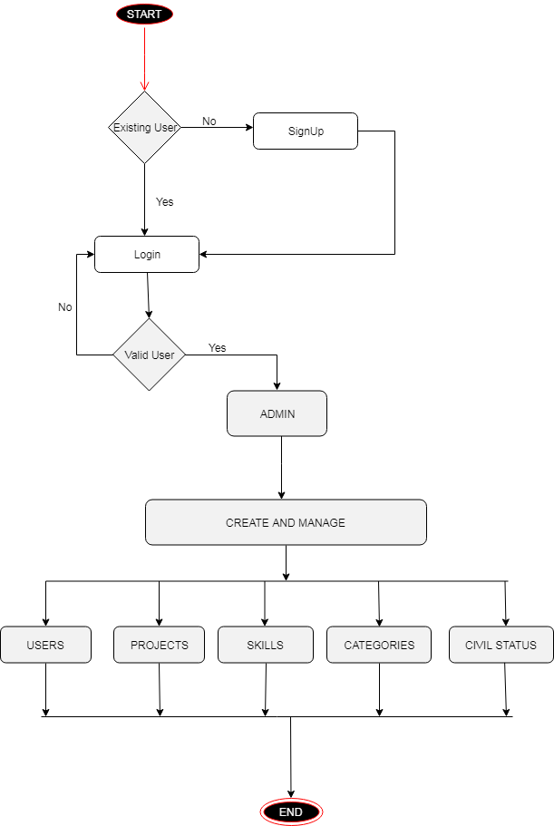
Project Execution
Notes:
Add the notes here.
Add instructor notes here.

Slide 7
Modules
ADMIN Module:
Admin can login if he have credentials else he can signup if he is a new user.
When Admin logs into the application he will be redirected to the admin home page where he has option to view User information, Project information, Civil Status, Category and Skills of users.
He can perform Edit, Delete and Update operations on User, Project, Civil Status, Category and Skills.
Notes:
Add the notes here.
Add instructor notes here.

Slide 8
Modules(contd…)
Admin can also create credentials for new users and edit credentials of existing users.
He can create new projects and edit project details for existing users.
He can edit Civil Status description.
He can create new Categories and edit Category details for existing users.
He can add new skills and edit existing skills of current users.

Slide 9


Slide 10
Opportunity for improvement
Encrypted passwords can be stored in the database instead of string.
UI styling can be made responsive.
Database can be improved.
Everything can be optimized.
Notes:
Add the notes here.
Add instructor notes here.

Slide 11
Q & A
Notes:
Add the notes here.
Add instructor notes here.

Slide 12

Notes:
Add the notes here.
Add instructor notes here.

