Slide 1
Applications of AI for Predictive Maintenance

Slide 2
Lab 2: Training GPU LSTM models using Keras + Tensorflow for Time Series

Slide 3
LAB 2 OVERVIEW
In this lab, we will leverage the Backblaze Hard Drive SMART data to train an LSTM model that will predict potential future failures. Unlike the previous lab, where the XGBoost model predicted based on current data, the LSTM model will leverage time series data to look for trends prior to a failure.
We will walk through creating the "normal" and "failing" sequences that will indicate when we expect to see early warning signs of a disk failure. Then we will use that data to train our model.
Notes:
In the second lab, we’ll train LSTM models for time series prediction. We will discuss RNN and LSTM models, as well as the Vanishing Gradient Problem. Furthermore, we’ll experiment with different RNN architectures.

Slide 4
workshop structure
LAB 1 (2 hrs.)
LAB 2 (2 hrs.)
Training GPU XGBoost models with RAPIDS for Time Series
Training GPU LSTM models using Keras+Tensorflow for Time Series
Discuss predictive maintenance, Blackblaze hard drive data, challenges of dealing with large noisy datasets.
Scope into short-term ML automation problem.
Ingest raw real dataset from GPU production line for XGBoost model.
Format DataFrames and into DMatrices to fit into model.
Analyze dataset statistics (i.e. false positives, true positives.)
Examine XGBoost performance over the model.
Learn how to balance imbalanced data and measure relevant KPIs to assess the model.
Discuss Recurrent Networks and Long Short-Term Memory (LSTMs).
Learn how to mitigate Vanishing Gradient Problem using LSTMs and get familiarized with their cell structure.
Learn how to create sequences of data to feed the temporal nature of RNNs.
Design different RNN architectures and even create your own model.
Learn how to create the confusion matrix and adjust the threshold to different f-1 scores.
LAB 3 (2 hrs.)
Training Autoencoder for Anomaly Detection
Focus on a different deep learning technique, which is called anomaly detection.
Learn how to use unsupervised learning algorithms like a deep autoencoder network to perform anomaly detection.
Learn how to create different autoencoder models in Keras.
General discussion on hyperparameter tuning and threshold settings.
Notes:
The workshop is appropriately broken down into 3 labs:
In the first lab, we’ll train an XGBoost model for failure classification. We will discuss the XGBoost model as model evaluation metrics.
In the second lab, we’ll train LSTM models for time series prediction. We will discuss RNN and LSTM models, as well as the Vanishing Gradient Problem. Furthermore, we’ll experiment with different RNN architectures.
In the third lab, we’ll train an Autoencoder for anomaly detection. We will discuss a deep autoencoder networks and perform hyperparameter tuning as well as threshold setting.

Slide 5
Recurrent Neural Networks

Slide 6
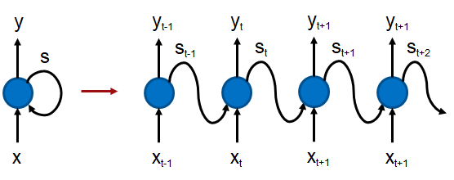
Recurrent Neural Networks
RNNs are created to solve the memory-persistence issue found in conventional feed forward networks.
RNNs maintain a loop that allows the information to be persistent in the network.
At each time step 𝑡 , the network receives input 𝑋𝑡 and outputs a value of 𝑦𝑡 . The left side of the figure shows an RNN cell with input 𝑋 and output 𝑦 . There is also a loop-back of the state, which represents the memory. At a given timestep 𝑡 , the output also depends on all previous timesteps 𝑡−1,𝑡−2,...,0 .
y_{t+2}
x_{t+2}
Notes:
A Recurrent Neural Network (RNN) is a class of artificial neural network that has memory or feedback loops that allow it to better recognize patterns in data. RNNs are an extension of regular artificial neural networks that add connections feeding the hidden layers of the neural network back into themselves - these are called recurrent connections. The recurrent connections provide a recurrent network with visibility of not just the current data sample it has been provided, but also it's previous hidden state. A recurrent network with a feedback loop can be visualized as multiple copies of a neural network, with the output of one serving as an input to the next. Unlike traditional neural networks, recurrent nets use their understanding of past events to process the input vector rather than starting from scratch every time.
A RNN is particularly useful when a sequence of data is being processed to make a classification decision or regression estimate but it can also be used on non-sequential data. Recurrent neural networks are typically used to solve tasks related to time series data. We can teach RNNs to learn and understand sequences of events.

Slide 7
Vanishing Gradient Problem and LSTMs
A simple RNN model only has a single hidden RNN layer while a stacked RNN model (needed for advanced applications) has multiple RNN hidden layers. A common problem in deep networks is the “vanishing gradient” problem, where the gradient gets smaller and smaller with each layer until it is too small to affect the deepest layers.
This is because small gradients or weights (values less than 1) are multiplied many times over through the multiple time steps, and the gradients shrink asymptotically to zero.
With the memory cell in LSTMs, we have continuous gradient flow (errors maintain their value) which thus eliminates the vanishing gradient problem and enables learning from sequences which are hundreds of time steps long.
Notes:
Like multi-layer perceptrons, recurrent neural networks can also be trained using the stochastic gradient descent (SGD), batch gradient descent, or mini-batch gradient descent algorithms. The only difference is in the back-propagation step that computes the weight updates for our slightly more complex network structure. After the error in the prediction is calculated in the first pass through the network, the error gradient, starting at the last output neuron, is computed and back-propagated to the hidden units for that time-step. This process is then repeated for each of the previous time-steps in order. The gradients that back-propagate to the hidden units are coming from both the output neurons and the units in the hidden state one step ahead in the sequence. We call this process Backpropagation Through Time (BPTT).
We can increase the number of neurons in the hidden layer and we can stack multiple hidden layers to create a deep RNN architecture. Unfortunately simple RNNs with many stacked layers can be brittle and difficult to train. This brittleness arises because the backpropagation of gradients within a neural network is a recursive multiplication process. This means that if the gradients are small they will shrink exponentially and if they are large they will grow exponentially. These problems are called the "vanishing" and "exploding" gradients respectively.

Slide 8
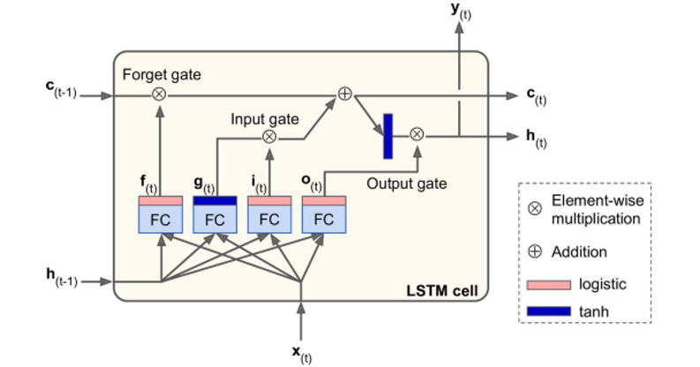
LSTM Model
Image from book: Hands-On Machine Learning with Scikit-Learn and TensorFlow: Concepts, Tools, and Techniques to Build Intelligent Systems by Aurélien Géron
Notes:
Some types of recurrent neural networks have a memory that enables them to remember important events that happened many time steps in the past. What distinguishes sequence learning from other regression and classification tasks is the need to use models such as LSTMs (Long Short-Term Memory) to learn temporal dependence in input data. This memory of past input is crucial for successful sequence learning. LSTM provides better performance compared to other RNN architectures by alleviating what is called the vanishing gradient problem, where the gradient gets smaller and smaller with each layer until it is too small to affect the deepest layers.
Similar to the RNN model, the LSTM architecture consists of linear units with a self-connection that allows the flow of a value (forward pass) or gradient (backward pass) to be preserved and subsequently retrieved at the required time step. The self-recurrent unit, the memory cell, is capable of storing information which lies a dozen of time-steps in the past. This is very powerful for many tasks. For example, for text data, an LSTM unit can store information contained in the previous paragraph and apply this information to a sentence in the current paragraph.
With the memory cell in LSTMs, we have continuous gradient flow (errors maintain their value) which thus eliminates the vanishing gradient problem and enables learning from sequences which are hundreds of time steps long. LSTM models are powerful enough to learn the most important past behaviours and understand whether or not those past behaviours are important features in making future predictions.

Slide 9
LSTM Applications
LSTMs, due to their ability to learn long term dependencies, are applicable to a number of sequence learning problems. These problems include language modeling and translation, acoustic modeling of speech, speech synthesis, speech recognition, audio and video data analysis, handwriting recognition and generation, sequence prediction, and protein secondary structure prediction.
In this lab, we apply the LSTM model to the Backblaze data we introduced in the previous lab to create a model that predicts the hard disk failure based on the recorded data-points at least a few days before the actual failure.
Notes:
Applications of recurrent neural networks include natural language processing, speech recognition, machine translation, character-level language modeling, image classification, image captioning, stock prediction, and financial engineering. We will use LSTM to build a model using Backblaze data to predict failure based on sequences of data-points.

Slide 10
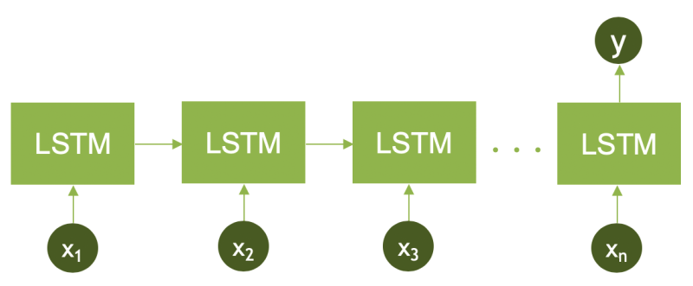
LSTM - create sequences of data based on the serial number
Here we have n time steps representing each data point in the DataFrame.
Also, only the last RNN (LSTM) cell is outputting the value 𝑦 , which in our model indicates whether the data sequence ends up in a failure state or not. Note that the input values 𝑥1,𝑥2,…,𝑥𝑛 are multi-dimensional values and not single scalars.
Notes:
We will have to transform the dataset differently than we had done in Lab 1 in order to create time-series features.

Slide 11
Stacked LSTMs
In reality, one-layer LSTM nodes are barely enough to capture the information encoded within a sequence. Alternatively, stacked LSTMs allow capturing more data complexity. In our model, we are going to use three layers of stacked LSTMs as shown in the next slide.
Notes:
We can stack LSTM layers to create a deep neural network. Based on our experimentation, we were able to achieve good results with 3 layers of stacked LSTMs, but will recommend more experimentation when you have time.

Slide 12
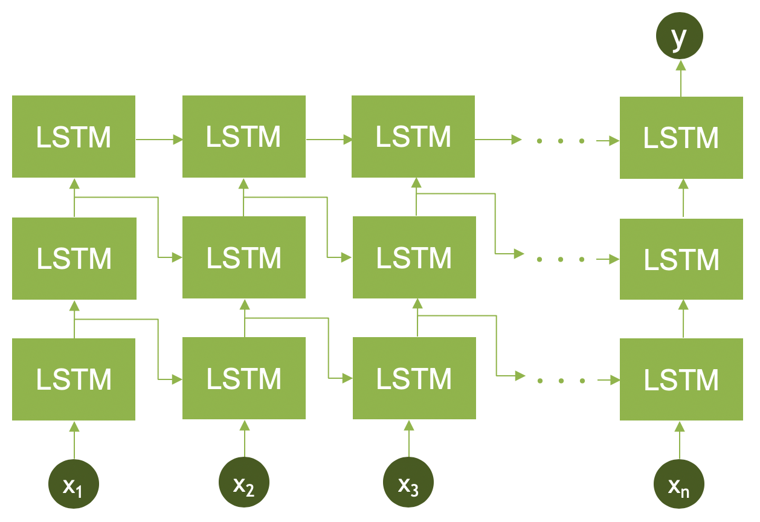
Stacked LSTMs
Notes:
This is what the architecture of 3 layers of stacked LSTM model looks like.

Slide 13
CNN LSTM Architecture
The CNN LSTM uses a convolutional neural layer to extract features from the sequence on top of the LSTM layers, which also inherently extract features. Since we are dealing with a one dimensional time series, we are going to use 1D convolutional network, starting with a kernel size of 12 and 50 filters. We also use a max pooling layer of size 2 to shrink the dimension of the data.
Notes:
A more advanced architecture, CNN LSTM Sequence Prediction model, is rising in popularity. This model is designed specifically for sequential prediction with spatial inputs (e.g. videos), however, could be applied to time series prediction as well. The CNN LSTM uses a convolutional neural layer to extract features from the sequence on top of the LSTM layers which also inherently extract features. Since we are dealing with one dimensional time series, we are going to use 1D convolutional network, starting with a kernel size of 12 and 50 filters. We also use a max pooling layer of size 2 to shrink the data size. Figure 5 shows the architecture of the new model.

Slide 14
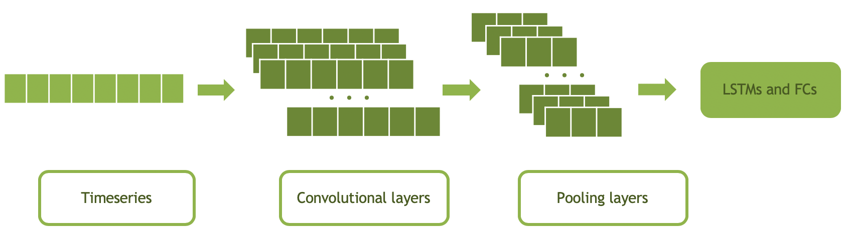
CNN LSTM Architecture
Notes:
This is what the architecture of CNN LSTM model looks like.

Slide 15
Keras

Slide 16
Keras
Keras: an API for specifying & training differentiable programs
“Keras is a high-level neural networks API, written in Python and capable of running on top of TensorFlow, CNTK, or Theano. It was developed with a focus on enabling fast experimentation. Being able to go from idea to result with the least possible delay is key to doing good research.
Allows for easy and fast prototyping (through user friendliness, modularity, and extensibility).
Supports both convolutional networks and recurrent networks, as well as combinations of the two.
Runs seamlessly on CPU and GPU.”
Source: https://keras.io/
Notes:
Keras is an open-source software library that provides a Python interface for artificial neural networks. It supports multiple backend neural network computation, including TensorFlow. In fact, the release of TensorFlow 2.0 (2019) made Keras the official high-level API of TensorFlow for quick and easy model design and training. In the context of the course, we use Keras as an interface for the TensorFlow library, since it is the backend we choose.

Slide 17
Keras
Keras: an API for specifying & training differentiable programs
KERAS API
TensorFlow, CNTK, MXNET, …
CPU
GPU
Notes:
Keras supports popular neural network frameworks and can run on CPU and GPU.

Slide 18
Keras – CODE SIMPLICITY
# load model definition API
from keras.models import Sequential
model = Sequential()
# load appropriate Keras layers and add to model
from keras.layers import Dense
model.add(Dense(units=64, activation='relu', input_dim=100))
model.add(Dense(units=10, activation='softmax'))
# load appropriate optimizer and compile model
from keras.optimizers import SGD
optimizer1 = SGD(lr=0.01, momentum=0.9, nesterov=True)
model.compile(loss=‘categorical_crossentropy’, optimizer=optimizer1, metrics=['accuracy'])
Notes:
Here is a snippet of how easy Keras has made deep learning development.

Slide 19
Keras – CODE SIMPLICITY
# visualize model
model.summary()
Model: "sequential_1"
_________________________________________________________________
Layer (type) Output Shape Param #
=================================================================
dense_1 (Dense) (None, 64) 6464
_________________________________________________________________
dense_2 (Dense) (None, 10) 650
=================================================================
Total params: 7,114
Trainable params: 7,114
Non-trainable params: 0
_________________________________________________________________
Notes:
With Keras, you can quickly visualize the neural network architecture with model.summary().

Slide 20
NOTE ABOUT LAB AND RUL
Day N+1
Day N+2
Day N+3
Day N+4
Day N+RUL1
Day N+RUL2
Day N+RUL3
Day N
Failed
Sensor 1
Sensor 2
. . . . .
. . . . .
. . . . .
Sensor 3
Sensor 4
For Lab 2, we will be training the model based with 5-day sequences and will use a 2-day look ahead to classify the sequence as failed or not.
Typically, you would train multiple models using the failed state from a date in the future (Ex: 2 weeks out, 1 month out, 3 months out)
Notes:
In this lab, we will develop a "classifier" which will indicate, based on SMART drive data, that a given hard drive will fail within the "sequnce_length“. By increasing the sequence_length, we could potentially learn to detect failures further in the future. In addition, different failure types could have different failure windows, so an ensemble of models, each with different windows and sequences could be leveraged for more advanced RUL predictions.

Slide 21
STARTING the lab

Slide 22

LAB 2 MODEL SUMMARY - LSTM
Train LSTM Model with sequences of length ‘S’ to predict failure ‘L’ days in future
Training: Use multi-day sequences of SMART features (from an individual hard drive) to train a LSTM model on whether a drive will fail ‘L’ days in the future
Inference: Pass sequence of SMART values for an individual hard drive over the last ‘S’ days to see if drive will fail ‘L’ days in the future
Day
Features (SMART Values for individual drive over ‘S’ days)
Label
Day
Features (SMART Values for individual drive over last ‘S’ days)
N+0
01
02
03
04
…
18
19
20
21
N-S+1
01
02
03
04
…
18
19
20
21
N+1
01
02
03
04
…
18
19
20
21
N-S+2
01
02
03
04
…
18
19
20
21
N+2
01
02
03
04
…
18
19
20
21
N-S+3
01
02
03
04
…
18
19
20
21
…
…
…
…
…
…
…
…
…
…
…
…
…
…
…
…
…
…
N+S-1
01
02
03
04
…
18
19
20
21
N
01
02
03
04
…
18
19
20
21
N+S+L-1
FAILED
LSTM Model
LSTM Model
Future Failure at day N+L
True / False

Slide 23
LAB 2 MODEL SUMMARY – 1D CONV / LSTM
Train LSTM Model with sequences of length ‘S’ to predict failure ‘L’ days in future
Training: Use multi-day sequences of SMART features (from an individual hard drive) to train a 1D CONV / LSTM model on whether a drive will fail ‘L’ days in the future
Inference: Pass sequence of SMART values for an individual hard drive over the last ‘S’ days to see if drive will fail ‘L’ days in the future
Day
Features (SMART Values for individual drive over ‘S’ days)
Label
Day
Features (SMART Values for individual drive over last ‘S’ days)
N+0
01
02
03
04
…
18
19
20
21
N-S+1
01
02
03
04
…
18
19
20
21
N+1
01
02
03
04
…
18
19
20
21
N-S+2
01
02
03
04
…
18
19
20
21
N+2
01
02
03
04
…
18
19
20
21
N-S+3
01
02
03
04
…
18
19
20
21
…
…
…
…
…
…
…
…
…
…
…
…
…
…
…
…
…
…
N+S-1
01
02
03
04
…
18
19
20
21
N
01
02
03
04
…
18
19
20
21
N+S+L-1
FAILED
1D CONV / LSTM Model
1D CONV / LSTM Model
Future Failure at day N+L
True / False

Slide 24
Summary

Slide 25
LAB 2 SUMMARY
Training GPU LSTM models using Keras+Tensorflow for Time Series
Discuss Recurrent Networks and Long Short-Term Memory (LSTMs).
Learn how to mitigate Vanishing Gradient Problem using LSTMs and get familiarized with their cell structure.
Learn how to create sequences of data to feed the temporal nature of RNNs.
Design different RNN architectures and even create your own model.
Learn how to create the confusion matrix and adjust the threshold to different f-1 scores.

Slide 26
WHAT’S NEXT (LAB 3)?
Training Autoencoder for Anomaly Detection
Focus on a different deep learning technique, which is called anomaly detection.
Learn how to use unsupervised learning algorithms like a deep autoencoder network to perform anomaly detection.
Learn how to create different autoencoder models in Keras.
Discuss how to create and deploy GAN models for detecting anomalies.
General discussion on hyperparameter tuning and threshold settings.

