Slide 1
Applications of AI for Predictive Maintenance

Slide 2
Lab 3: Training Autoencoder for Anomaly Detection

Slide 3
LAB 3 OVERVIEW
In this section we focus on a deep learning technique, which is called anomaly detection. This is different from traditional time series analytics.
In a nutshell, because only a small portion of the hard drives are defective in our use case, we can treat those as anomalies.
For example, out of three million samples we dealt with in our training set within the previous lab, only 256 samples were defective. Those are "anomalies" among the big pool of well-functioning hard drives.
Now, if we could have a model capable of learning what a proper functioning hard drive looks like, it could detect hard drives with a different behavior pattern.
Notes:
In the third lab, we’ll train an autoencoder for anomaly detection.

Slide 4
workshop structure
LAB 1 (2 hrs.)
LAB 2 (2 hrs.)
Training GPU XGBoost models with RAPIDS for Time Series
Training GPU LSTM models using Keras+Tensorflow for Time Series
Discuss predictive maintenance, Backblaze hard drive data, challenges of dealing with large noisy datasets.
Scope into short-term ML automation problem.
Ingest raw real dataset from GPU production line for XGBoost model.
Format DataFrames and into DMatrices to fit into model.
Analyze dataset statistics (i.e. false positives, true positives.)
Examine XGBoost performance over the model.
Learn how to balance imbalanced data and measure relevant KPIs to assess the model.
1. Discuss Recurrent Networks and Long Short-Term Memory (LSTMs).
2. Learn how to mitigate Vanishing Gradient Problem using LSTMs and get familiarized with their cell structure.
3. Learn how to create sequences of data to feed the temporal nature of RNNs.
4. Design different RNN architectures and even create your own model.
5. Learn how to create the confusion matrix and adjust the threshold to different f-1 scores.
LAB 3 (2 hrs. + 2 hrs.)
Training Autoencoder for Anomaly Detection and Hyperparameter Optimization
Focus on a different deep learning technique, which is called anomaly detection.
Learn how to use unsupervised learning algorithms like a deep autoencoder network to perform anomaly detection.
Learn how to create different autoencoder models in Keras.
General discussion on hyperparameter tuning and threshold settings.
Notes:
The workshop is appropriately broken down into 3 labs:
In the first lab, we’ll train an XGBoost model for failure classification. We will discuss the XGBoost model as model evaluation metrics.
In the second lab, we’ll train LSTM models for time series prediction. We will discuss RNN and LSTM models, as well as the Vanishing Gradient Problem. Furthermore, we’ll experiment with different RNN architectures.
In the third lab, we’ll train an Autoencoder for anomaly detection. We will discuss a deep autoencoder networks and perform hyperparameter tuning as well as threshold setting.

Slide 5
Autoencoders

Slide 6
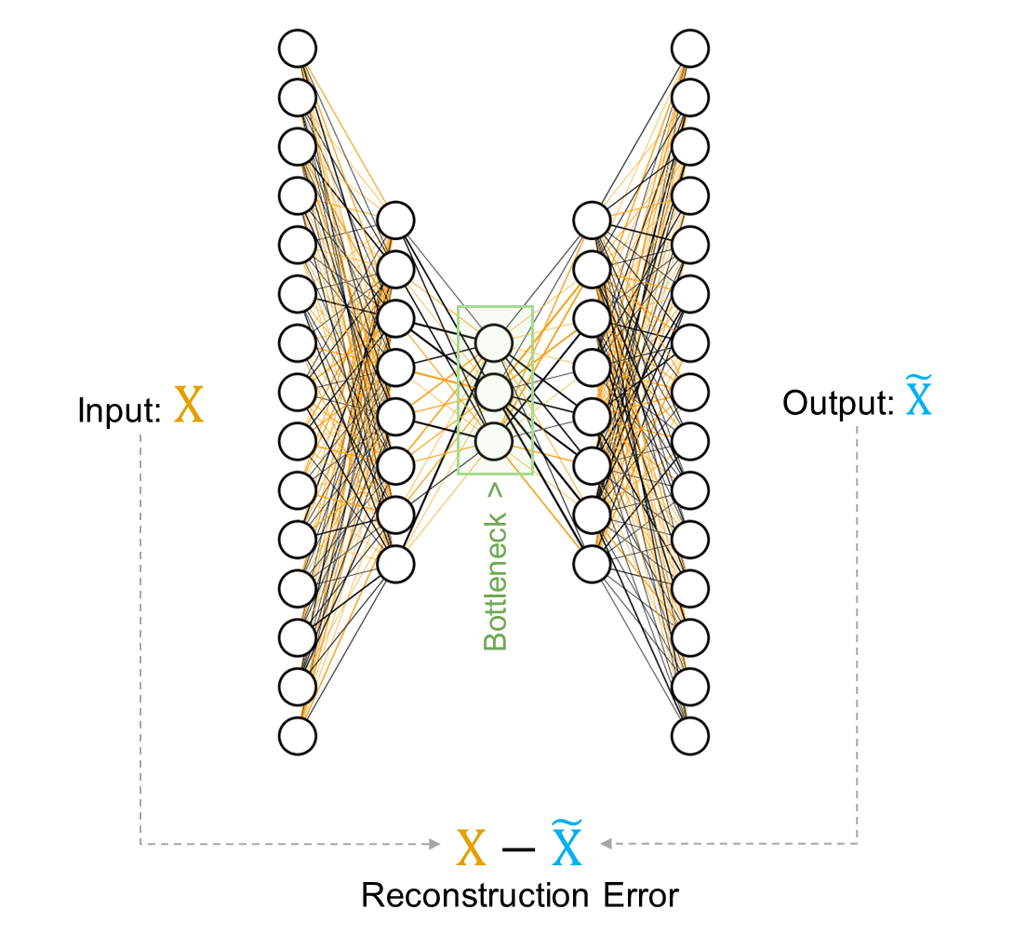
AUTOENCODERS
Deviation based anomaly detection method
Autoencoders are a form of unsupervised learning and have applications outside of anomaly detection
An autoencoder consists of two parts the encoder and decoder
Encoder is a neural network that maps the input to a (typically) lower-dimensional space
Decoder is a neural network that maps the encoded data back to the input
Anomalies have high reconstruction error
Notes:
Autoencoder is an unsupervised artificial neural network that learns how to efficiently compress and encode data then learns how to reconstruct the data back from the reduced encoded representation to a representation that is as close to the original input as possible. Autoencoder, by design, reduces data dimensions by learning how to ignore the noise in the data. This technique works well if some sort of structure exists in the because the encoding operation relies on the correlated features to compress the data.
Autoencoders consists of 4 main parts:
Encoder: In which the model learns how to reduce the input dimensions and compress the input data into an encoded representation.
Bottleneck: which is the layer that contains the compressed representation of the input data. This is the lowest possible dimensions of the input data.
Decoder: In which the model learns how to reconstruct the data from the encoded representation to be as close to the original input as possible.
Reconstruction Loss: This is the method that measures measure how well the decoder is performing and how close the output is to the original input.
Using this technique, anomalies will have high reconstruction error because the network fails to reconstruct the input.

Slide 7
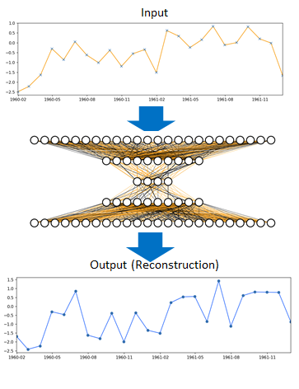
AUTOENCODERS
Notes:
Here is an example of a single time series input passing through the autoencoder. The encoder part is used to compress some data and the decoder part is used to decompress the data.

Slide 8
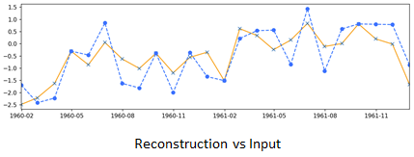
Time series Reconstruction
To train this type of neural network, we can calculate the difference between the input and the output and use that loss, typically called a reconstruction loss, as our loss function for training our model
Notes:
The training involves using back propagation in order to minimize the network’s reconstruction loss.

Slide 9
Reconstruction error of a regular sample
Encoder-Net
Decoder-Net
x₁
0.0
0.0
1.0
0.0
0.0
…
0.0
0.02
-0.01
1.11
0.0
0.08
…
0.05
x₁
x₂
.
.
.
.
.
.
x₂
z₁
Reconstruction error of a single sample
x₃
.
.
.
.
.
.
x₃
z₂
.
x₄
.
.
.
.
.
.
.
x₄
0.0215
.
.
.
.
.
.
.
x₅
.
.
x₅
.
.
z_{n}
.
.
.
.
.
.
.
.
.
.
.
.
.
.
.
.
.
.
.
.
.
.
.
.
.
x_{i}
x_{i}
Notes:
Let’s compare the reconstruction loss between a regular sample vs. an anomaly. The reconstruction loss for a regular sample will be low.

Slide 10
Reconstruction error of an anomaly
Encoder-Net
Decoder-Net
x₁
0.0
0.0
1.0
0.0
0.0
…
0.0
0.52
0.03
0.01
0.07
-1.08
…
1.45
x₁
x₂
.
.
.
.
.
.
x₂
z₁
Reconstruction error of a single sample
x₃
.
.
.
.
.
.
x₃
z₂
.
x₄
.
.
.
.
.
.
.
x₄
4.5252
.
.
.
.
.
.
.
x₅
.
.
x₅
.
.
z_{n}
.
.
.
.
.
.
.
.
.
.
.
.
.
.
.
.
.
.
.
.
.
.
.
.
.
x_{i}
x_{i}
Notes:
We would get a high reconstruction loss for an outlier or anomaly because the network fails to reconstruct the input.

Slide 11
In this lab
We will be working with 2 types of ”Autoencoders” for this lab:
LSTM-based AE (also know as a Seq2Seq Model)
1D-Convolution-based AE
Notes:
For this lab, the input sequences represent an individual hard drive and tracks the S.M.A.R.T. data features over 7 continuous days. Our objective is to build an autoencoder to identify sequences of normal hard drive operation. Once the autoencoder has been trained, we can use it to identify anomalies and outliers when the reconstruction error is high. There are various types of autoencoders that are applicable.

Slide 12
Seq2seq Model
Model
Traditional LSTM-based model
Takes sequence as input and produces sequence
Input
LSTM
Repeat Vector
LSTM
LSTM
Output
Notes:
A sequence to sequence takes a sequence as input and outputs another sequence. The most common architecture used to build a Seq2Seq model is encoder-decoder. It’s widely used for Machine Translation, Text Summarization, Conversational Modeling, Image Captioning, and more. It has since been used for a variety of other tasks, in our case for identifying pattern anomaly. The encoder and decoder are LSTM models to handle the sequence-based data. For anomaly detection, we will compare the input with the output and determine if it’s an anomaly or outlier based on a “threshold” of difference.

Slide 13
1d-Convolution AE Model
Conv1D Layer
Based on 1D Convolutions
Similar to traditional 2D-Convolutions, but individual kernels focused on single features
Feature 1
Feature 2
Feature 3
Feature 4
Feature 5
Day 1
Day 2
Day 3
Kernel (Size=5)
Day 4
Day 5
Day 6
Day 7
Day 8
Notes:
Another type of autoencoder uses Convolutional models. This is commonly used for image reconstruction or image noise reduction. Autoencoders are unsupervised neural network models that summarize the general properties of data in fewer parameters while learning how to reconstruct it after compression. In order to extract features from multi-dimensional data, Convolutional Neural Networks can be a suitable alternative as they capture neighboring information.

Slide 14
1d-Convolution AE Model
Input (8, 5)
Output (4, 5)
Feature 1
Feature 2
Feature 3
Feature 4
Feature 5
Day 1
Day 2
Day 3
Kernel (Size=5)
Day 4
Day 5
Two boxes highlighted to show how applied weights generate new hidden layer features
Day 6
Day 7
Day 8
Notes:
Here is a representation of what the Convolution model helps to achieve.

Slide 15
1d-Convolution AE Model
Input
Easier to train than traditional LSTM models
Less susceptible to noisy or missing data
Significantly faster to train
LSTM’s require large amounts of data to train
Good paper discussing: https://arxiv.org/pdf/1803.01271.pdf
Conv 1D
Maxpooling
Conv 1D
Maxpooling
Conv 1D
Upsampling
Conv 1D
Upsampling
Conv 1D
Output
Notes:
Convolutional autoencoders can be stacked in such a way that each Convolutional autoencoder takes the latent representation of the previous Convolutional autoencoder for higher-level representations. The tricky part of Convolutional autoencoders is at the decoder side of the model. During encoding, the features get shrunk by subsampling with either average pooling or max-pooling. Both operations result in information loss which is hard to re-obtain while decoding. Decoding typically involves upsampling. Similar as before, we will compare the input with the output and determine if it’s an anomaly or outlier based on a “threshold” of difference.

Slide 16
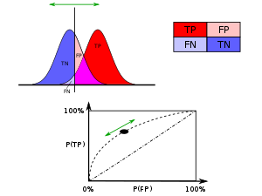
ROC Curve
The performance of the anomaly detection model is affected by the threshold. The ROC curve helps us understand model performance by plotting the True Positive rate and False Positive rate at different thresholds.
The threshold is high at the y-intercept, resulting in a 0% False Positive rate and a low True Positive rate. As the threshold decreases, the True Positive rate will increase but so will the False Positive rate.
https://en.wikipedia.org/wiki/Receiver_operating_characteristic
Notes:
The ROC curve plots the False Positive rate along the horizontal axis and the True Positive rate along the vertical axis. False Positive rate and True Positive rate will change based on the various decision threshold values. In another words, each marker on the line plot represents the same model’s prediction at a specific decision threshold. The decision threshold is high at the y-intercept, resulting in a 0% False Positive rate and a low True Positive rate. Lowering the classification threshold classifies more items as positive, thus increasing both False Positives and True Positives.

Slide 17
ROC Curve
Interpretation
Count
AUC = 0.99 ~1
0
1
0
1
0.5
False Positive Rate
Probability
Notes:
On the left is the distribution of the predicted probabilities (of being positive) for each actual class. When the two curves don’t overlap, it means the model has a high degree of separability, or the ability to distinguish between classes. A perfect classification would occur if the distribution of anomalous disks and normal disks are completely separated. This would yield a point in the upper left corner of the ROC space, where the False Positive rate is 0% and the True Positive rate is 100%. This example shows when the model has high degree of separability. The Area Under the Curve, AUC, is high. The higher the AUC – ROC, the better the model is at distinguishing between anomalous disks and normal disks.

Slide 18
ROC Curve
Interpretation
True Positive Rate
Count
auc = 0.5
0
0.5
1
0
1
False Positive Rate
Probability
Good Separation Between Classes = High Performance Model/Classifier
Notes:
When AUC – ROC is 0.5, it means the model has no class separation capacity whatsoever.

Slide 19
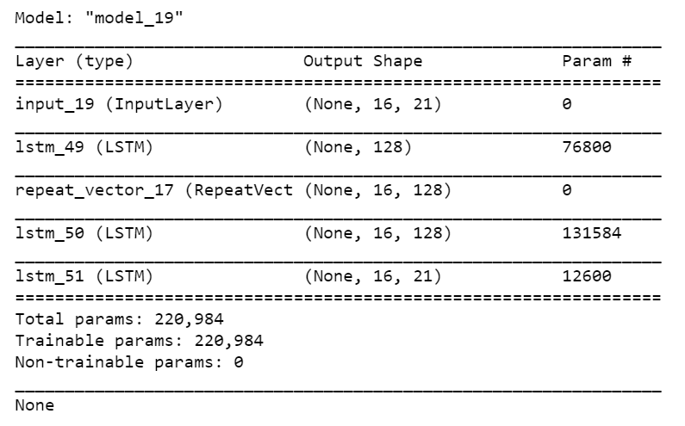
Comment on lab 3
Seq2Seq models look similar to traditional FC AE’s
Our model:
Input (16, 21)
336 features
Latent Vector (128)
Repeat (16, 128)
Output (16, 21)
Encoder
Decoder

Slide 20
Comment on lab 3
We’ll use a slightly different form of Keras model creation where we specify the individual layers and combine to build models. This is useful with Autoencoders when you want to split up the model to leverage the encoder or decoder.
Lab 3 LSTM AE:
inputs = Input(shape=(data_shape))
encoded = LSTM(lstm_width, dropout = dp_lvl, recurrent_dropout = dp_lvl, return_sequences = False,
activation='relu')(inputs)
decoded = RepeatVector(data_shape[0])(encoded)
decoded = LSTM(lstm_width, return_sequences=True, activation='relu')(decoded)
decoded = LSTM(data_shape[1], activation='tanh', return_sequences=True)(decoded)
autoencoder = Model(inputs, decoded)
Lab 2 LSTM:
model = Sequential()
model.add(LSTM(units, input_shape=(x_train.shape[1], x_train.shape[2]),dropout = dp_lvl,recurrent_dropout = dp_lvl,
return_sequences = True ))
model.add(LSTM(units, dropout = dp_lvl,recurrent_dropout = dp_lvl, return_sequences = True ))
model.add(LSTM(units, dropout = dp_lvl,recurrent_dropout = dp_lvl, return_sequences = False ))
model.add(Dense(units, activation='tanh',activity_regularizer=regularizers.l2(regularizer_lvl)))
model.add(Dropout (0.2))
model.add(Dense(units, activation='tanh',activity_regularizer=regularizers.l2(regularizer_lvl)))
model.add(Dense(1, activation='tanh',activity_regularizer=regularizers.l2(regularizer_lvl)))
Encoder

Slide 21

LAB 3 MODEL SUMMARY – AE’s
Train AE Model with “normal” sequences of length ‘S’ days
Training: Use multi-day sequences of SMART features (from an individual “normal” hard drives) to train a AE. Features and Label will be the full sequence.
Inference: Pass sequence of SMART values for an individual hard drive over the last ‘S’ days. For “normal” hard drives, should reconstruct with minimal error.
Day
Features & Label (SMART Values for individual drive over ‘S’ days)
Day
Features (SMART Values for individual drive over last ‘S’ days)
N+0
01
02
03
04
…
18
19
20
21
N-S+1
01
02
03
04
…
18
19
20
21
N+1
01
02
03
04
…
18
19
20
21
N-S+2
01
02
03
04
…
18
19
20
21
N+2
01
02
03
04
…
18
19
20
21
N-S+3
01
02
03
04
…
18
19
20
21
…
…
…
…
…
…
…
…
…
…
…
…
…
…
…
…
…
…
N+S-1
01
02
03
04
…
18
19
20
21
N
01
02
03
04
…
18
19
20
21
AE Model
AE Model
Reconstructed Sequence
S (days), 21 (features)

Slide 22
End of lab notes

Slide 23
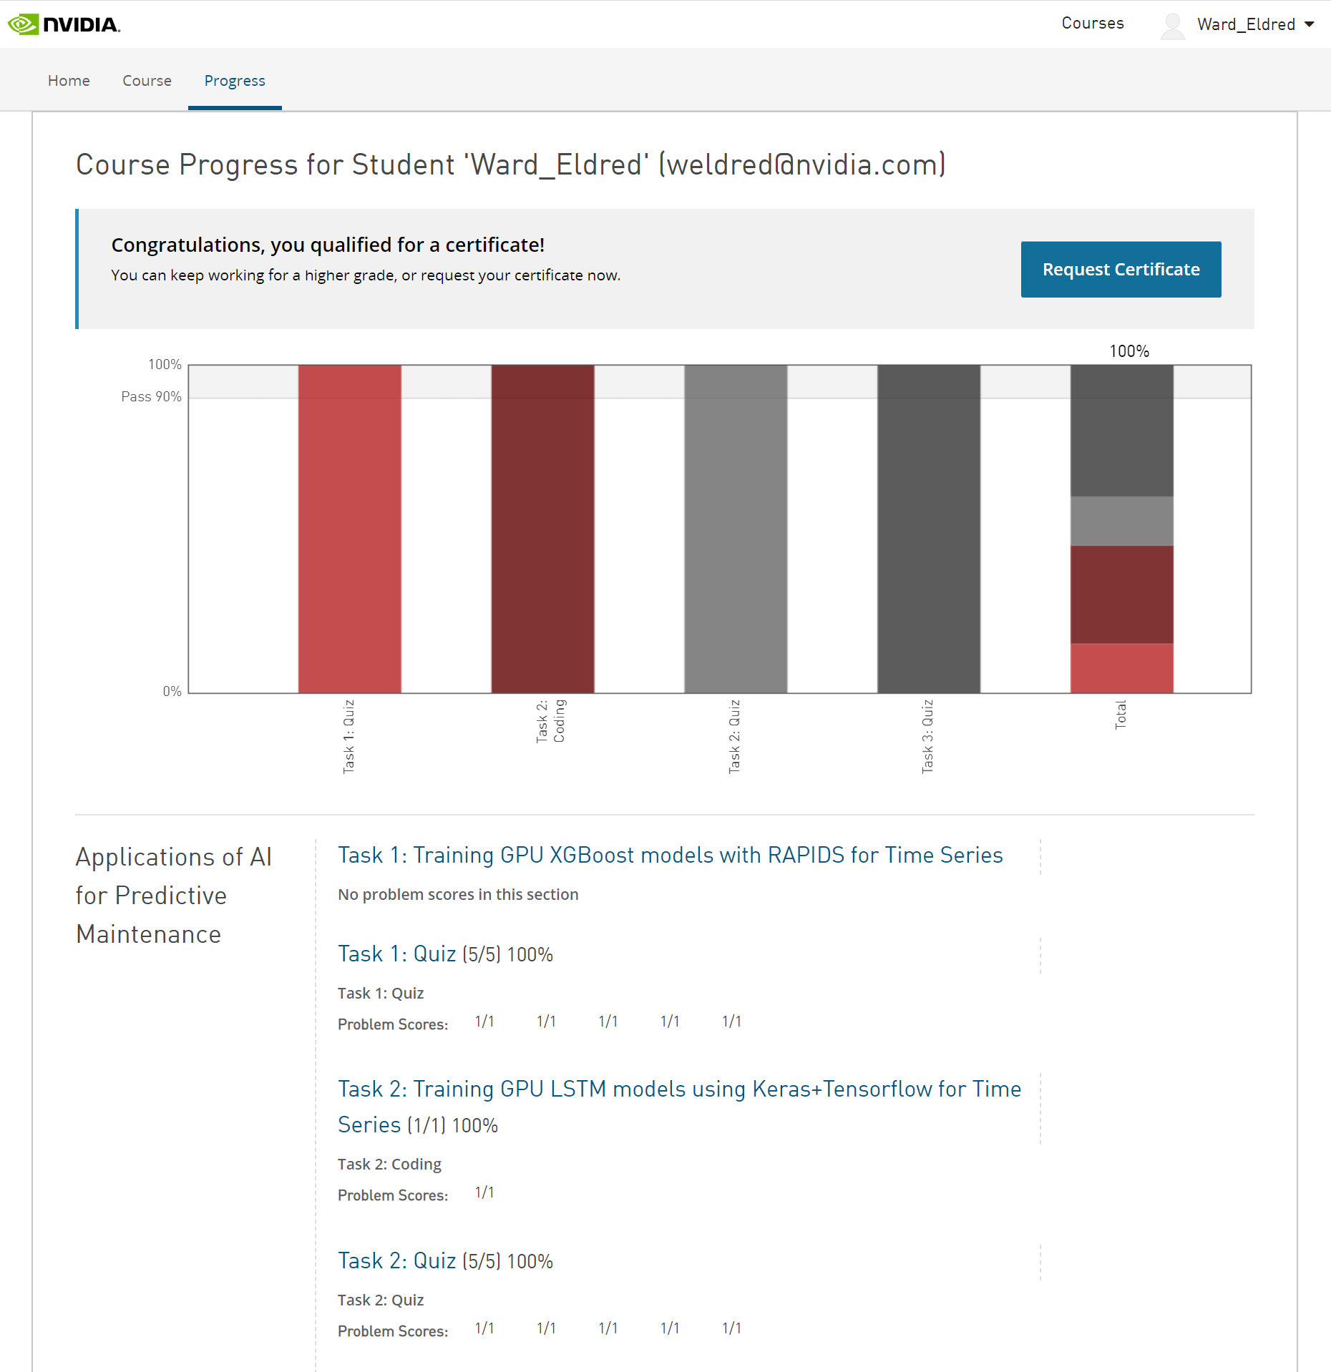
END OF LAB
Certificate: When you’ve completed the lab and Task 2 Assessment, go to “Progress” to request your certificate for completing this course.
Feedback: From the Task 3 Course page, you can select Next to complete the course survey

Slide 24
STARTING the lab

Slide 25
Summary

Slide 26
LAB 3 SUMMARY
Training Autoencoder for Anomaly Detection
Focus on a different deep learning technique, which is called anomaly detection.
Learn how to use unsupervised learning algorithms like a deep autoencoder network to perform anomaly detection.
Learn how to create different autoencoder models in Keras.

Slide 27
Hyperparameter optimization (OPTIONAL Discussion topic)

Slide 28
Hyperparameter Search
Hyperparameters are inputs to a machine learning/deep learning model. They are specified before the model training using a specified dataset starts. A trained model is the outcome of this process. So hyperparameters for a specific ML/DL model along with the dataset define the actual model to be used for inference.
Examples include sigma and C parameters for SVM (ML) and learning rate in LSTM/AE/CNNs in DL.
Loss functions in ML/DL represent the ability of a specified model with specified hyperparameters to adapt to a specific dataset. They can very multi-modal and change significantly with regard to change in hyperparameters.
Hence it is important to search for a good selection of hyperparameters for a particular model and a specified dataset. There are several options to do hyperparameter search/optimization : a brute force approach of grid search, randomized search, Bayesian optimization and evolutionary optimizations and many others.

Slide 29
Issues with Traditional Strategies
Data Scientists have, traditionally, leveraged Grid Search to check parameter spaces - which is SLOW !!
Models complexity is going up
Training is taking longer
Manual hyperparameter tuning is more difficult
Need to move to more optimal search solutions…

Slide 30
Issues with Traditional Strategies
Data Scientists have, traditionally, leveraged Grid Search to check parameter spaces - which is SLOW !!
Models complexity is going up
Training is taking longer
Manual hyperparameter tuning is more difficult
Need to move to more optimal search solutions…
Recent Test GridSearch I Ran:
fine_gbm_param_grid = {
**base_grid,
"min_child_weight": [1, 3, 5, 7, 9],
"gamma": [0, 1, 2, 4],
"subsample": [0.6, 0.8, 1.0],
"colsample_bytree": [0.6, 0.8, 1.0],
"max_depth": [1, 2, 3, 4, 5, 8],
"reg_alpha": [0, 1],
"reg_lambda": [0, 1],
"learning_rate": [0.30, 0.35, 0.40, 0.45, 0.50, 0.55,
0.60, 0.65, 0.70],}
38,880 combinations (5*4*3*3*6*2*2*9)
Each training took ~3 minutes
Total Search Time = 81 DAYS

Slide 31
Bayesian Optimization
Any hyperparameter search will consist of a few initial model trainings to understand the change of the loss function with regard to the change in hyperparameters.
This parameter space can be very multi-modal. As it is often expensive to run model trainings, it is important to select the next set of hyperparameters in an optimal way. This can be done taking into account the results so far and the uncertainty associated with them.
Bayesian Optimization takes this approach by sequentially selecting points based on the mean and uncertainty in a surface approximating the loss function result with regard to the hyper parameters.
“Bayesian Optimization: Open Source constrained global optimization tool for Python” Fernando Nogueira, 2014
https://github.com/fmfn/BayesianOptimization

Slide 32
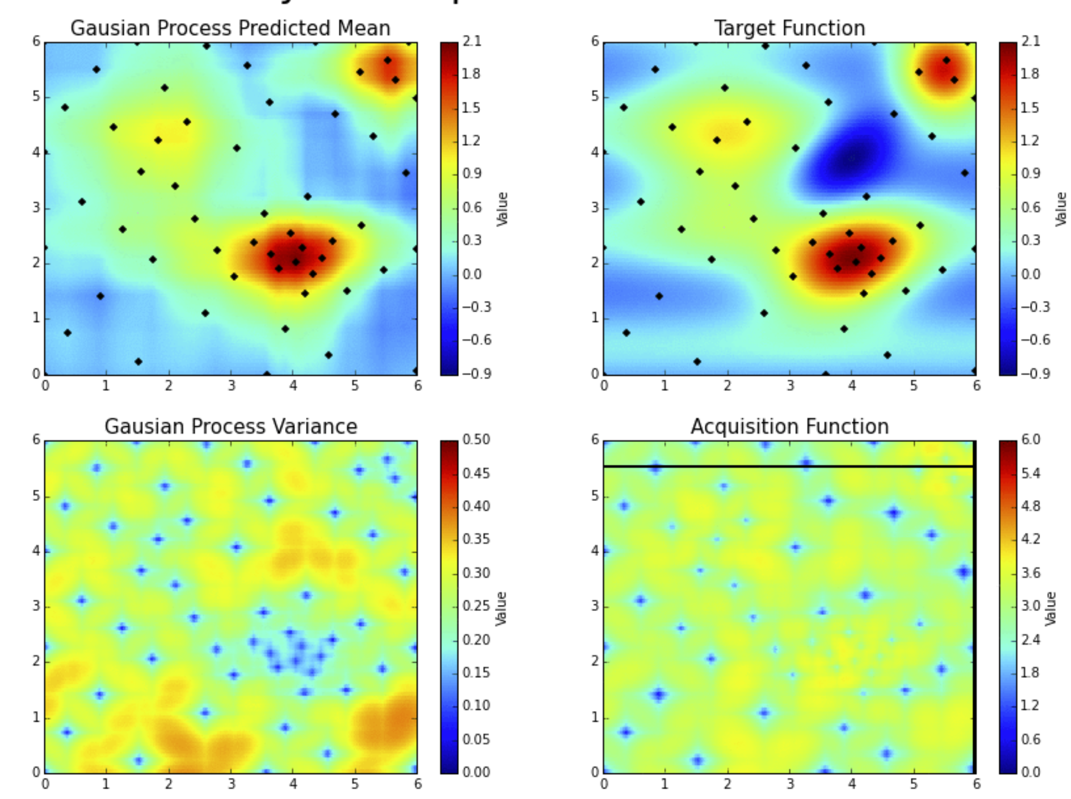
Bayesian Optimization
Actual function
Estimated function using Gaussian Processes
Upper and lower bounds for prediction
Function evaluation
Optimization in two- dimensional hyper parameter space
Function evaluation
Next suggested point for function evaluation based on acquisition function
Acquisition function
https://github.com/fmfn/BayesianOptimization

Slide 33
Parameter Space
Using Bayesian Optimization, we will explore hyperparameter optimization for the LSTM based autoencoder explained in this Lab.
The hyperparameters are taken to be :
Learning rate
LSTM width
We will also use the package shown earlier to perform hyperparameter optimization

Slide 34
references
Brief overview on hyperparameter optimization https://en.wikipedia.org/wiki/Hyperparameter_optimization
Some popular opensource packages
Katib, H2O AutoML, hyperopt, scikit-optimize
Commerical services
Google Hypertune, Sigopt
A Tutorial on Bayesian Optimization
https://arxiv.org/abs/1807.02811

Slide 35
STARTING the lab

Slide 36
Summary

Slide 37
LAB 3 PART 2 SUMMARY
Hyperparameter Optimization
Hyperparameter optimization is key to maximizing model accuracy
Traditional methods of hyperparameter search are slow and computationally expensive
Leveraging new, optimized techniques are beneficial
Faster to obtain results
Able to sweep larger parameter spaces

Slide 38
COURSE Summary

Slide 39
workshop REVIEW
LAB 1 (2 hrs.)
LAB 2 (2 hrs.)
Training GPU XGBoost models with RAPIDS for Time Series
Training GPU LSTM models using Keras+Tensorflow for Time Series
Discuss predictive maintenance, Blackblaze hard drive data, challenges of dealing with large noisy datasets.
Scope into short-term ML automation problem.
Ingest raw real dataset from GPU production line for XGBoost model.
Format DataFrames and into DMatrices to fit into model.
Analyze dataset statistics (i.e. false positives, true positives.)
Examine XGBoost performance over the model.
Learn how to balance imbalanced data and measure relevant KPIs to assess the model.
Discuss Recurrent Networks and Long Short-Term Memory (LSTMs).
Learn how to mitigate Vanishing Gradient Problem using LSTMs and get familiarized with their cell structure.
Learn how to create sequences of data to feed the temporal nature of RNNs.
Design different RNN architectures and even create your own model.
Learn how to create the confusion matrix and adjust the threshold to different f-1 scores.
LAB 3 (2 hrs.)
Training Autoencoder for Anomaly Detection
Focus on a different deep learning technique, which is called anomaly detection.
Learn how to use unsupervised learning algorithms like a deep autoencoder network to perform anomaly detection.
Learn how to create different autoencoder models in Keras.
General discussion on hyperparameter tuning and threshold settings.

Slide 40
FINAL THOUGHTS
You’ll have access to this course for a year, so feel free to come back at your leisure and review the content.
Hopefully you can apply some of your learnings to your own data. We’d love to hear about any interesting findings you might have.
Please take the course survey to provide us feedback on what you enjoyed and what we can improve.

