Slide 1
PitchBook x Madrona
LIVE PODCAST RECORDING
Durability, IPOs,
and the Duopoly Myth
A late-stage private-company research brief: what makes an AI startup
defensible, why the biggest companies stay private, and whether
"two winners per category" is a real pattern or a counting error.
Segments 01 . 03 . 04 Prepared July 17, 2026 Sources: PitchBook Premium and named press

Slide 2
THE RUNDOWN
Three corrections to how the market talks
01
03
04
Durability
AI IPOs
The Duopoly
Defensibility is measurable, and the exit predictor already keeps a history you can chart. The IA40's churn is the signal.
Not a drought, a backlog. 945 unicorns worth $5.3T sit private because capital is cheap and one listing now dwarfs a decade.
It is winner-take-most, miscounted. Count the business, not the round, and the second name usually disappears.
Segment 02 (market structure) is out of scope for this brief.
PitchBook with Madrona
PitchBook, a Morningstar company . with Madrona
CONFIDENTIAL . 01

Slide 3
SEG 01
WHAT DOES THE DATA SHOW ON DURABILITY?
Defensibility is measurable, and the tool has a memory
PitchBook with Madrona
PitchBook, a Morningstar company . with Madrona
CONFIDENTIAL . 02

Slide 4
SEG 01 . THE EXIT PREDICTOR
Does PitchBook's exit predictor keep history? Yes.
Every scored company carries a Historical Predictions chart: success, IPO and M&A probability tracked over time, with financing rounds overlaid. The compelling angle is on the table.
EXIT PREDICTOR KEEPS HISTORY
SUCCESS VS NO-EXIT ACCURACY
M&A VS IPO ACCURACY
IA40 TURNOVER PER YEAR
NAMES ON ALL FIVE IA40 LISTS
Yes
71%
94%
~50%
1
Per-company time series on every profile
Out-of-sample
Given a successful exit
27 first-time winners in 2025
Databricks, only
Caveat: the productized time series is per-company. A vertical-wide trend is a cohort pull, not a built-in view.
PitchBook with Madrona
PitchBook, a Morningstar company . with Madrona
CONFIDENTIAL . 03

Slide 5
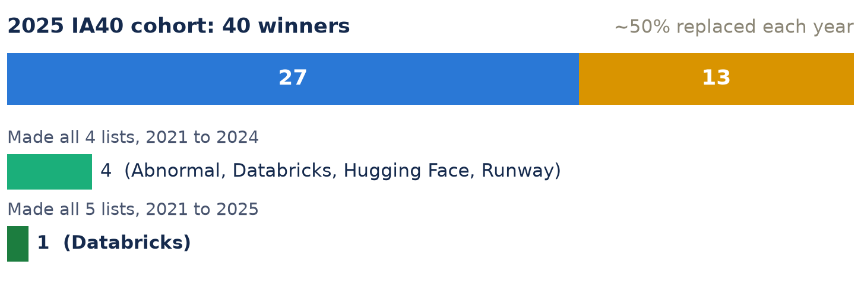
SEG 01 . FIG 1
IA40 staying power is rare: churn is the durability signal
2025 was the fifth annual list.
Roughly half the cohort is replaced every year. Of the four names that made all four lists through 2024, only Databricks carried into 2025, the sole five-time winner.
Application-layer names rotate out; the infrastructure layer compounds.
Source: Madrona / PitchBook IA40 (ia40.com), 2025 edition. Methodology uses the VC Exit Predictor Opportunity Score as an input.
PitchBook with Madrona
PitchBook, a Morningstar company . with Madrona
CONFIDENTIAL . 04

Slide 6
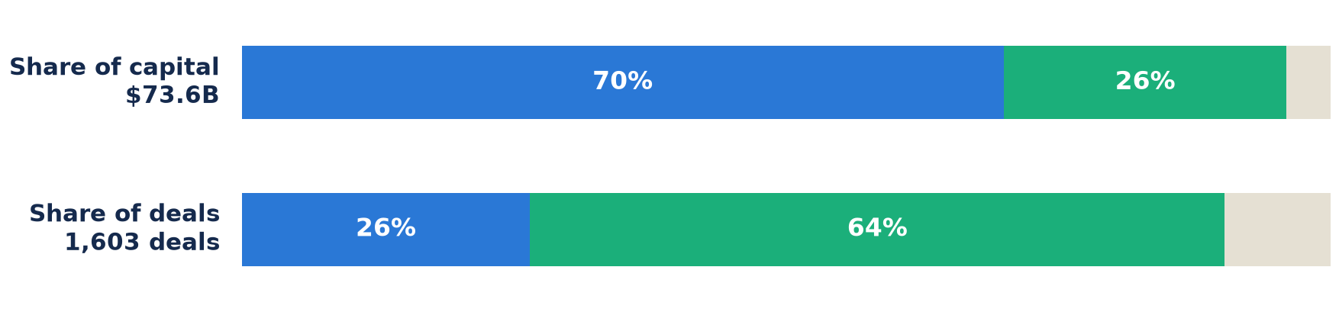
SEG 01 . FIG 2
The last mile, priced in dollars
SHORT LAST MILE
Absorbed by the frontier: little between the model and the outcome. Copy, images, coding assistants, first-pass drafts.
LONG LAST MILE
Q1 2025 set a record for AI/ML venture at $73.6B across 1,603 deals. Vertical apps were ~60% of the deals but under a third of the capital: many small bets. A vertical model costs ~$3M to $10M to build; a horizontal LLM costs hundreds of millions.
Regulation and liability sit between model and outcome. Tax filing, audit-ready accounting, licensed healthcare. Owning liability is insurance pricing.
Source: PitchBook Q1 2025 AI & ML VC Trends; framework: N. Bobba, Better Tomorrow Ventures (Feb 2026), not Madrona / Sabrina Wu.
PitchBook with Madrona
PitchBook, a Morningstar company . with Madrona
CONFIDENTIAL . 05

Slide 7
SEG 03
STATE OF AI IPOs
The drought is a mirage. The value is real, just private
PitchBook with Madrona
PitchBook, a Morningstar company . with Madrona
CONFIDENTIAL . 06

Slide 8
SEG 03 . THE PRIVATE BACKLOG
There is no shortage of exit-scale companies
ACTIVE US UNICORNS
AGGREGATE UNICORN VALUE
HELD BY SPACEX, OPENAI, ANTHROPIC
2025 UNICORN IPOs
LP CASH OUT > CASH BACK
945
$5.3T
>25%
17
4 yrs
Record, Q2 2026
+9.4% vs year-end 2025
Three names, a quarter of the herd
14 priced below their mark
Distributions have trailed
The backlog is a liquidity choice, not an absence of exits. Mega-rounds plus secondary markets (annualized ~$112B in Q1 2026) let companies stay private while an IPO is telegraphed. ~30% of unicorns are AI-native or AI-adjacent.
PitchBook with Madrona
PitchBook, a Morningstar company . with Madrona
CONFIDENTIAL . 07

Slide 9
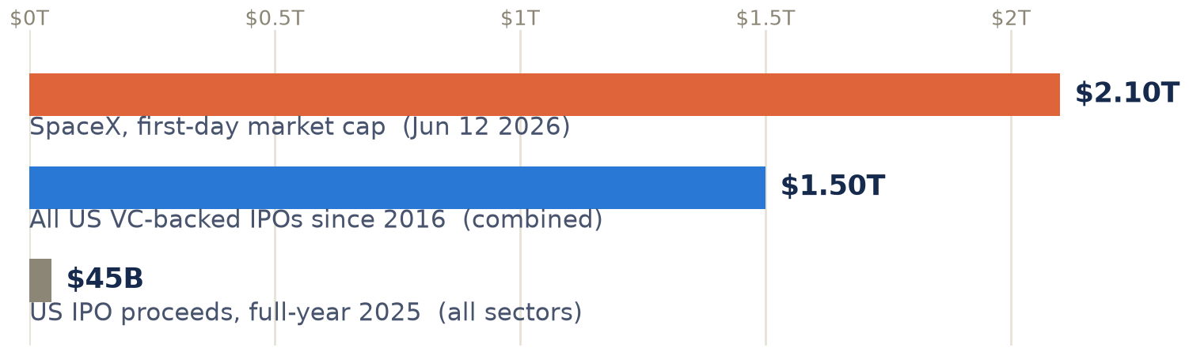
SEG 03 . FIG 3
One listing versus a decade of the asset class
SpaceX priced at a $1.78T valuation and closed day one near $2.1T.
That single number exceeds the combined value of every US venture-backed public listing since 2016.
"IPO drought" is the wrong frame: the pipe is holding a few objects too large to move.
Source: PitchBook Q2 2026 Venture Monitor; CNBC Jun 12 2026. The looser "half of every tech IPO since the internet" claim is not sourceable; this is the verifiable version.
PitchBook with Madrona
PitchBook, a Morningstar company . with Madrona
CONFIDENTIAL . 08

Slide 10
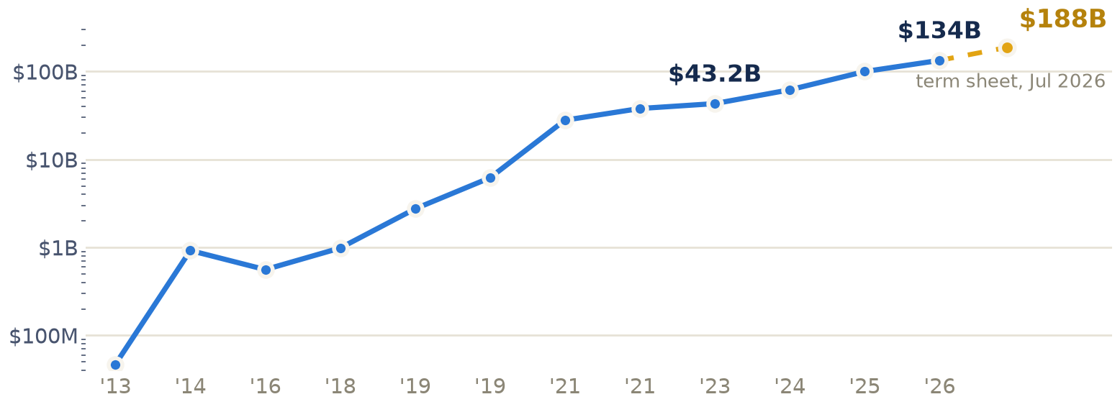
SEG 03 . FIG 4
Databricks: a $47M to $188B climb, still private
NEW: $188B strategic round.
Term sheet signed July 16 2026, led by Coatue, expected to close this summer, up from the $134B Series L (Feb 2026).
Why raise at this scale? Private capital is cheap and CEO Ali Ghodsi called 2026 "a terrible year to go public." The company never needed the exit.
Source: Databricks newsroom & Bloomberg, Jul 16-17 2026 ($188B term sheet); PitchBook Premium financing records (entity 59199-40). $134B is the last closed round.
PitchBook with Madrona
PitchBook, a Morningstar company . with Madrona
CONFIDENTIAL . 09

Slide 11
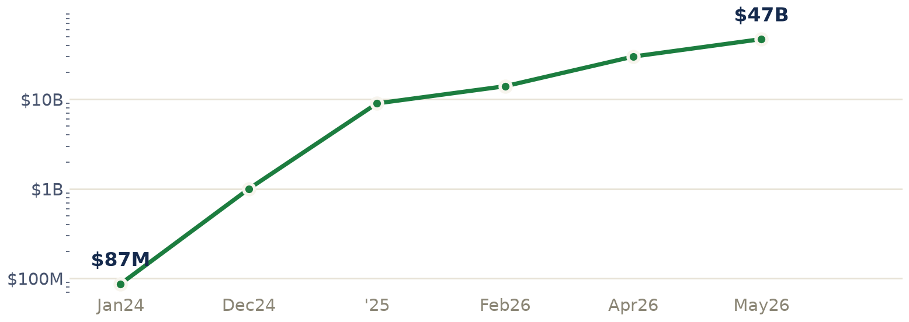
SEG 03 . FIG 5
Anthropic: the revenue the IPO is timed around
$87M to ~$47B run-rate in 17 months,
overtaking OpenAI on ARR in April 2026. Now $965B (Series H), filed confidentially in June for an expected October listing.
The risk is the narrative, not demand: an enterprise shift away from "token maxing," plus export-control uncertainty on chips.
Source: PitchBook Premium; TechCrunch / VentureBeat / CNBC, Jan 2024 to May 2026. Run-rate figures annualized.
PitchBook with Madrona
PitchBook, a Morningstar company . with Madrona
CONFIDENTIAL . 10

Slide 12
SEG 04
THE IDEA: TWO WINNERS IN EVERY CATEGORY
It is not a duopoly. It is winner-take-most, miscounted
PitchBook with Madrona
PitchBook, a Morningstar company . with Madrona
CONFIDENTIAL . 11

Slide 13
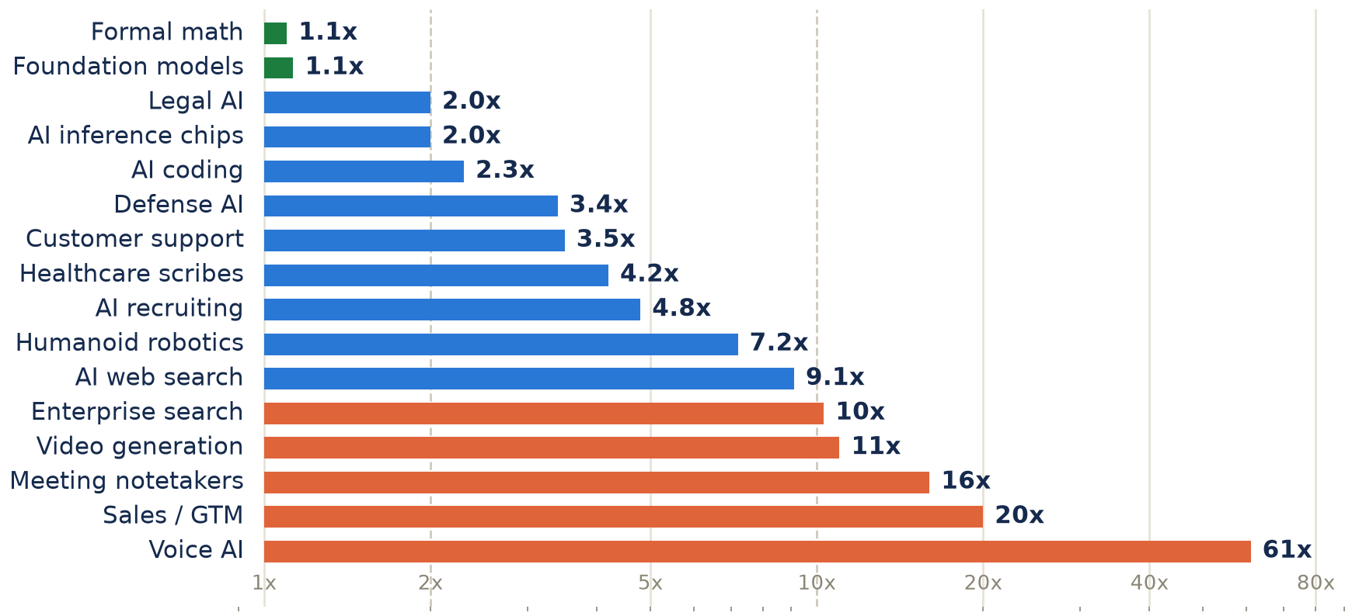
SEG 04 . FIG 6
The #1-to-#2 valuation ratio across 16 AI verticals
A true duopoly sits near 1x.
Only formal math and foundation models qualify (green).
Of 16 verticals: 2 near-parity, 6 above 10x, and 3 more where the #2 has no venture mark at all.
The modal outcome is not a split. It is one company many times larger than whatever sits in second.
Voice AI shown at ElevenLabs' pending $22B secondary (61x); the last priced mark, $11B, reads as 30x.
PitchBook with Madrona
PitchBook, a Morningstar company . with Madrona
CONFIDENTIAL . 12

Slide 14
SEG 04 . THE FULL MAP (1 of 2)
Every #1 and #2, named: near-parity to blowout
VERTICAL
#1 (valuation, date)
#2 (valuation, date)
RATIO
PATTERN
Foundation models
Anthropic $965B
OpenAI $852B
1.1x
Near parity; xAI ~$1.76T inside SpaceX breaks the top-2 frame
Formal math AI
Axiom $1.6B 3/26
Harmonic $1.45B 11/25
1.1x
Genuine dead-heat duopoly
Legal AI
Harvey $11B 3/26
Legora $5.6B 4/26
2.0x
Clean hierarchy; real exit, Robin AI to Microsoft
AI inference chips
Cerebras $40.6B IPO 5/26
Groq $20B (to Nvidia) 12/25
2.0x
Real dual exits: one IPO, one M&A
AI coding
Cursor $60B (to SpaceX) 6/26
Cognition $26B 5/26
2.3x
Clean hierarchy; real $60B exit
Defense AI
Anduril $61B ($4.3B rev) 5/26
Helsing $18B 5/26
3.4x
Real duopoly, but geographic: US vs EU sovereign-tech
Customer support
Sierra $15.8B 5/26
Decagon $4.5B 1/26
3.5x
Clear leader
Healthcare scribes
Abridge $5.3B 6/25
Ambience $1.25B 7/25
4.2x
Clear leader
AI recruiting
Mercor $10B 10/25
Eightfold $2.1B 2021 (stale)
4.8x
LLM-native disruptor eclipsing pre-genAI incumbent
Humanoid robotics
Figure $39B 5/25 (stale)
Physical Intelligence $5.4B
7.2x
Clear leader; ~$11B PI round pending would be 3.5x
PitchBook with Madrona
PitchBook, a Morningstar company . with Madrona
CONFIDENTIAL . 13

Slide 15
SEG 04 . THE FULL MAP (2 of 2)
Every #1 and #2, named: the blowouts and the invisibles
VERTICAL
#1 (valuation, date)
#2 (valuation, date)
RATIO
PATTERN
AI web search
Perplexity $20B 9/25-5/26
Exa $2.2B 5/26
9.1x
False duopoly: agent-search infra vs consumer answers
Enterprise search
Glean $7.2B 11/25
Hebbia $700M 10/24 (stale)
10.3x
Blowout
Video generation
Runway $5.3B 2/26
Pika $470M 7/24 (stale)
11x
Blowout; also Sora, Veo, not a 2-name story
Meeting notetakers
Granola $1.5B 3/26
Otter.ai $94M 2021 (stale)
16x
Inverted on revenue: Otter discloses $100M TTM, Granola none
Sales / GTM agents
Clay $3B 6/25
Artisan $150M 5/25
20x
Blowout
Voice AI
ElevenLabs $22B 7/26 (pending)
Cartesia $362M 3/25
61x
Blowout
Image generation
Black Forest Labs $3.1B 12/25
Midjourney no VC, $500M rev
n/a
Revenue leader invisible to funding-concentration data
Data labeling, RLHF
Scale AI $29B 6/25 (Meta stake)
Surge AI no VC, $1.4B rev
n/a
Funding leader is not the revenue leader (Surge > Scale)
AI companion apps
Character.ai $1B (frozen 8/24)
Replika $33M 2017 (frozen)
n/a
Category stagnation, not concentration
PitchBook with Madrona
PitchBook, a Morningstar company . with Madrona
CONFIDENTIAL . 14

Slide 16
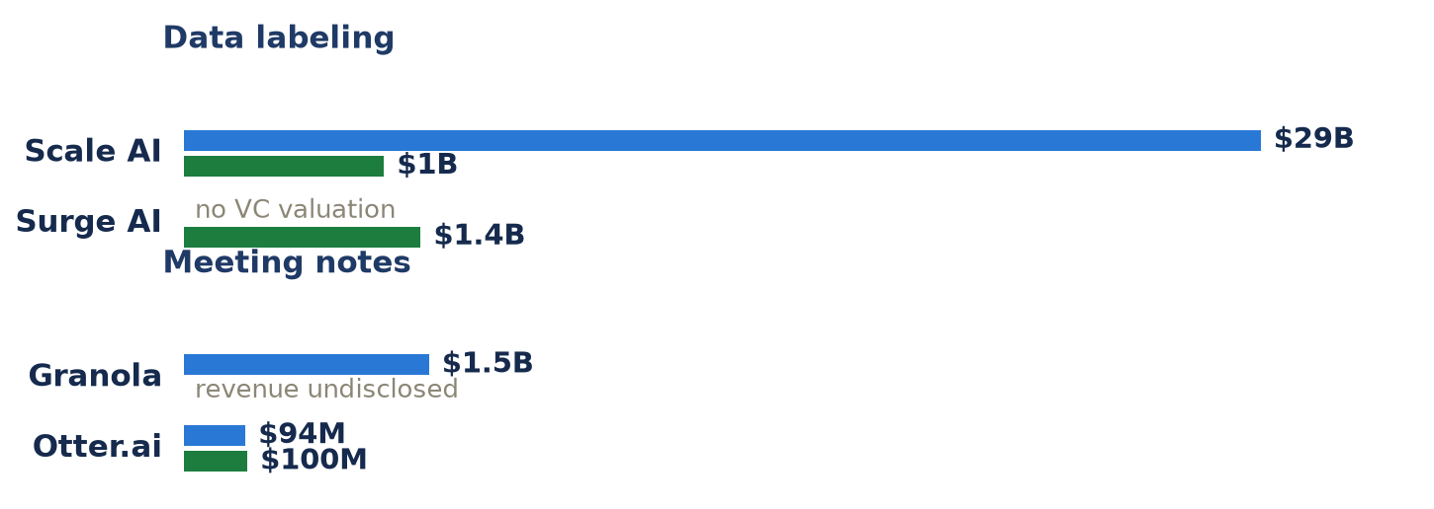
SEG 04 . FIG 7
The biggest round is not the biggest business
Blue: valuation. Green: disclosed revenue.
Surge out-earns Scale with zero venture funding. Otter out-earns Granola on disclosed revenue. Midjourney does ~$500M and has no valuation to plot.
Frame winners by round size and you miss the best unit economics in the category.
Source: PitchBook Premium. Scale ~$1B rev / $29B val; Surge ~$1.4B rev, no VC; Otter ~$0.1B rev / $94M val; Granola $1.5B val, rev undisclosed.
PitchBook with Madrona
PitchBook, a Morningstar company . with Madrona
CONFIDENTIAL . 15

Slide 17
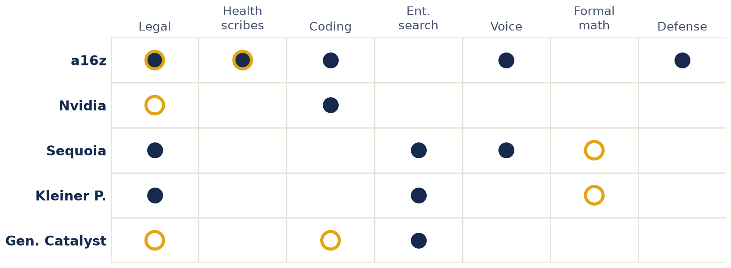
SEG 04 . FIG 8
Who manufactures the "2": the same funds sit on both sides
● Backs the #1 ○ Backs the #2
a16z holds both #1 and #2 in legal (Harvey + Legora) and health scribes (Abridge + Ambience).
The same 10 to 15 crossover funds capitalize both seats, a hedge that manufactures a "2" rather than picking a winner.
Source: PitchBook Premium investor records. Sequoia backs Harvey but not Legora; Kleiner backs Harvey and Harmonic but not Cerebras.
PitchBook with Madrona
PitchBook, a Morningstar company . with Madrona
CONFIDENTIAL . 16

Slide 18
SEG 04 . THE EXITS ARE ALREADY LIVE
Six real exits, and strategics paid up for the #1
Cursor → SpaceX
Cerebras → Nasdaq
Scale AI → Meta
$60B M&A
$40.6B IPO
$29B* Stake + CEO
Category leader in AI coding, bought at the top
Profitable print (warrant-aided); AI inference chips
Effective absorption: large stake, CEO poached
Groq → Nvidia
Robin AI → Microsoft
Neeva → Snowflake
$20B M&A
n/d Acquihire
n/d M&A
Now an Nvidia subsidiary; still raising
The sub-scale "priced out" case, the counter-example
Search talent and tech folded into a platform
*Meta took a ~$14.3B stake and hired the CEO. Pattern: strategics buy the outright #1, not the struggling runner-up. The AI-vertical exit environment is live now, not five years out.
PitchBook with Madrona
PitchBook, a Morningstar company . with Madrona
CONFIDENTIAL . 17

Slide 19
SEG 04 . BEFORE YOU CALL IT A DUOPOLY
When you see a "2", check which kind it is
GEOGRAPHIC, NOT COMPETITIVE
STAGNATION, NOT CONCENTRATION
MANUFACTURED BY THE SAME CAPITAL
A US champion beside a non-US sovereign-tech champion serving different regulatory buyers. Defense: Anduril (US) vs Helsing (EU). Legal: Harvey (US) vs Legora (Stockholm). A 1 + 1, not a head-to-head 2.
AI companions: Character.ai frozen since its founders left for Google (Aug 2024), Replika since 2017. The real winners became features inside Grok and Meta AI. Some categories converge to zero investable names.
Sequoia, a16z, Kleiner, Founders Fund, Index, General Catalyst back both seats vertical after vertical. The "2" is often a deliberate hedge, not two independent winners.
The modal outcome is winner-take-most. Real two-way splits show up about one in ten; the other nine times it is a 10x-to-60x gap, or the biggest business never took venture money at all.
PitchBook with Madrona
PitchBook, a Morningstar company . with Madrona
CONFIDENTIAL . 18

Slide 20
SEG 04 . AT THE FRONTIER
The two-name story breaks at the top too
"Anthropic vs OpenAI" reads as a clean 1.1x duopoly ($965B vs $852B).
But PitchBook's Frontier Five note counts five, not two, and the highest-valued names score lowest on quality. And xAI is not a standalone third: it is folded inside a ~$2.4T SpaceX.
The two-name story does not survive contact with the cap tables.
THE VALUATION-QUALITY PARADOX
Databricks AIBQ 8.7
Tops the Frontier Five, only member with positive free cash flow.
OpenAI AIBQ 4.8
Highest profile, lowest business-quality score.
PitchBook with Madrona
PitchBook, a Morningstar company . with Madrona
CONFIDENTIAL . 19

Slide 21
PitchBook with Madrona
THE THROUGH-LINE
Count the business, not the round
Durability is measurable
The IPO drought is a choice
The "duopoly" is winner-take-most
and has a history you can chart. It moved up the stack from the model to the workflow.
not an absence of exit-scale companies. The value is private, and enormous.
with a nominal second place that funding data overstates.
Sources: PitchBook Premium (financing, investors, VC Exit Predictor, Venture Monitor, Frontier Five); Madrona/PitchBook IA40; company disclosures; CNBC, Bloomberg, TechCrunch. Verified July 17, 2026.

