Slide 1

Date:06/05/2025
Viva voce
Major Project Winter Semester 2024-25
Department of Electronics and Communication Engineering
Title: Sub-Terahertz Meta-Stickers for Non-Invasive Food Sensing Using Machine Learning
Domain: Communication domain
Project Team Members
Hrushikesh.K (20702)
Naveen K.M (20713)
Tarun kumar.S (20738)
Supervisor
Dr. J. Josephine Pon Gloria
Assistant Professor

Slide 2
CONTENT
Abstract
Introduction
Objective
Problem Statement
Literature Survey
Methodology
Block Diagram
Design & Implementation
Results
Conclusion
References

Slide 3
INTRODUCTION
With the growing demand for efficient and non-destructive methods to assess fruit quality in agriculture, innovative sensing technologies are gaining significant attention. Traditional methods often involve physical handling and cutting of fruit, leading to wastage and reduced market value. Sub-terahertz (THz) meta-stickers provide a novel, non-invasive alternative by using electromagnetic waves in the sub-THz spectrum to analyze the internal and external properties of fruits without causing damage. This project focuses on applying sub-THz meta-stickers for apple fruit sensing, integrated with machine learning models to interpret the captured THz data. By analyzing features such as ripeness, quality, and the presence of internal defects, this approach enhances the accuracy and speed of fruit assessment.

Slide 4
OBJECTIVE
To design and develop Sub-Terahertz (Sub-THz) meta-stickers for non-invasive food sensing applications.
To analyze the interaction of Sub-THz waves with food samples and extract relevant spectral features.
To collect and preprocess Sub-THz signal data for accurate food quality assessment.
To implement machine learning algorithms for classifying and predicting food freshness, spoilage, and contamination.
To evaluate the performance of different ML models and optimize them for real-time food sensing applications.
To explore the feasibility of integrating the developed system into practical food safety and quality monitoring solutions

Slide 5
PROBLEM STATEMENT
Ensuring food quality and safety is a critical global challenge, as traditional methods for detecting spoilage, contamination, and freshness often require invasive sampling, chemical analysis, or expensive laboratory testing. These conventional approaches are time-consuming, destructive, and impractical for real-time monitoring.
Sub-Terahertz (Sub-THz) waves offer a promising non-invasive alternative for food sensing, but the efficient detection and interpretation of Sub-THz signals remain a challenge. The integration of machine learning techniques can help analyze these signals and accurately classify food quality parameters.
This project aims to develop Sub-THz meta-stickers for non-invasive food sensing and implement machine learning algorithms to predict food freshness, spoilage, and contamination based on spectral data. The goal is to provide an efficient, real-time, and cost-effective solution for food quality monitoring, ensuring safety and reducing food waste.

Slide 6
LITERATURE SURVEY
S.No | Authors | Title | Journal details with year | Study | Inference
1 | Mohamad G Abiad, Lokman I Meho | Food Loss and Food Waste Research in the Arab World | Food Security (2018) | Reviewed food loss and waste in the Arab world | Emphasized better waste management
2 | Sayed Saad Afzal et al. | AgriTera: Non-Invasive Fruit Ripeness Sensing | ACM MobiCom (2023) | Used sub-terahertz signals for ripeness detection | Achieved accurate, non-invasive sensing
3 | Mondher Bouzayen et al. | Mechanism of Fruit Ripening | Springer (2009) | Explained biochemical ripening processes | Identified key genetic factors
4 | Ethan Chou et al. | Low-Power D-Band CMOS Receiver | ESSCIRC-IEEE (2022) | Developed energy-efficient receiver | Enhanced sub-terahertz applications

Slide 7
S.No | Authors | Title | Journal details with year | Study | Inference
5 | Cornelius Barry, James Giovannoni | Ethylene and Fruit Ripening | Plant Growth Regulation (1997) | Studied ethylene’s role in ripening | Confirmed ethylene as key regulator
6 | Tie J Cui et al. | Light: Science & Applications (2014) | Light: Science & Applications (2014) | Reviewed digital metamaterials | Enabled advanced applications
7 | Subhajit Karmakar et al. | Sub-Terahertz Meta-Stickers for Fruit Ripeness | Nature Food (2024) | Used metamaterial stickers for ripeness detection | Improved accuracy, reduced food waste
8 | Lili Zhu, Petros Spachos | SVM & YOLO for Mobile Food Grading | arXiv (2021) | Classified banana ripeness via ML | Achieved 96.4% accuracy

Slide 8
METHODOLOGY
Data Collection Using Sub-Terahertz Meta-Stickers:
Meta-Stickers: Thin, flexible stickers embedded with sub-THz wave sensors are applied to apple surfaces.
Data Collection Process:
Collect samples of apples varying in ripeness, quality, and defects.
Attach meta-stickers to the apple's surface to capture reflections of sub-THz waves.
Record raw THz spectral data that contains information about internal and surface properties of the apples.
Data Preprocessing:
Noise Reduction: Use signal processing techniques (e.g., smoothing, filtering) to clean raw data.
Model Training & Evaluation
Splitting Dataset
Train/Test split (e.g., 80% training, 20% testing).
Cross-validation (e.g., k-fold) to ensure model generalization.
Performance Metrics
Accuracy, Precision, Recall, and F1-score for classification tasks.
Mean Squared Error (MSE) and R² score for regression tasks.

Slide 9
BLOCK DIAGRAM
Meta Sticker
Design
Adding Fruit Layers to the Design
WSimulation of Ansys HFSS
RTraining and Validation
Applying ML
Algorithm
Data Collection
fPerfomance
Assessment

Slide 10
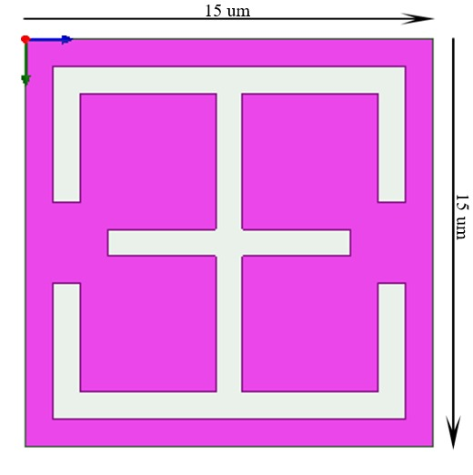
META STICKER
Meta Sticker

Slide 11
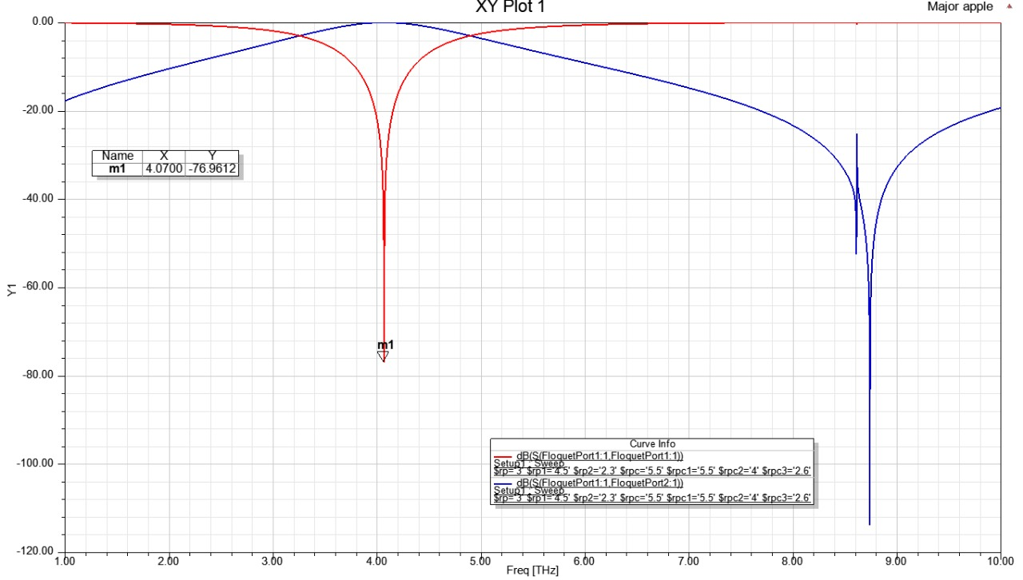
TRANSMITION AND REFLECTION ANALYSIS OF META STICKER :

Slide 12
Meta-Sticker Design :
Designed to be flexible and compact, the meta-sticker features a layered dielectric structure optimized for real-world application on fruits such as apples. The SRR-based sensor is fabricated on a thin dielectric substrate and is compatible with bendable surfaces. The resonators are patterned to maximize sensitivity in the sub-THz band. In HFSS, the unit cell parameters are iteratively adjusted to fine-tune the resonance behavior to respond distinctively to different dielectric environments. The sensor’s ability to distinguish Good, Medium, and Rotten apple layers is a result of the carefully engineered resonance conditions enabled by these structural optimizations.
Simulation Process :
• The multilayered apple structure is modeled using accurate dielectric properties.
• The meta-sticker is integrated with the apple model in HFSS.
• Dielectric constants and loss tangents are assigned for each apple condition.
• Sub-THz waves are simulated to interact with the model.
• Reflection and transmission data are recorded across 2.8–3.3 THz
• Data is exported for machine learning analysis.
Using Random Forest Classifier ( ML Algorithm ) analysis is done.

Slide 13
CLASSIFICATON OF FRUIT PROPERTIES
Layer | Di electric Constant | Loss Tangent
Core | 10 | 0.005
Flesh | 50 | 0.1
Skin | 10 | 0.25
Layer | Di electric Constant | Loss Tangent
Core | 5 | 0.005
Flesh | 40 | 0.1
Skin | 5 | 0.25
A) Good
B) Medium
Layer | Di electric Constant | Loss Tangent
Core | 2 | 0.005
Flesh | 20 | 0.1
Skin | 2 | 0.25
C) Rotten

Slide 14
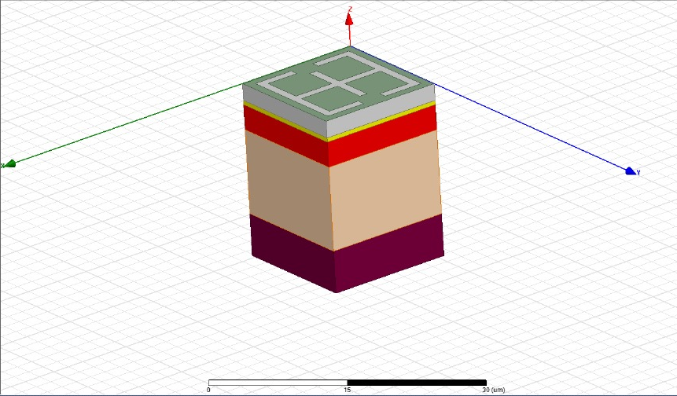
DESIGN & IMPLEMENTATION
Meta Sticker
Layers

Slide 15
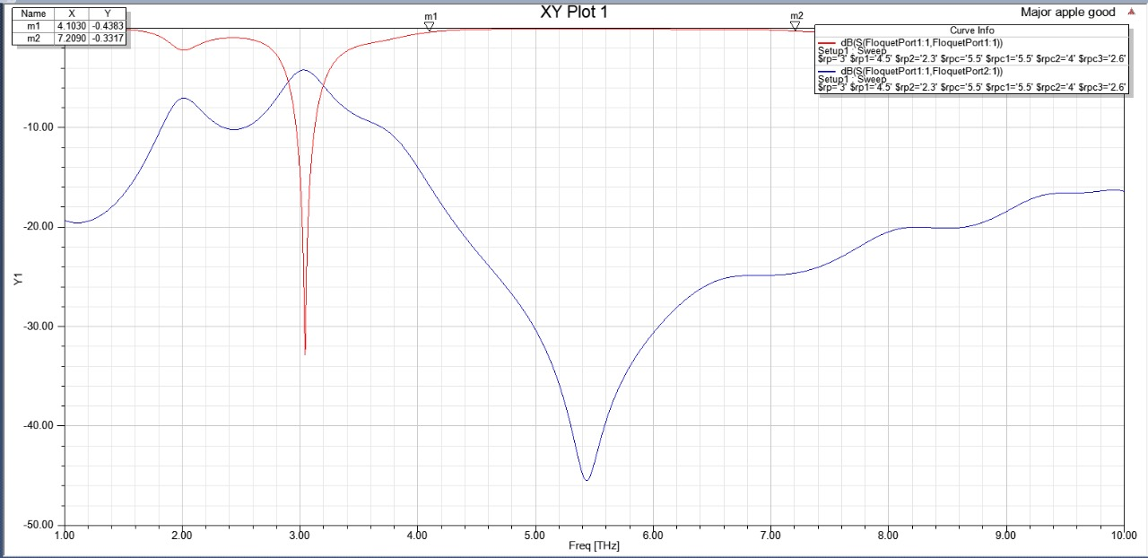
A) Good

Slide 16
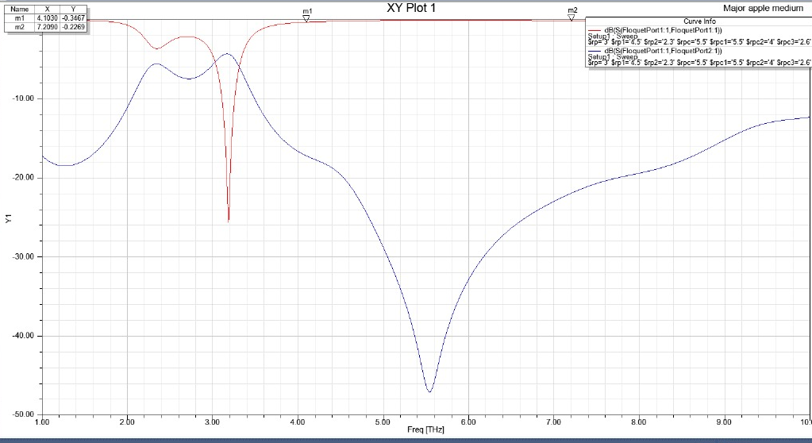
B) Medium

Slide 17
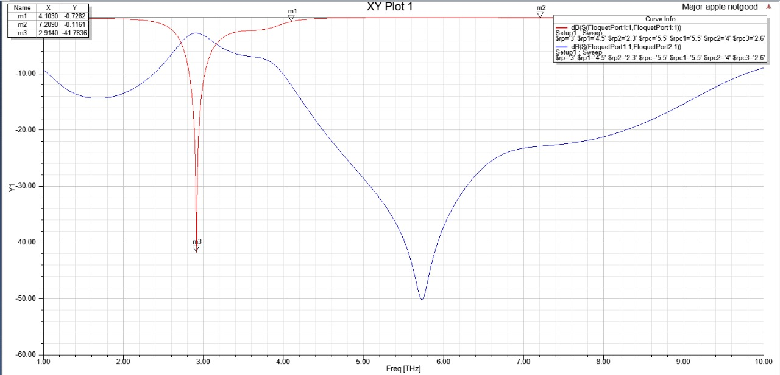
C) Rotten

Slide 18
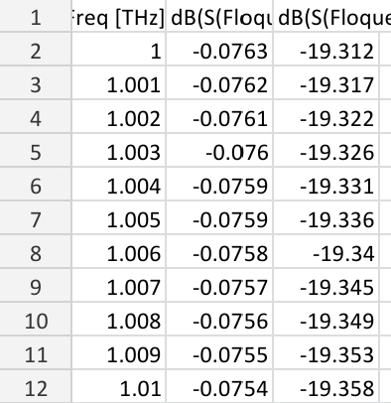
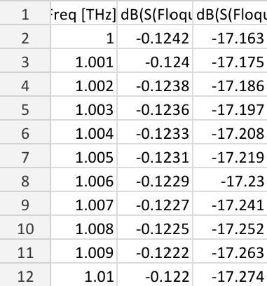
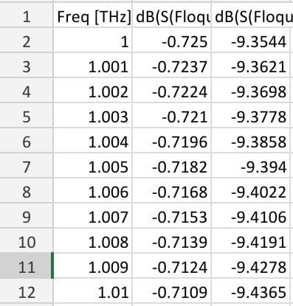
DATA SETS
A) Good
B) Medium
C) Rotten

Slide 19
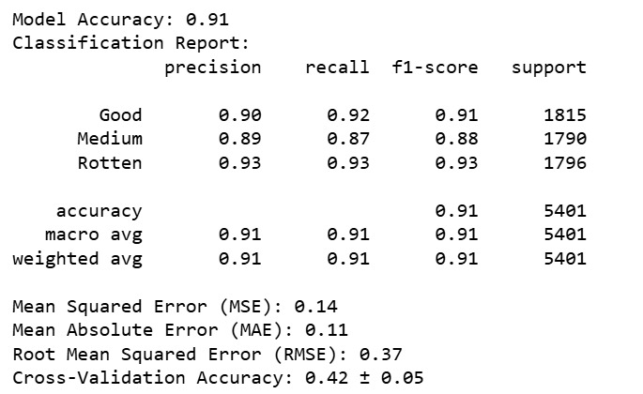
RESULTS

Slide 20
CONCLUSION
In this project, we introduced an innovative approach to non-invasive food sensing by leveraging sub-terahertz meta-stickers in combination with machine learning. The use of metamaterials allows for precise and contactless analysis of food quality, offering a significant advancement over traditional methods. To classify the spectral data obtained from the sensing process, we employed the Random Forest Classifier due to its robustness and high performance. The model achieved an impressive prediction accuracy of 91%, indicating the effectiveness of our approach in detecting and classifying food quality parameters.
This level of accuracy highlights the potential of combining machine learning with sub-terahertz technology to create scalable, real-time, and cost-effective food monitoring systems. Our method can detect issues like contamination, spoilage, and freshness levels without damaging the product. The flexible and reusable nature of the meta-stickers adds to the system’s practicality and sustainability. With future enhancements such as expanding the dataset and exploring deep learning models, this solution can be adapted to various food types and industry applications. Ultimately, our work demonstrates a successful integration of material science and artificial intelligence to address modern food safety challenges, paving the way for intelligent, eco-friendly, and efficient food quality control systems.

Slide 21
REFERENCE
2023. How Many Fruits and Veggies do We Waste per Year? https://www.goruvi. com/blogs/news/644-million-tons-of-wasted-fruits-and-veggies-each-year Accessed: 2023-03-11.
Mohamad G Abiad and Lokman I Meho. 2018. Food Loss and Food Waste Research in the Arab World: A Systematic Review. Food Security 10 (2018), 311–322.
Sayed Saad Afzal, Atsutse Kludze, Subhajit Karmakar, Ranveer Chandra, and Yasaman Ghasempour. 2023. AgriTera: Accurate Non-Invasive Fruit Ripeness Sensing via Sub-Terahertz Wireless Signals. In Proceedings of the 29th Annual International Conference on Mobile Computing and Networking (Madrid, Spain) (ACM MobiCom ’23). Association for Computing Machinery, New York, NY, USA, Article 61, 15 pages.

Slide 22
Mondher Bouzayen, Alain Latché, Pavendra Nath, and Jean-Claude Pech. 2009. Mechanism of fruit ripening. In Plant Developmental Biology-Biotechnological Perspectives: Volume 1. Springer, 319–339.
Ethan Chou, Nima Baniasadi, Hesham Beshary, Meng Wei, Emily Naviasky, Lorenzo Iotti, and Ali Niknejad. 2022. A Low-Power and Energy-Efficient DBand CMOS Four-Channel Receiver with Integrated LO Generation for Digital Beamforming Arrays. In ESSCIRC 2022-IEEE 48th European Solid State Circuits Conference (ESSCIRC). IEEE, 489–492.
Tie J Cui, Mei Q Qi, Xiang Wan, Jie Zhao, and Qiang Cheng. 2014. Coding Metamaterials, Digital Metamaterials and Programmable Metamaterials. Light: Science & Applications 3, 10 (2014), e218–e218.
Cornelius Barry and James Giovannoni. 1997. Ethylene and Fruit Ripening. Journal of Plant Growth Regulation 26 (1997), 143–159.

Slide 23
THANK YOU

