Slide 1

IS362 – Fall 2020 – Final Project

Slide 2
IS362 – Final Project
For my final project, I have selected my data source from NYC Open Data. The Data Source I have selected is the SAT Scores for NYC.
Data Source:
SAT Statistics for 2012 school year from NYC Open Data
https://data.cityofnewyork.us/Education/2012-SAT-Results/f9bf-2cp4
Questions for the data set.
Number of schools for each borough that participated in the SAT examination
Number of students for each borough that participated in the SAT examination
Highest number of test taker in a school for each Borough
Highest Reading Average Score in a school by Borough
Highest Math Average Score in a school by Borough
Highest Writing Average Score in a school by Borough

Slide 3
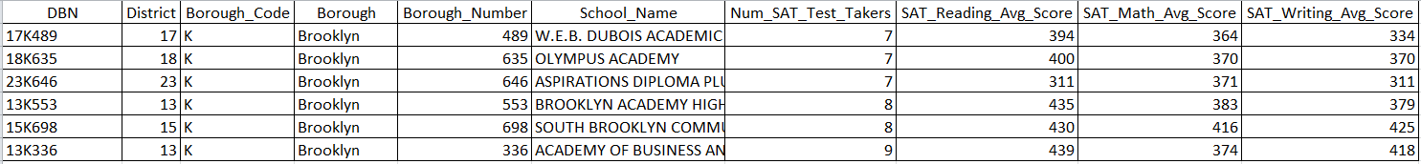
Data Source Analysis
Once I download the data source, I did a visual inspection to determine if the data source have a consistent format.
The field DBN (District, Borough, Number) was the only field I must change where I broke the DBN into 3 separate columns and convert the Borough code to Borough Name.

Slide 4
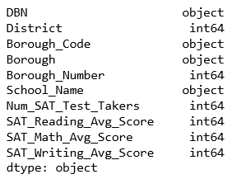
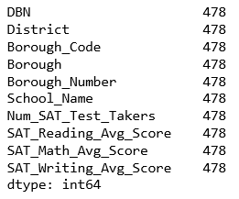
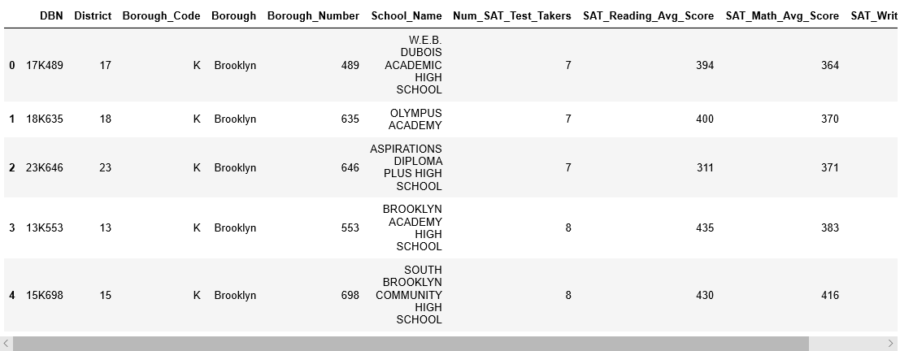
Data Source Validation
After the data source is ready, I read the data into python panda data frame.
With data validation, I must check the data frame to ensure the datatype is correct and all rows have data to maintain consistency.
Run the head function to ensure data are read into data frame correctly.

Slide 5
Total number of schools and students that participated in the SAT examination
Total Schools
Total Students

Slide 6
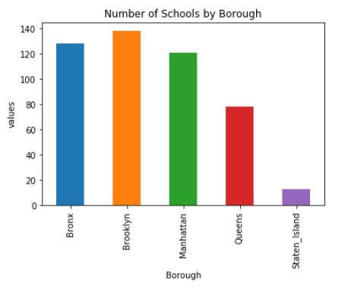
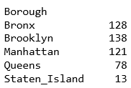
Number of schools for each borough that participated in the SAT examination

Slide 7
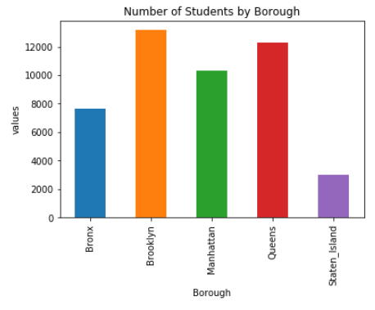
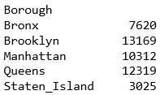
Number of students for each borough that participated in the SAT examination

Slide 8
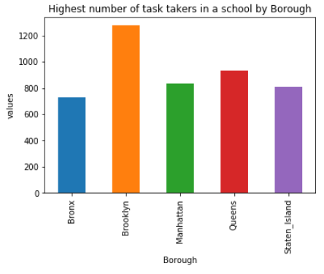
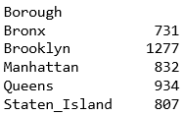
Highest number of test taker in a school for each Borough

Slide 9
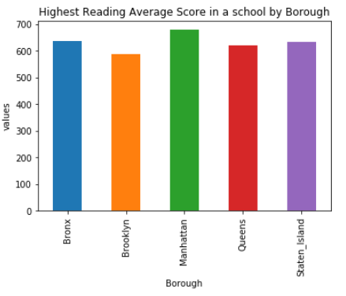
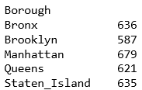
Highest Reading Average Score in a school by Borough

Slide 10
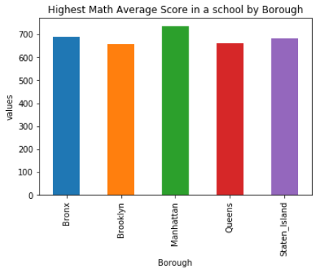
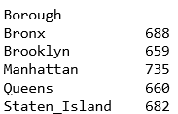
Highest Math Average Score in a school by Borough

Slide 11
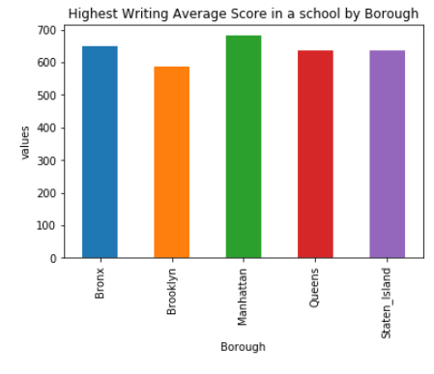
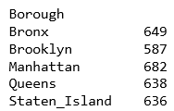
Highest Writing Average Score in a school by Borough

Slide 12
Conclusion
Based on my analysis of the 2012 New York SAT taker data source. The borough that has the highest number of schools and highest numbers of SAT takers is in Brooklyn with 138 Schools and 13169 Students that took the SAT. However, in reviewing the highest avg in a school for each of the 3 tested categories of Reading, Math and Writing, Manhattan schools has the highest average even though Manhattan have 121 schools and 10312 students. We can easily conclude that higher number of schools and SAT takers does not guarantee a higher SAT score average.

