Slide 1
₹
BANK MANAGEMENT SYSTEM
A Final Capstone Project in Data Structures & Algorithms (C)
BST • Stack • Queue • Sorting • Searching • Recursion • File Handling
NAME: HARSH KUMAR CHAUHAN

Slide 2
Problem Statement
!
Existing Problem
✓
Proposed Solution
Manual or poorly structured bank record-keeping makes it slow to search customers, error-prone to track balances, and hard to review recent transactions or process loan requests fairly.
A console Bank Management System that stores accounts in a BST for efficient search, uses a Stack to undo the last transaction, and a Queue to process loan requests fairly (FIFO).
Expected Benefits
Target Users
Faster account lookup (O(log n))
Bank Clerks • Branch Administrators • Loan Officers
Safer transactions with Undo support
Fair, ordered loan processing
Data persists across sessions
Bank Management System
2

Slide 3
Project Objectives
1
Create and store new bank accounts
2
Deposit and withdraw funds
3
Search account by number (BST)
4
Search account by name (Linear Search)
5
Display all accounts sorted
6
Generate Top Balance report (Sorting)
7
Delete an account safely
8
Undo last transaction (Stack)
9
Process loan requests (Queue)
Bank Management System
3

Slide 4
System Architecture
main.c (Menu)
Core: bst.c (BST)
stack.c
(Undo)
queue.c
(Loan Requests)
sort_search.c
(Reports)
file_ops.c
(Persistence)
sample-data/bank_data.txt
Bank Management System
4

Slide 5
Functional Modules
Module | Description
Main Menu | User-friendly menu-driven console application
CRUD Operations | Create, Search, Update (deposit/withdraw), Delete
Searching | BST search by account no.; Linear search by name
Sorting | Bubble Sort for the Top Balance report
File Storage | Persistent storage between runs
Undo (Stack) | Reverse the most recent transaction
Loan Queue | FIFO processing of pending loan requests
Reports | Bank summary via recursion (count + total balance)
Bank Management System
5

Slide 6
Data Structures & Algorithms Used
1
2
3
4
BST
Stack
Queue
Bubble Sort
Account storage, recursive ops
Undo last transaction
FIFO loan requests
Top Balance report
5
6
7
8
Linear Search
Recursion
File Handling
Dynamic Memory
Search by name
BST insert/search/delete
Persistent storage
malloc/free per BST node
Bank Management System
6

Slide 7
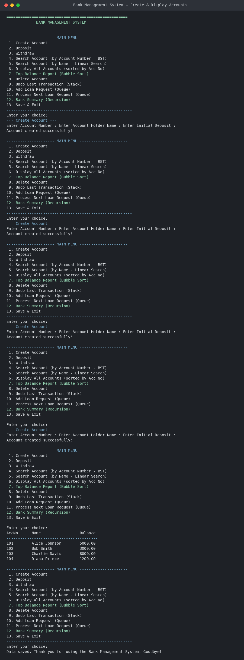

Application Demonstration
Create & Display Accounts
Top Balance Report (Sorting)
Bank Management System
7

Slide 8
Complexity Analysis
Operation | Structure | Time | Space
Insert / Search / Delete | BST | O(log n) avg, O(n) worst | O(h)
In-order Display | BST | O(n) | O(h)
Search by Name | Array | O(n) | O(n)
Top Balance Sort | Bubble Sort | O(n²) | O(1)
Push / Pop | Stack | O(1) | O(1)
Enqueue / Dequeue | Queue | O(1) | O(1)
Save / Load | File + BST | O(n) / O(n log n) | O(n)
n = number of accounts; h = height of the BST (O(log n) balanced, O(n) worst case)
Bank Management System
8

Slide 9
Challenges & Learning Outcomes
Challenges Faced
Learning Outcomes
Handling BST deletion with two children correctly
Applied a BST to a real search/storage problem
Keeping recursion stack depth reasonable
Understood Stack vs Queue through Undo vs FIFO
Designing clean Stack/Queue boundaries (full/empty)
Practiced recursion beyond textbook examples
Synchronizing file data with the in-memory BST
Learned to reason about time/space complexity
Bank Management System
9

Slide 10
GitHub Repository
BankManagementSystem/
|-- include/bank.h
|-- src/
| |-- main.c
| |-- bst.c
| |-- sort_search.c
| |-- stack.c
| |-- queue.c
| `-- file_ops.c
|-- docs/complexity_analysis.md
|-- report/
|-- presentation/
|-- screenshots/
|-- sample-data/bank_data.txt
|-- README.md
|-- LICENSE
`-- Makefile
✓
Public repository, complete source + commit history
✓
README with setup, DSA concepts, and screenshots
✓
Makefile for a one-command build
✓
MIT License included
Bank Management System
10

Slide 11
Future Enhancements
→
Self-balancing tree (AVL) for guaranteed O(log n)
→
Hashing for O(1) average account lookup
→
Merge / Quick Sort for large account volumes
→
Multi-level undo using a larger/linked stack
→
Graphical User Interface
→
Database integration (SQLite / MySQL)
Bank Management System
11

Slide 12
Questions & Answers
Thank you for your time.

