Slide 1
$
SUPERMARKET BILLING SYSTEM
Manage Products • Calculate Bills • Generate Invoices
A C Programming Mini Project | Structures & Arrays
Team Members: <Your Name>, <Teammate 2>, <Teammate 3>
Guide: <Faculty / Guide Name>

Slide 2
Problem Statement
!
Existing Problem
✓
Proposed Solution
Supermarkets often calculate bills manually or with outdated methods — leading to slow checkout, calculation errors, and poor tracking of stock and sales.
A console-based Supermarket Billing System in C that manages products, calculates bills automatically, and generates invoices for every customer.
Target Users
Expected Benefits
Cashiers • Store Managers • Billing Staff
Faster billing & checkout
Automatic bill & tax calculation
Reduced manual error
Organized product & sales data
Supermarket Billing System
2

Slide 3
Project Objectives
1
Add new products to inventory
2
Store product details (code, name, price, quantity)
3
Calculate total bill amount
4
Apply discount & tax calculations
5
Generate itemized invoice
6
Search product by code
7
Update product price / stock
8
Delete product records
9
Store & retrieve data using file handling
Supermarket Billing System
3

Slide 4
User Stories
Key stories driving the feature set
ID | User Story | Acceptance Criteria | Priority
US-01 | Admin adds a new product to maintain inventory. | Saved successfully; duplicate codes rejected. | High
US-02 | Cashier searches a product by code for quick billing. | Correct product details displayed. | High
US-05 | System auto-calculates total bill with tax/discount. | Correct total generated from cart items. | High
US-06 | Admin wants records stored in a file to persist data. | Records saved & loaded via file handling. | High
US-07 | Cashier wants an invoice generated for the customer. | Itemized invoice with total is produced. | High
Supermarket Billing System
4

Slide 5
Functional Requirements
FR-01
FR-02
FR-03
✓
Add Product
✓
Display Product List
✓
Search Product
FR-04
FR-05
FR-06
✓
Update Product Details
✓
Delete Product
✓
Calculate Bill
FR-07
FR-08
FR-09
✓
Generate Invoice
✓
Save Records to File
✓
Load Records from File
Supermarket Billing System
5

Slide 6
System Flowchart
Start / Load Products
Display Main Menu
Add
Product
Search /
Update / Delete
Billing
(Cart)
Calculate
Bill (Tax)
Generate
Invoice
Save to File (Data)
Exit
Supermarket Billing System
6

Slide 7
Project Modules
Module | Description | C Concepts Used
Product Registration | Add new product information | Structures, Functions
Stock Entry | Enter & manage product quantities | Arrays
Bill Calculation | Subtotal, tax, discount & total | Functions
Product Search | Search records using Product Code | Loops
Update Record | Modify existing product details | Functions
Delete Record | Remove product records | Arrays
Invoice Generation | Generate itemized invoice | Functions, File Handling
File Management | Save / retrieve records | File Handling
Supermarket Billing System
7

Slide 8
C Programming Concepts Used
1
2
3
4
Structures
Arrays
Functions
Loops
Product record management
Store products & cart items
Modular program design
Menu-driven operations
5
6
7
8
Switch Case
Conditionals
File Handling
Variables
Menu selection
Validation & discount rules
Permanent data storage
Prices, totals, tax
Supermarket Billing System
8

Slide 9
Code Explanation
Core structure and billing logic
Product Structure
Bill Calculation Logic
typedef struct {
int code;
char name[NAME_LEN];
float price;
int quantity;
} Product;
typedef struct {
int code;
char name[NAME_LEN];
float price;
int qty;
float total;
} CartItem;
for (i = 0; i < cartCount; i++)
*subtotal += cart[i].total;
if (*subtotal > DISCOUNT_LIMIT)
*discount = *subtotal * DISCOUNT_RATE;
else
*discount = 0;
*tax = (*subtotal - *discount)
* TAX_RATE;
*grandTotal = (*subtotal - *discount)
+ *tax;
Supermarket Billing System
9

Slide 10
Program Demonstration
1
Launch the program — existing products load automatically from Data/products.txt
2
Add products via Menu Option 1 (Product Code, Name, Price, Stock)
3
Start a bill via Menu Option 6 — add items to the cart by Product Code & Quantity
4
System validates stock, calculates subtotal, discount, tax and grand total automatically
5
An itemized invoice is displayed and saved to the Data folder
Supermarket Billing System
10

Slide 11
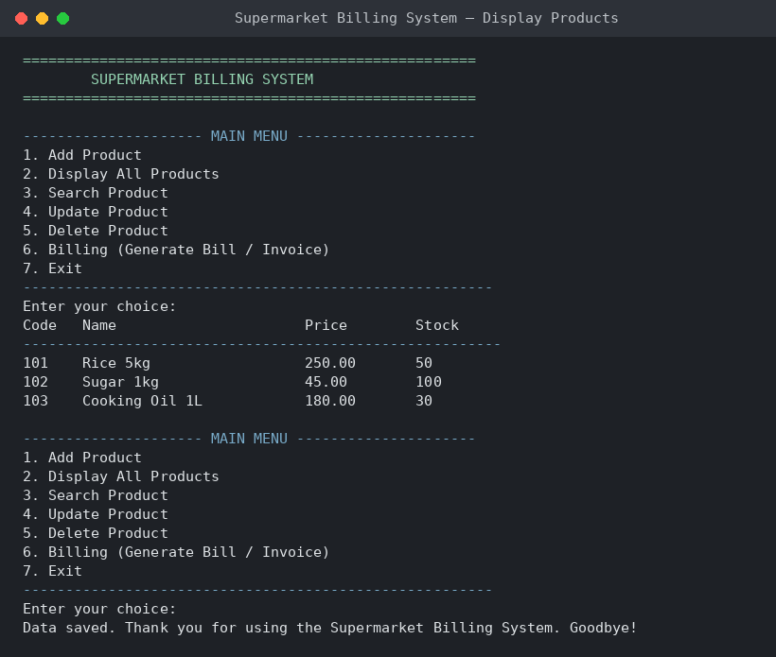
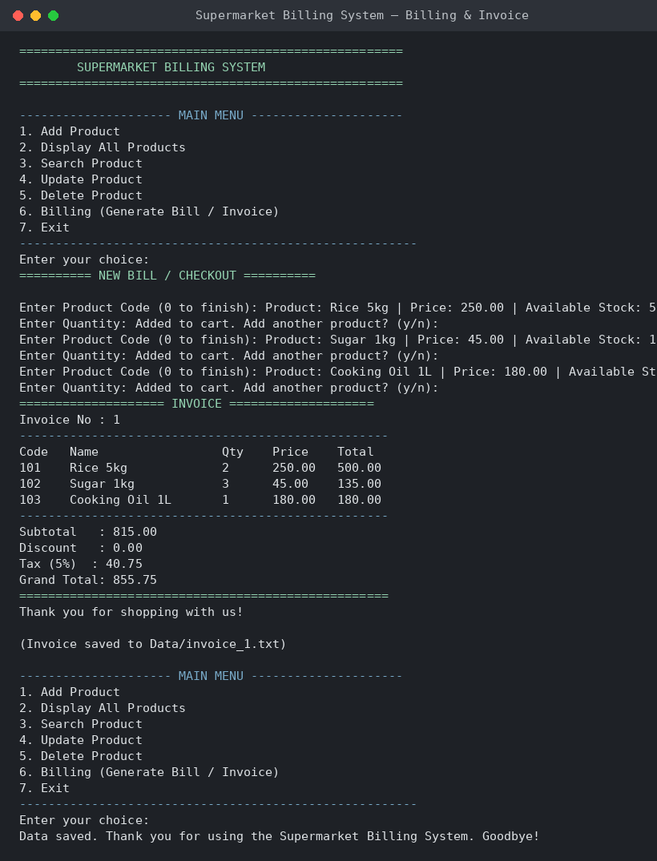
Output Screenshots
Sample console output from the running program
Display Products
Billing & Invoice Generation
Supermarket Billing System
11

Slide 12
Challenges Faced
Stock Validation
Input Buffer Handling
Preventing a sale from exceeding available stock in real time.
Managing leftover newline characters between scanf() calls.
Discount & Tax Rules
Invoice Numbering
Designing a clean formula for tiered discounts plus tax.
Keeping invoice numbers unique across multiple program runs.
Data Persistence
Duplicate Records
Reliably saving and reloading records via file handling.
Rejecting duplicate product codes during registration.
Supermarket Billing System
12

Slide 13
Future Enhancements
→
Barcode / QR code scanning for faster billing
→
GST-compliant multi-slab tax calculation
→
Graphical User Interface (GUI) using a GUI toolkit
→
Database integration (SQLite / MySQL) instead of text files
→
Customer loyalty points & membership discounts
→
Multi-user login for cashiers and admin roles
→
Cloud sync for multi-branch supermarkets
→
Printable / PDF invoice export
Supermarket Billing System
13

Slide 14
GitHub Repository Demo
✓
Public repository with complete, executable source code
Supermarket-Billing-System
|-- SourceCode
| |-- main.c
| |-- billing.c
| `-- billing.h
|-- Report
| `-- Project_Report.docx
|-- PPT
| `-- Presentation.pptx
|-- Output
| `-- Screenshots
|-- Data
| `-- products.txt
|-- README.md
`-- LICENSE
✓
README documents setup, features, and how to run
✓
Minimum 10 meaningful commits tracking development
✓
Report, presentation, and screenshots included
✓
MIT License for open use and reference
Supermarket Billing System
14

Slide 15
Conclusion
The Supermarket Billing System demonstrates how core C concepts — Structures, Arrays,
Functions, and File Handling — come together to solve a real-world retail problem:
faster, more accurate billing and better inventory management.
Thank You
Questions?

